Slide 1
GROUP 5
Sentiment analysis Covid Vaccine

Slide 2
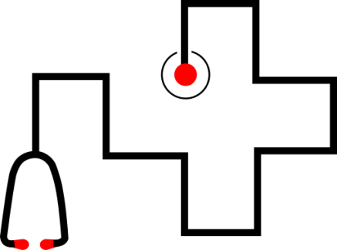
Our intent:
The intent is to provide a dashboard that could visualize the sentiment extracted from natural language in tweets regarding the Covid pandemic, with a particular focus
on the topic of vaccinations.
In order to do that the sentiment will be evaluated in
relation with other variables such as time, geographical location, specifics related to Twitter (verified accounts,
number of follower et cet.).

Slide 3
Task Complished

Slide 4
First of all we have focused on the preparation of
the dataset, The starting data are:
All COVID-19 Vaccines Tweets (Kaggle).
01
Preprocessing of the data
02
Compute geographical coordinates based
on name of locations
03
Infer the sentiment of the tweets
Technology used:
-python geopy library for the latitude and longitude evaluation
-textblob API and python nltk library for sentiment analysis.
References:
https://www.kaggle.com/gpreda/all-covid19-vaccines-tweets
https://pypi.org/project/geopy
https://textblob.readthedocs.io/en/dev
http://www.nltk.org

Slide 5
Next steps
Here there are some ideas we want to insert in the dashboard

Slide 6
dashboard
Variation in sentiment with respect to the number of deaths (or cases or non-cases)
01
Chart: x-axis will present the number of deaths
per month and on the y-axis we will have the
number of users divided by positive and negative
Sentiment. This allow us to show the trend that
exists between sentiment of vaccines when the number of death increases or decreases.
variation in sentiment with respect to number of vaccinated
02
Chart: in analogous ways of before

Slide 7
dashboard
Sentiment with regards to the number of followers (we would like
to test our hypothesis: those with more followers may not expose themselves extremely negatively)
We will divide of the observations into classes based on the number of
followers and visualize the sentiment with a barplot with the number
Classes on the abscissa and the ratio of positive to negative tweets on the
Ordinates (percentage of positive tweet - percentage of negative ones).
Moreover we will provide tooltips to exactly show the sentiment score, the
text of the tweet and the specifics of each instance.

Slide 8
dashboard
Examples of information could be obtained:
10%
Variation of sentiment in the period
of blocking of various vaccines
(e.g. astrazeneca scandal)
Of positive sentiment about vaccines after the election of Biden
will be visualized in the charts providing a
slider on time and legend showing the time intervals of the ’salient’ events.
25%
Of negative sentiment more after astraZeneca temporary block.

Slide 9

dashboard
40%
A map with colour gradations will show in which states is sentiment higher and in which states is it lower
30%
20%
10%

Slide 10
dashboard
Variation in sentiment
with respect to vaccine type over
time will be showed with smiles
that fill up based on the changing of the sentiment.
Sentiment differences between verified and unverified
accounts will be visualized
applying a filter in other graphs or just in the map.
Sentiment change with regard
to number of retweets/likes
with a slider on the map
described above.

Slide 11
Thank you
Group 5

