Slide 1
Machine Learning
NLP: Author identification

Slide 2
Summary
Data
Features Extraction
High dimensionality
PCA
Model Selection & Multiclass Classification
Classification: RLS, KRLS, KRLR
RLS & KRLS with PCA

Slide 3
Data
N = 19578
TEXT | AUTHOR
This process, however, afforded me no means of... | EAP
It never once occurred to me that the fumbling... | HPL
In his left hand was a gold snuff box, from wh... | EAP
How lovely is spring As we looked from Windsor... | MWS
Finding nothing else, not even gold, the Super... | HPL

Slide 4
Features Extraction
Tokenization from sentence to a list of words
Stopwords removal & lower case transformation
Stemming reducing inflected words to base or root form (ex. Running -> run)
Bag of Words from list of words to words frequencies in the sentence
Dictionary building & Y {‘EAP’, ‘HPL’, ‘MWS’} {[1 0 0], [0 1 0], [0 0 1]}
X₁₉₅₇₈ _{x 13781}

Slide 5
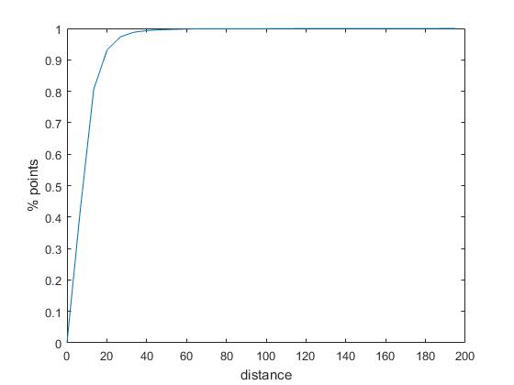

High Dimensionality
A subset of samples has been selected for testing
Range of distances of that subset: [0 , 200] (approximated)
As we can see 95% (94.16%) of points has distance $∈$[0, 20]
A local method such KNN seem not to be appropriate with such high dimensional space

Slide 6
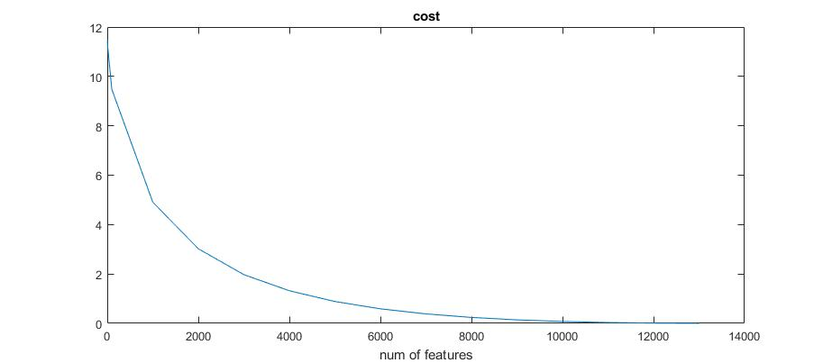
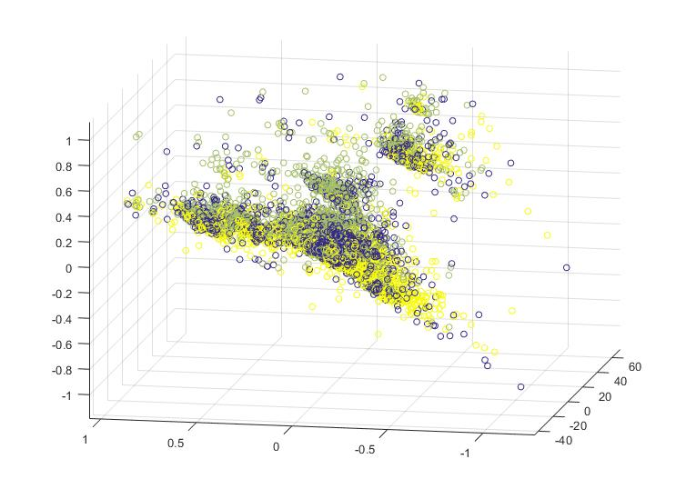
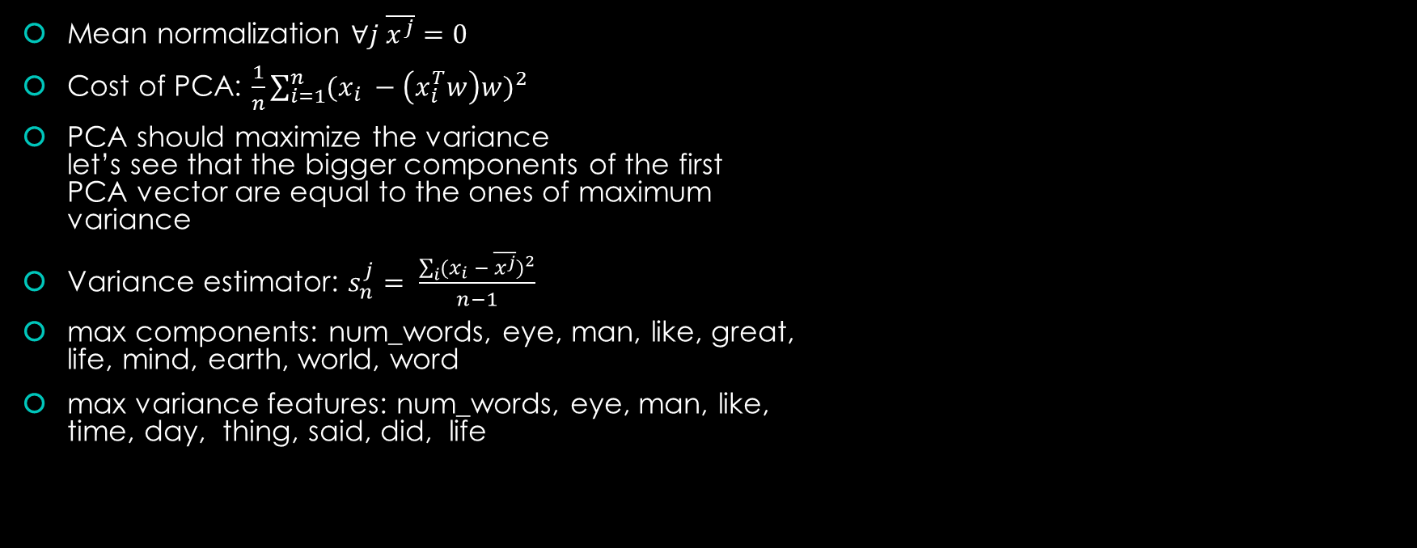
PCA
Mean normalization $∀j \overline{x^{j}}=0$
Cost of PCA: $\frac{1}{n}\sum_{i=1}^{n}{{(x_{i} −\left(x_{i}^{T}w\right)w)}^{2}}$
PCA should maximize the variance let’s see that the bigger components of the first PCA vector are equal to the ones of maximum variance
Variance estimator: $s_{n}^{j}= \frac{\sum_{i}{{(x_{i} − \overline{x^{j}})}^{2}}}{n−1}$
max components: num_words, eye, man, like, great, life, mind, earth, world, word
max variance features: num_words, eye, man, like, time, day, thing, said, did, life

Slide 7
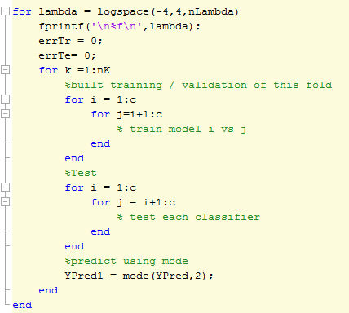

Model Selection & Multiclass Classification
OVO: $\#classificatori= \frac{c\left(c−1\right)}{2}$
Each classifier is trained on a smaller problem
Prediction based on the most voted class (mode)
Model Selection done over K fold cross validation
Each fold build over stratified sampling to ensure correct distribution of classes

Slide 8
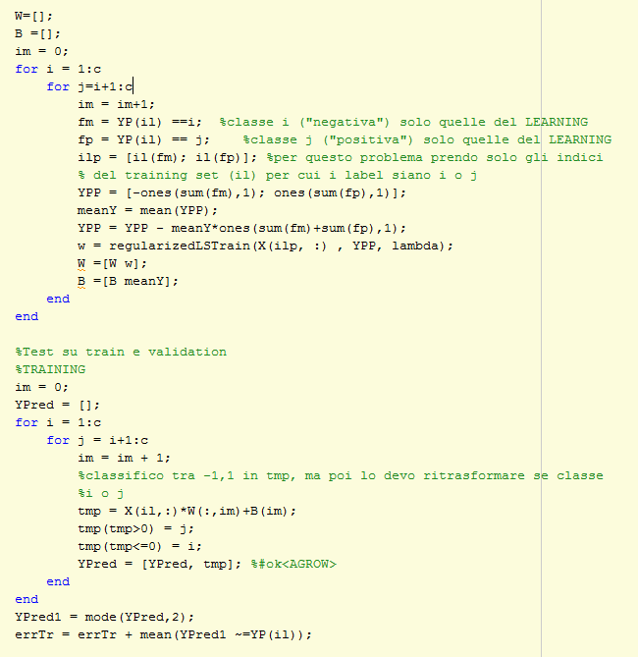
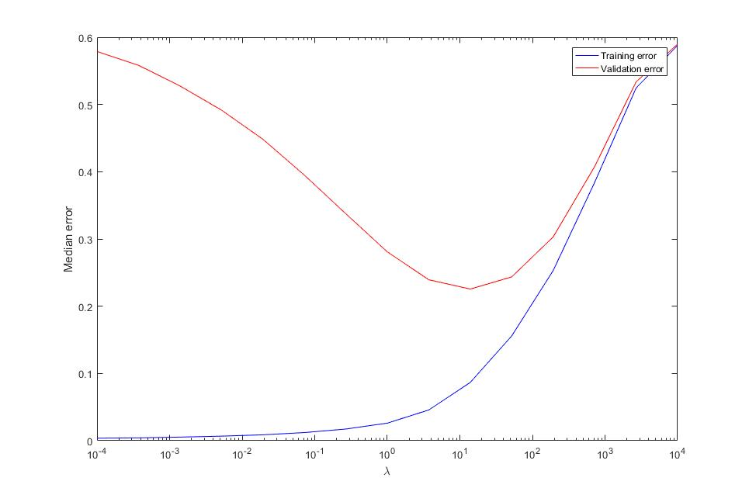
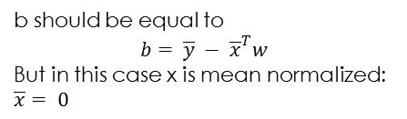
Regularized Least Squares
b should be equal to
$$b= \overline{y} − {\overline{x}}^{T}w$$
But in this case x is mean normalized: $\overline{x}= 0$

Slide 9
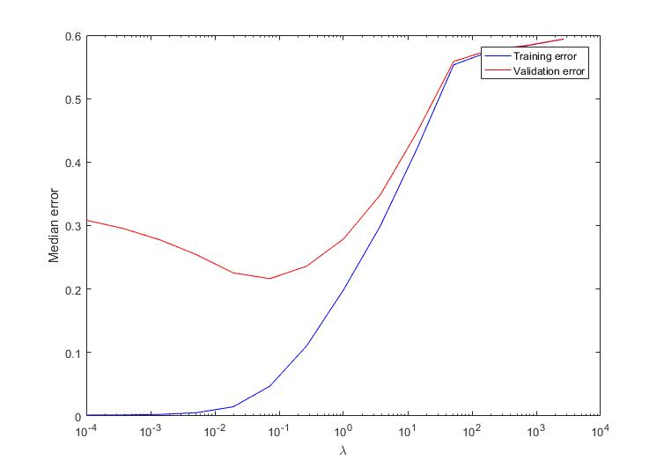

Kernel Regularized Least Squares
Gaussian kernel
Sigma precomputed as: $σ= \frac{1}{n}\sum_{i,j}{{||x_{i}− x_{j}||}^{2}}$
Kernel Matrix K computed just once at the beginning
with small $λ$ the result is better than RLS

Slide 10
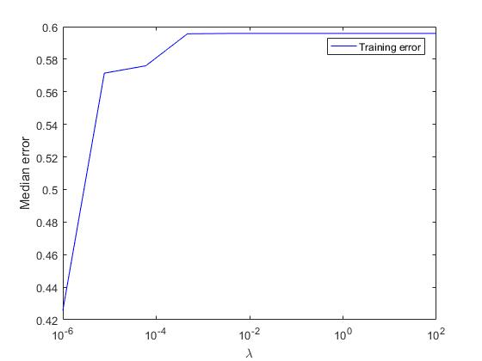
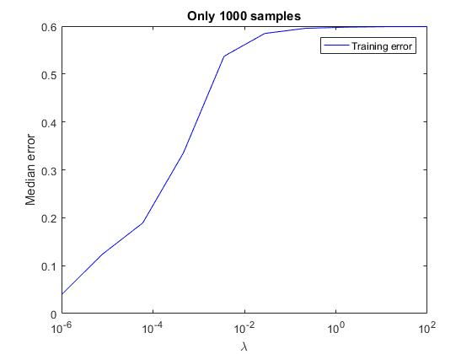

Kernel Regularized Logistic Regression
Gradient Descent optimization constrains:
${|Loss}_{k+1}−{Loss}_{k}|> {10}^{−6}$
Max iterations: 1000
Seem not good result but:
Data are not “variance” normalized, features have different ranges -> Gradient Descent doesn’t work well
Augmenting our limits to ${10}^{−8}$, max 10000 iterations considering a subset of only 1000 samples (for time reason) result seems better

Slide 11
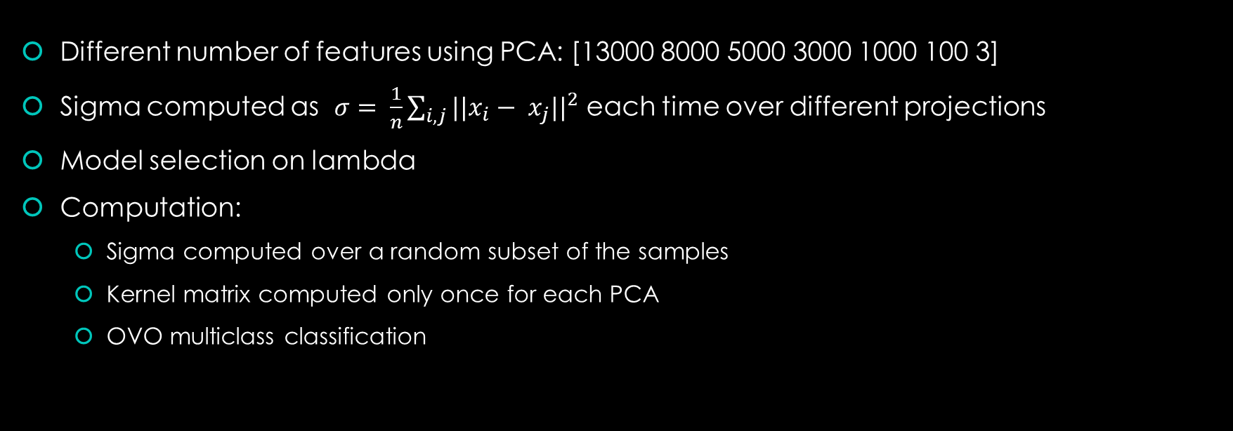
KRLS & PCA: Experiment
Different number of features using PCA: [13000 8000 5000 3000 1000 100 3]
Sigma computed as $σ= \frac{1}{n}\sum_{i,j}{{||x_{i}− x_{j}||}^{2}}$ each time over different projections
Model selection on lambda
Computation:
Sigma computed over a random subset of the samples
Kernel matrix computed only once for each PCA
OVO multiclass classification

Slide 12
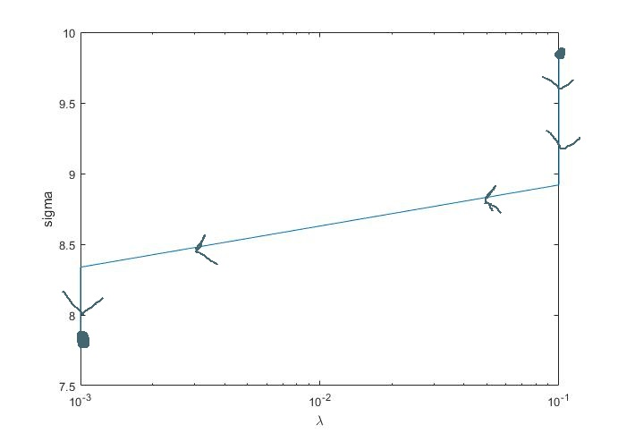
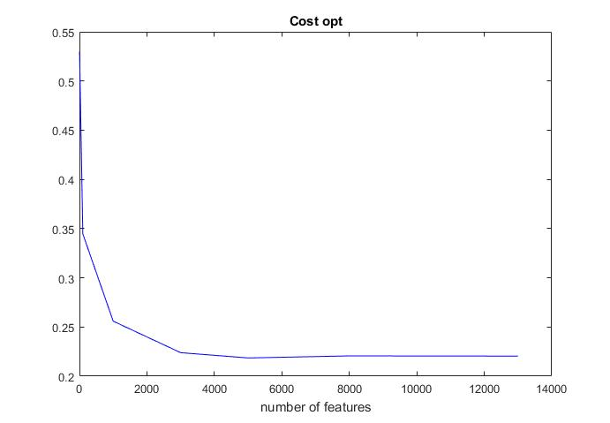
KRLS & PCA: Results
num features decreases

Slide 13
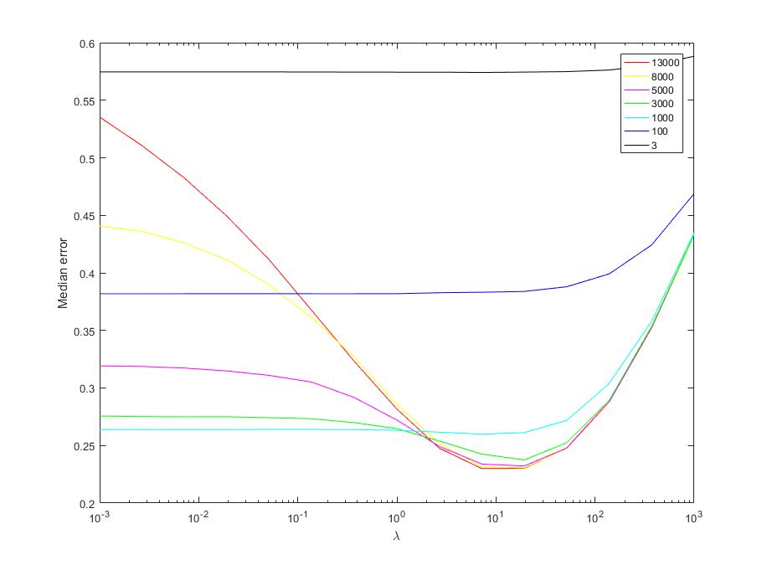
RLS & PCA: Results
num features > 1000
underfitting: same error for all models, with more features we have more degrees of freedom but we don’t exploit them
Overfitting: with more features we are more prone to overfitting
num features < 1000
the models aren’t flexible enough: “high bias”
Here we see that KRLS is more flexible with num features = 100 (cost 0.34 vs 0.38)
Overfitting
Underfitting

