Slide 1
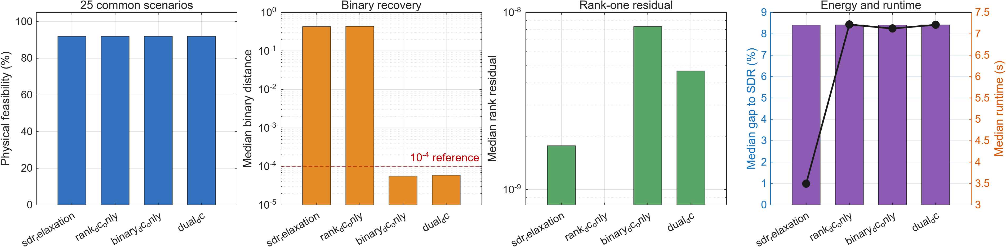
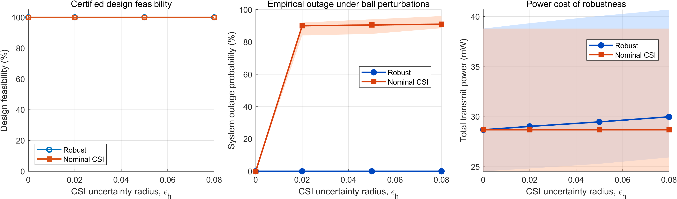
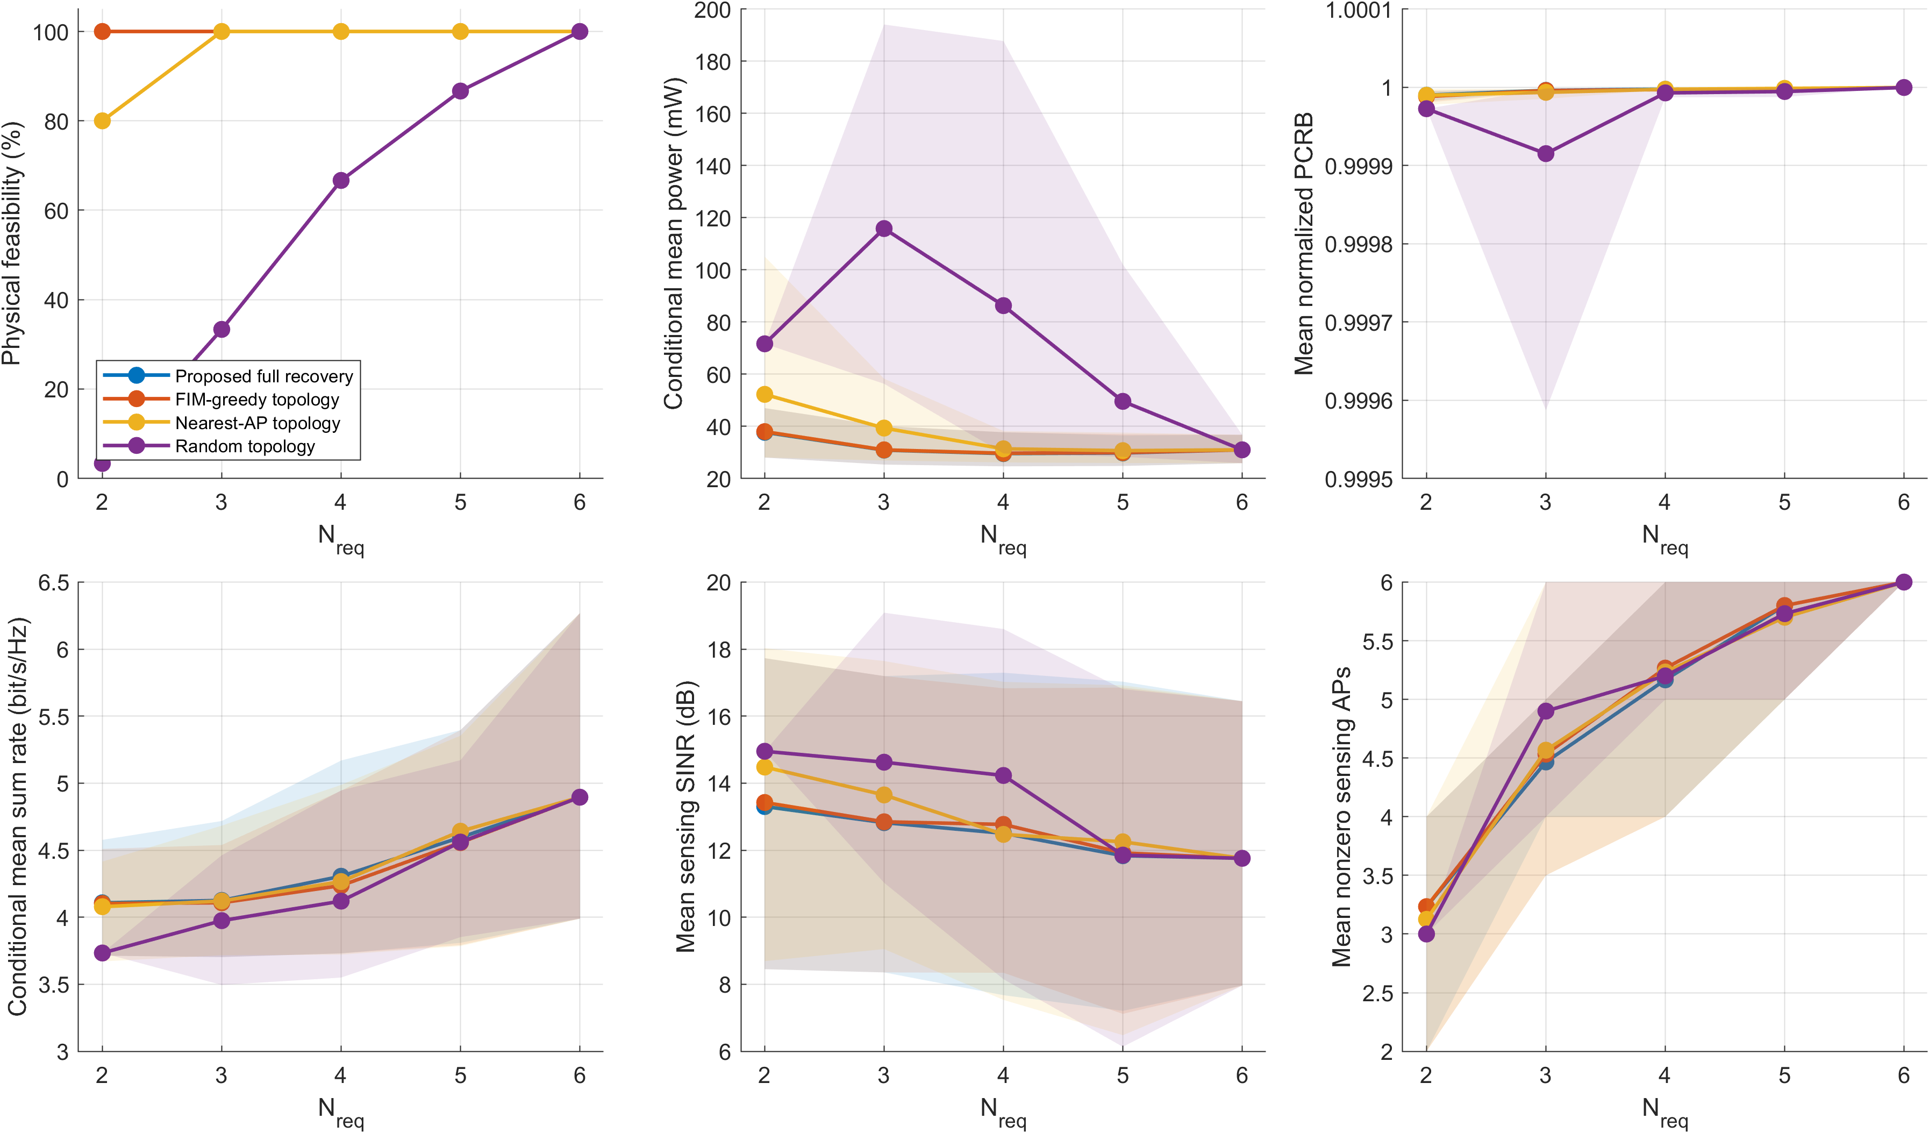
Thesis 2026
Robust Beamforming for Participation-Constrained
Cell-Free ISAC Systems
Xinpeng Yu | Supervisors: Derrick Ng and Shaokang Hu
ABSTRACT & RATIONALE
MODEL AND CLAIM
Cell-free ISAC retains globally cooperative communication while using a sparse, physically meaningful sensing cluster. We minimize transmit power subject to robust communication SINR, sensing SINR, and PCRB tracking constraints.
The binary variable b_mp authorizes only the target-p dedicated sensing waveform S_p.
M=6 APs, N_t=2 antennas/AP, K=3 UEs and P=2 targets. Each target has exactly N_req sensing AP authorizations; AP power is hard limited by P_max.
FIM geometry determines the sensing cluster; robust beamforming manages communication QoS.
CORE ALGORITHM: DUAL-DC RECOVERY WITH PHYSICAL CERTIFICATION
THREE-STAGE OPTIMIZATION
DUAL-DC ABLATION
1 Relax
Lift covariances, apply the S-procedure, and express PCRB using Schur-complement LMIs.
2 Recover
Use coupled rank and binary DC penalties to form a stable AP-target topology.
3 Certify
Fix b, re-optimize the continuous covariances, and validate AP power, sensing gate, SINR, PCRB, and rank constraints.
Only certified fixed-topology solutions enter the experiment statistics.
Coupled DC reaches a median binary distance of 5.94脳10鈦烩伒; rank-only relaxation leaves the association fractional.
ROBUST CSI PROTECTION
METHOD COMPARISON VERSUS N_req
Robust S-procedure: 0 sampled outage. Nominal CSI: 89鈥?2% mean outage.
FIM-aware recovery retains physical feasibility where nearest-AP and random baselines can fail.
CONCLUSIONS, LIMITATIONS & FUTURE WORK
KEY PARAMETERS
Findings: sensing authorization is geometry-aware, and robust CSI protection is essential. The relaxed solution is accepted only after fixed-topology re-optimization and physical validation. Limitation: fronthaul and compute energy are not yet modelled. Future work: distributed optimization and hardware-in-the-loop validation.
Network: M=6 APs, N_t=2, K=3 UEs, P=2 targets
Area: 400 m x 400 m
Participation: N_req=2 to 6 (default 3)
Pmax=0.1 W; CSI uncertainty: epsilon_h=0.05
Evidence: audited MATLAB experiment package
Notes:
[Sources]
- Internal experiment package: participation_model_experiment_package/README.md and paper/numerical_results.tex.
- Internal mathematical derivation: math_derivation_tex_v10/math_derivation_en.tex.
- Figure assets: experiment-package/figures/*.png.
- Local design benchmarks reviewed: Kai Lin, Lauren Spooner and Matthew Garrett winner posters; EET Thesis C/Project C marking form.
- Design approach inspired by Paper2Poster: https://github.com/paper2poster/paper2poster
[/Sources]

