Slide 1
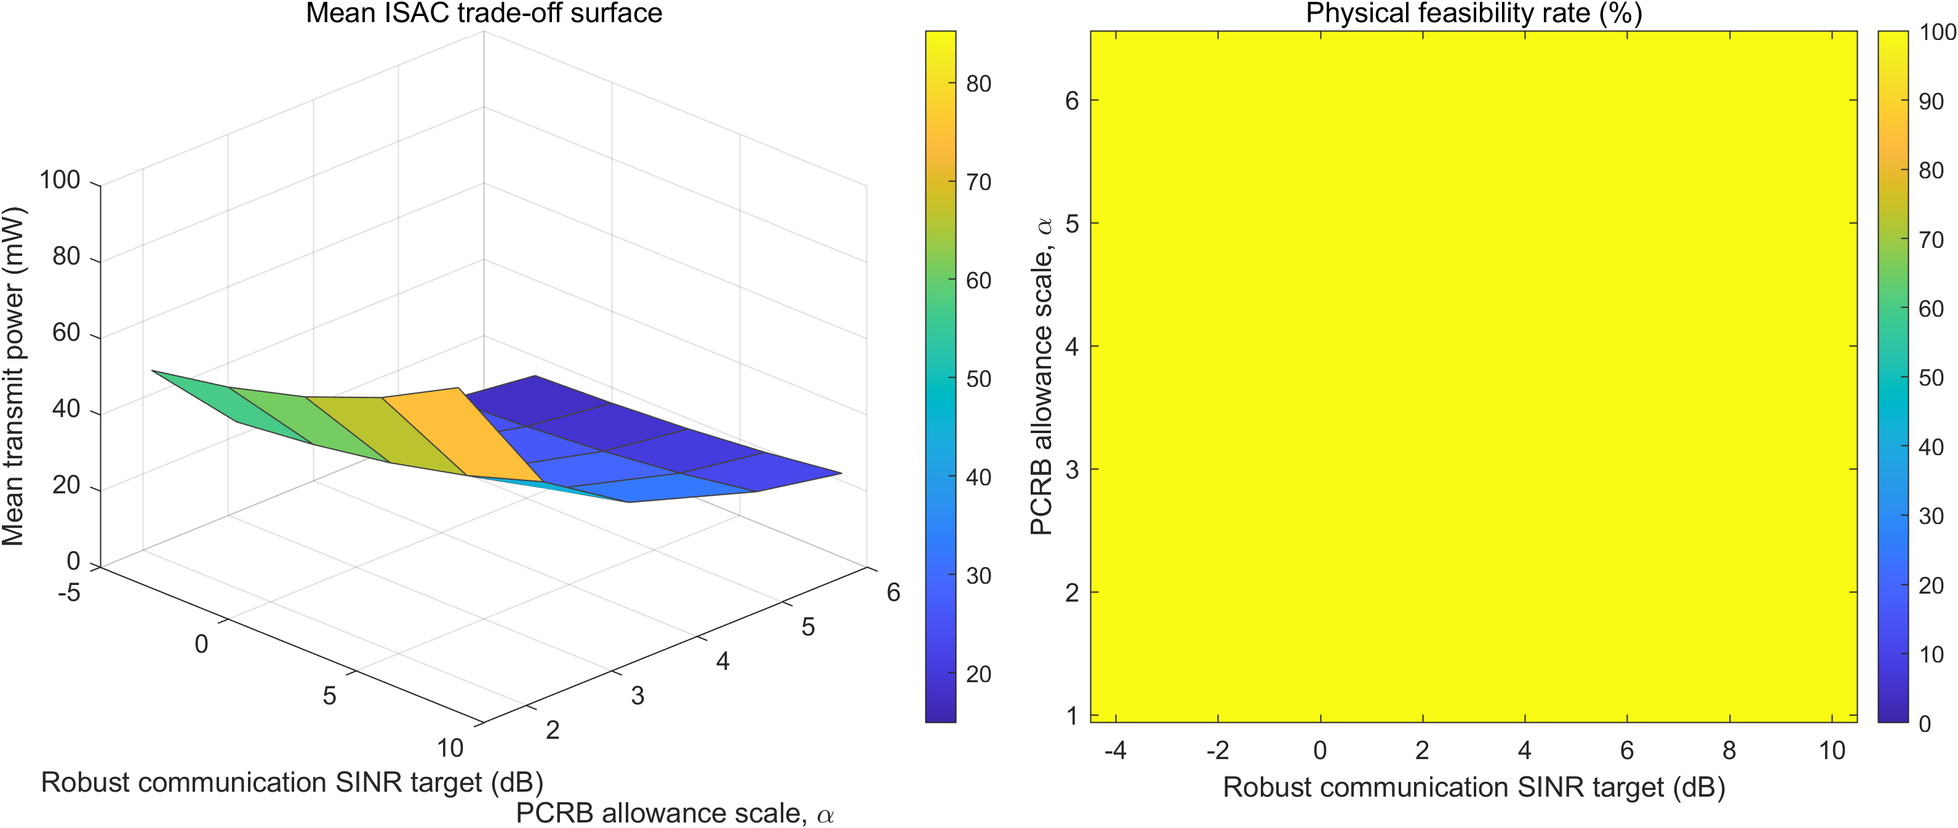
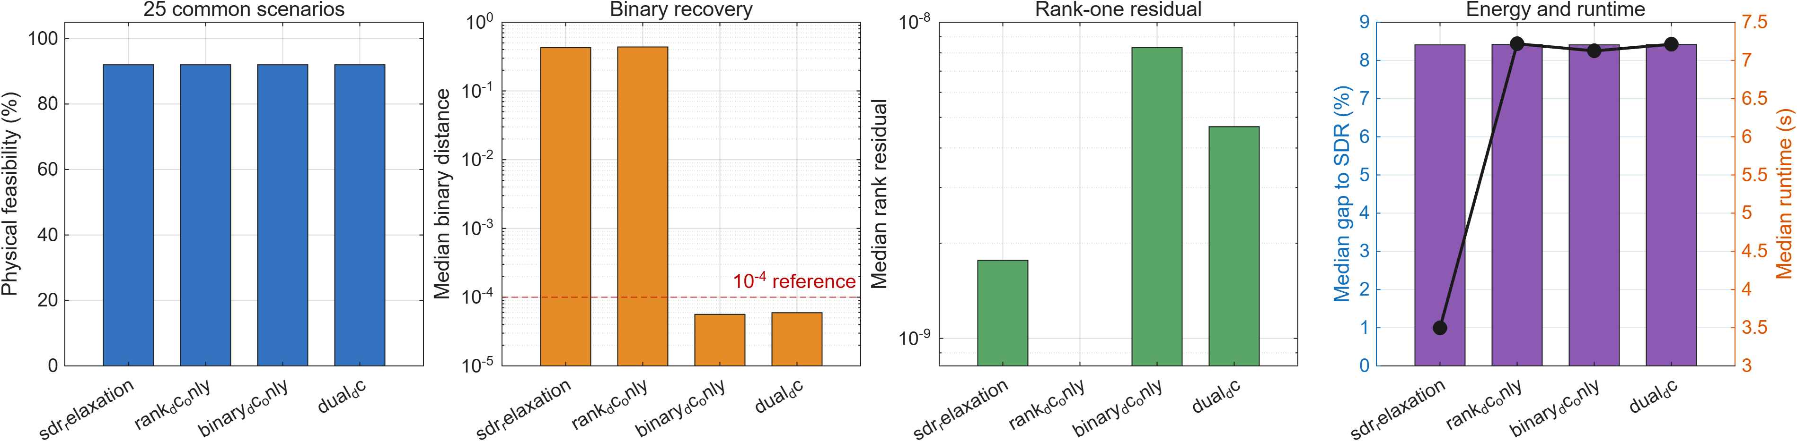
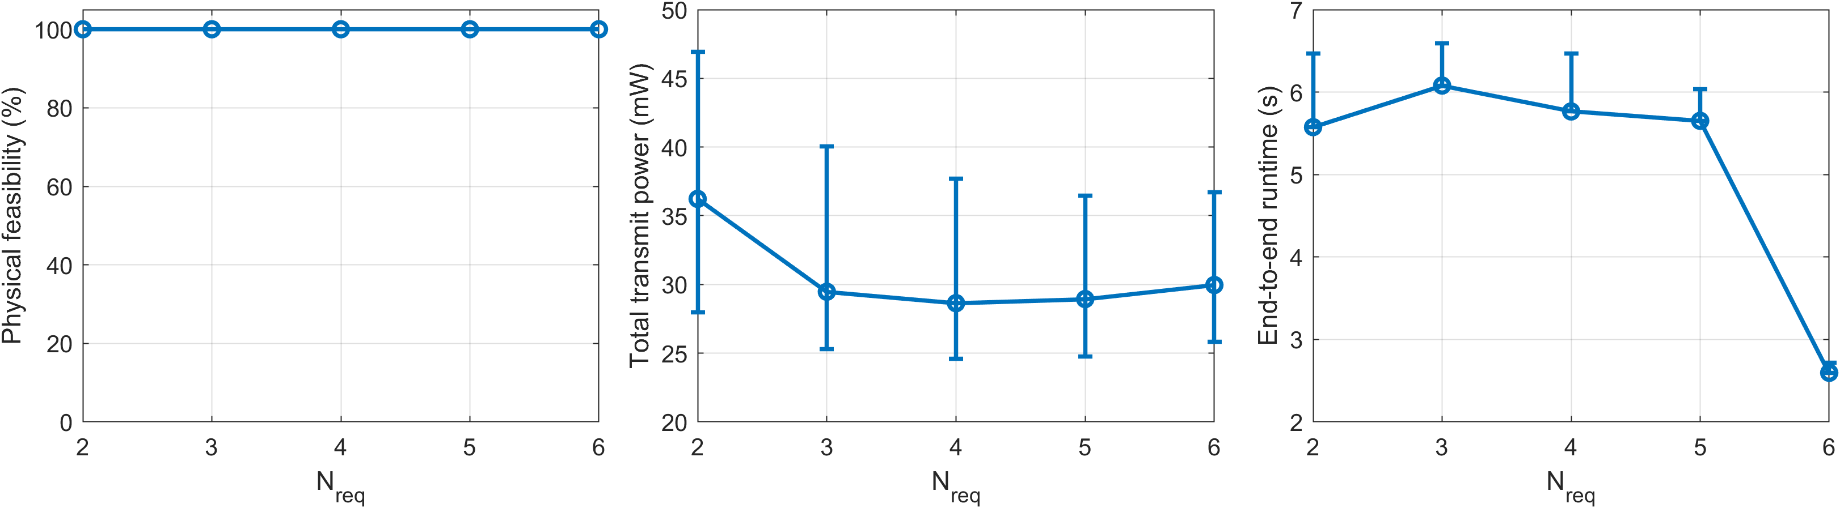
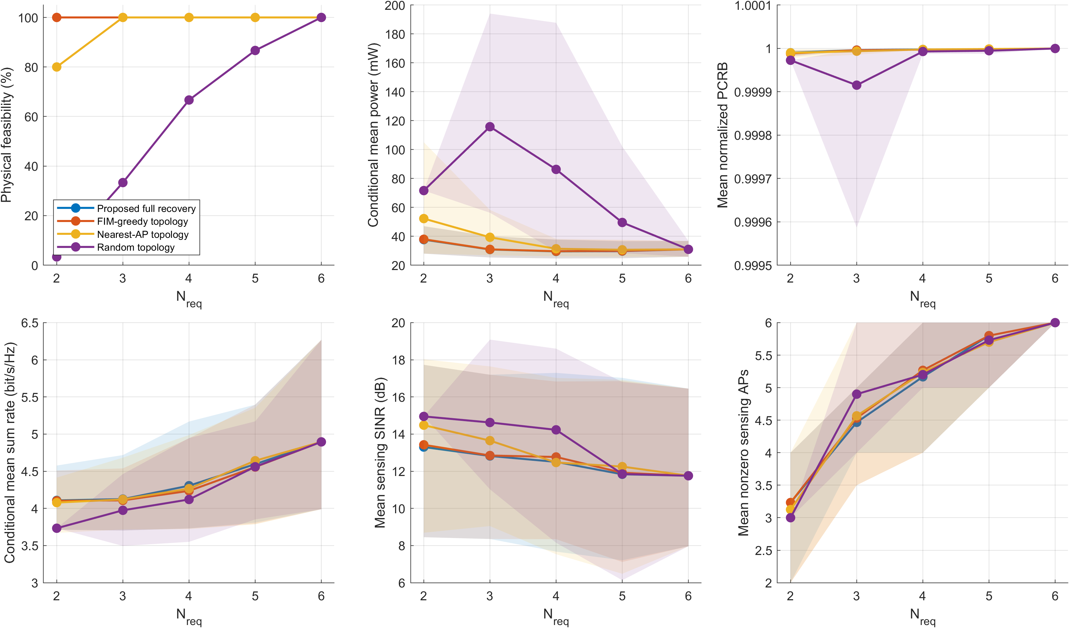
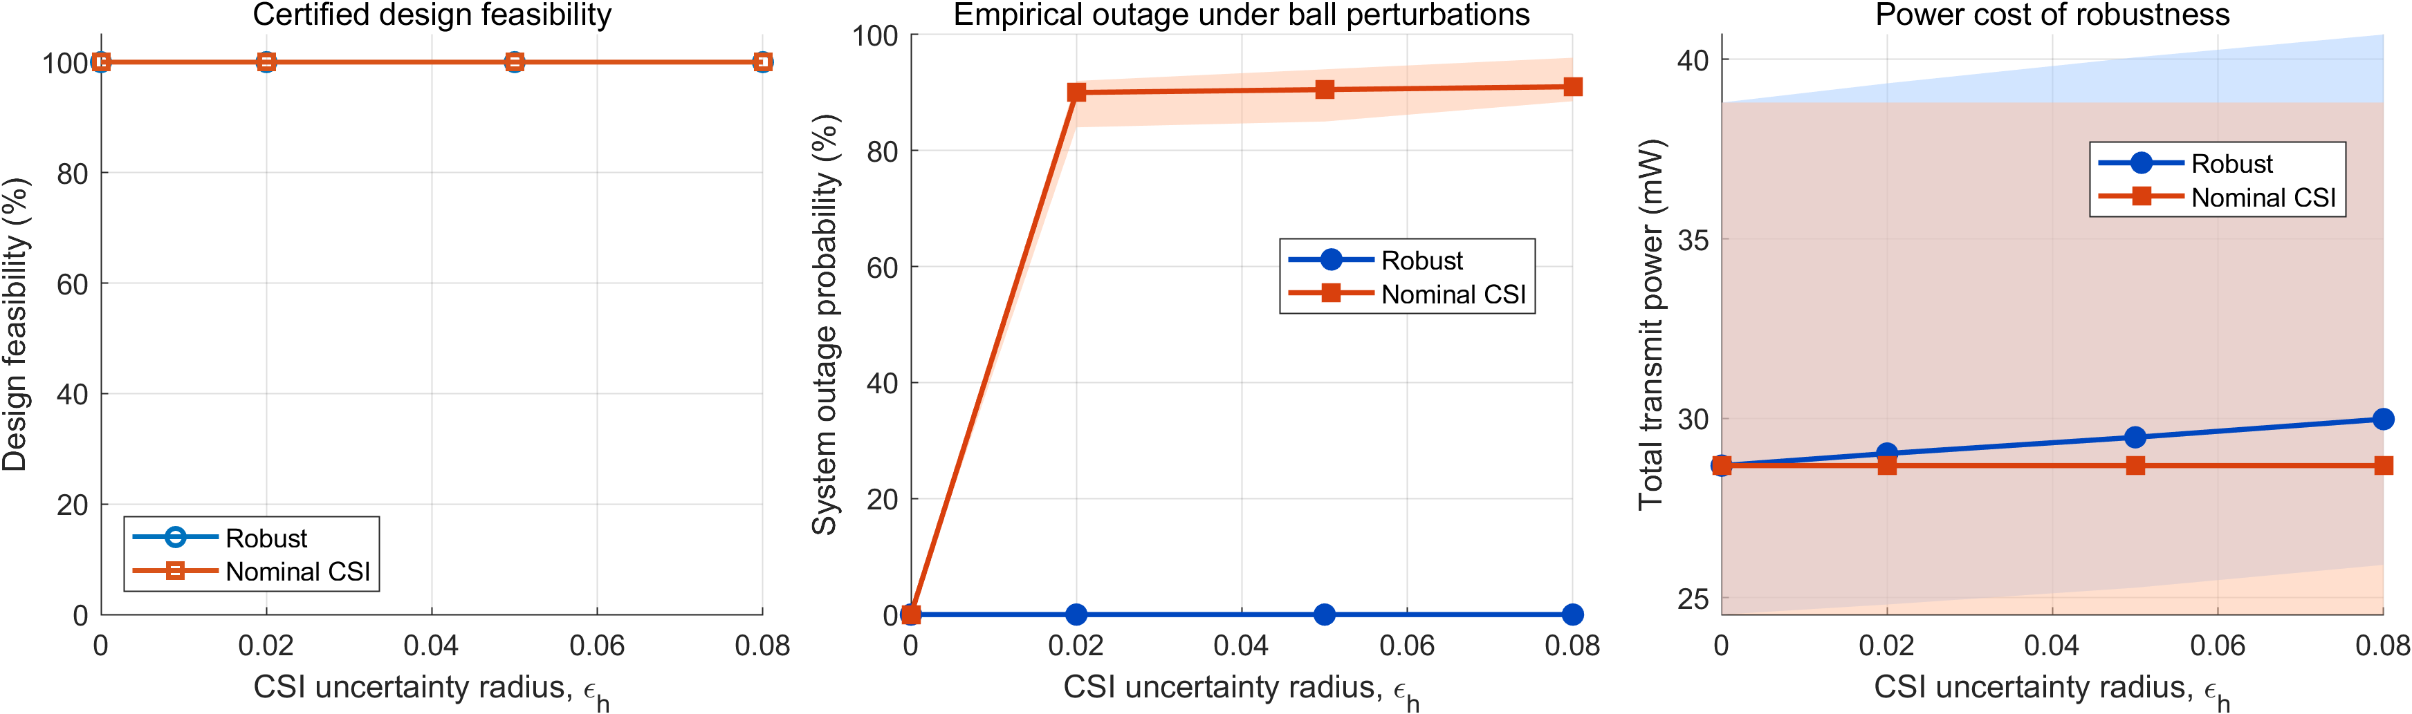
Thesis 2026
Robust Beamforming for Participation-Constrained Cell-Free ISAC Systems
Xinpeng Yu | Supervisors: Derrick Ng and Shaokang Hu
ABSTRACT & RATIONALE
MODEL AND CLAIM
Cell-free ISAC must retain globally cooperative communication while using a sparse and physically meaningful sensing cluster. We minimize transmit power under robust communication SINR, sensing SINR, and PCRB tracking constraints.
The association b_mp gates only the target-p dedicated sensing waveform S_p. Communication covariances remain globally cooperative.
M=6 APs, N_t=2 antennas/AP, K=3 UEs, P=2 targets. Each target has exactly N_req sensing AP authorizations.
AP power is hard limited by P_max. Selected APs carry nonzero dedicated sensing power. Geometry determines sensing-cluster quality; robust beamforming manages communication QoS.
ABSTRACT & RATIONALE
- 6G applications need simultaneous communication and high-precision sensing. Cell-free massive MIMO ISAC avoids duplicated spectrum, but imperfect CSI and non-convex resource allocation hinder deployment.
- Gap: a nearest/path-loss AP cluster can contain APs with zero dedicated sensing power, so nominal selection is not physically meaningful participation.
- Aim: minimise total transmit power while meeting robust communication SINR, sensing SINR and position-PCRB tracking constraints.
- Thesis claim: AP-target participation must be optimised jointly with robust beamforming to obtain physically feasible, energy-efficient sensing clusters.
- Evidence is reported only after fixed-topology re-optimisation and explicit feasibility validation.
CORE ALGORITHM: DUAL-DC RECOVERY WITH PHYSICAL CERTIFICATION
THREE-STAGE OPTIMIZATION
DUAL-DC ABLATION
1 Relax
OBJECTIVES & SYSTEM MODEL
CORE ALGORITHM
Lift covariances, use the S-procedure, and express PCRB with Schur-complement LMIs.
1. Optimise AP-target participation and robust transmit covariances jointly.
2. Tested system: M=6 APs, Nt=2 antennas/AP, K=3 UEs, P=2 targets, 400 m x 400 m.
3. Each target selects exactly Nreq APs through b_mp in {0,1}.
4. The sensing-power gate forces every selected AP to radiate nonzero dedicated sensing power.
5. Communication remains globally cooperative; only dedicated sensing is participation-gated.
1. Covariance lifting and semidefinite relaxation (SDR).
2. S-procedure for bounded CSI uncertainty in robust SINR constraints.
3. Schur-complement LMI reformulation of the PCRB tracking constraint.
4. Dual-DC successive convex approximation for rank and binary recovery.
5. Fix recovered topology, re-optimise, then validate power, SINR, PCRB and association gates.
2 Recover
Apply coupled rank and binary DC penalties to form a stable AP-target topology.
RESULTS & DEMONSTRATION
HOW TO READ THE SIX RESULT PANELS
3 Certify
Fix recovered b, re-optimize continuous covariances, and validate the AP-power, participation-gate, SINR, PCRB, and rank constraints. Only certified designs contribute to reported statistics.
1. Feasibility: all clusters pass the nonzero-power gate.
2. Power: Nreq=4 gives the minimum, 29.50 mW.
3. Runtime: SCA solves one trial in 2.6-6.1 s.
4. Certified feasibility: both designs pass before perturbation.
5. Outage: robust 0%; nominal 89.0-91.9%.
6. Robustness cost: power rises slightly with CSI uncertainty.
Recovery is not accepted merely because the relaxed problem is feasible.
The coupled scheme reaches a median binary distance of 5.94×10⁻⁵; rank-only relaxation leaves the association fractional.
ROBUST CSI PROTECTION
METHOD COMPARISON VERSUS N_req
Robust S-procedure design: 0 sampled outage. Nominal CSI: 89–92% mean outage under the same perturbations.
FIM-aware recovery retains physical feasibility where nearest-AP and random baselines can fail.
CONCLUSIONS, LIMITATIONS & FUTURE WORK
KEY PARAMETERS
Findings: sparse sensing authorization should be geometry-aware; robust CSI protection is essential; the final design is certified after fixed-topology re-optimization. Limitation: fronthaul and compute energy are not yet included. Future work: distributed optimization and hardware-in-the-loop validation.
Network: M=6 APs, Nt=2, K=3 UEs, P=2 targets
Area: 400 m x 400 m
Participation: Nreq=2 to 6 (default 3)
Pmax=0.1 W; sensing gate = 1 to 100 mW
CSI uncertainty: epsilon_h=0.05; 30 common seeds
Notes:
[Sources]
Edited directly from C:/Users/yxp02/Desktop/Thesis_Xinpeng/poster/Participation_Constrained_Cell_Free_ISAC_Poster_v7.pptx; original page dimensions, header/logo and lower branded block retained.
Technical content and numerical claims: C:/Users/yxp02/ISAC-Research/math_derivation_tex_v10/math_derivation_en.pdf and audited experiment package v1.0.
Figures: fig2_dual_dc_ablation, fig9_csi_robustness, fig10_method_comparison_vs_nreq.

