Slide 1
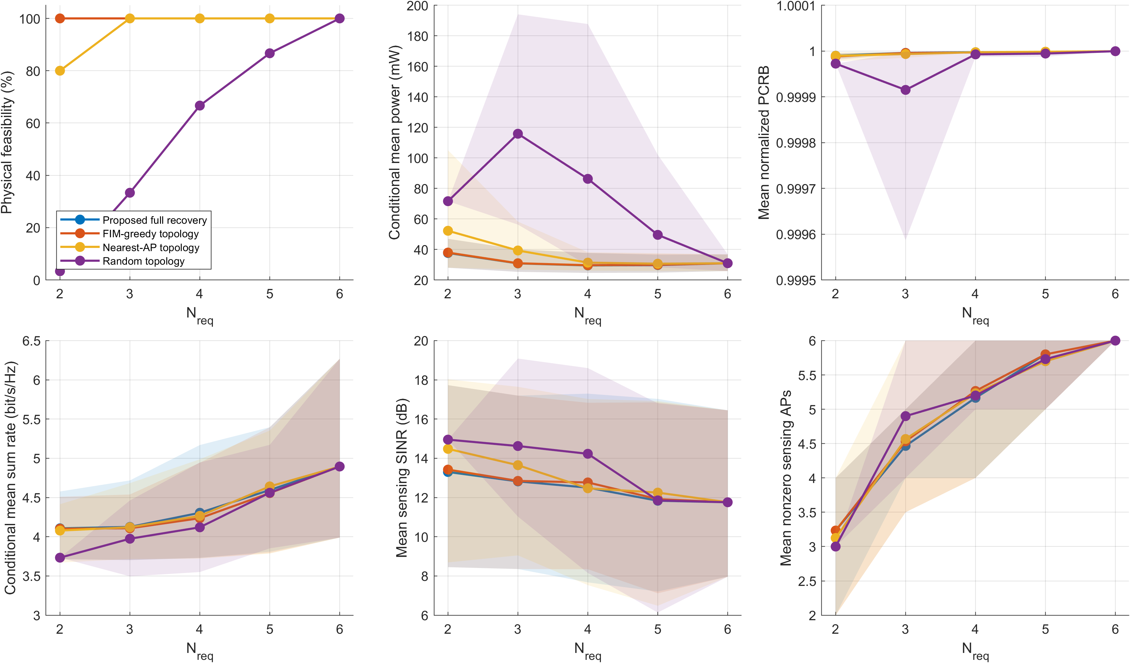
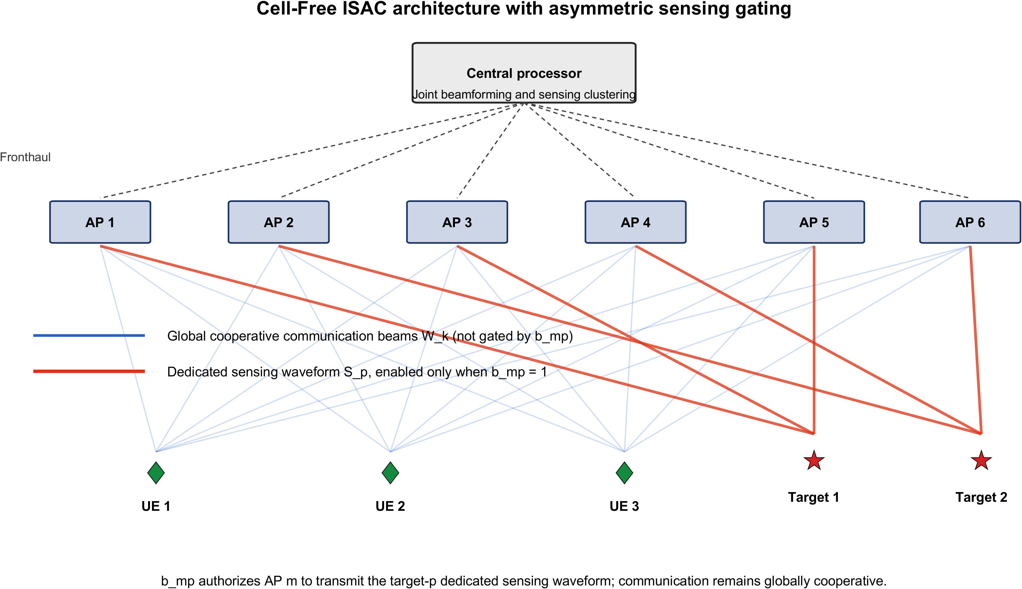
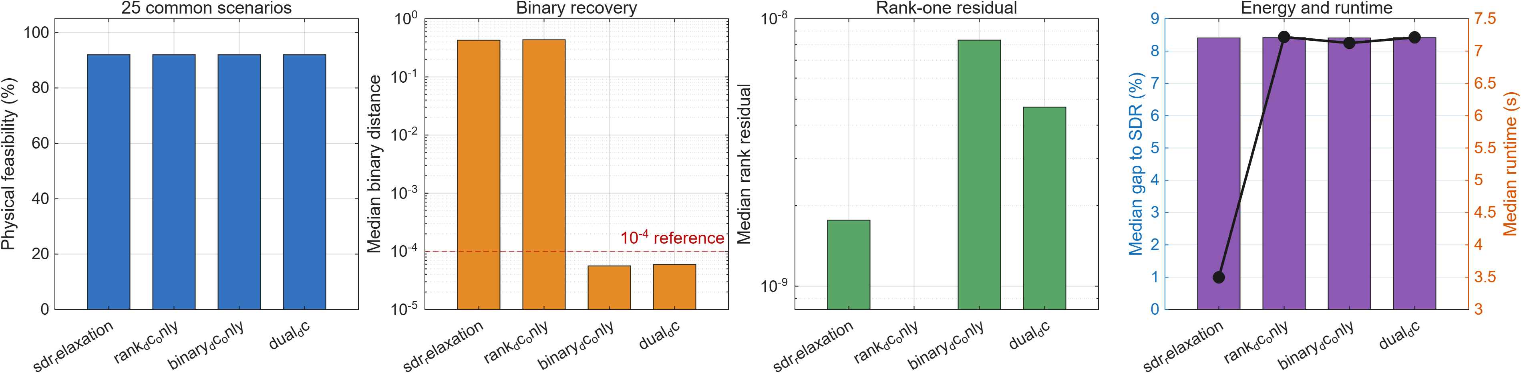
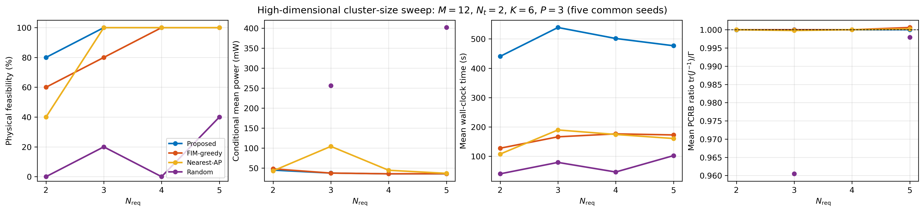
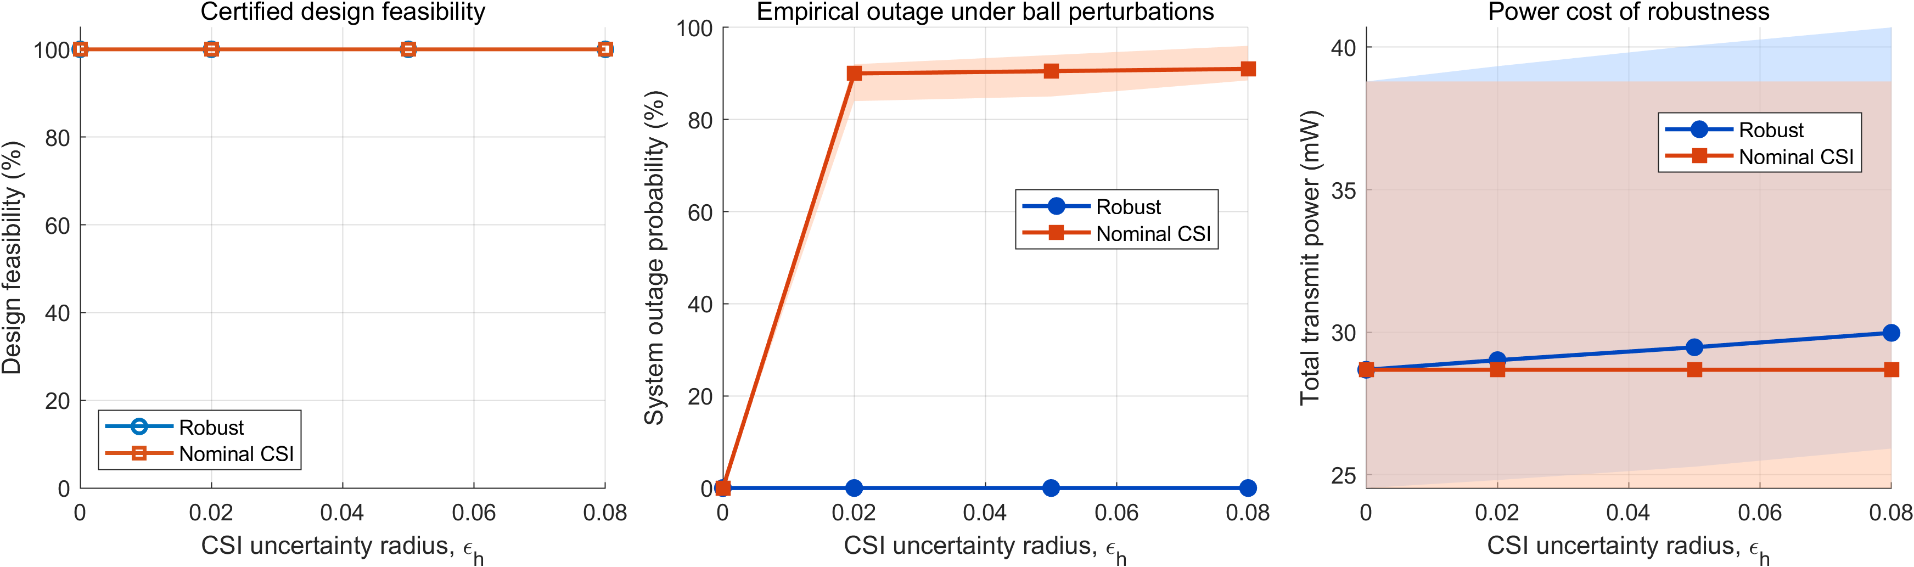
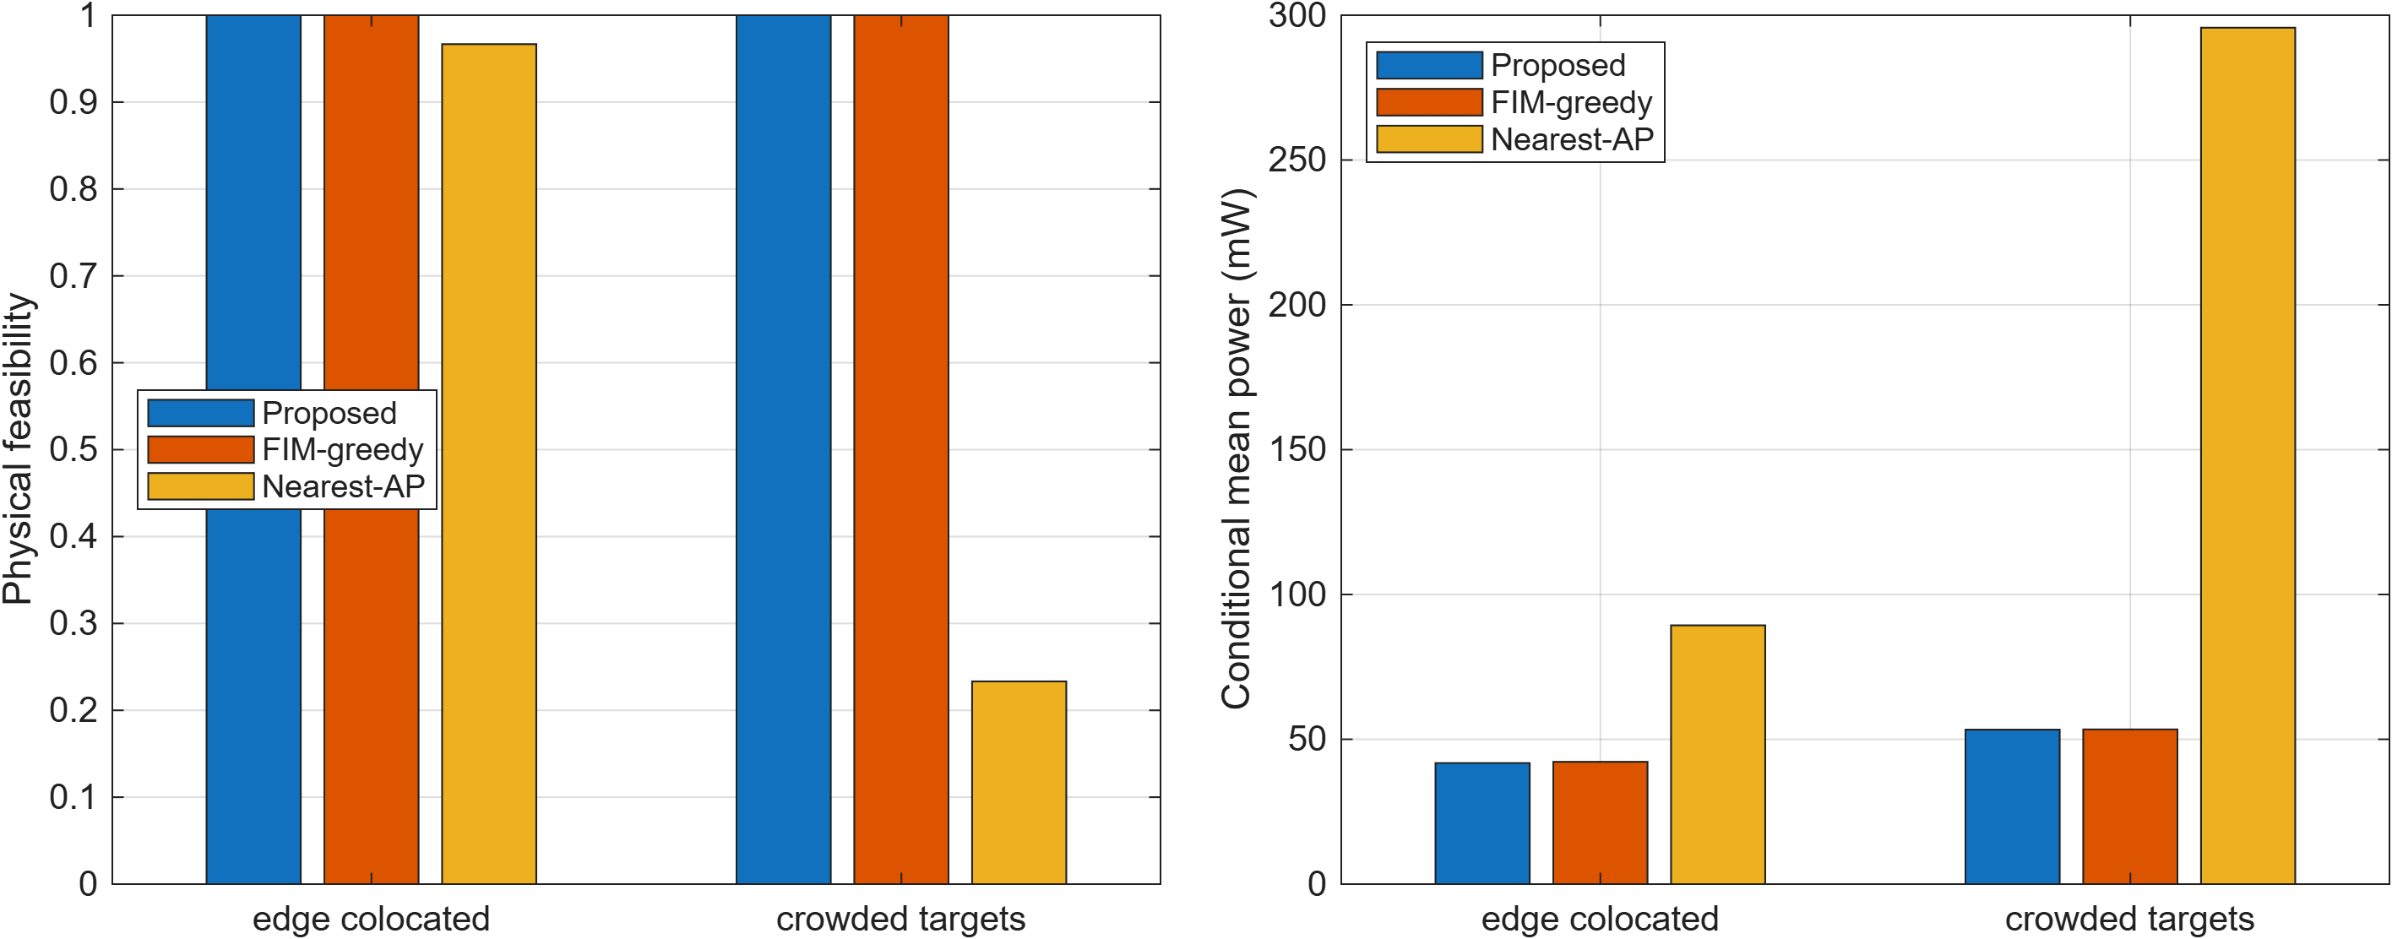
Robust Beamforming for Participation-Constrained Cell-Free ISAC
Geometry-aware AP-target sensing authorization with globally cooperative communication
RESEARCH POSTER | CELL-FREE ISAC
WHY THIS MATTERS
PROPOSED DESIGN
EVIDENCE
Sensing clusters should be sparse,
but communication should remain global.
Jointly optimize
association and robust covariances
Geometry-aware recovery delivers
feasibility and energy efficiency
•
Each target needs exactly Nreq authorized APs for its dedicated sensing waveform.
R_X = sum_k W_k + sum_p S_p
•
A poor AP-target geometry can make PCRB tracking infeasible or power-hungry.
1 Relax
Solve the robust SDR with AP power, PCRB and SINR constraints.
•
Communication beams are globally cooperative; only dedicated sensing waveforms are gated.
2 Recover
Use rank and binary DC penalties, then recover an integer association.
3 Certify
Re-optimize with fixed b and accept only physically validated solutions.
M=9 study: proposed recovery is physically feasible for every tested Nreq; random and nearest-AP baselines lose feasibility in challenging regimes.
b_mp authorizes AP m to transmit the target-p dedicated sensing waveform; communication remains globally cooperative.
Dual DC reduces the median binary distance to 5.94e-5; rank-only relaxation stays near 0.43.
M=12 study: lowest observed conditional mean power is 35.72 mW at Nreq=4; PCRB remains tight.
ROBUSTNESS AND SCALABILITY
TAKEAWAY
Dedicated sensing should be
geometry-aware and sparsely
authorized.
Our dual-DC recovery finds
physically feasible binary
clusters, while robust
beamforming absorbs QoS
pressure through the global
communication degrees of freedom.
Robust design: zero sampled outage. Nominal CSI design: 89-92% mean outage under tested perturbations.
Crowded-target geometry exposes the weakness of distance-only association; FIM-aware choices remain reliable.
Metrics: feasibility is unconditional; power and QoS values are conditioned on physical feasibility unless stated otherwise.
Author / affiliation / QR: add before printing
Notes:
[Sources]
All claims and graphics are derived from C:/Users/yxp02/ISAC-Research/math_derivation_tex_v10/math_derivation_en.pdf and its audited experiment package.
Figures: fig1_system_architecture, fig2_dual_dc_ablation, fig9_csi_robustness, fig10_method_comparison_vs_nreq, fig12_pressure_geometries, and fig12_m12_nreq_scalability.
No external image assets or unverified numerical claims are used.

