Slide 1
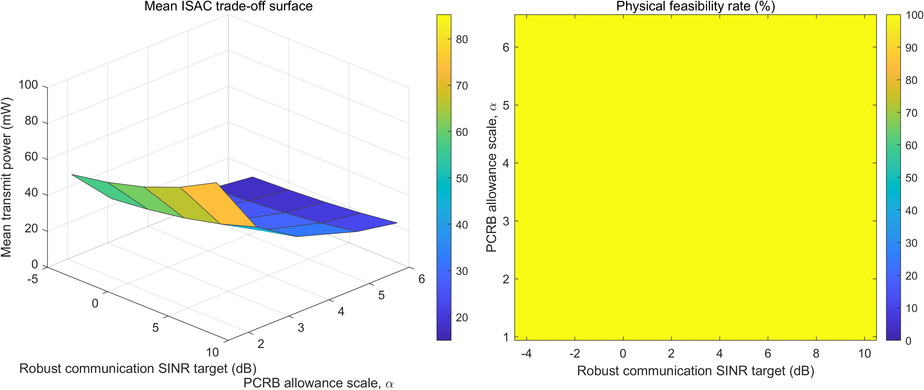
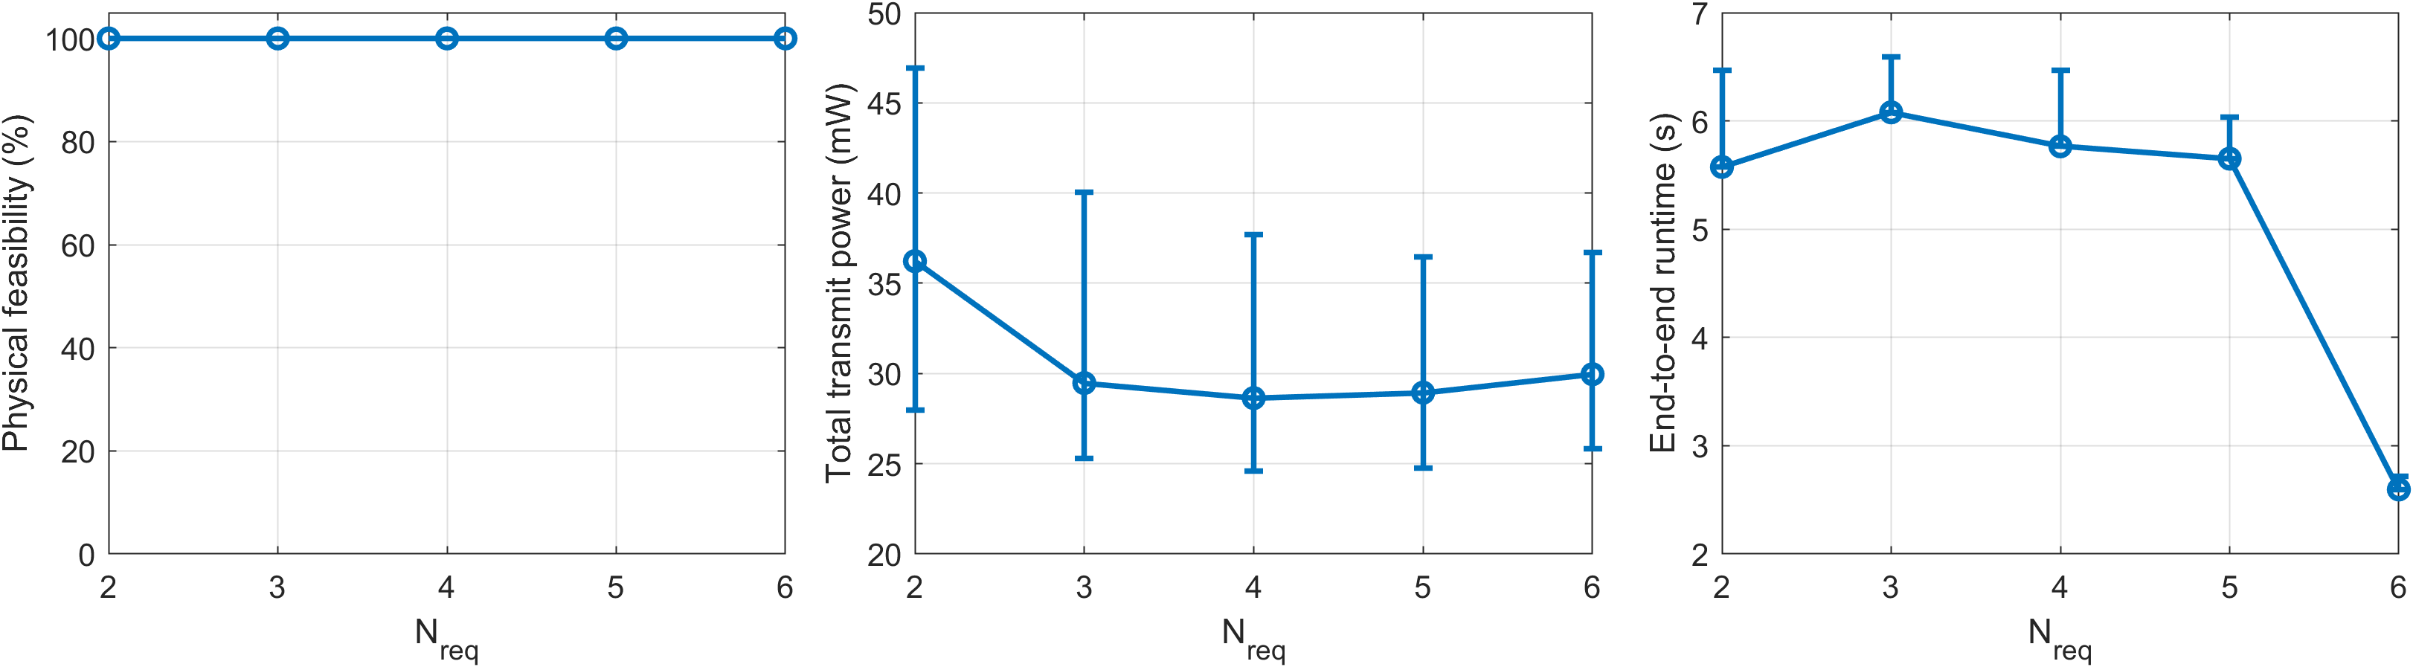
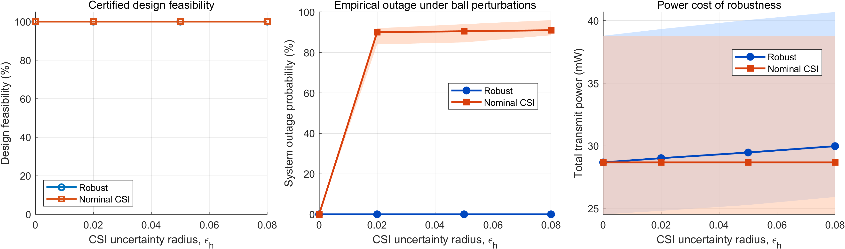
Thesis 2026
Resource Allocation for Integrated Sensing
and Communication (ISAC) in Cell-Free Massive MIMO Systems
Xinpeng Yu | Supervisors: Derrick Ng and Shaokang Hu
ABSTRACT & RATIONALE
- 6G applications need simultaneous communication and high-precision sensing. Cell-free massive MIMO ISAC avoids duplicated spectrum, but imperfect CSI and non-convex resource allocation hinder deployment.
- Gap: a nearest/path-loss AP cluster can contain APs with zero dedicated sensing power, so nominal selection is not physically meaningful participation.
- Aim: minimise total transmit power while meeting robust communication SINR, sensing SINR and position-PCRB tracking constraints.
- Thesis claim: AP-target participation must be optimised jointly with robust beamforming to obtain physically feasible, energy-efficient sensing clusters.
- Evidence is reported only after fixed-topology re-optimisation and explicit feasibility validation.
OBJECTIVES & SYSTEM MODEL
CORE ALGORITHM
1. Optimise AP-target participation and robust transmit covariances jointly.
2. Tested system: M=6 APs, Nt=2 antennas/AP, K=3 UEs, P=2 targets, 400 m x 400 m.
3. Each target selects exactly Nreq APs through b_mp in {0,1}.
4. The sensing-power gate forces every selected AP to radiate nonzero dedicated sensing power.
5. Communication remains globally cooperative; only dedicated sensing is participation-gated.
1. Covariance lifting and semidefinite relaxation (SDR).
2. S-procedure for bounded CSI uncertainty in robust SINR constraints.
3. Schur-complement LMI reformulation of the PCRB tracking constraint.
4. Dual-DC successive convex approximation for rank and binary recovery.
5. Fix recovered topology, re-optimise, then validate power, SINR, PCRB and association gates.
RESULTS & DEMONSTRATION
HOW TO READ THE SIX RESULT PANELS
1. Feasibility: all clusters pass the nonzero-power gate.
2. Power: Nreq=4 gives the minimum, 29.50 mW.
3. Runtime: SCA solves one trial in 2.6-6.1 s.
4. Certified feasibility: both designs pass before perturbation.
5. Outage: robust 0%; nominal 89.0-91.9%.
6. Robustness cost: power rises slightly with CSI uncertainty.
CONCLUSIONS, LIMITATIONS & FUTURE WORK
KEY PARAMETERS
FINDINGS
- The participation gate removes selected-but-silent APs; FIM clusters are physically defensible.
- In this six-AP study, Nreq=4 is minimum-power and robust CSI is necessary.
LIMITATION
- Simulation only: fronthaul and compute energy are not yet included.
FUTURE WORK
- Scale with distributed optimisation; add radio/fronthaul/compute cost; perform hardware-in-the-loop sensing validation.
Network: M=6 APs, Nt=2, K=3 UEs, P=2 targets
Area: 400 m x 400 m
Participation: Nreq=2 to 6 (default 3)
Pmax=0.1 W; sensing gate = 1 to 100 mW
CSI uncertainty: epsilon_h=0.05; 30 common seeds
Notes:
[Sources]
- Internal experiment package: participation_model_experiment_package/README.md and paper/numerical_results.tex.
- Internal mathematical derivation: math_derivation_tex_v10/math_derivation_en.tex.
- Figure assets: experiment-package/figures/*.png.
- Local design benchmarks reviewed: Kai Lin, Lauren Spooner and Matthew Garrett winner posters; EET Thesis C/Project C marking form.
- Design approach inspired by Paper2Poster: https://github.com/paper2poster/paper2poster
[/Sources]

