Slide 1


Please attribute as SimpleITK Historical Overview (SPIE Medical Imaging 2018)
This work is copyrighted by the Insight Software Consortium
It is distributed under a Creative Commons Attribution 4.0 International License: https://creativecommons.org/licenses/by/4.0/

Slide 2




SimpleITK Historical Overview: Standing on the Shoulders of Giants
¹Hans J. Johnson, ²Bradley C. Lowekamp, ³Ziv Yaniv
¹The University of Iowa
²National Institutes of Health ³TAJ Technologies Inc.
⁴MSC LLC

Slide 3
What is SimpleITK?
A simplified multi-language interface to the National Library of Medicine’s Insight Segmentation and Registration Toolkit (ITK).
Available in:
C++, Python, R, Java, C#, Lua, Ruby, TCL
github.com/SimpleITK/SimpleITK

Slide 4
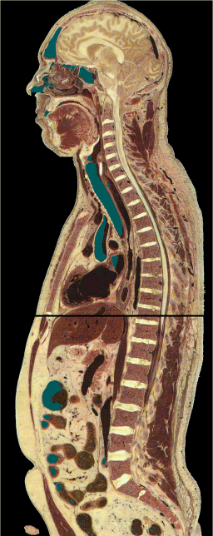
In the Beginning There Was Data
1994
“The Visible Human Male: A Technical Report", V. Spitzer et al., J. Am. Med. Inform. Assoc.,3(2), pp. 118-130, 1996.
Notes:
Visible human data comes in, but we don’t have the tool to analyze it.
Male dataset released in 1994.

Slide 5

Need to Analyze the Data
Insight Segmentation and Registration Toolkit
2002
“Engineering and Algorithm Design for an Image Processing API: A Technical Report on ITK - the Insight Toolkit”, T. S. Yoo et al., Stud. Health Technol. Inform., 85, pp. 586-592, 2002.

Slide 6

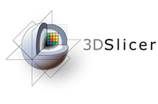
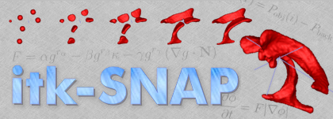




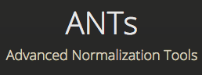




Open Source
Notes:
Image analysis from a cell (GoFigure2) to our planet’s surface (Orfeo).
http://gofigure2.sourceforge.net/
http://www.slicer.org/
http://www-sop.inria.fr/asclepios/software.php
http://www.itksnap.org/
http://www.bioimagexd.net/
http://co-me.ch/internal/marvin/index.en.html
http://www.osirix-viewer.com/
http://www.analyzedirect.com/
http://www.mitk.org/
http://elastix.isi.uu.nl/
http://www.igstk.org/

Slide 7









Commercial Entities
Based on mailing list – Likely.
But we have no written testimony.
Notes:
These companies likely use ITK but we have no sure way of knowing.

Slide 8
Why SimpleITK
Change in programming expertise:
Shift from C++ to Python and R.
Change in expectations:
No need to compile/build software.
Software should be easy to install.

Slide 9
SimpleITK by the Numbers
17 Minor releases, 1 Major release.
25 Contributors.
9396 Commits.
191,718 lines of code.
Starred 154 times on github.
More than 68,500 downloads since 1/2013.
Notes:
List all tags: git tag
Number of commits in repo: git rev-list --all --count
Number of contributors: git log --format='%aN' | sort -u -k2; then count and remove people with multiple appearances (Dave Chen, David T. Chen…)
11,156 downloads from Anaconda cloud
18286 downloads from PyPI (till it stopped recording in Feb. 2016).
39,435 downloads from sourceforge

Slide 10
User Community

Slide 11
User Community

Slide 12
How to Cite
B. C. Lowekamp, D. T. Chen, L. Ibáñez, D. Blezek, "The Design of SimpleITK", Front. Neuroinform., 7:45. https://doi.org/10.3389/fninf.2013.00045, 2013.
Z. Yaniv, B. C. Lowekamp, H. J. Johnson, R. Beare, "SimpleITK Image-Analysis Notebooks: a Collaborative Environment for Education and Reproducible Research", J Digit Imaging., https://doi.org/10.1007/s10278-017-0037-8, 2017.
R. Beare, B. Lowekamp, and Z. Yaniv, “Image segmentation, registration and characterization in R with SimpleITK,” Journal of Statistical Software, in press.

Slide 13


