Slide 1



SOUND CLASSIFICATION USING EFFICIENTNET-B2 AND SPECTROGRAM-BASED FEATURES
By Group 8:
IIT2022194 Sambhav Sinha
IIT2022198 Aastha Ojha
IIT2022215 Akash Adak
IIT2022238 Ashutosh Sahu
IFI2022006 Rahatal Dnyanda Santosh

Slide 2

PROJECT GOALS
  Build a deep learning model that can classify different types of environmental sounds from the dataset.
  Challenge : Environmental sounds are highly variable — same class may sound different depending on location or intensity.
  Many classes overlap acoustically (e.g., wind vs. rain).
  Audio Clip → Spectrogram → Deep Learning Model → Sound Label
01

Slide 3
DATASET
  2,000 labeled audio clips of 5 seconds each.
  50 classes (40 clips per class).
  5-fold cross-validation setup provided officially.
  Each file: .wav format sampled at 44.1 kHz.
  Categories (5 main groups):
    Animal sounds (dog bark, crow, insects)
    Natural sounds (rain, thunder, wind)
    Human sounds (sneeze, cough, clapping)
    Domestic sounds (vacuum, clock tick)
    Urban noises (siren, engine, drilling)
02

Slide 4
DATA ORGANIZATION & CHALLENGES
  Preprocessing Decisions:
    Standardized clips to 5 seconds and 44.1 kHz.
    Converted stereo to mono (averaged channels).
    Split data into 5 folds for cross-validation.
  Challenges in Environmental Sound Data:
    Noise: Background or overlapping sounds (e.g., dog barking during rain).
    Class Imbalance: Some sounds more diverse than others.
    Acoustic Overlap: Similar frequency patterns across classes (e.g., rain vs. waterfall).
03

Slide 5
DATA PREPROCESSING & FEATURE EXTRACTION
  Implemented the audio preprocessing and feature extraction pipeline.
  Ensured consistent, reproducible preprocessing through a custom ESC50Dataset class.
  Focused on transforming raw environmental audio into informative spectrogram representations suitable for CNN models.
  Designed a PyTorch Dataset class to:
  Load and preprocess ESC-50 audio files consistently.
  Apply waveform + spectrogram augmentations on-the-fly.
  Ensure uniform data transformations during training and validation.
04

Slide 6

SPECTROGRAM GENERATION
  Converted raw 1D audio waveforms (5 s, 44.1 kHz) → 2D Mel-Spectrograms using torchaudio.
  Used Mel scale to mimic human auditory perception.
  Generated log-scaled spectrograms for dynamic range compression and better visual representation.
DELTA AND DELTA-DELTA FEATURES
  Computed temporal derivatives of the Mel-Spectrogram:
    Δ (Delta): Captures first-order temporal changes (short-term dynamics).
    ΔΔ (Delta-Delta): Captures second-order changes (acceleration of features).
  Combined Mel + Δ + ΔΔ → 3-channel input (like RGB image) for CNN processing.
05

Slide 7
DATA AUGMENTATION PIPELINE
Waveform Augmentations – Time-Series Level
  Gain Adjustment: Random amplitude scaling for loudness variation.
  Noise Injection: Adds Gaussian noise to simulate real-world background sounds.
  Pitch Shift: Alters pitch while preserving tempo.
  Shift (Time Roll): Temporally shifts waveform to introduce variety.
(b) Spectrogram Augmentations – Image Level
  SpecAugment:
    Time Masking – randomly hides time bands.
    Frequency Masking – hides Mel frequency bands.
  Increases robustness and prevents overfitting.
05

Slide 8
MODEL ARCHITECTURE: EFFICIENTNET-B2 FOR ENVIRONMENTAL SOUND CLASSIFICATION
Key Idea: Use an image-based CNN (EfficientNet-B2) on spectrogram-like inputs.
Waveform →
Mel Spectrogram (dB)→
Δ →
ΔΔ →
Stack (3-channel image)
EfficientNet-B2 →
Softmax (50 classes)
Input Representation:
  3 channels → Mel Spectrogram, Delta, Delta-Delta
  Each audio → 5-second clip → 128×128 Mel image resized to model size (260×260)
Model Architecture Flow
06

Slide 9
TRAINING CONFIGURATION & TECHNIQUES
Regularization:
  Mixup (α = 0.4): improves generalization by blending samples
  Label smoothing (0.1): reduces over-confidence
Optimizer: AdamW (lr = 3e-4, weight decay = 1e-2)
Scheduler: CosineAnnealingLR → gradually reduces learning rate
Batch size: 32
Augmentations: SpecAugment (time & frequency masking)
07

Slide 10
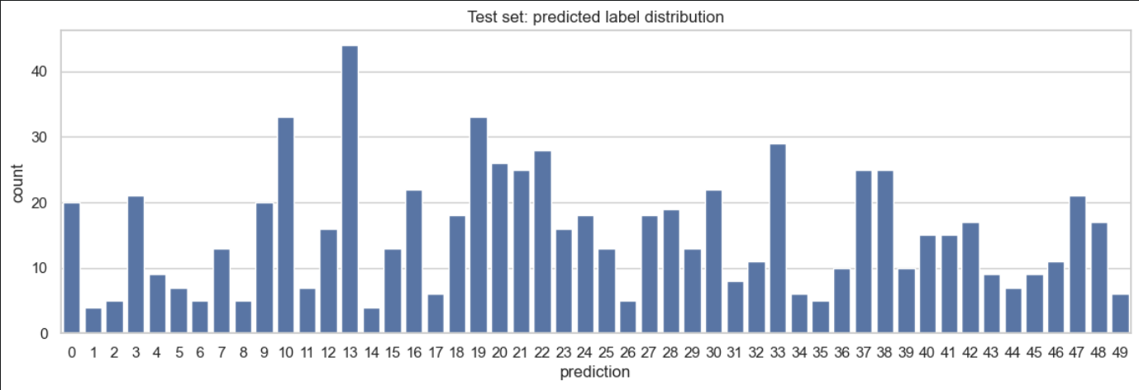
MODEL EVALUATION & RESULTS
Cross-Validation: 5-fold setup (trained on 4 folds, validated on 1)
Performance: Best validation Accuracy: ~90.25 % , stable accuracy across folds (~89–91 %)
Observation: Model learned strong sound-class features

Slide 11
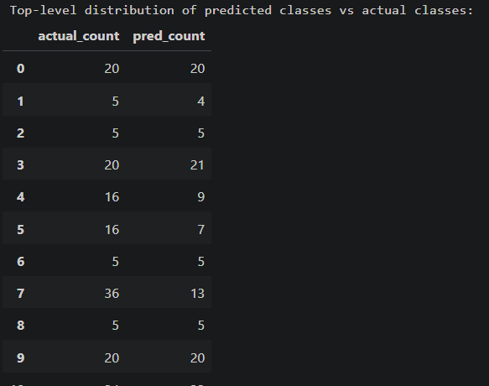
PERFORMANCE EVALUATION ON THE TEST SET
Validation Accuracy: 90.25 %
Test Accuracy: 59.82 %
Large drop → indicates generalization issue
Possible causes:
  Similar sounding classes
  Overfitting to training patterns
09

Slide 12
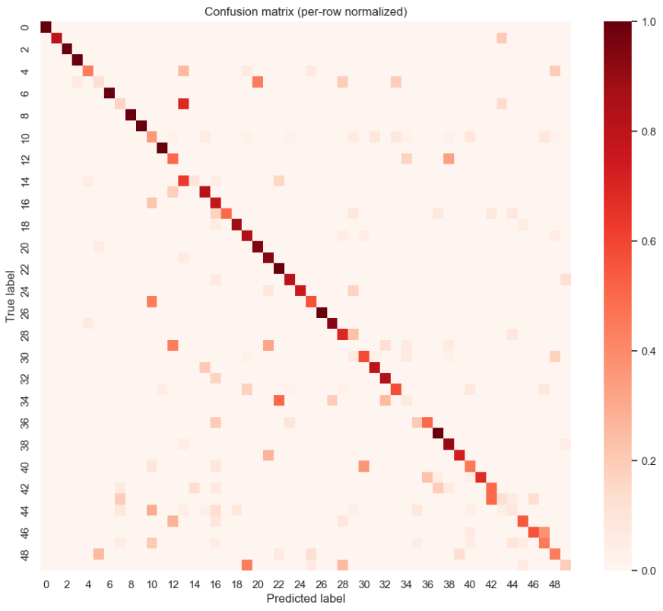
UNDERSTANDING MISCLASSIFICATIONS
Computed 50 × 50 confusion matrix.
Observed strong diagonal but significant confusion between acoustically similar classes:
  Rain ↔ Sea waves
  Dog bark ↔ Crow
  Wind ↔ Rustling leaves
Computed per-class accuracy to find weakest categories.
Checked sample spectrograms of misclassified files.
09

Slide 13
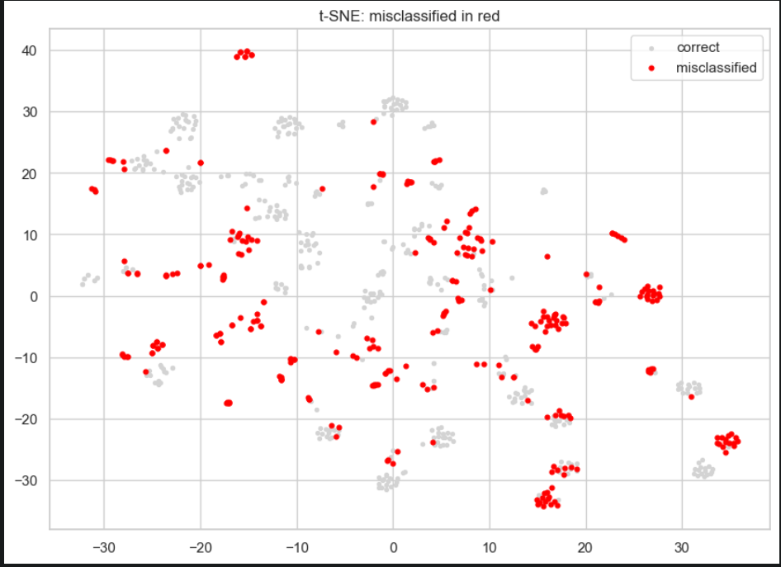
VISUALIZING FEATURE SPACE WITH T-SNE
Extracted embeddings from the model’s penultimate layer.
Reduced dimensions using t-SNE → visualized clusters.
Observations:
  Some classes form tight clusters (clear separation).
  Overlapping regions correspond to frequent misclassifications
09

Slide 14
Acoustic Similarity & Error Insights
Goal: Understand why the model made certain mistakes.
Approach:
• Calculated mel-spectral centroid distances between classes
• Compared each misclassified sample with both its true class and predicted class
• Observed confusion patterns in similar-sounding classes (rain vs sea waves, dog vs
crow)
Key Insight:
• Many errors happened because classes were acoustically similar, not random
• Model learned broad sound characteristics but struggled with fine-grained separation
• Shows model followed meaningful audio cues, confirming interpretability

Slide 15
Summary of Analytical Findings
• Combined centroid distances, confusion matrix trends, and t-SNE clusters
• Environmental audio forms continuous acoustic space, not perfectly
separable groups
• Large validation-to-test gap emphasized need for source-based cross-
validation
• Analysis confirmed that data leakage inflated validation accuracy
• Interpretability helped reveal sound-class relationships and model limits
• Future steps: strict cross-validation, ablation on augmentations, use stronger pretrained models for higher real-world accuracy

Slide 16
THANK YOU
10

