Slide 1
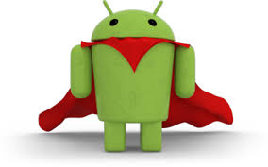
Android praksa - ITS
Dan 4 (od 8)

Slide 2

Ciljevi dana
Activity Lifecycle - ekperiment
Čuvanje stanja aktivnosti
Log, debug I ostale korisne a pomalo dosadne stvari

Slide 3
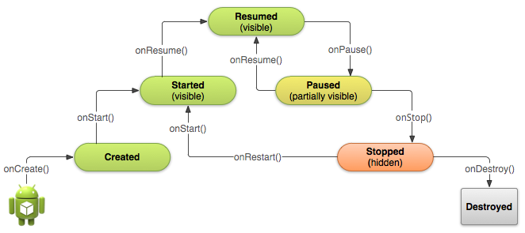
Aktivnost

Slide 4
LifeCycle
onCreate
Definisanje UI-ja
Incijalizacija field varijabli
onDestroy
Ovde možemo olakšati GC-u
Osloboditi reference na teže elemente, slike
Notes:
Single Screen that user can manipulate
Background process, no interface
Manages shared set of app data
Responds to system broadcasts

Slide 5
LifeCycle
onPause
Stopirati tekuce procese
Video, zvuk, animaciju
Osloboditi resurse
onResume
Nastavak procesa
Re-inicijalizacija resursa
onStart
onStop
Notes:
Single Screen that user can manipulate
Background process, no interface
Manages shared set of app data
Responds to system broadcasts

Slide 6
Čuvanje stanja aktivnosti
onSaveInstanceState
Poziva se nakon onPause
Iz onCreate možemo pokupimo sačuvana stanja
Karakterističan primer - rotacija
Notes:
Single Screen that user can manipulate
Background process, no interface
Manages shared set of app data
Responds to system broadcasts

Slide 7
Debug
Android monitor
Filteri
Emulator/Device
Applikacije
Prioritet
Ključne reči
Notes:
Single Screen that user can manipulate
Background process, no interface
Manages shared set of app data
Responds to system broadcasts

Slide 8
LOG poruke
Util klasa
Prioriteti
Verbose – Log.v(
Debug - Log.d(
Info - Log.i(
Warning - Log.w(
Error - Log.e(
Notes:
Single Screen that user can manipulate
Background process, no interface
Manages shared set of app data
Responds to system broadcasts

Slide 9
Hvala na pažnji!
Probajte da ...
Info
Biblija - https://developer.android.com/
PPT + Source code na - https://github.com/SimpleSmiki/ITSAndroidPraksa
Slobodno donesite svoje uredjaje i testirajte na njima
Vidimo se u utorak :)

