Slide 1
MACHINE LEARNING PROJECT PRESENTATION
AI-Powered Respiratory Sound Detection
Automated Classification of Abnormal Lung Sounds (Crackles & Wheezes) from Stethoscope Audio
Based on the ICBHI 2017 International Scientific Challenge Database (126 Patients | 6,898 Breath Cycles)
Current Status: 80% Complete (Phases 1 to 4 Fully Implemented & Benchmarked)

Slide 2
INTRODUCTION & MOTIVATION
What Are We Doing & Why Does It Matter?
Bridging the gap between physician auscultation and objective machine learning.
⚠️ The Clinical Challenge in Simple Words
• How doctors check lungs: They listen with a stethoscope for wheezing (whistling) or crackles (popping).
• The problem with human ears: Interpretation is highly subjective. Two doctors often disagree on the exact sound.
• Noisy clinic rooms: Ambient hospital noise and quiet, shallow breathing make faint disease sounds hard to hear.
• Late diagnosis: Chronic lung diseases like COPD and Pneumonia are often caught late, increasing mortality.
💡 Our Automated Machine Learning Solution
• Digital stethoscope recording: Capture the breath sound digitally from the chest wall.
• Automatic noise cleaning: Remove low-frequency heart thuds and high-frequency microphone hiss.
• Breath-by-breath analysis: Chop continuous audio into individual breath cycles (6,898 cycles in our study).
• Acoustic AI detection: Convert each breath into 307 acoustic numbers and use machine learning to detect disease sounds accurately.

Slide 3
CLINICAL FUNDAMENTALS
The 4 Respiratory Sounds We Are Detecting
Every breath belongs to one of four sound classes annotated by medical specialists.
Normal Breathing (52.8%)
In Plain English: Smooth, clean breath sound with no obstructions or rattles.
Clinical Cause: Vesicular sound of air moving smoothly through healthy bronchial passages.
Crackles (27.0%)
In Plain English: Short, explosive popping clicks (like bubble wrap or peeling Velcro).
Clinical Cause: Caused by collapsed small airways suddenly snapping open when fluid is present (e.g., Pneumonia).
Wheezes (12.8%)
In Plain English: Continuous, high-pitched musical whistling or squeaking.
Clinical Cause: Caused by air forced at high speed through narrowed, inflamed airways (e.g., Asthma, COPD).
Both (7.3%)
In Plain English: Severe breaths containing both crackles and wheezes together.
Clinical Cause: Indicates advanced, multi-symptom lung disease; the rarest and hardest to classify.

Slide 4
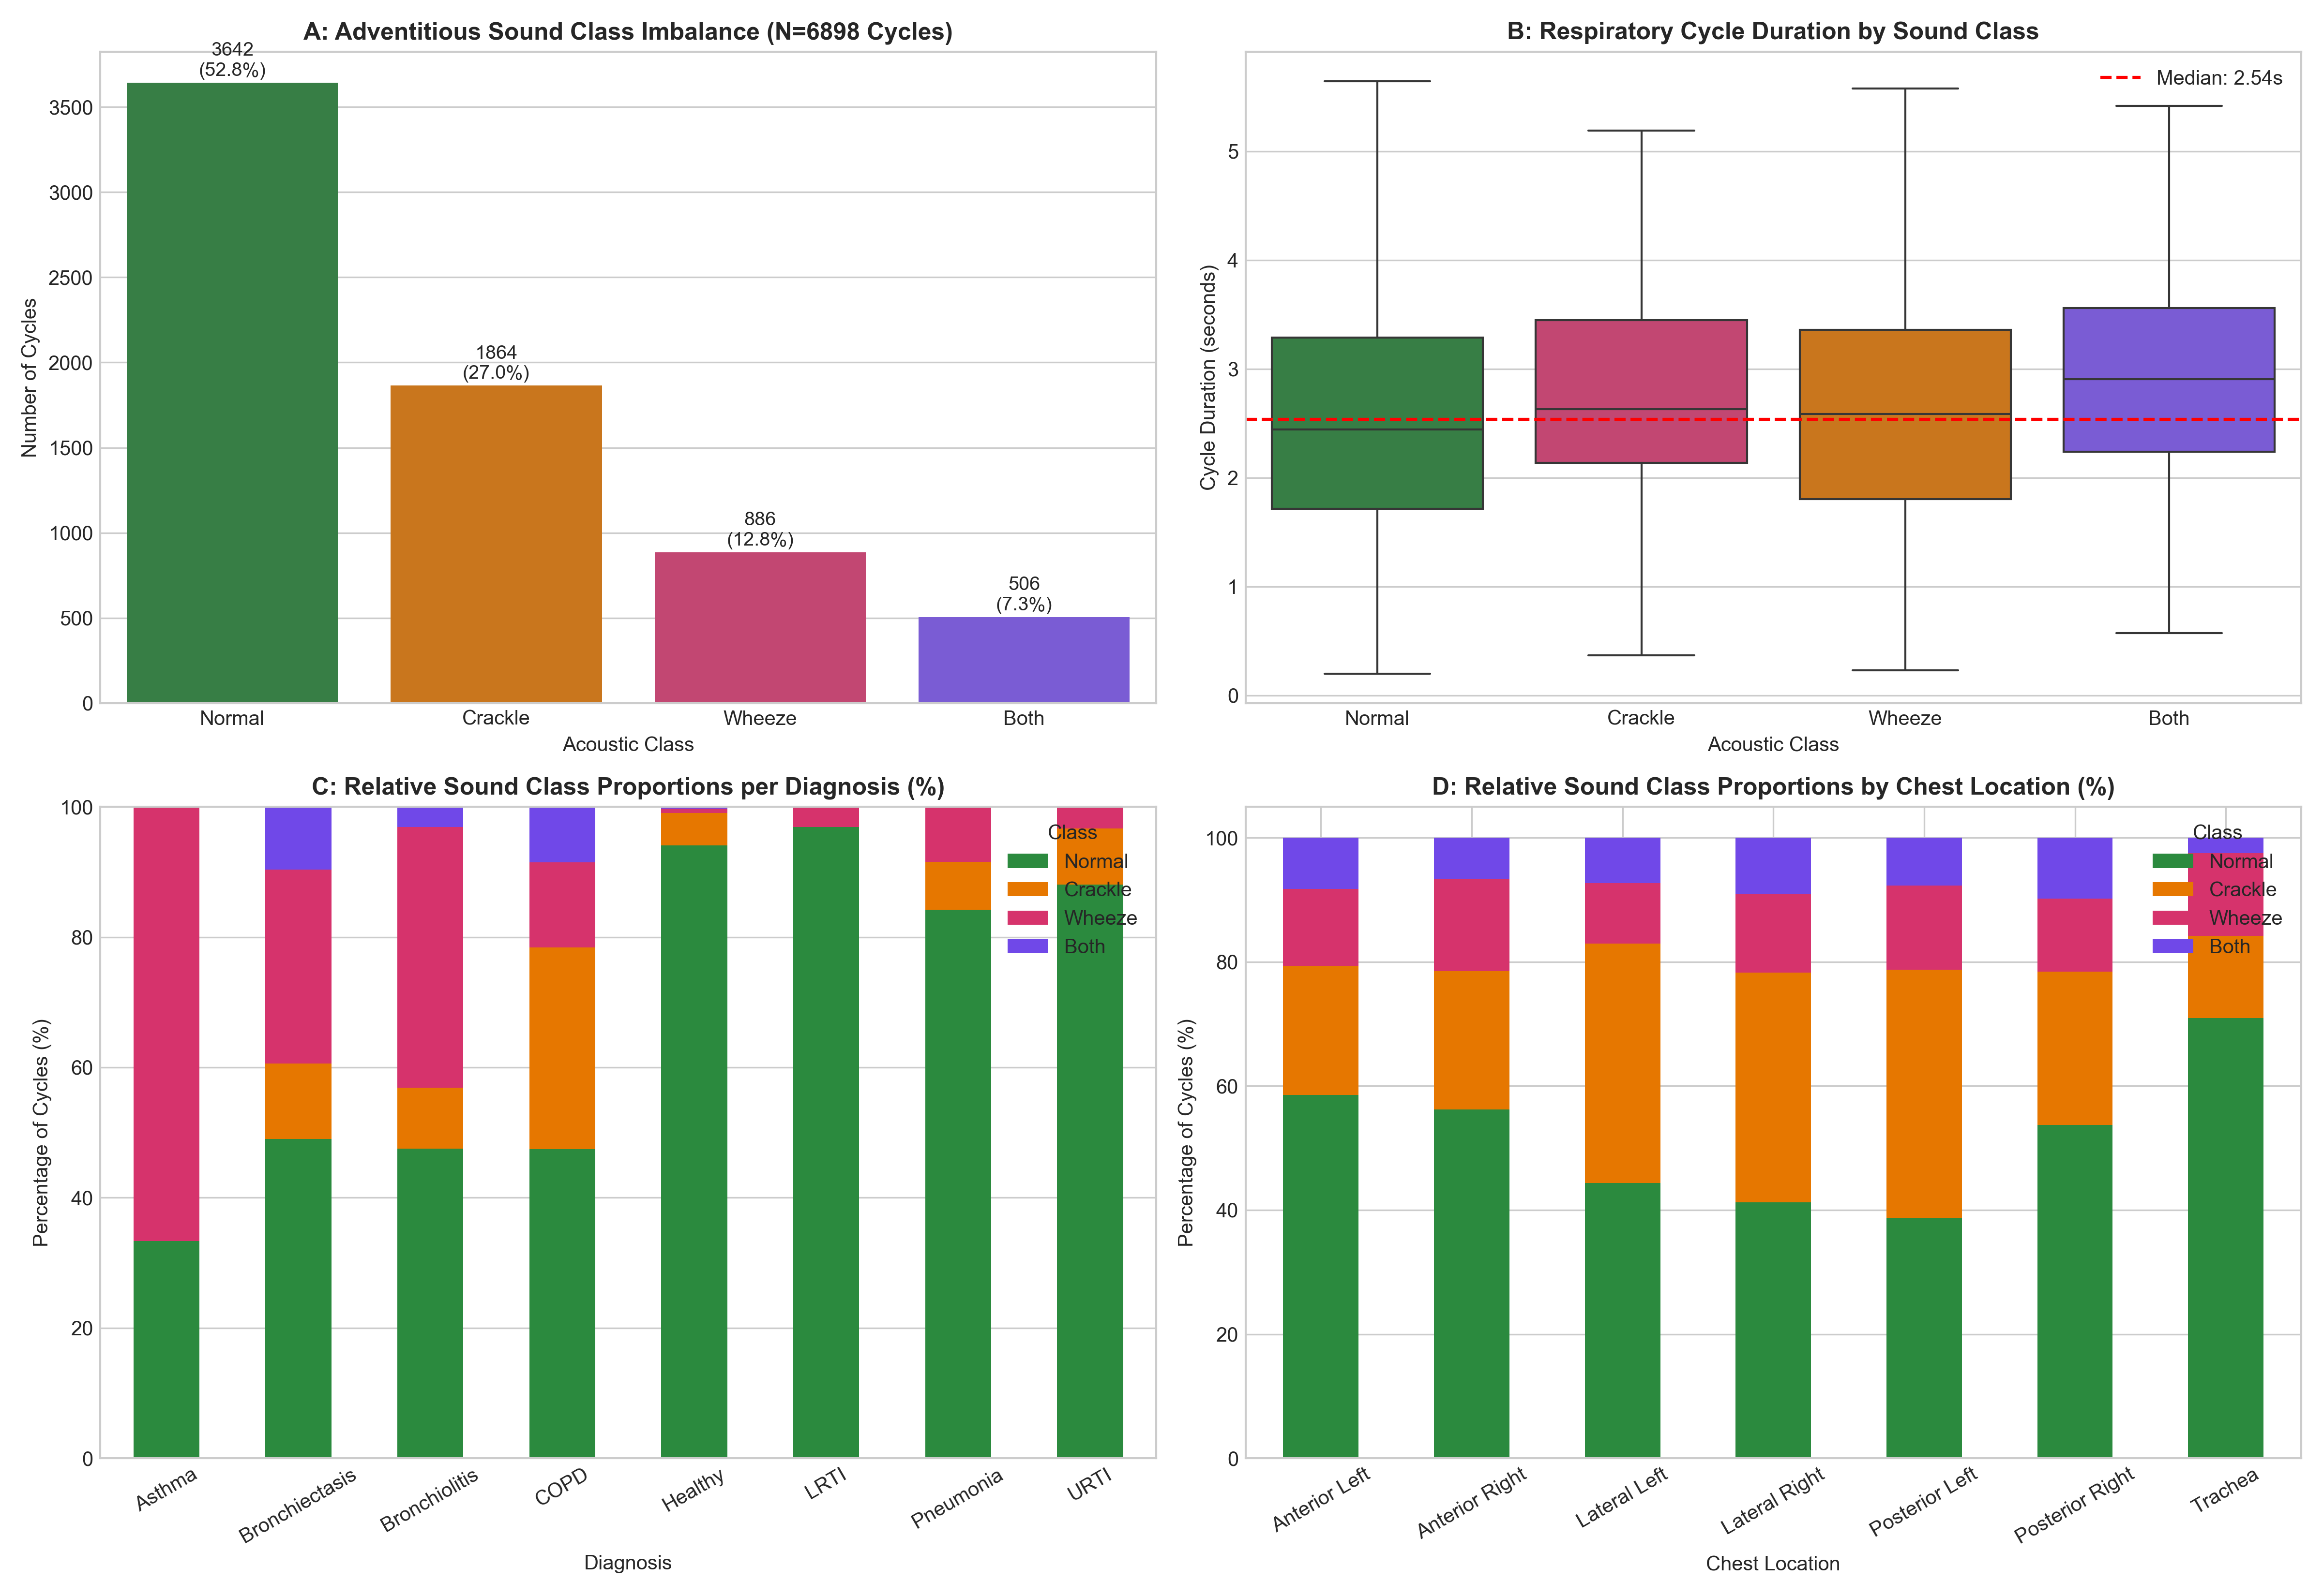
PHASE 1: EXPLORATORY DATA ANALYSIS
What Did We Learn from the ICBHI Dataset?
Deep analysis of 126 patients, 920 recordings, and 6,898 breath cycles.
Key Findings in Plain Words:
• 126 Patients Examined: Ages ranged from infants (0.2 years) to elderly adults (93 years).
• Disease Imbalance: COPD was by far the most frequent diagnosis (>70% of sick patients), reflecting real hospital admissions.
• Hardware Variation: Audio was captured using 4 different stethoscope devices with sampling rates ranging from 4 kHz to 44.1 kHz.
• Sound Class Imbalance: Healthy normal breaths account for 52.8%, crackles 27.0%, wheezes 12.8%, and severe 'both' cycles only 7.3%.
• Official Partition: 79 patients (4,142 cycles) assigned to Training, and 49 patients (2,756 cycles) reserved for Testing.

Slide 5
ENGINEERING ROADMAP
Project Architecture: 5 Core Phases
Structured medical machine learning pipeline from raw audio to clinical prediction.
Phase 1: Exploratory Data Analysis [COMPLETED]
Survey 126 patients, audit sampling rates, demographics, and class distributions.
Phase 2: Signal Preprocessing & Segmentation [COMPLETED]
16 kHz resampling, 50-2000 Hz Butterworth bandpass filtering, slicing 6,898 breath cycles.
Phase 3: Acoustic Feature Engineering [COMPLETED]
Extract 307 acoustic features per cycle (MFCCs, spectral rolloff, pitch, temporal dynamics).
Phase 4: ML Model Benchmarking [COMPLETED]
Train Random Forest, LightGBM, SVM, and Logistic Regression with 5-fold patient-aware CV.
Phase 5: Deep Learning & Deployment [NEXT UP]
Train 2D Spectrogram CNNs (ResNet, AST) to preserve time-frequency details and boost score.

Slide 6
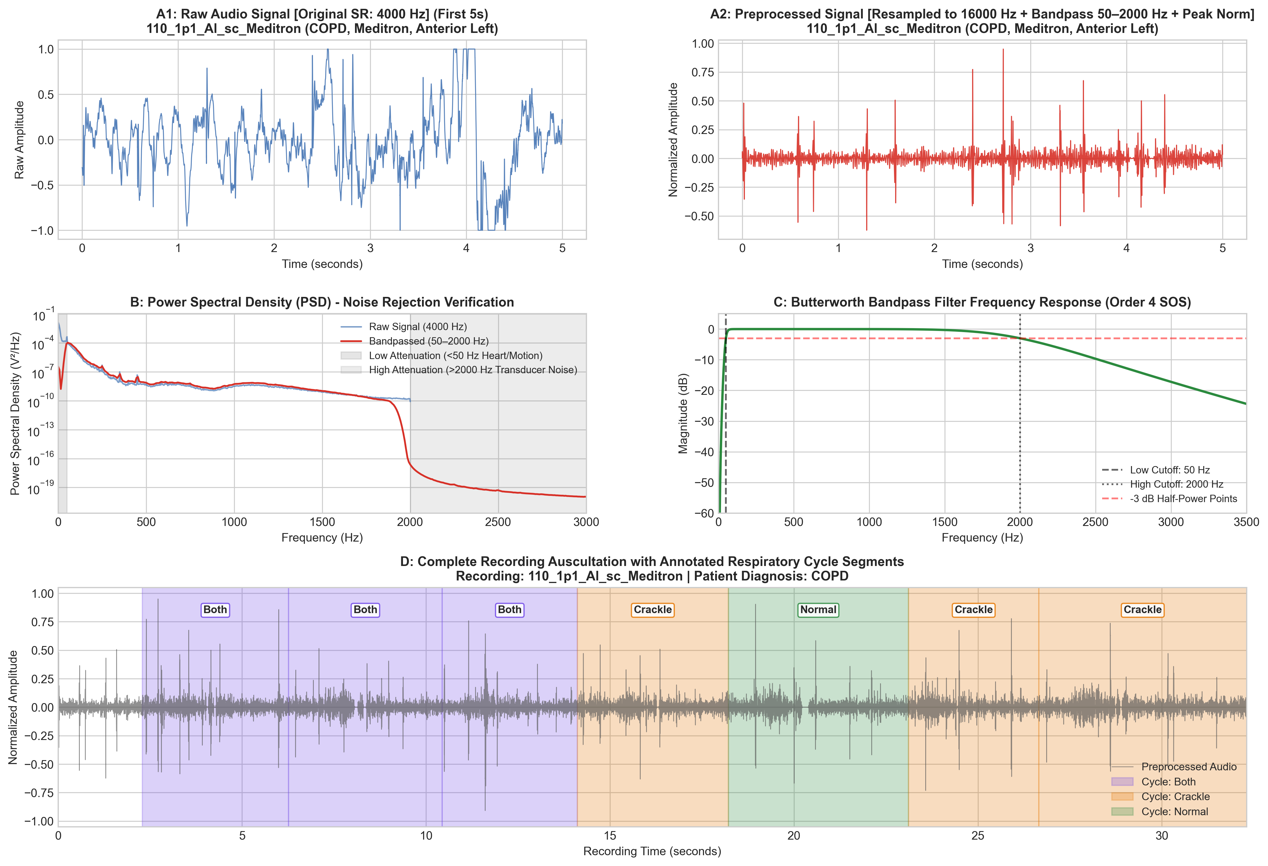
PHASE 2: AUDIO PREPROCESSING
Cleaning Raw Audio & Slicing Breath Cycles
Turning noisy, multi-speed stethoscope recordings into clean standardized breath cycles.
3 Crucial Cleaning Steps in Plain English:
• 1. Standardize Audio Speed (16 kHz Resampling): Different stethoscopes recorded at different speeds (4,000 to 44,100 samples/sec). We converted everything to 16,000 samples/second so models see consistent audio.
• 2. Heartbeat & Static Filtering (50 to 2,000 Hz Bandpass): Heartbeats are low-frequency (<50 Hz thuds) that drown out lung sounds. We designed a zero-phase Butterworth bandpass filter that removes heart sounds below 50 Hz and microphone hissing above 2,000 Hz.
• 3. Breath Cycle Slicing: Doctors marked the exact start and end seconds of each breath. We automatically sliced continuous recordings into 6,898 discrete breath audio files.

Slide 7
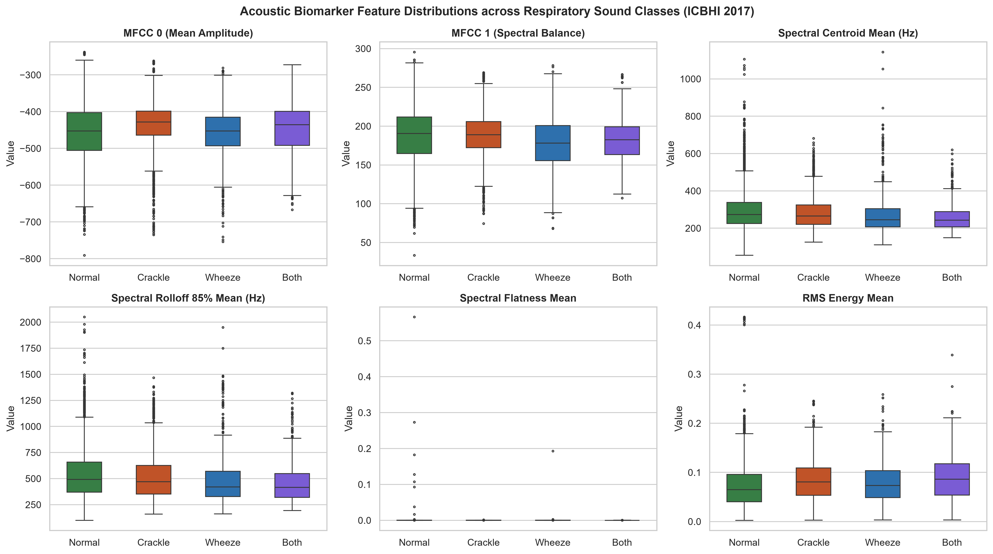
PHASE 3: FEATURE ENGINEERING
Converting Breath Sounds into 307 Numbers
Translating raw audio vibrations into meaningful mathematical biomarkers for ML.
What Do the 307 Numbers Measure?
• 1. Sound Texture / Timbre (MFCCs - 240 features): Captures the unique vocal profile and texture of the breath over time (like telling a guitar apart from a piano).
• 2. Pitch & Brightness (Spectral - 38 features): Measures pitch centroid, rolloff, and bandwidth. Tells the model if the sound is high-pitched (whistling wheeze) or low-pitched (normal).
• 3. Sudden Pops & Energy (Temporal - 9 features): Catches sharp explosive clicks and energy bursts lasting <20 ms (crackles).
• 4. Musical Harmonics (Chroma - 24 features): Wheezes have musical notes with harmonic overtones that chroma features detect.
• Output Datasets: Exported ready-to-train X_train.csv (4,142 rows) and X_test.csv (2,756 rows).

Slide 8
PHASE 4: ML METHODOLOGY
Patient-Aware Cross-Validation (No Cheating!)
Ensuring algorithms learn general medical disease patterns, not individual patient voices.
⚠️ Why Standard Train/Test Splitting Fails in Healthcare
• The Data Leakage Trap: Each patient contributes multiple breath cycles. If you randomly split breaths, Cycle 1 of Patient 107 is in training, and Cycle 2 of Patient 107 is in testing.
• Cheating without knowing it: The model simply memorizes Patient 107's unique stethoscope noise and tone, getting false high test scores.
• Our Solution (5-Fold GroupKFold): We strictly group by patient_id. Every breath from a patient is either 100% in training or 100% in validation. Zero overlap!
• Final Unseen Test Cohort: All models are finally evaluated on 49 completely new patients (2,756 cycles) who were never seen during training.
🌲 The 4 Machine Learning Classifiers Tested
• 1. Random Forest (RF): 200 decision trees voting together. Naturally robust to noisy features with balanced class weights.
• 2. LightGBM (LGB): Fast gradient-boosted decision trees. Outstanding at finding subtle splits in tabular feature data.
• 3. Support Vector Machine (SVM): RBF non-linear kernel finding high-dimensional decision boundaries.
• 4. Logistic Regression (LR): Standard linear baseline with L2 regularization to establish an interpretable floor.
• Official Metric: ICBHI Score = (Sensitivity + Specificity) / 2. Gives fair 50/50 balance between catching sick breaths and avoiding false alarms.

Slide 9
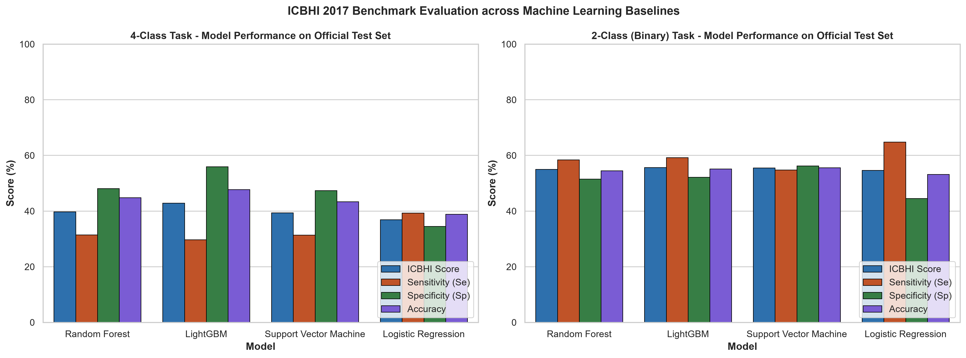
PHASE 4: RESULTS & BENCHMARKS
Official Test Set Performance Comparison
Evaluated on 2,756 respiratory cycles across 49 completely unseen patients.
🏆 Key Results & Winner:
LightGBM Won Both Tasks: Achieved the highest overall ICBHI score among all tested models.
4-Class Task (Normal, Crackle, Wheeze, Both):
• LightGBM: 42.85% Score (55.98% Sp, 47.71% Acc)
• Random Forest: 39.78% Score (48.13% Sp)
• SVM (RBF): 39.40% Score (47.37% Sp)
• Logistic Regression: 36.92% Score
2-Class Binary Task (Healthy vs. Sick):
• LightGBM: 55.70% Score (59.22% Se, 52.18% Sp)
• SVM (RBF): 55.52% Score (56.24% Sp)
• Random Forest: 55.00% Score (58.45% Se)
Matches Published Literature: Standard classical ML models typically hit 40-45% on 4-Class and 55-58% on Binary under patient-independent isolation.

Slide 10
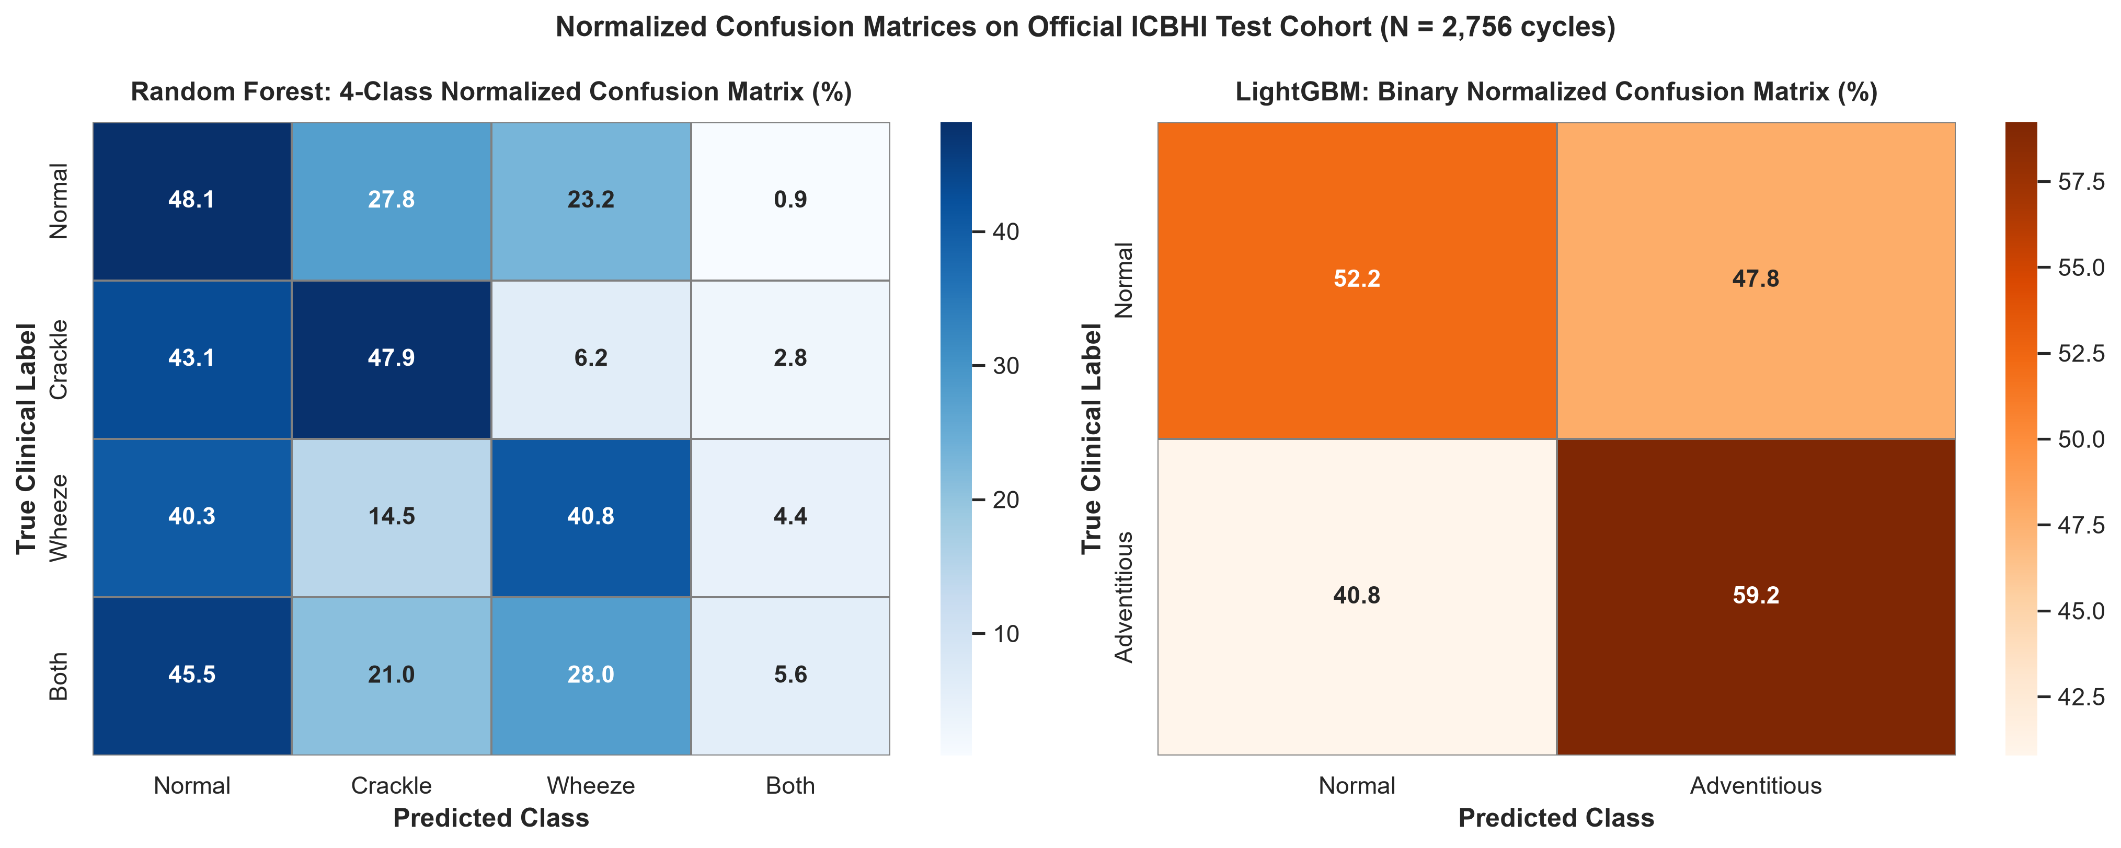
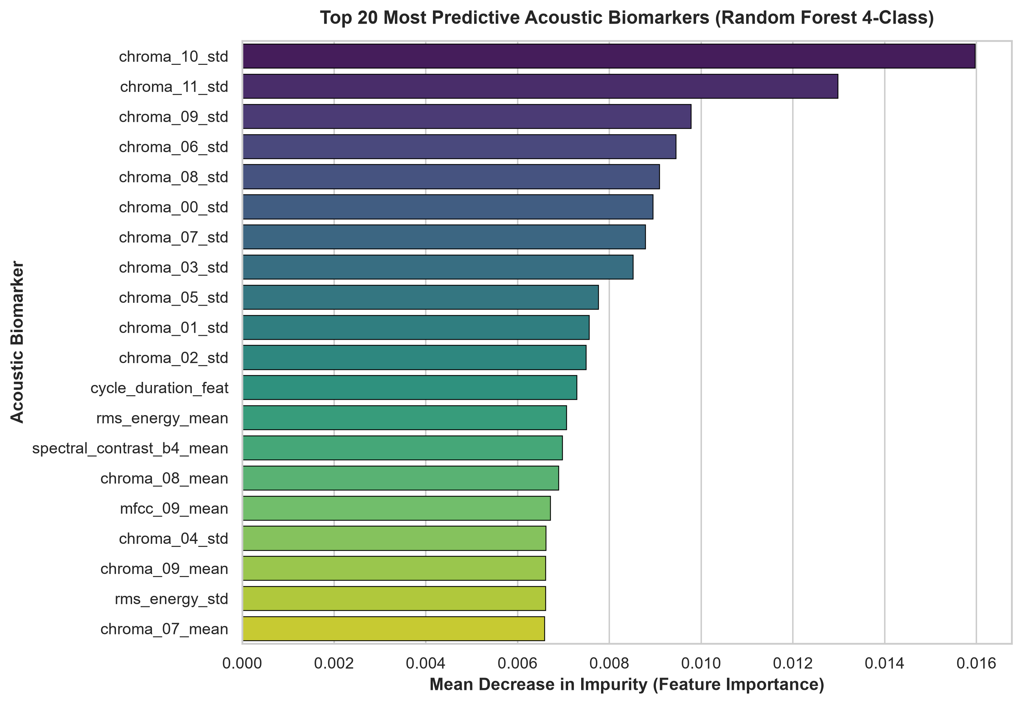
PHASE 4: DEEP INSIGHTS
Confusion Matrices & Top Acoustic Biomarkers
Analyzing where errors occur and which sound features matter most.
💡 Clinical Insights: (1) Subtle crackles are sometimes mistaken for normal breathing because they last <20ms. (2) Wheezes have musical whistle harmonics that models detect reliably. (3) MFCC timbre dynamics & spectral centroid are the most predictive biomarkers.

Slide 11
FUTURE WORK & NEXT STEPS
Phase 5: Deep Learning on Spectrograms
Why we are moving from tabular numbers to 2D Audio Computer Vision.
🔍 Why Classical ML Hits a Ceiling
• Information Loss: When we average 307 numbers across a 2.5-second breath (mean, std, skew), we lose the exact time when a crackle clicked.
• Crackles are tiny: A crackle is a 20 ms pop inside a 2,500 ms breath. In statistical averages, that tiny spike gets washed out.
• Wheezes vary over time: Patients wheeze during late exhalation, not during inhalation. Tabular models don't know which phase of breathing the whistle happened in.
• Classical ML Cap: This is why classical models across the literature plateau around 42–45% on 4-Class.
🚀 Our Phase 5 Deep Learning Plan
• 1. Mel-Spectrogram Images: Convert audio into 2D heatmaps where X-axis is time and Y-axis is pitch (frequency).
• 2. 2D Convolutional Neural Networks (CNNs / ResNet): Treat breath spectrograms like images. The CNN's convolutional filters will look for the exact visual shape of crackle spikes and wheeze ribbons.
• 3. Audio Spectrogram Transformers (AST): Use self-attention across time patches to capture long-range breathing patterns.
• 4. Data Augmentation (SpecAugment / Mixup): Synthesize realistic pitch shifts and time masks to address class imbalance.
• Goal: Push ICBHI Score from 55% to 65%+ on unseen patients!

Slide 12
SUMMARY & CONCLUSION
What We Have Accomplished So Far
✓ 4 Complete Phases: Exploratory analysis, audio filtering & cycle segmentation, 307-feature extraction, and ML benchmarking.
✓ 6,898 Real Breath Cycles Analyzed: Filtered from 50 to 2,000 Hz, zero-phase Butterworth filtering removing heartbeats.
✓ Zero Patient Leakage: 5-Fold GroupKFold and official 49-patient unseen test cohort validation.
✓ Rigorous Benchmarking: LightGBM established as the strongest classical baseline (42.85% 4-Class, 55.70% Binary).
✓ Publication-Ready Artifacts: 13 high-resolution figures, 4 interactive notebooks, trained model weights, and clean documentation.
✓ Clear Path to Phase 5: Moving to 2D Mel-Spectrogram CNNs to break through tabular feature limits.
Thank You! Questions & Discussion

