Slide 1
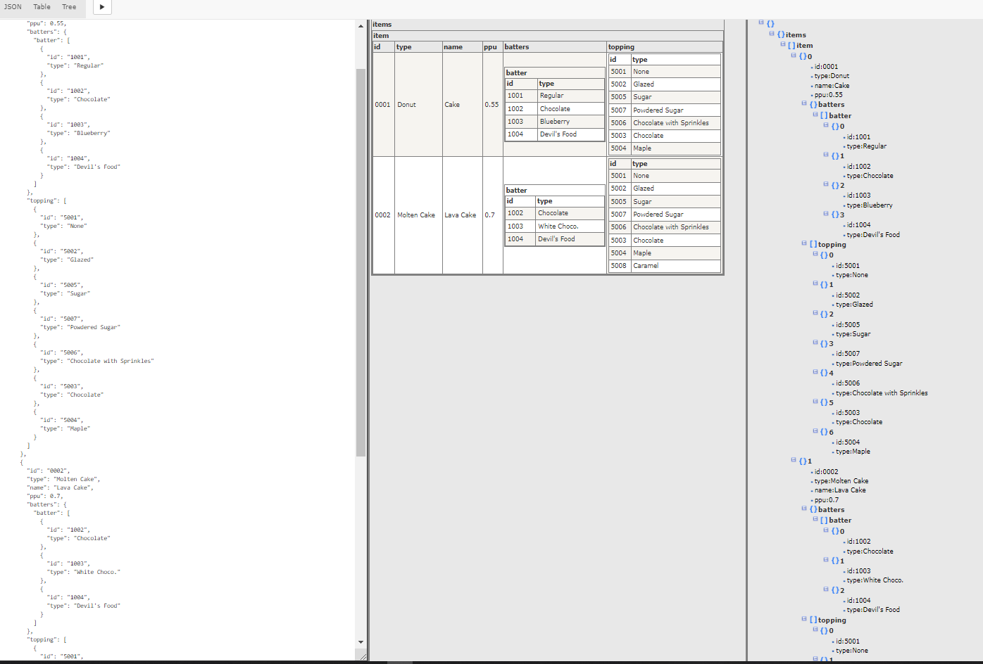
JSON Conversion Assignment
Expected outcome:
• Program correctness:
o Open file, read file data, form the table of data, write to file
o Command process
• Program output format, clarity, completeness, and accuracy
• Program indentation and readability
• Choice of significant names for identifiers
• Comments - description of variables and constants
Reference file: “Sample.json”
Based on the above, I’ve tried a couple of ways to achieve the above:
Approach 1: Using Powershell scripting but was stucked at nested conversion hence tried another way (file: “json_table.ps1” included as attachment)
Approach 2: Using Javascript scripting, was able to print out the table in HTML but was facing some problems reading it from the JSON file. The static approach works but not the dynamic approach. (files: “require.js”, “json_table3_static.html”, “json_table3_dynamic.html” included as attachment)
Also, just for sharing, found an online tool which able to do the conversion nicely:
http://json2table.com/
Notes:
(To further refine)
Over the years, multiple projects that have been implemented with solutions provisioned. Documentation are stowed away in folders with intrinsic knowledge only within the project team.
Please explain your approach to develop the enterprise architecture for the business (baseline), and how the architecture roadmap can be developed and maintained.
Propose a technology strategy roadmap for a manufacturing industry (i.e. Pulp&Paper, Palm Oil) with emphasis on Industry 4.0.

