Slide 1
MECHATRONIC SYSTEMS & ROBOTICS

Slide 2
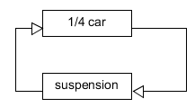
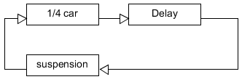
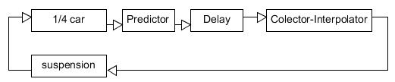
Digitbrain experiment. FMUs, Maestro and delay compensators
Some simulations that implement delay and compensation of delay in the transmission of data between the model of quarter car and a testrig testing a suspension are model defined.
Ideal case
Delayed case
Simulation with delay and compensator
Three cases are considered:
- Ideal case: it represents a co-simulation using two FMU, or a simulator connected to a testrig testing a prototype of suspension.
- Delayed case: the second model represents same co-simulation, but there is a delay between the simulator and the testrig.
- Simulation with delay and compensation: it includes a predictor and an interpolator to compensate the messages loses or delayed from the quarter car model to the damper test rig.

Slide 3
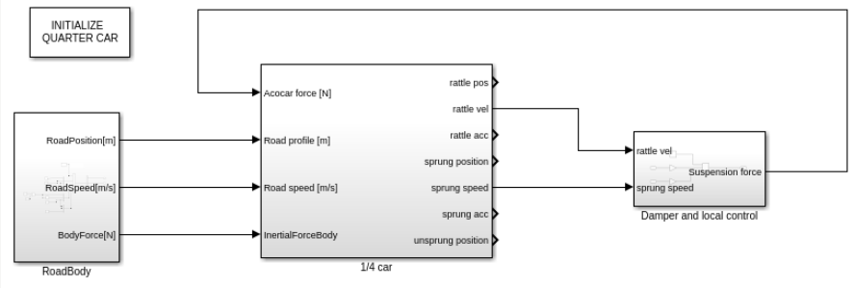
Ideal case.
This SIMULINK simulation works in the ideal case. A model of the external inputs to the car “RoadBody” , a quarter car model and the model of the active damper. The Simulink model is initiated pushing double click the button “INITIALIZE QUARTER CAR”
Ideal case
¼ car
Damper
File: CompleteSimulationBaseCase.xls

Slide 4
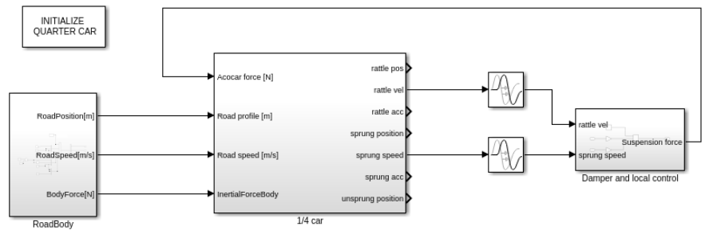
Delayed case
This SIMULINK model shows the behaviour of the model with transmission delay between the simulation and the testrig.
In order to reduce the complexity of the example, only the delay from the simulator to the test rig is defined.
Delay
Delayed case
File: CompleteSimulationBaseCaseDelayed.xls

Slide 5
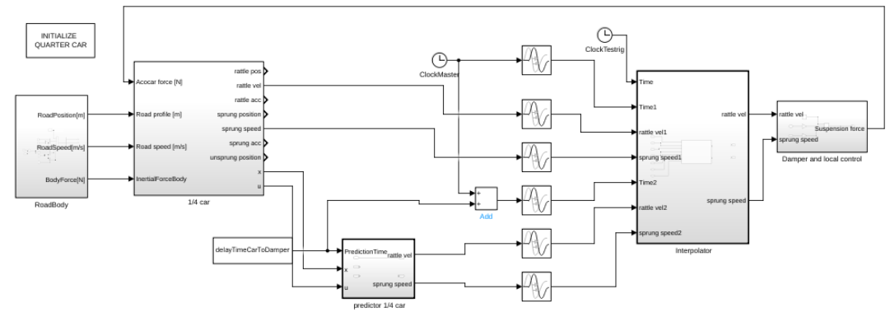
Delay and compensation
This SIMULINK model shows the behaviour of the model with transmission delay between the simulation and the test rig. It also includes the delay compensation..
Collector-Interpolator
Sender
Simulation with delay and compensator
Predictor
File: CompleteSimulationBaseCaseDelayedCompensated.xls

Slide 6
FMUs generated
In order to previous compositions using FMU, five FMUs are generated.
FMU_QuarterCar
FMU_Sender
FMU_Delay
FMU_Receiver
FMU_Damper
FMU_Delay
FMU_Receiver
FMU_Sender
FMU_Damper
FMU_QuarterCar
File: CompleteSimulationBaseCaseDelayedCompensated.xls

Slide 7
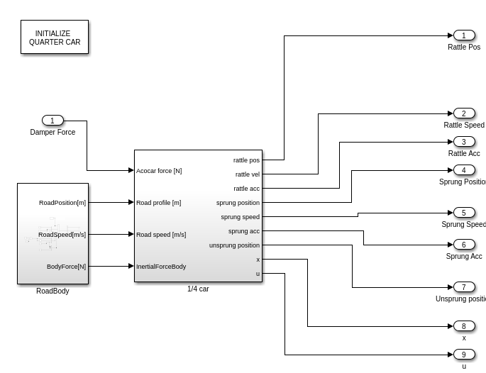
FMU_QuarterCar

Slide 8
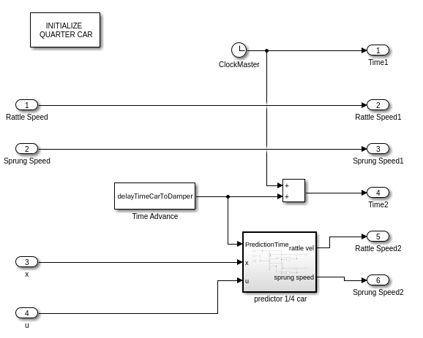
FMU_Sender

Slide 9
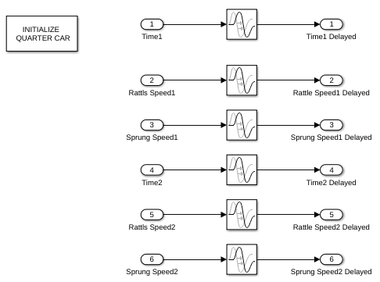
FMU Delay

Slide 10
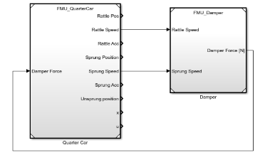
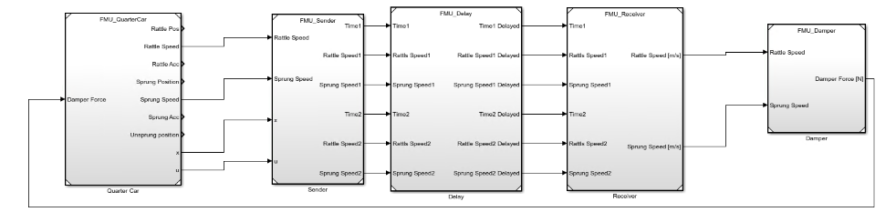
FMU compilation and composition
This SIMULINK models are compiled for Linux64 target. The FMU can be composed to generate different scenarios.
Simulation without delay
Delay compensation.

Slide 11
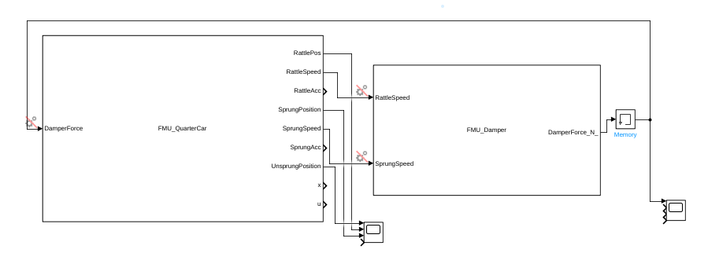
Execution issue
The FMUs have been tested and compared with the FMU equivalent simulation:
- The execution of a simulation with two Simulink blocks of QuarterCar and Damper runs smoothly.
- The execution of the co-simulation with two FMUs simulation stops with a warning of algebraic loop. A memory is necessary to stabilize the simulation.
Memory

