Slide 1
Automatically extracting RDF triples from texts about historical figures
Kai Bruijn
Rune Bruijn
Bas Gerding

Slide 2
Our system
“How can we build a system that automatically extracts RDF triples from a text about historical figures?”
“Zachary Taylor was born on November 24, 1784, in Orange County, Virginia.”
<Zachary Taylor; birth_date; November 24, 1784>
<Zachary Taylor; birth_place; Orange County, Virginia>

Slide 3

Data
Texts about historical figures from https://www.history.com/topics/us-presidents
Copy to .txt files
Create gold label

Slide 4
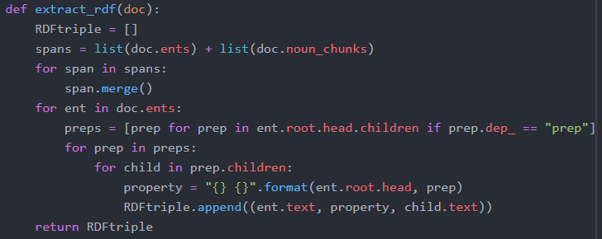
Method
Read data as .txt files
Replace he/she with actual names
Extract RDF triple
def extract_rdf(doc)
Hard-code property
Zachary Taylor, born in; November 24, 1784
<Zachary Taylor; birth_date; November 24, 1784>
Create a nice .html output file

Slide 5
Results

Slide 6
Conclusion and discussion
Conclusion:
Future work:

Slide 7
The End
Questions?

