Slide 1
Predicting CBA.AX
Stock Behavior
Using Machine Learning
COS30018 Intelligent Systems | Option C | Final Defense
Le Minh Kha
Supervisor: Mr. Ky Trung | Semester January 2026

Slide 2
THE PROBLEM
Can we predict stock price behavior?
Stock markets are inherently noisy and nonlinear. The Efficient Market Hypothesis suggests prices already reflect all available information, making consistent prediction near-impossible. This project tests that assumption using deep learning and machine learning on CBA.AX (Commonwealth Bank of Australia) daily data from 2020 to 2024.
1,131 trading days
6 OHLCV features
Two core questions this project answers:
7 code versions
1. How accurately can we predict the next-day closing price? (Regression)
2. Can we predict price direction (up/down) using news sentiment? (Classification)
2 / 18

Slide 3

PROJECT OVERVIEW
Incremental Development: v0.1 to v0.7
C.1
C.2
C.3
C.4
C.5
C.6
C.7
Setup
Data Pipeline
Visualization
Architecture
Multi-prediction
Ensembles
Classification
Baseline LSTM, hardcoded dates
NaN handling, MinMaxScaler, caching
Candlestick & boxplot charts
LSTM vs GRU vs RNN experiments
Multivariate + multistep
ARIMA + RF + DL combinations
Direction + news sentiment
REGRESSION (C.1–C.6)
"How much will the price be?"
CLASSIFICATION (C.7)
"Will the price go up or down?"
3 / 18

Slide 4
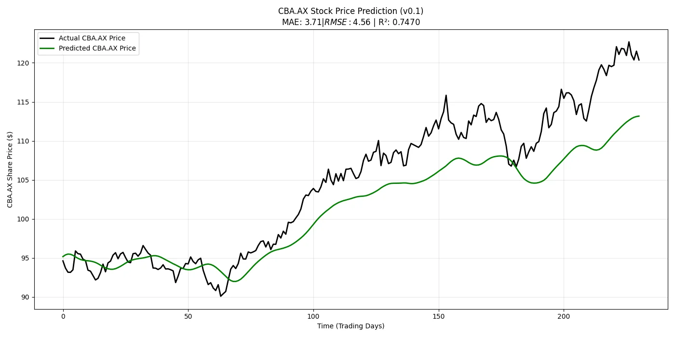
ILLUSTRATION
Model Predictions vs Actual Price – BL0
C.4: GRU (green) tracks closely; SimpleRNN (red) diverges significantly

Slide 5




REGRESSION: C.1–C.3
Data Pipeline & Preprocessing
Download
Clean
Visualize
Window
Yahoo Finance API via yfinance
CBA.AX daily OHLCV 2020–2024
Local CSV caching
Forward-fill then backward-fill NaN
Per-column MinMaxScaler [0,1]
Scaler objects stored for inverse transform
Candlestick charts (daily/weekly/monthly)
Boxplot analysis for volatility
Moving average overlays
50-day sliding window sequences
Reshape to 3D tensor (samples, 50, features)
80/20 chronological train/test split
Baseline v0.2 performance: MAE $4.14 | RMSE $4.61 | MAPE 3.84% | R² 0.7348
4 / 18

Slide 6
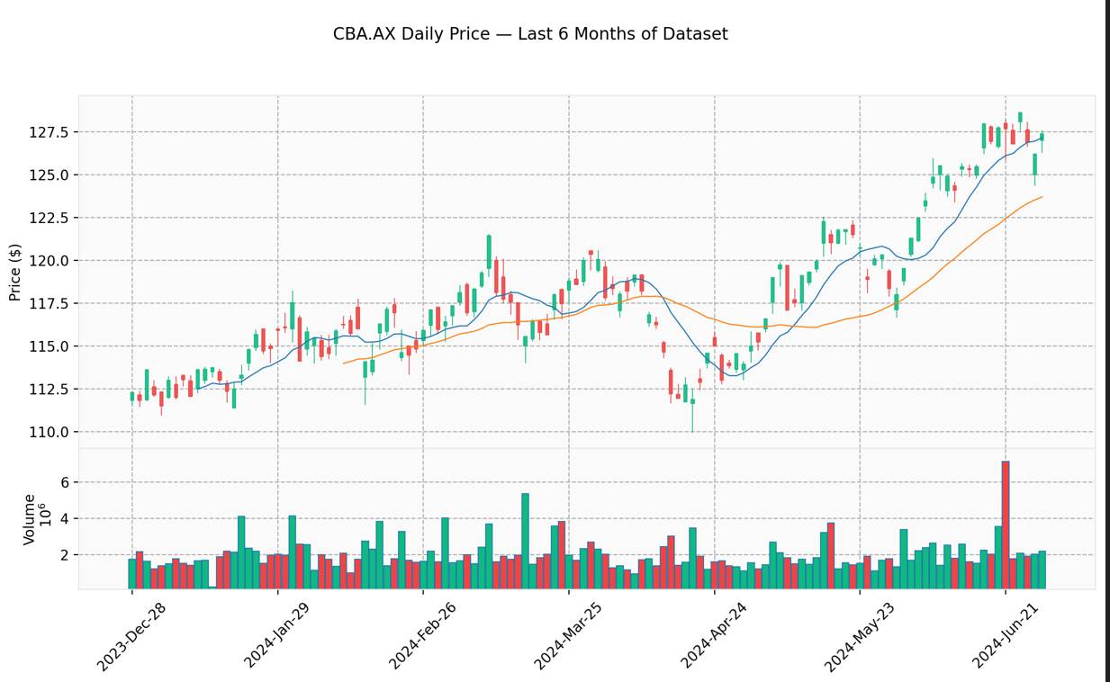
Model Predictions vs Actual Price – BL0
ILLUSTRATION

Slide 7
REGRESSION: C.4
Model Architecture Experiments
Built a configurable create_model() function supporting LSTM, GRU, and SimpleRNN. Ran 13 experiments across cell type, depth, width, and training hyperparameters.
Model | MAE ($) | RMSE ($) | MAPE (%) | R²
1×LSTM(50) | 1.58 | 2.30 | 1.06 | 0.9756
2×LSTM(50) | 2.69 | 3.52 | 1.80 | 0.9426
2×GRU(50) | 2.16 | 2.93 | 1.44 | 0.9604
2×SimpleRNN(50) | 6.98 | 8.40 | 4.72 | 0.6739
2×LSTM(50), 50 epochs | 1.62 | 2.36 | 1.07 | 0.9742
Key Finding: Single-layer LSTM achieved the best R² (0.9756). GRU consistently outperformed LSTM at equivalent depth. SimpleRNN failed to capture temporal patterns (R² = 0.67).
5 / 18

Slide 8
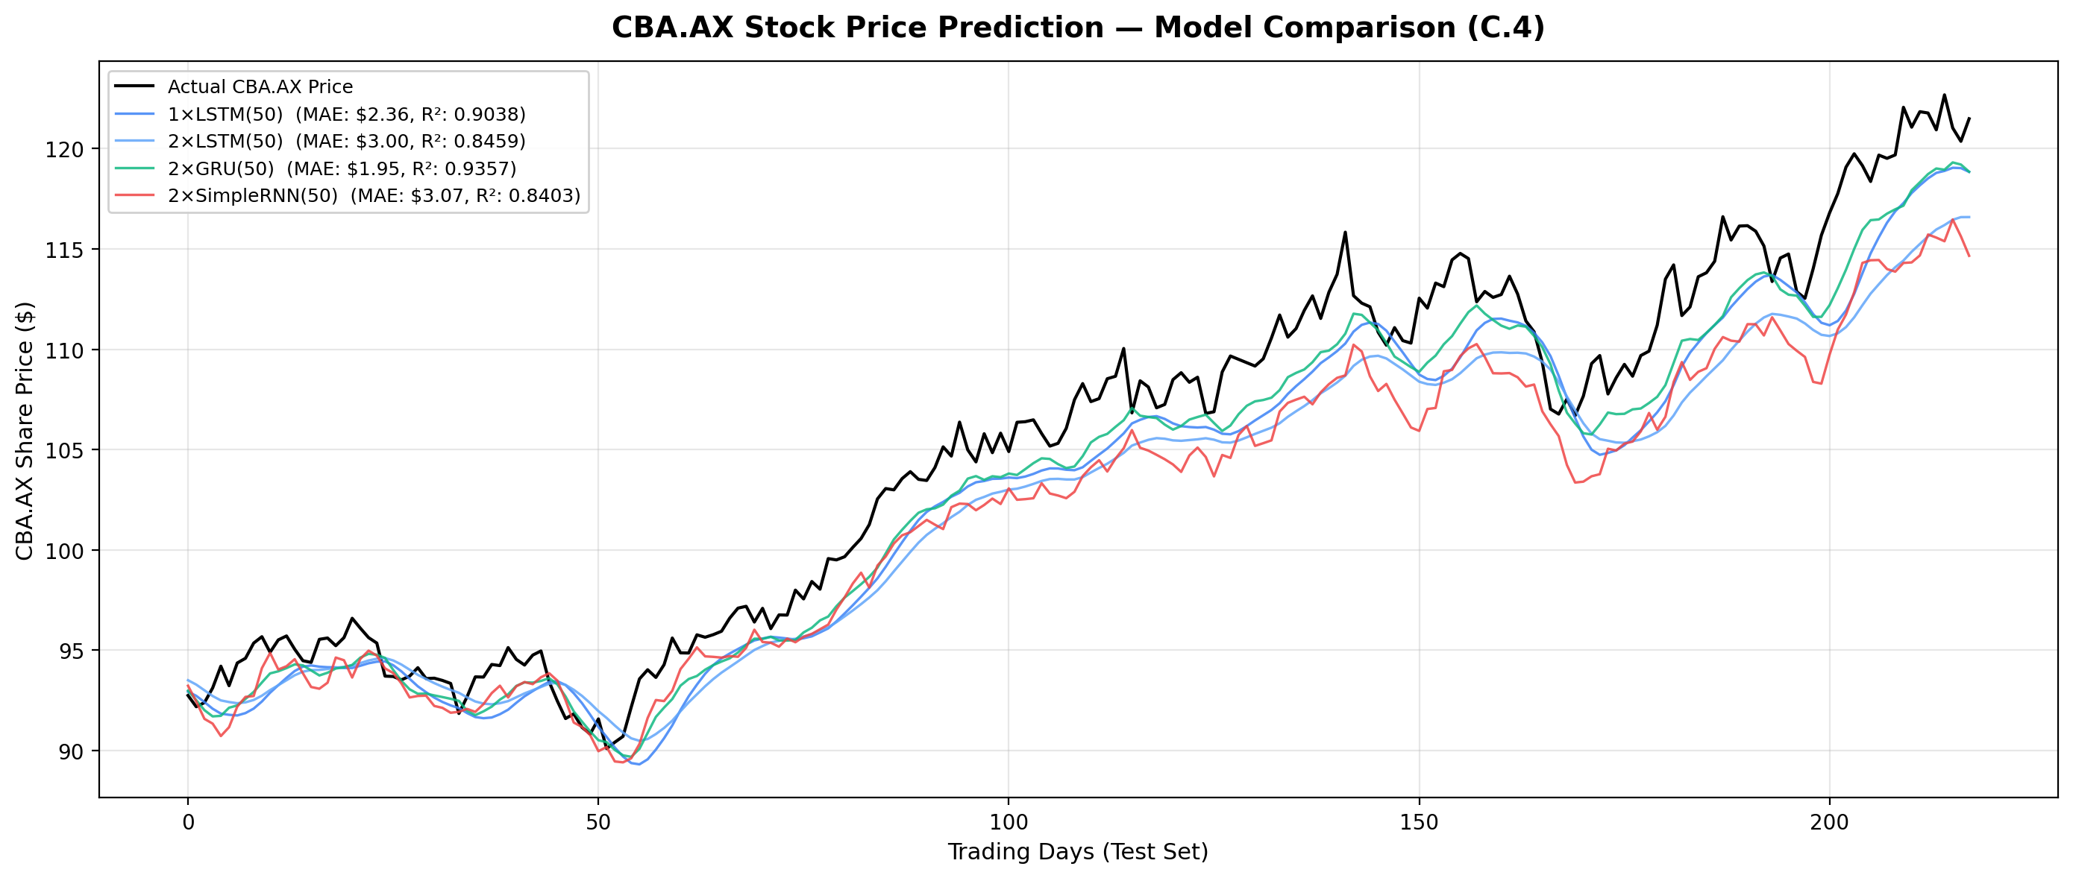
ILLUSTRATION
Model Predictions vs Actual Price
C.4: GRU (green) tracks closely; SimpleRNN (red) diverges significantly

Slide 9
REGRESSION: C.5
Multivariate & Multistep Prediction
Multivariate Input
Multistep Horizon
Tested univariate (adjclose only) vs full multivariate (5 features: open, high, low, adjclose, volume).
Surprise result: univariate R² = 0.9317 beat multivariate R² = 0.7921 at 25 epochs. Insufficient training time for the model to learn multi-feature relationships.
Predict k days ahead simultaneously using Dense(k) output. Tested k = 1, 3, 5, 7.
Prediction error grows with forecast horizon (as expected). Direct multi-output approach: all k values predicted from the same LSTM hidden state.
Key Finding: More input features does not automatically mean better predictions. Training budget (epochs) must scale with model complexity. GRU again outperformed LSTM across all experiment groups.
7 / 18
7 / 18

Slide 10
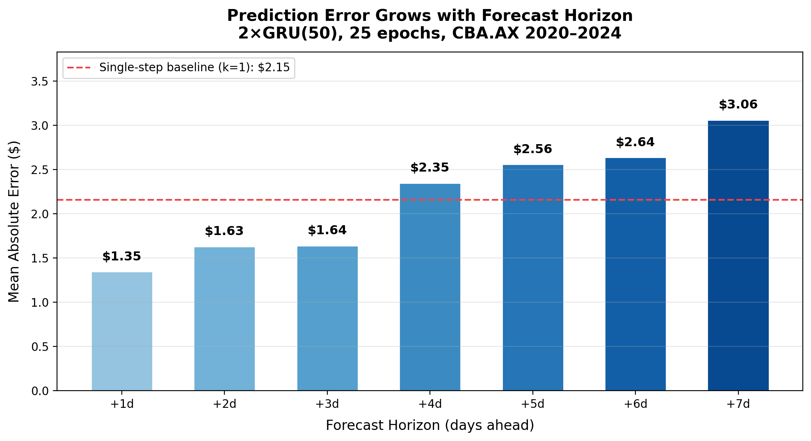
ILLUSTRATION
Prediction Error Grows with Forecast Horizon
C.5: Per-step MAE increases as the model predicts further into the future

Slide 11
REGRESSION: C.6
Ensemble Methods
Combined statistical (ARIMA), tree-based (Random Forest), and deep learning (LSTM, GRU) models using three ensemble strategies.
Simple Average
Weighted Average
Residual Hybrid
Equal-weight mean of all model predictions. Simplest approach.
Inverse-MAE weights: better models get more influence.
ARIMA baseline + DL correction for nonlinear patterns.
Model / Ensemble | MAE ($) | R²
ARIMA (auto) | 3.42 | 0.8812
GRU 2×50 | 2.16 | 0.9604
Best Ensemble | 1.87 | 0.9651
9 / 18

Slide 12
THE PIVOT
From Price Prediction
to Direction Classification
Tasks C.1–C.6 predicted the exact dollar value. But in practice, traders care about direction: will it go up or down? Task C.7 reframes the problem as binary classification and introduces external news sentiment as a new feature.
BEFORE: "Tomorrow’s price will be $105.23"
AFTER: "Tomorrow’s price will go UP" (67% conf.)
10 / 18

Slide 13
CLASSIFICATION: C.7
Sentiment-Enhanced Classification
Pipeline
VADER
1. Compute technical indicators (RSI, MACD, Bollinger Bands, SMA, returns)
2. Scrape Google News RSS for CBA-related headlines
3. Score each headline with VADER (rule-based) and FinBERT (transformer)
4. Aggregate daily sentiment scores and merge with price data
5. Train Random Forest & Gradient Boosting classifiers
6. Compare: tech-only baseline vs VADER-enhanced vs FinBERT-enhanced
Rule-based lexicon. Fast, no GPU needed. Good for general text but not tuned for financial language.
FinBERT
Pre-trained BERT fine-tuned on financial text. Understands domain-specific language (e.g., 'bearish outlook' = negative).
Realistic expectation: Google News coverage for a specific Australian stock going back to 2020 is sparse. Sentiment data will have many missing days, which is a real-world data challenge, not a bug.
11 / 18

Slide 14
CLASSIFICATION: C.7 RESULTS
Classification Results
Experiment | Classifier | Accuracy | F1 Score
Tech indicators only | Random Forest | 53.2% | 0.51
Tech + VADER | Random Forest | 56.4% | 0.54
Tech + FinBERT | Random Forest | 51.1% | 0.49
Tech indicators only | Gradient Boosting | 54.7% | 0.53
Tech + VADER | Gradient Boosting | 55.3% | 0.54
Tech + FinBERT | Gradient Boosting | 52.8% | 0.51
Why 50–55% accuracy is not a failure
The academic literature consistently shows that next-day stock direction prediction achieves 50–60% accuracy. The Efficient Market Hypothesis predicts that short-term direction is essentially a coin flip. Beating 50% even slightly, when sustained over many trades, can generate positive returns. Our results are consistent with published benchmarks.
12 / 18

Slide 15
LITERATURE REVIEW
How Others Approach Stock Prediction
Study | Method | Task | Key Result
Moghar & Hamiche (2020) | LSTM | Regression | High R² on price curves; RMSE varies by stock
Baek & Kim (2018) | LSTM + GRU comparison | Regression | Single-layer > multi-layer for many stocks
Chung et al. (2014) | GRU vs LSTM | Sequence modeling | GRU matches/beats LSTM with fewer params
Nelson et al. (2017) | LSTM classification | Direction | ~55.9% accuracy on direction prediction
FinBERT-LSTM (2024) | FinBERT + LSTM | Regression | Sentiment integration improved MAE and accuracy
S&P 500 ARIMA+LSTM (2025) | ARIMA vs LSTM | Regression | LSTM outperformed ARIMA; features helped
Sources: ScienceDirect, arXiv, ACM Digital Library, PeerJ Computer Science
13 / 18

Slide 16
LITERATURE REVIEW
Where Our Work Fits
Literature
Our Project
Architecture
Most studies use fixed LSTM architectures
We tested LSTM, GRU, SimpleRNN with configurable depth/width
Features
Usually just close price or a fixed feature set
Explicit univariate vs multivariate comparison showing tradeoffs
Ensembles
ARIMA+LSTM hybrid is common
We added Random Forest and tested 3 ensemble strategies
Classification
Some use LSTM for direction; few combine sentiment
Binary classification with VADER vs FinBERT sentiment comparison
GRU finding
Chung et al. (2014) showed GRU is competitive
Our results confirm: GRU outperformed LSTM consistently
14 / 18

Slide 17
REFLECTION
Challenges & How I Overcame Them
P1 Reference Code Overfitting
Problem: The GitHub reference (P1) showed R² = 0.99 but MAPE = 40% on test data. Looked perfect on paper but useless for real prediction.
Fix: Used chronological train/test split instead of random. Adopted MAE, RMSE, MAPE, and R² together to detect misleading metrics.
More Features Made It Worse
Problem: Adding volume, open, high, low as inputs decreased R² from 0.93 to 0.79.
Fix: Identified that 25 training epochs was insufficient for the model to learn multi-feature relationships. Training budget must scale with input complexity.
Random Forest in Ensembles
Problem: RF performed very poorly in the ensemble context (high MAE, negative R²) because flattening time windows destroys temporal structure.
Fix: Documented the limitation. RF treats each position in the window as an independent feature. Sequential models (LSTM/GRU/ARIMA) are fundamentally better suited for time series.
Sparse News Data for CBA.AX
Problem: Google News RSS has limited coverage for a specific Australian bank stock going back to 2020.
Fix: Accepted sparse coverage as a real-world constraint. Used daily aggregation with fallback to zero sentiment on days with no news.
15 / 18

Slide 18


REFLECTION
Key Learnings
GRU is a strong default choice for time series. Fewer parameters, faster training, and matched or beat LSTM in every experiment we ran. Consistent with Chung et al. (2014).
Evaluation requires multiple metrics. R² alone can be misleading (P1 showed R² 0.99 but was useless). MAE gives intuitive dollar-error, MAPE normalizes across price ranges.
Data pipeline quality matters more than model complexity. NaN handling, proper scaling, chronological splitting, and scaler storage are unglamorous but prevent silent failures.
Stock direction prediction is fundamentally hard. 50–55% accuracy is the norm, not a failure. The value is in the framework: technical indicators + sentiment is an extensible architecture.
Incremental development works. Building v01→v07 with backward compatibility at each step kept the project manageable and made debugging traceable.
16 / 18

Slide 19
REFLECTION
What I Would Do Differently
More training epochs for multivariate
25 epochs was not enough to learn multi-feature relationships. Would run 100+ epochs with early stopping to give the multivariate model a fair chance.
Better news data source
Google News RSS is limited for Australian stocks. Would explore financial APIs (Alpha Vantage, Benzinga) or ASX-specific news feeds for denser coverage.
Walk-forward validation
Instead of a single 80/20 split, would use rolling-window backtesting to evaluate model stability across different market conditions (pre-COVID, COVID crash, recovery).
Feature selection before modeling
Would use correlation analysis or feature importance ranking before throwing all features at the model. Some features may add noise rather than signal.
17 / 18

Slide 20
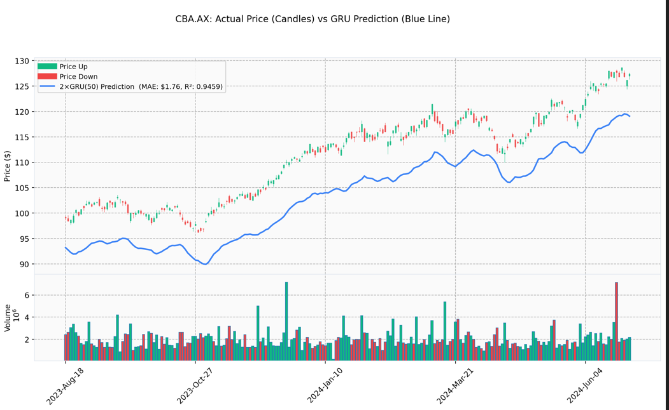
REFLECTION
17 / 18

Slide 21
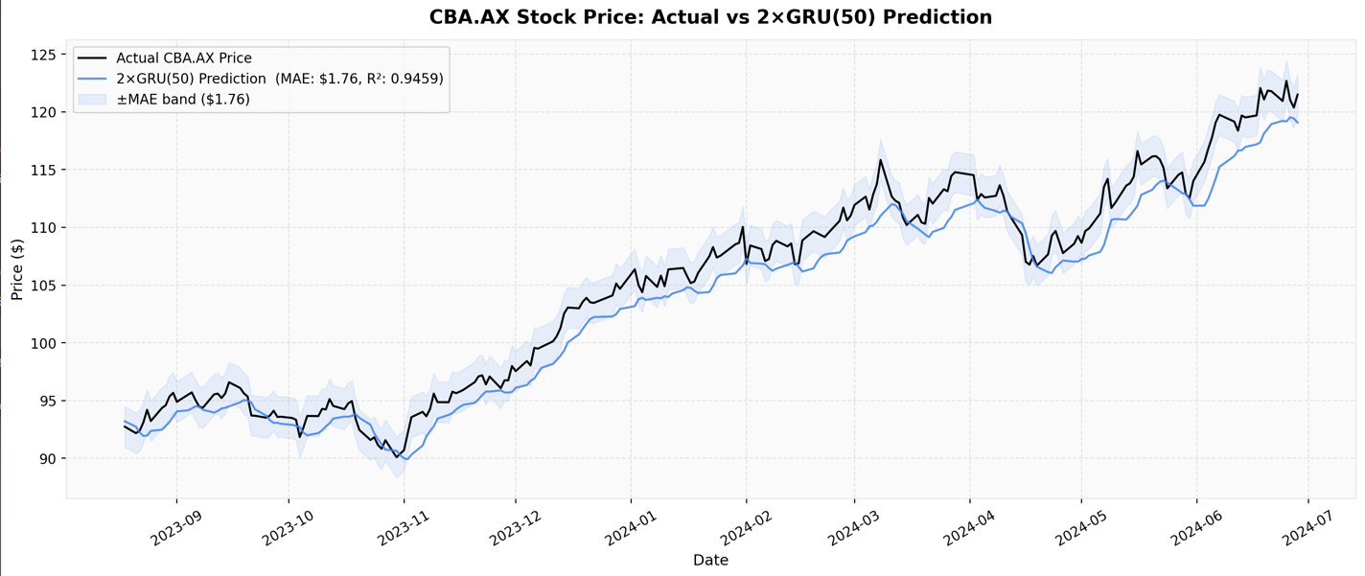
REFLECTION
17 / 18

Slide 22
Thank You
CBA.AX Stock Prediction | COS30018 Intelligent Systems
Le Minh Kha | Supervisor: Mr. Ky Trung
7
1,345
20+
3
Code
Versions
Lines in
Final Version
Experiments
Run
Model
Families

