Slide 1
Model Performance Metrics
CBA.AX Stock Price Prediction · W9 Experiment Results
MAE
RMSE
MAPE
R²
$1.28
$1.57
1.22%
0.9683
GRU 2×50 ↓ Best
GRU 2×50 ↓ Best
GRU 2×50 ↓ Best
GRU 2×50 ↑ Best
Model | MAE ($) | RMSE ($) | MAPE (%) | R²
ARIMA (auto) | 45.47 | 478.43 | 42.68 | −2936.6
ARIMA (5,1,0) | 51.44 | 482.29 | 48.95 | −2984.2
LSTM 2×50 | 1.83 | 2.31 | 1.72 | 0.932
GRU 2×50 ★ | 1.28 | 1.57 | 1.22 | 0.968
Random Forest | 8.68 | 11.10 | 7.88 | −0.581
Avg (ARIMA+LSTM) | 23.19 | 239.15 | 21.75 | −733.0
Avg (ARIMA+GRU) | 22.88 | 239.16 | 21.46 | −733.0
Avg (ARIMA+LSTM+RF) | 17.69 | 159.29 | 16.48 | −324.6
Weighted (ARIMA+LSTM) | 3.29 | 18.51 | 3.07 | −3.40
Weighted (ARIMA+GRU+RF) | 2.94 | 11.56 | 2.72 | −0.716
Weighted (All 4) | 2.48 | 7.42 | 2.30 | 0.293
Hybrid (ARIMA+LSTM) | 3.29 | 18.55 | 3.07 | −3.42
Hybrid (ARIMA+GRU) | 2.26 | 13.12 | 2.11 | −1.21

Slide 2
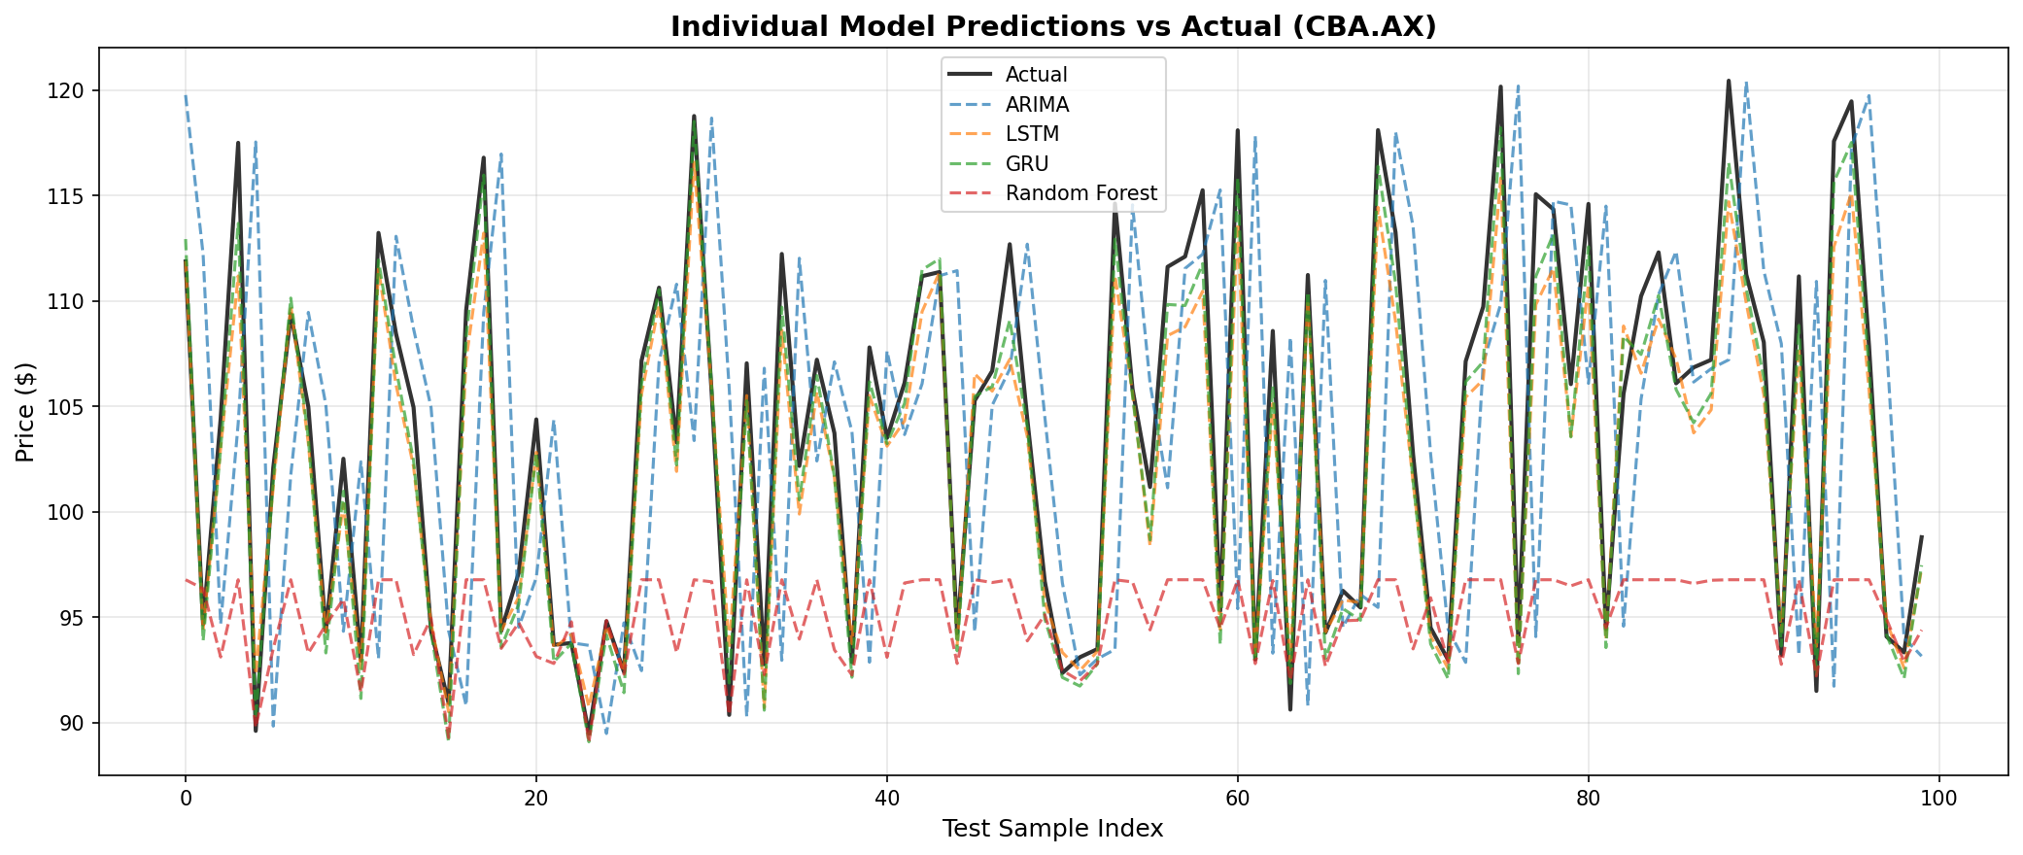
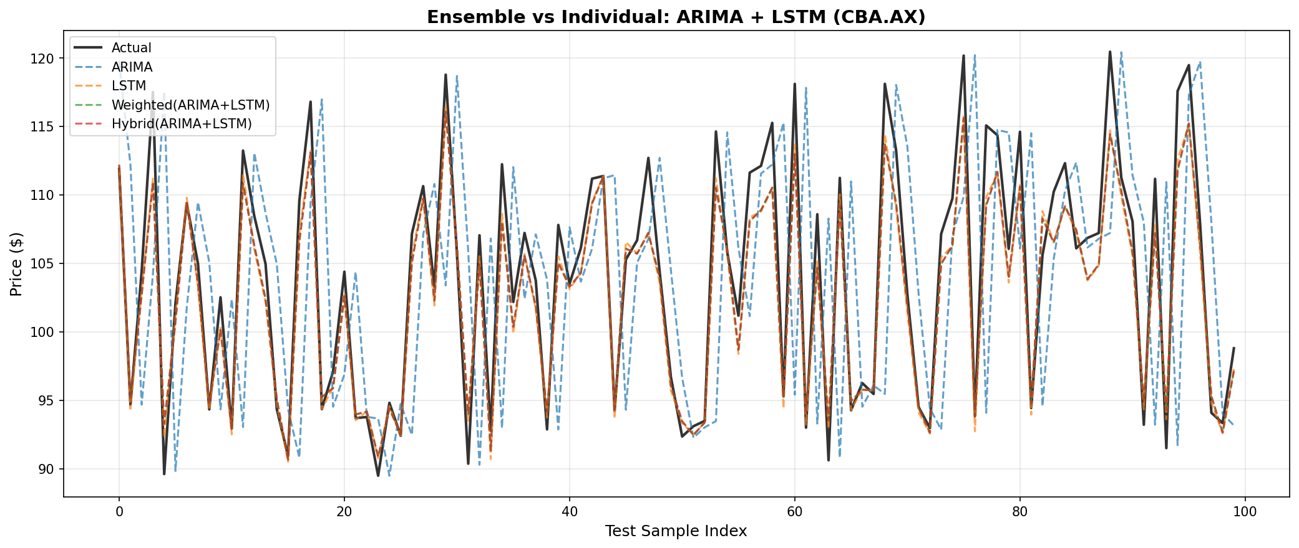
Prediction Visualisations
CBA.AX · Individual Models vs Actual | Ensemble Comparison
Individual Model Predictions vs Actual
Ensemble vs Individual: ARIMA + LSTM
Key finding: GRU 2×50 tracks actual price most closely (R²=0.968). Simple averaging ensembles with ARIMA significantly degrade accuracy. Weighted ensembles partially recover, but GRU alone remains the strongest predictor.

