Slide 1
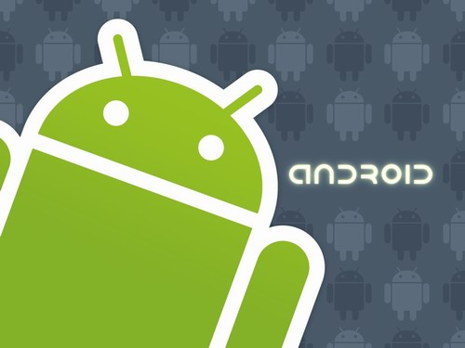
Мы пришли с миром…Ат-Ат-Ат!

Slide 2

System Architecture

Slide 3
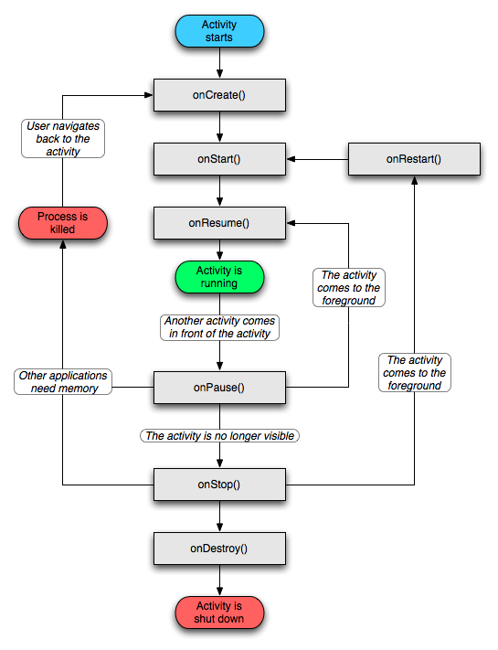
Activity

Slide 4
Application Components
Activities An activity presents a visual user interface for one focused endeavor the user can undertake. For example, an activity might present a list of menu items users can choose from or it might display photographs along with their captions. A text messaging application might have one activity that shows a list of contacts to send messages to, a second activity to write the message to the chosen contact, and other activities to review old messages or change settings. Though they work together to form a cohesive user interface, each activity is independent of the others. Each one is implemented as a subclass of the Activity base class. An application might consist of just one activity or, like the text messaging application just mentioned, it may contain several. What the activities are, and how many there are depends, of course, on the application and its design. Typically, one of the activities is marked as the first one that should be presented to the user when the application is launched. Moving from one activity to another is accomplished by having the current activity start the next one.
Each activity is given a default window to draw in. Typically, the window fills the screen, but it might be smaller than the screen and float on top of other windows. An activity can also make use of additional windows — for example, a pop-up dialog that calls for a user response in the midst of the activity, or a window that presents users with vital information when they select a particular item on-screen.
The visual content of the window is provided by a hierarchy of views — objects derived from the base View class. Each view controls a particular rectangular space within the window. Parent views contain and organize the layout of their children. Leaf views (those at the bottom of the hierarchy) draw in the rectangles they control and respond to user actions directed at that space. Thus, views are where the activity's interaction with the user takes place. For example, a view might display a small image and initiate an action when the user taps that image. Android has a number of ready-made views that you can use — including buttons, text fields, scroll bars, menu items, check boxes, and more.
A view hierarchy is placed within an activity's window by the Activity.setContentView() method. The content view is the View object at the root of the hierarchy. (See the separate User Interface document for more information on views and the hierarchy.)
Services A service doesn't have a visual user interface, but rather runs in the background for an indefinite period of time. For example, a service might play background music as the user attends to other matters, or it might fetch data over the network or calculate something and provide the result to activities that need it. Each service extends the Service base class. A prime example is a media player playing songs from a play list. The player application would probably have one or more activities that allow the user to choose songs and start playing them. However, the music playback itself would not be handled by an activity because users will expect the music to keep playing even after they leave the player and begin something different. To keep the music going, the media player activity could start a service to run in the background. The system would then keep the music playback service running even after the activity that started it leaves the screen.
It's possible to connect to (bind to) an ongoing service (and start the service if it's not already running). While connected, you can communicate with the service through an interface that the service exposes. For the music service, this interface might allow users to pause, rewind, stop, and restart the playback.
Like activities and the other components, services run in the main thread of the application process. So that they won't block other components or the user interface, they often spawn another thread for time-consuming tasks (like music playback). See Processes and Threads, later.
Broadcast receivers A broadcast receiver is a component that does nothing but receive and react to broadcast announcements. Many broadcasts originate in system code — for example, announcements that the timezone has changed, that the battery is low, that a picture has been taken, or that the user changed a language preference. Applications can also initiate broadcasts — for example, to let other applications know that some data has been downloaded to the device and is available for them to use. An application can have any number of broadcast receivers to respond to any announcements it considers important. All receivers extend the BroadcastReceiver base class.
Broadcast receivers do not display a user interface. However, they may start an activity in response to the information they receive, or they may use the NotificationManager to alert the user. Notifications can get the user's attention in various ways — flashing the backlight, vibrating the device, playing a sound, and so on. They typically place a persistent icon in the status bar, which users can open to get the message.
Content providers A content provider makes a specific set of the application's data available to other applications. The data can be stored in the file system, in an SQLite database, or in any other manner that makes sense. The content provider extends the ContentProvider base class to implement a standard set of methods that enable other applications to retrieve and store data of the type it controls. However, applications do not call these methods directly. Rather they use a ContentResolver object and call its methods instead. A ContentResolver can talk to any content provider; it cooperates with the provider to manage any interprocess communication that's involved. See the separate Content Providers document for more information on using content providers.

Slide 5

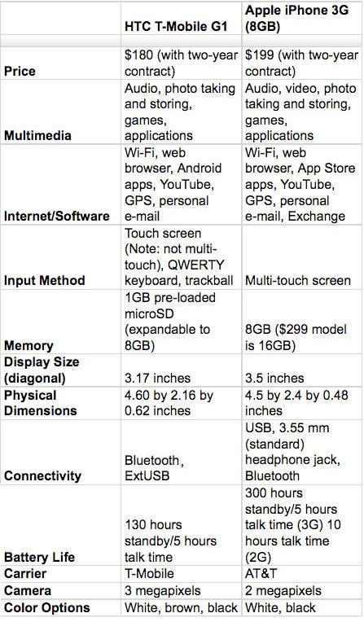
T-Mobile G1 vs iPhone

Slide 6
android-sdk-windows-1.5_pre
New features
On-screen soft keyboard
  Works in both portrait and landscape orientation
  Support for user installation of 3rd party keyboards
  User dictionary for custom words
Home screen
  Widgets
    Bundled home screen widgets include: analog clock, calendar, music player, picture frame, and search
  Live folders
Camera & Gallery
  Video recording
  Video playback (MPEG-4 & 3GP formats)
Bluetooth
  Stereo Bluetooth support (A2DP and AVCRP profiles)
  Auto-pairing
  Improved handsfree experience
Browser
  Updated with latest Webkit browser & Squirrelfish Javascript engines
  Copy 'n paste in browser
  Search within a page
  User-selectable text-encoding
  UI changes include:
    Unified Go and Search box
    Tabbed bookmarks/history/most-visited screen
Contacts
  Shows user picture for Favorites
  Specific date/time stamp for events in call log
  One-touch access to a contact card from call log event
System
  New Linux kernel (version 2.6.27)
  SD card filesystem auto-checking and repair
  SIM Application Toolkit 1.0
Google applications
  View Google Talk friends' status in Contacts, SMS, MMS, GMail, and Email applications
  Batch actions such as archive, delete, and label on Gmail messages
  Upload videos to Youtube
  Upload photos on Picasa
New APIs and developer tools
UI framework
  Framework for easier background/UI thread interaction
  New SlidingDrawer widget
  Horizontal ScrollView widget
Home Screen framework
  APIs for creating secure home screen widgets
  APIs for populating live folders with custom content
Media framework
  Raw audio recording and playback APIs
  Interactive MIDI playback engine
  Video recording APIs for developers (3GP format)
  Video and photo sharing Intents
  Media search Intent
Input Method framework
  Text prediction engine
  Ability to provide downloadable IMEs to users
Speech recognition framework
  Support for using speech recognition libraries via Intent
Misc API additions
  LocationManager - Applications can get location change updates via Intent
  WebView - Touch start/end/move/cancel DOM event support
  SensorManager - redesigned sensor APIs
  GLSurfaceView - convenience framework for creating OpenGL applications
  Broadcast Intent for app update install succeeded - for smoother app upgrade experience
Developer tools
  Support for multiple versions of Android in a single SDK installation
  Improved JUnit support in ADT
  Easier application performance profiling

Slide 7
Open Handset Alliance
What is the Open Handset Alliance™?
The Open Handset Alliance is a group of 47 technology and mobile companies who have come together to accelerate innovation in mobile and offer consumers a richer, less expensive, and better mobile experience. Together we have developed Android™, the first complete, open, and free mobile platform. We are committed to commercially deploy handsets and services using the Android Platform.
What types of companies are in the Open Handset Alliance?
All parts of the mobile ecosystem are represented in the Alliance. Members include mobile operators, handset manufacturers, semiconductor companies, software companies, and commercialization companies.
What have members of the Alliance committed to?
All members of the Alliance have committed to making the initial version of the platform a commercial success. Some companies have contributed significant intellectual property to the Alliance that will be released under the Apache v2 Open Source license. Others are working to make sure their chipsets support the platform. Handset manufacturers and mobile operators are working to develop handsets based on the platform. Commercialization partners are working with the industry to support the platform via a professional services model.

Slide 8
>:)

