Slide 1

1st ATHEIST CHALLENGE
“Moreover, if we can account of something on the basis of a few original causes, we ought not to use many. But it seems we can account for everything that we find in the world on the basis of various original causes even if we suppose that God does not exist. Nature can be taken as the original cause of natural things…” (Perry. P. 80)

Slide 2
2nd ATHEIST CHALLENGE
“But, when we use the word ‘God,’ we mean ‘something infinitely good.’ Therefore, if God were to exist, nothing would be bad. But there are bad things in the world. Therefore, God does not exist.” (Perry, p. 80)

Slide 3
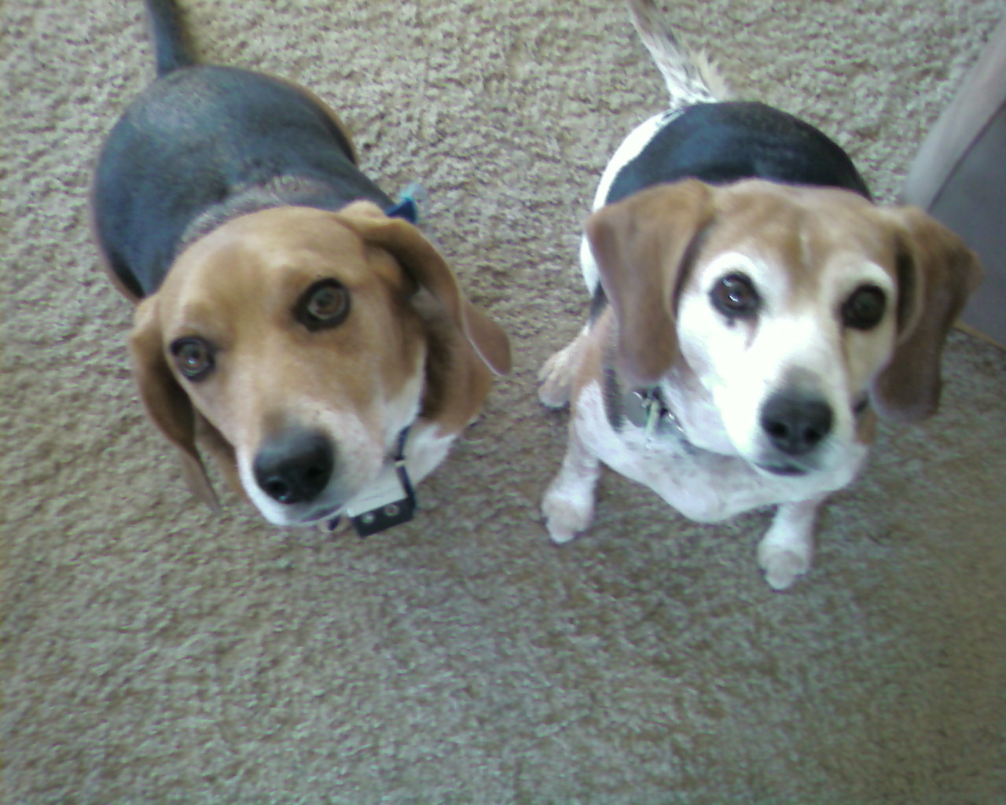
Dogs

Slide 4
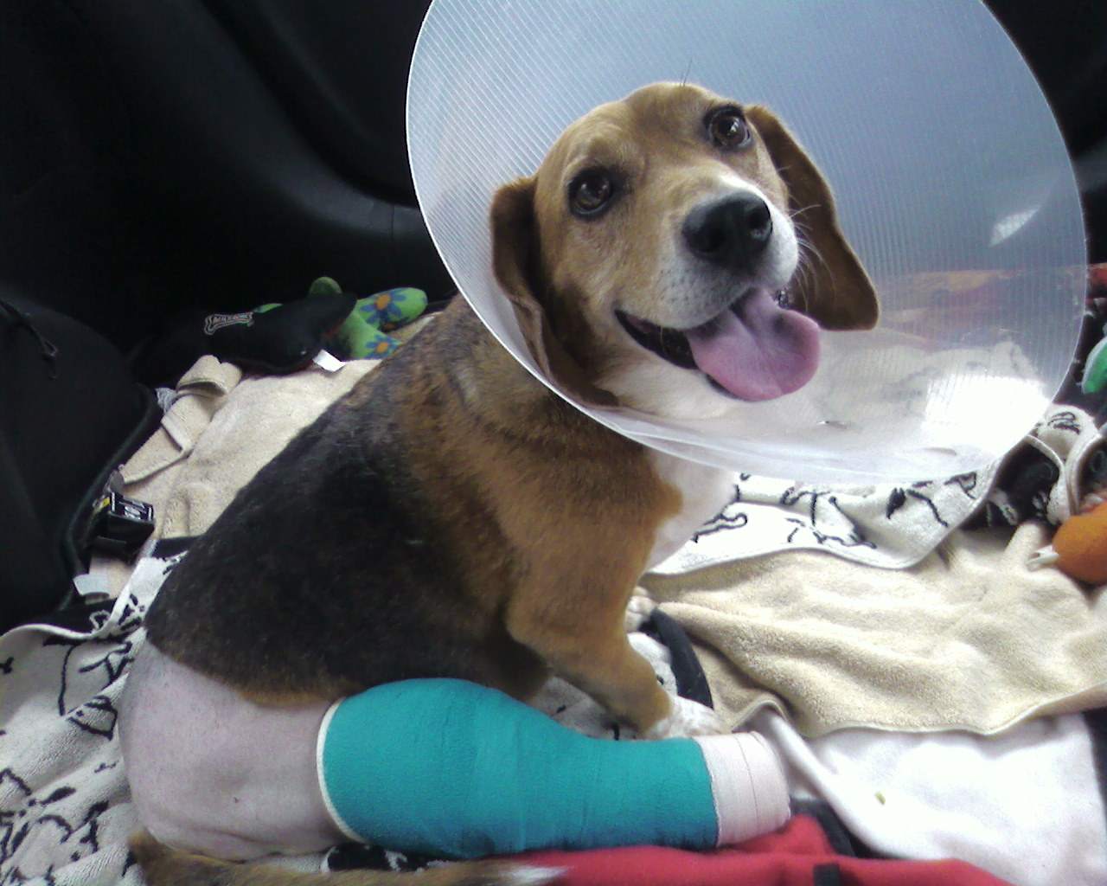
Winston

Slide 5
TWO THINGS I COULD DO AT THIS MOMENT
LET THE DOG WASTE LAY WHERE IT IS AND MOVE ON
PICK UP THE DOG WASTE AND CARRY IT TO THE NEAREST TRASH CAN

Slide 6
I KNOW WHAT WOULD BE THE RIGHT OR RESPONSIBLE OR GOOD THING TO DO: PICK UP THE PICK UP THE WASTE
I HAVE THE POWER TO DO THE RIGHT THING
I’M A GOOD PERSON. I WANT TO DO THE RIGHT THING
QUESTION: WHAT DID I DO?
ANSWER: PICKED UP THE WASTE

Slide 7
THE TRI-OMNI CONCEPTION OF GOD
A) GOD IS OMNISCIENT: HE IS ALL-KNOWING
B) GOD IS OMNIPOTENT: HE IS ALL-POWERFUL
C) GOD IS OMNIBENEVOLENT: HE IS ALL-LOVING

Slide 8
THERE IS EVIL IN THE WORLD
1) MORAL EVIL: EVIL THAT RESULTS FROM INTENTIONAL OR FREE ACTION (OR INACTION) e.g. MURDER, ADULTERY, TORTURE, NOT PICKING UP DOG WASTE
2) NATURAL EVIL: EVIL THAT RESULTS FROM NATURAL EVENTS e.g. HURRICANE, DISEASE, DROUGHT

Slide 9
A) GOD IS OMNISCIENT
B) GOD IS OMNIPOTENT
C) GOD IS OMNIBENEVOLENT
D) EVIL EXISTS

Slide 10
TWO (OR MORE) STATEMENTS ARE INCONSISTENT IF AND ONLY IF IT IS LOGICALLY IMPOSSIBLE FOR ALL OF THE STATEMENTS TO BE TRUE.

Slide 11
ARE THESE TWO STATEMENTS CONSISTENT?
“GEORGE WASHINGTON WAS THE FIRST U.S. PRESIDENT”
“MICHAEL JORDAN WAS THE SECOND U.S. PRESIDENT”

Slide 12
ARE THESE TWO STATEMENTS CONSISTENT?
“SHAQ IS TALLER THAN KOBE”
“KOBE IS TALLER THAN SHAQ”

Slide 13
“SHAQ IS TALLER THAN KOBE” & “KOBE IS TALLER THAN SHAQ” ARE INCONSISTENT BECAUSE WE CAN DERIVE A CONTRADICTION
1) SHAQ IS TALLER THAN KOBE
2) KOBE IS TALLER THAN SHAQ
3) IF A IS TALLER THAN B, THEN B IS NOT TALLER THAN A
4) SO, KOBE IS NOT TALLER THAN SHAQ (1,3)
5) KOBE IS TALLER THAN SHAQ AND KOBE IS NOT TALLER THAN SHAQ (2,4)

Slide 14
INCONSISTENCY OF THE TRI-OMNI CONCEPTION AND EVIL
i) GOD IS OMNISCIENT, OMNIPOTENT, AND OMNIBENEVOLENT (assume)
ii) IF GOD IS OMNISCIENT, THEN HE KNOWS HOW TO MAKE A WORLD WITH NO EVIL IN IT
iii) IF GOD IS OMNIPOTENT, THEN HE IS ABLE TO MAKE A WORLD WITH NO EVIL IN IT
iv) IF GOD IS OMNIBENEVOLENT, THEN HE WANTS TO MAKE A WORLD WITH NO EVIL IN IT.
v) SO, EVIL DOES NOT EXIST
vi) BUT EVIL DOES EXIST
vii) EVIL EXISTS AND EVIL DOESN’T EXIST

Slide 15
1) IF GOD EXISTS, THEN GOD IS OMNIPOTENT, OMNISCIENT, AND OMNIBENEVOLENT
2) THAT GOD IS OMNIPOTENT, OMNISCIENT, AND OMNIBENEVOLENT IS INCONSISTENT WITH THE EXISTENCE OF EVIL
3) EVIL EXISTS IN THE WORLD
4) SO IT IS NOT THE CASE THAT GOD IS OMNIPOTENT, OMNISCIENT, AND OMNIBENEVOLENT (2, 3)
5) SO, GOD DOES NOT EXIST (1, 4)

Slide 16
CRITICAL EVALUATION OF THE ARGUMENT: EXPLORING OBJECTIONS

Slide 17
1st OBJECTION:
REJECT PREMISE #1
1) IF GOD EXISTS THEN HE IS OMNIPOTENT, OMNISCIENT, AND OMNIBENEVOLENT

Slide 18
2nd OBJECTION: REJECT PREMISE #2
2) THAT GOD IS OMNISCIENT, OMNIPOTENT, AND OMNIBENEVOLENT IS INCONSISTENT WITH THE EXISTENCE OF EVIL
THE PROBLEM OF EVIL: HOW CAN WE EXPLAIN THE EXISTENCE OF AN ALL-POWERFUL, ALL-KNOWING, ALL-LOVING GOD IN WORLD FILLED WITH EVIL?

Slide 19
HOW TO ANSWER THE PROBLEM OF EVIL
DEMONSTRATE HOW IT IS POSSIBLE FOR THESE FOUR STATEMENTS TO BE TRUE:
A) GOD IS OMNISCIENT
B) GOD IS OMNIPOTENT
C) GOD IS OMNIBENEVOLENT
D) EVIL EXISTS

Slide 20
“DIALOGUE ON GOOD, EVIL, AND THE EXISTENCE OF GOD” (John Perry)
MAIN CHARACTERS
GRETCHEN WEINROB (ATHEIST): CONVINCED THAT THERE COULDN’T BE A (CHRISTIAN) GOD, SINCE THERE IS EVIL IN THE WORLD
SAM MILLER (THEIST): TRIES TO OFFER POSSIBLE REASONS WHY GOD WOULD ALLOW EVIL

Slide 21
POSSIBLE REASON FOR EVIL #1:
THE BEST OF ALL WORLDS REQUIRES SOME EVIL IN IT

Slide 22
AN IMPORTANT DISTINCTION
THERE BEING A POSSIBLE EXPLANATION FOR EVIL
PROVIDING AN ARTICULATION OF THAT POSSIBLE EXPLANATION

Slide 23
“GEORGE WASHINGTON WAS THE FIRST U.S. PRESIDENT”
“MICHAEL JORDAN WAS THE SECOND U.S. PRESIDENT”

Slide 24
A THEODICY IS A DETAILED STORY THAT RECONCILES THE TRI-OMNI CONCEPTION OF GOD WITH THE PRESENSE OF EVIL

Slide 25
POSSIBLE REASON FOR EVIL #2: FREE WILL THEODICY
A WORLD CONTAINING CREATURES THAT ARE FREE IS BETTER, OTHER THINGS EQUAL, THAN A WORLD CONTAINING CREATURES THAT ARE NOT FREE

Slide 26
IF GOD WANTS THE BEST POSSIBLE WORLD, HE WOULD HAVE CREATED A WORLD WITH FREE BEINGS. BUT IF GOD HAS GIVEN US THE GIFT OF FREE WILL, IT IS UP TO US TO CHOOSE THE OUTCOME OF WHAT WE DECIDE
PEOPLE HAVE THE FREEDOM TO CLEAN UP AFTER THEIR DOGS OR NOT
THEY HAVE THE FREEDOM TO SMILE AND WAVE AT THOSE THEY SEE ON THE STREET, OR TO TAKE OUT A KNIFE AND DO TERRIBLE THINGS
THEY HAVE THE FREEDOM TO STUDY REALLY HARD IN SCHOOL, OR TO TRY TO CHEAT ON THEIR TESTS

Slide 27
SO, IF FREE WORLDS ARE BETTER THAN NON-FREE WORLDS, THEN IT IS POSSIBLE THAT GOD HAS CREATED THE BEST POSSIBLE WORLD. THE COST OF DOING SO IS THAT HE CAN’T GUARANTEE THAT THERE WON’T BE EVIL

Slide 28
TWO RESPONSES TO THE FREE WILL THEODICY
MORAL VS. NATURAL EVIL
THE THEODICY IS UNSUCCESSFUL AT EXPLAINING MORAL EVIL

