Slide 1


Slide 2
IMMORAL ACTIONS
BREAKING YOUR PROMISE
LYING, ADULTERY
KILLING INFANTS
POOR HEALTHCARE TO VETERANS
MORALLY GOOD ACTIONS
GIVING TO CHARITY
ASSISTING THE ELDERLY
INSTITUTING DEMOCRATIC POLICIES
OFFERING SPECIAL EDUCATION TO THE MENTALLY HANDICAPPED
NEITHER GOOD NOR BAD: ALLOWABLE
GOING TO THE MOVIES
WALKING AT A BRISK PACE
PAYING THE ELECTRIC BILL A DAY LATE

Slide 3
CONTROVERSIAL CASES
ABORTION
EUTHANASIA
LYING FOR ALTRUISTIC REASONS
WAR
POLLUTING THE ENVIRONMENT
CAPITAL PUNISHMENT

Slide 4
AN ETHICAL QUESTION: WHAT MAKES AN ACTION MORALLY GOOD (OR BAD)?

Slide 5
IS MORALITY OBJECTIVE?

Slide 6
THE EARTH IS 4.6 BILLION YEARS OLD
CHOCOLATE ICE CREAM IS BETTER THAN VANILLA
MULLETS ARE STYLISH

Slide 7
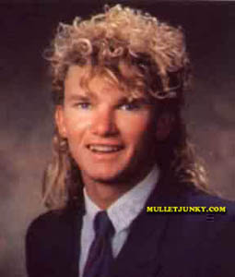


Slide 8
--JAN LOVES CHOCOLATE; HATES VANILLA
--JIM LOVE VANILLA; HATES CHOCOLATE
THE STATEMENT:
“CHOCOLATE IS BETTER THAN VANILLA”
-IS TRUE RELATIVE TO JAN
-IS FALSE RELATIVE TO JIM

Slide 9
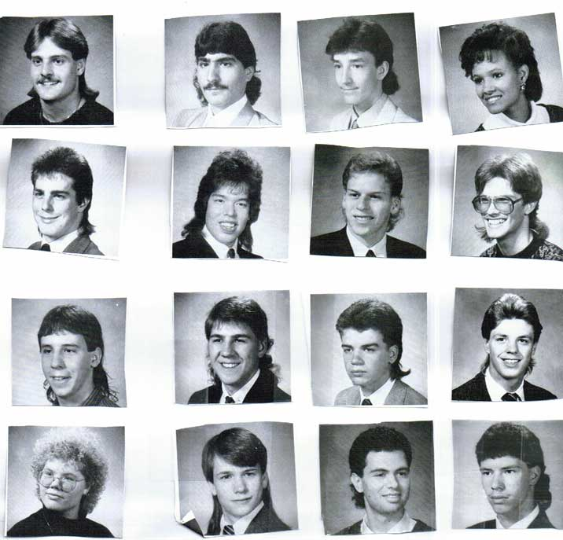
IS THE TRUTH-VALUE OF “MULLETS ARE STYLISH” OBJECTIVE OR RELATIVE?

Slide 10
“MULLETS ARE STYLISH”
FALSE, RELATIVE TO EARLY 21ST CENTURY SOUTHERN CALIFORNIA CULTURE
TRUE, RELATIVE TO EARLY 1990’S MISSOURI CULTURE

Slide 11
“The ‘right’ way is the way which the ancestors used and which has been handed down. The tradition is its own warrant. It is not held subject to verification by experience. The notion of right is in the folkways. It is not outside of them, of independent origin, and brought to test them. In the folkways, whatever it, is right. This is because they are traditional, and therefore contain in themselves the authority of the ancestral ghosts. When we come to the folkways we are at the end of our analysis.” (W. G. Sumner, Folkways, 1906)

Slide 12
CULTURAL RELATIVISM: MORAL STATEMENTS ARE TRUE OR FALSE RELATIVE TO THE CULTURE IN WHICH THEY ARE UTTERED

Slide 13
FREEDOM OF RELIGION IS MORALLY RIGHT (AMERICAN CULTURE VS. SAUDIA ARABIAN CULTURE)
WOMEN SHOULD BE ALLOWED TO VOTE (AMERICAN VS. IRANIAN) (21ST CENTURY AMERICA VS. 19TH CENTURY AMERICA)
INFANTICIDE IS IMMORAL (AMERICAN VS. INUIT ESKIMOS)

Slide 14
THREE PROBLEMS FOR CULTURAL RELATIVISM (CR)
ARGUMENT FOR CR
MOTIVATION FOR CR
IMPLICATIONS OF CR

Slide 15
ARGUMENT FOR CULTURAL RELATIVISM
INUIT ESKIMOS BELIEVE THAT KILLING THEIR INFANTS IS NOT MORALLY WRONG
AMERICANS BELIEVE THAT KILLING THEIR INFANTS IS MORALLY WRONG
THEREFORE, THERE IS NO OBJECTIVE TRUTH AS TO WHETHER KILLING INFANTS IS MORALLY WRONG

Slide 16
ARGUMENT FOR CULTURAL RELATIVISM
SOME CULTURES BELIEVE THAT THE OPPRESSION OF WOMEN IS MORALLY PERMISSIBLE
OTHER CULTURES BELIEVE THAT THE OPPRESSION OF WOMEN IS MORALLY IMPERMISSIBLE
THEREFORE, THERE IS NO OBJECTIVE MORAL TRUTH AS TO WHETHER OPPRESSING WOMEN IS MORALLY PERMISSIBLE

Slide 17
THE ARGUMENT FROM CULTURAL DIFFERENCES
SOME CULTURES BELIEVE X IS IMMORAL
OTHER CULTURES BELIEVE X IS NOT IMMORAL
THEREFORE, THERE IS NO OBJECTIVE TRUTH AS TO WHETHER X IS IMMORAL

Slide 18
IS THE ARGUMENT FROM CULTURAL DIFFERENCES VALID?
STRUCTURE OF ARGUMENT
SOME CULTURES BELIEVE THAT P IS TRUE
OTHER CULTURES BELIEVE THAT P IS NOT TRUE
THEREFORE, THERE IS NO OBJECTIVE TRUTH AS TO WHETHER P

Slide 19
SOME CULTURES BELIEVE THAT P IS TRUE
OTHER CULTURES BELIEVE THAT P IS NOT TRUE
THEREFORE, THERE IS NO OBJECTIVE TRUTH AS TO WHETHER P
COUNTEREXAMPLE #1
SOME CULTURES BELIEVE THE EARTH IS 4.6 BILLION YEARS OLD
OTHER CULTURES BELIEVE THE EARTH IS NOT 4.6 BIL. YEARS OLD
THEREFORE, THERE IS NO OBJECTIVE TRUTH AS TO THE AGE OF THE EARTH

Slide 20
SOME CULTURES BELIEVE THAT P IS TRUE
OTHER CULTURES BELIEVE THAT P IS NOT TRUE
THEREFORE, THERE IS NO OBJECTIVE TRUTH AS TO WHETHER P
COUNTEREXAMPLE #2
SOME CULTURES BELIEVE HUMANS ARE CAUSING GLOBAL WARMING
OTHER CULTURES BELIEVE HUMANS ARE NOT CAUSING GLOBAL WARMING
THEREFORE, THERE IS NO OBJECTIVE TRUTH AS TO WHETHER HUMANS ARE CAUSING GLOBAL WARMING

Slide 21
SECOND PROBLEM FOR CULTURAL RELATIVISM: MOTIVATIONS
POLYGAMY
THE CASE FOR THE IRAQ WAR

Slide 22
DIFFERENT CULTURES HAVE DIFFERENT MORAL CODES, AND THE MORAL CODE OF A CULTURE DETERMINES WHAT IS RIGHT WITHIN THAT CULTURE
THERE IS NO OBJECTIVE STANDARD THAT CAN BE USED TO JUDGE ONE’S CULTURE BETTER THAN ANOTHER’S.
THE MORAL CODE OF OUR OWN CULTURE HAS NO SPECIAL STATUS
THERE IS NO OBJECTIVE TRUTH IN ETHICS
IT IS MERE ARROGANCE TO JUDGE THE CONDUCT OF OTHER PEOPLES. CULTURES SHOULD ADOPT AN ATTITUDE OF TOLERANCE TOWARD THE PRACTICES OF OTHER CULTURES

Slide 23
“TOLERATION SHOULD BE ADOPTED”
“THERE IS NO OBJECTIVE TRUTH IN ETHICS”

Slide 24
3rd PROBLEM FOR CR: IMPLICATIONS
ACCORDING TO CR: IF CULTURE A BELIEVES THAT X IS MORALLY PERMISSIBLE, THEN X IS MORALLY PERMISSIBLE RELATIVE TO A
SLAVERY, GENOCIDE, DISCRIMINATION, MURDER?

