Slide 1

UC410: Moral Relativisms
Reading for next class:
Arthur pp. 32-37 (2 articles)
Optional: pp. 38-41 (1 article)

Slide 2
Problems With Theories
Logical (Validity) Problems
Self-Contradictory
Self-Defeating
Logical Fallacies (Equivocation, Strawman)
Counterintuitive Problems
Gives the wrong answer
Gives strange answers

Slide 3
Problems With Theories
Completeness Problems
Fails to explain what it claims to explain
Fails to consider all types of moral action
Gives vague answers
Practical Problems
Too hard to implement
Based on factual errors

Slide 4


Moral (ethical) Relativism
Main Thesis:
There are no universal moral standards. Every moral standard is relative to a society or individual.

Slide 5
Ethical Relativism and Ethical Absolutism
The opponent: Ethical (or Moral) Absolutism is the view that at least some moral standards are universal.
But these definitions are vague.
Question: Can we get an ethical principle out of this definition?

Slide 6
Descriptive Ethics
Descriptive ethics is an enterprise that seeks to describe and explain people’s moral attitudes and the moral practices of societies.
Part of Psychology, Sociology, Anthropology

Slide 7
Normative Ethics
Normative ethics is concerned with the determination of what is morally right or wrong, what practices society ought to have (as opposed to what practices it does have).
Part of Religion, Politics, Law

Slide 8

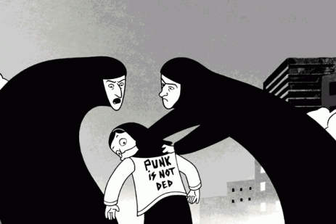
Movie Recommendations
Persepolis
The Dark Knight

Slide 9
Descriptive Ethical Relativism (DER)
Even at the most fundamental level, there are no moral judgments that are universally shared, no moral practices that are universally adopted (or accepted).

Slide 10
Normative Ethical Relativism (NER)
There are no universally applicable moral standards and there are no practices that it would be correct to apply universally.

Slide 11
Normative Ethical Relativism (NER)
If the crayons belong to Julie and she wants them back, then Billy should give them back to her.
The crayons belong to Julie.
Julie wants the crayons back.
Billy should give them back to her.
T or F?
“The presumed objectivity of moral judgments thus being a chimera, there can be no moral truth.” Westermarck, Arthur pp. 34

Slide 12
Philosophical Questions About Ethical Relativism
Do the established facts support DER?
Does DER support NER?
What are the implications of NER?

Slide 13
Evaluating the Evidence for DER
The Evidence
  Cultural/Individual Variation
The Type of Argument
  “Inference to the Best Explanation”

Slide 14

Argument for DER
Social Practices
1. Different foundational moral beliefs lead to different social practices.
2. There are different social practices in the world.
There are different foundational moral beliefs in the world. (DER)
Foundational Moral Beliefs

Slide 15
Criticism of the Argument for DER
The street is wet
Social Practices
Raining
Snowing
Foundational Moral Beliefs
Social Circumstances
and Non-moral Beliefs

Slide 16

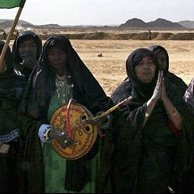
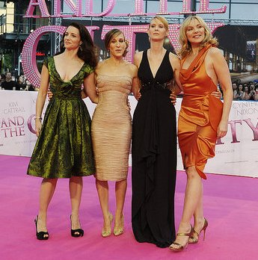

Circumstantial Variation
Different practices or moral attitudes toward specific actions may result from applying the same fundamental moral judgments to different circumstances.

Slide 17
Strengthening the Argument from Cultural Variation
If these other factors that can produce different cultural practices are ruled out as explaining the differences, the argument from cultural variation does establish the truth of descriptive ethical relativism (DER).

Slide 18

Philosophical Questions About Ethical Relativism/Absolutism
Do the established facts support DER?
Does DER support NER?
What are the implications of NER?

Slide 19
From DER to NER ???
Normative Ethical Relativism (NER) does not follow automatically from Descriptive Ethical Relativism (DER).
Equivocation Fallacy
Confusing the different meanings of “Ethical Relativism” leads some to think it does.

Slide 20
From DER to NER (cont’d.)
The fact that people have different beliefs about the truth of a judgment does not, in general, show that there is no fact of the matter about whether the judgment is true.
  Examples: Medicine, Killing your Parents

Slide 21
From DER to NER (cont’d.)
If the defender of NER wants to draw support from DER, she has to show why moral judgments are different from other judgments.

Slide 22
Philosophical Questions About Ethical Relativism
Do the established facts support DER?
=> Not really. Only if you rule out circumstantial variation
Does DER support NER?
=> No. Only if you can show that moral judgments are different than any other judgments
What are the implications of NER?

Slide 23
The Implications of NER
1. Impossibility of Intercultural Judgments
  Moral judgments across cultures
  Moral comparisons of different cultures

Slide 24
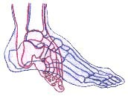
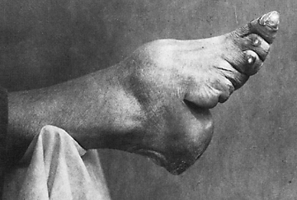
An Example: Foot Binding
Foot binding in China lasted from the 10th Century until 1911, when it was outlawed.
At some points, a majority of Chinese women had bound feet.

Slide 25
Moral Relativism and
Foot Binding
The Normative Ethical Relativist is forced to say that the condemnation of this practice is “culturally bound”—reflecting our own cultural norms, which are not any more justified than those of the “foot binders.”
It is impossible to make justified cross-cultural moral judgments.

Slide 26
Impossibility of Intercultural Judgments
The impossibility of intercultural judgments prevents praise of other cultures as well.
  “[W]e certainly do need to praise other societies… But it is hardly possible that we could praise them effectively if we could not, in principle, criticize them. Our praise would be worthless if it rested on no definite grounds, if it did not flow from some understanding.”
      Mary Midgley, “Trying Out One’s New Sword”

Slide 27
Implications of NER (cont’d.)
2. Incoherence of ‘Moral Progress’
  If we cannot make moral comparisons of different cultures, then we cannot judge one culture to have improved over time.
    We cannot claim that an America without slavery is morally superior to one with slavery.

Slide 28
Implications of NER (cont’d.)
3. Degeneration of Cultural Relativism into Individual Relativism
  If there is serious moral disagreement between factions in a society, to this degree, there are different cultures in the society.
  How many people do you need for a “majority”? Is that the same over time?

Slide 29
Implications of NER (cont’d.)
4. Undermining Tolerance
- Tolerance: We should not impose our moral standards universally.

Slide 30
Relativism and Tolerance: An Illustrative Example
Britain’s Wolfenden Report (1957) recommended decriminalization of homosexual acts and acts of prostitution.

Slide 31

  These acts are “victimless crimes”
  Appeal to John Stuart Mill’s On Liberty.
  You are not allowed to prevent someone’s liberty or cause him harm “for his own moral or physical good”.

Slide 32
Devlin’s Dissent
Lord Patrick Devlin dissented.
He argued for:
  A public right to enforce society’s moral principles by law
  The claim that immoral actions are ones that provoke in the average citizen feelings of “intolerance, indignation and disgust”

Slide 33
Question: Who is the Moral Relativist?
Answer:
Certainly NOT John Stuart Mill
Lord Patrick Devlin is the moral
relativist in this dispute
Under this (relativist) view, tolerance for other cultures is undermined.

Slide 34
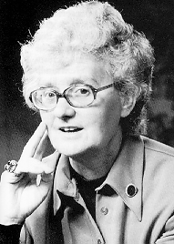
Relativism and Tolerance: Conclusion
We are rightly angry with those who despise, oppress or steamroll other cultures. We think that doing these things is actually wrong. But this is itself a moral judgement. We could not condemn oppression and insolence if we thought that all our condemnations were just a trivial local quirk of our own culture. We could still less do it if we tried to stop judging altogether.
      Mary Midgley, “Trying Out One’s New Sword”
Mary Midgley
1919 -

Slide 35
What the Moral Absolutist Says
There is at least one moral principle that is objectively correct in the sense that it is correctly applicable independently of a culture’s (or an individual’s) beliefs about what is right or wrong.
This principle might be general or culturally/environmentally sensitive
We are not justified in coercing others to accept our moral standards.

Slide 36
Philosophical Questions About Ethical Relativism
Do the established facts support DER?
=> Not really. Only if you rule out circumstantial variation
Does DER support NER?
=> No. Only if you can show that moral judgments are different than any other judgments
What are the implications of NER?
=> Negative. It even undermines tolerance.

Slide 37


Question for Friday
Is Batman justified in killing Joker?
- Joker will kill a lot more people if left alive
- One person dead is better
than “a lot more DEAD”
=> UTILITARIANISM

Slide 38
Summary
Three Levels of Moral Discourse (Talk)
  Descriptive
  Normative
  Metaethical

Slide 39
Summary (cont’d.)
Relativism, and Absolutism, can be applied an any level. We have only talked about descriptive and normative versions.

Slide 40
Summary (cont’d.)
Definitions of:
  Descriptive Ethical Relativism (DER)
  Normative Ethical Relativism (NER)

Slide 41
Summary (cont’d.)
Philosophical Issues
  Strength of Argument for DER
  Relation between DER and NER
  Implications of Accepting NER

Slide 42
Summary (cont’d.)
Strength of Arguments for DER
  It is not obvious, given the evidence available, that DER is true because DER requires that there be NO moral principles that are universally applied.

Slide 43

Summary (cont’d.)
Relation between DER and NER
  DER → NER

Slide 44
Summary (cont’d.)
Implications of NER
  Impossibility of objective intercultural moral judgments
  Incoherence of ‘moral progress’
  Degeneration of cultural relativism to individual relativism
  Undermining of a Principle of Tolerance

