Slide 1
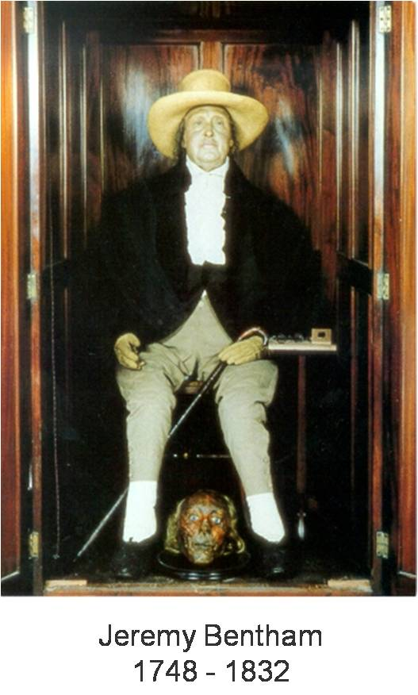
UC410: Kantianism
Reading for next 2 classes:
Thomas Nagel – “War and Massacre”
On Blackboard (pdf & html)

Slide 2
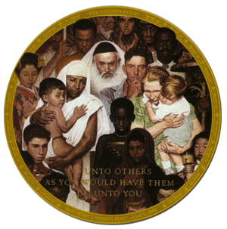
The Categorical Imperative
The Moral Law
At least three formulations, but all are intended to be versions of the same basic idea:
Respect other people as equal to yourself.

Slide 3
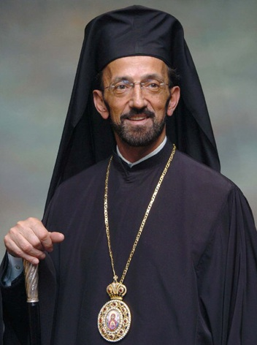
The Many Versions of The Golden Rule: Christianity
“Therefore all things whatsoever ye would that men should do to you, do ye even so to them: for this is the law of the prophets.” (Matthew, 7:12)

Slide 4
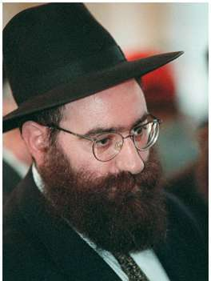
The Many Versions of The Golden Rule: Judaism:
“What is hateful to you, do not to your fellowman. This is the entire Law; the rest is commentary.”
(Talmud, Shabbat, 31a)

Slide 5
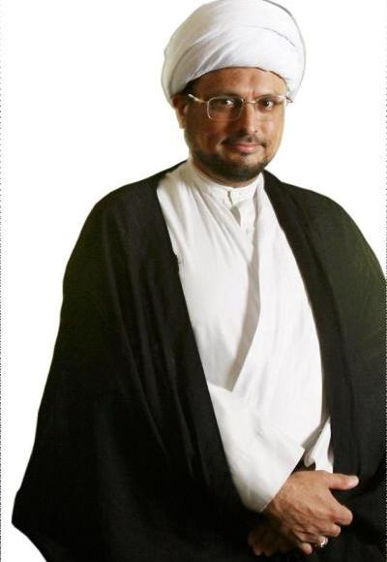
The Many Versions of The Golden Rule: Islam
“No one of you is a believer until he desires for his brother that which he desires for himself.”
(Sunnah)

Slide 6

The Many Versions of The Golden Rule: Brahmanism
“This is the sum of duty: do naught unto others which would cause you pain if done to you.” (Mahabharata, 5, 1517)

Slide 7
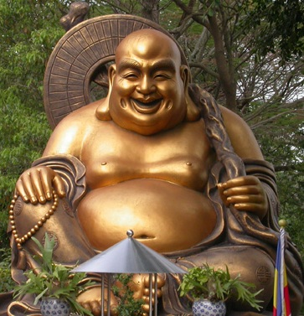
The Many Versions of The Golden Rule: Buddhism
“Hurt not others in ways that you yourself would find hurtful.” (Udana-Varga, 5, 18)

Slide 8
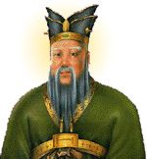
The Many Versions of The Golden Rule: Confucianism
“Surely it is the maxim of loving-kindness: Do not unto others that you would not have them do unto you.”
(Analects, 15, 23)

Slide 9
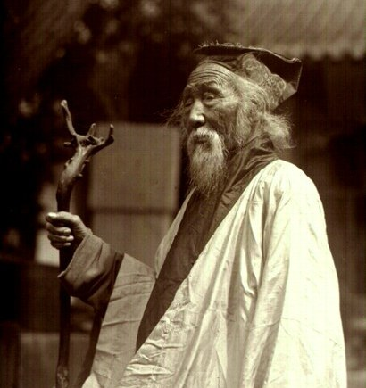
The Many Versions of The Golden Rule: Taoism
“Regard your neighbor’s gain as your own gain and your neighbor’s loss as your own loss.”
(T’ai Shang Kang Ying P’ien)

Slide 10
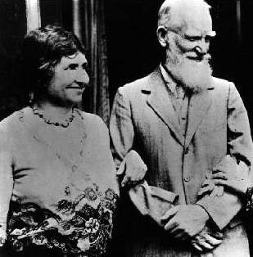
The Many Versions of The Golden
Rule: Dissenter’s View
“Do not do unto others as you would have them do unto you. Their tastes may not be the same.”
(George Bernard Shaw, 1903)

Slide 11
Universal Law Formulation
Act only on that maxim that you can at the same time will as universal law
    Maxim: description of your intended action
    Universal Law: governing everyone’s actions equally
Kant: It is irrational to act on a maxim that one cannot at the same time will as universal law!
Acting irrationally is immoral (and crazy)

Slide 12
Lying
Is it possible to universalize a maxim that permits lying?
What is the maxim?
  “It’s ok to lie when you want/need to”
Can this consistently be willed as a universal law?
  No, it undermines itself, destroying the rational expectation of trust upon which it depends.

Slide 13

Academic Cheating
Cheating involves not playing by the rules. Is it possible for the cheater to will his/her maxim as a universal law?
No, because then others (including the teacher) could refuse to follow the rules as well, failing the cheater even with a good grade.

Slide 14
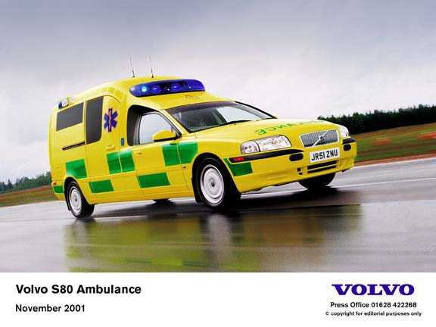
Exceptions
Are exceptions possible for Kant?
  Yes, as long as they can be consistently universalized
Example
  The speeding car
    We can universalize an exception for something like ambulance drivers

Slide 15
Problem of Determining the Maxim of an Action
Actions are particular events; Maxims are general => Problem of generality.
Allowing too much
  I, Vasilis Tsompanidis, Greek teacher of Ethics in Capital University, will steal any blue pens I want.
  I will lie to everyone who’s too stupid to realize it when it’s to my advantage.
  I will kill all gays, Gypsies and Jews when I’m powerful enough to get away with it.
Ruling out too much
  I will go to every Muse concert.

Slide 16
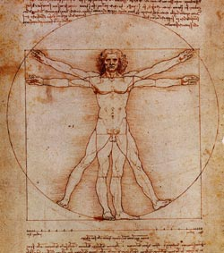
Humanity Formulation
Act in such a way so that you treat humanity, whether in yourself or others, always as an end and never merely as means.
Humanity: the ability to
  Set goals
  Utilize the means to achieve these goals
  Organize these means and goals into a coherent whole

Slide 17
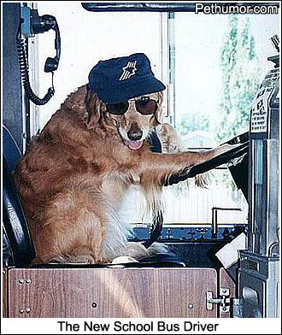
Never merely as a means
  1. Suicide
  2. Lying to borrow money
  3. Self-indulgence
  4. Not helping others
  Bus driver example

Slide 18
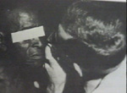
Using People as Mere Means
The Tuskegee Syphilis Experiments
  More than four hundred African American men infected with syphilis went untreated for four decades in a project the government called the Tuskegee Study of Untreated Syphilis in the Negro Male.
  Continued until 1972
Notes:
http://www.fa-ir.org/90.htm
http://www.med.virginia.edu/hs-library/historical/apology/report.html

Slide 19

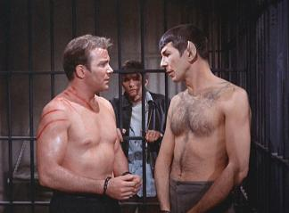

“One for many” Problems
Killer at the door
Killing one to save more
  Sophie’s Choice
  Master & Commander
  Spock: It is logical. The needs of the many outweigh…
  Kirk: …the needs of the few.
  Spock: …or the one.

Slide 20
Differences with Utilitarianism
Kant’s theory has less scope than utilitarianism
  - You don’t have to consider ALL acts, just see if act A uses people as mere means.
Kant’s theory has more precision than UT
  - You don’t have to know the act’s consequences, so you can evaluate acts better
Kant concentrates on intentions, not results
- Kant says: “intentions on which you actually act”
4. Respect for human life is paramount for Kant
- In UT you can sacrifice a life without consent

Slide 21
Criticisms of Kant
1. Determining the Maxim of an Action
2. One for many

Slide 22
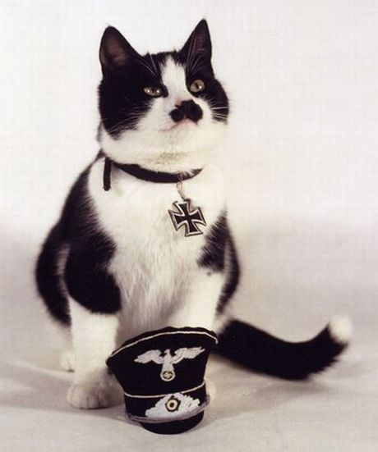
3. Problem of the Rationality
Kant has to give us an account of the “rationality” in order for his theory to explain the following examples.
Example 1: The Rugged
Individualist
Example 2: The Fanatic Nazi

Slide 23
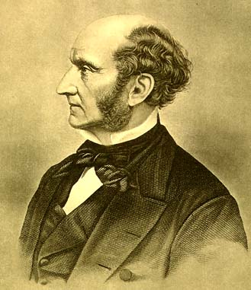
4. Closet Utilitarianism
Mill suggests that Kant is really a “Utilitarian in Deontologist’s Clothing”
Mill is alleging:
  Rational contradictions are just appeals to consequences
A defense:
  - hypothetical consequences
  - happiness bad because of rationality, not utilitarian

