Slide 1
Philosophy 3
Critical Thinking
Winter 2009
UCSB

Slide 2
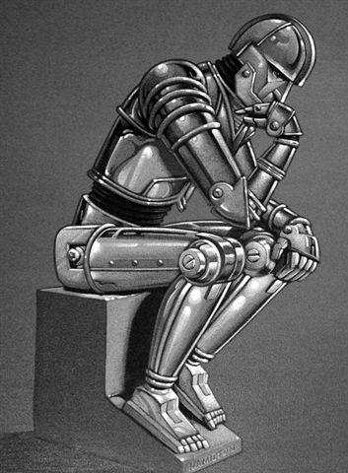
what is it?
Critical thinking is the study of reasoning and argumentation.
In particular, critical thinking is concerned with how to sort good reasoning from bad reasoning.

Slide 3
bad reasoning is rampant!
There's something in our water supply!

Slide 4
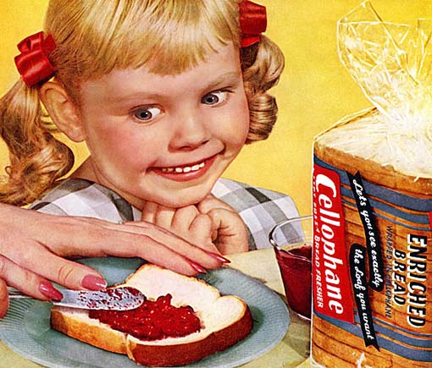
so is good reasoning
Susie wants some toast but can’t find the jelly. She thinks to herself:
Either the jelly is in the fridge or it is in the cupboard. The jelly is not in the fridge, so it must be in the cupboard.

Slide 5
Logic
Logic is not subjective, arbitrary, or culturally-relative.
Logic is . . .
the study of methods for evaluating whether the premises of an argument adequately support its conclusion.

Slide 6
what is an argument?
When people think about arguments they tend to have in mind something like a heated dispute.
This is not the technical notion you find when studying logic.
Consider:
JoeBob: Linkin Park is the best band to come out of the 90s.
Slim: Nah man you’re crazy, Tool is easily the best.
JoeBob: Nuh-uh, shut up you’re wrong.
Slim: What are you going to do about it?
…

Slide 7
An argument is a set of statements where some of the statements, called the premises, are intended to support another, called the conclusion.

