Slide 1
TODAY’S LECTURE
2/9
Chapter 5: Categorical Logic

Slide 2
CATEGORICAL LOGIC
is the study of arguments whose validity depends on the relationships among sets, classes, or categories.
historically traced back to Aristotle and was the primary approach to logic with the medievals
it dominated until the 19th century

Slide 3
STANDARD FORMS OF CATEGORICAL STATEMENTS

Slide 4
CATEGORICAL STATEMENTS
Recall, a categorical statement is a statement that relates two classes or categories.
Examples:
All cats are animals
No bricks are people
Some madmen are geniuses
Some subatomic particles are not electrons

Slide 5
4 DIFFERENT FORMS
A
  All cats are animals
I
  Some madmen are geniuses
E
  No bricks are people
O
  Some subatomic particles are not electrons

Slide 6
Elements of cat. statements must appear in the following order:
Quantifier ("all", "no", "some")
Subject term (a word/phrase that names a class or category)
Copula ("are" or "are not")
Predicate term (a word/phrase that names a class or category)

Slide 7
Name
Form
A
E
I
O
All S are P.
No S are P.
Some S are P.
Some S are not P.

Slide 8
WHAT COUNTS AS A TERM?
It need not be a single word like ‘animal’.
  E.g. Some people wearing green are students.
A proper name like ‘Obama’ is not a categorical term because it denotes a particular individual and not a class.
Adjectives are not terms, as they do not (as such) pick out a class.
  ‘All paintings are beautiful’ is not in standard categorical form
  ‘All paintings are beautiful things’ is in standard form, because ‘beautiful things’ is a noun-phrase.

Slide 9
QUALITY AND QUANTITY
Quality: every cat. statement has a quality, either affirmative or negative.
Affirmative statements affirms that one class is wholly or partially included in another class.
Negative statements denies that one class is wholly or partially included in another.
Quantity: every cat. statement has a quantity, either universal or particular.
Universal cat. statements refer to all members of the class denoted by the subject term.
Particular cat. statements refer to only some members of the class denoted by the subject term.

Slide 10
Name | Form | Quantity | Quality
A | All S are P | Universal | Affirmative
E | No S are P | Universal | Negative
I | Some S are P | Particular | Affirmative
O | Some S are not P | Particular | Negative

Slide 11
PUTTING CATEGORICAL STATEMENTS INTO STANDARD FORM
- Four strategies

Slide 12
When the predicate is an adjective we can add an appropriate noun to create a noun phrase.
Examples:
Some lightning strikes are beautiful.
becomes
Some lightning strikes are beautiful things.
No hopes are trivial
becomes
No hopes are trivial things.

Slide 13
When the elements are not in the right order, we can shift them around.
Examples:
Rubies are all gems.
becomes
All rubies are gems.
Hindus all believe in reincarnation.
becomes
All Hindus are believers in reincarnation.

Slide 14
When a categorical statement contains a verb other than "are" we can add "are" and shift the original verb onto the predicate.
Examples:
Some fish swim.
becomes
Some fish are swimmers (or swimming things)
  All material bodies have spatial extension.
  becomes
  All material bodies are things that have spatial extension.

Slide 15
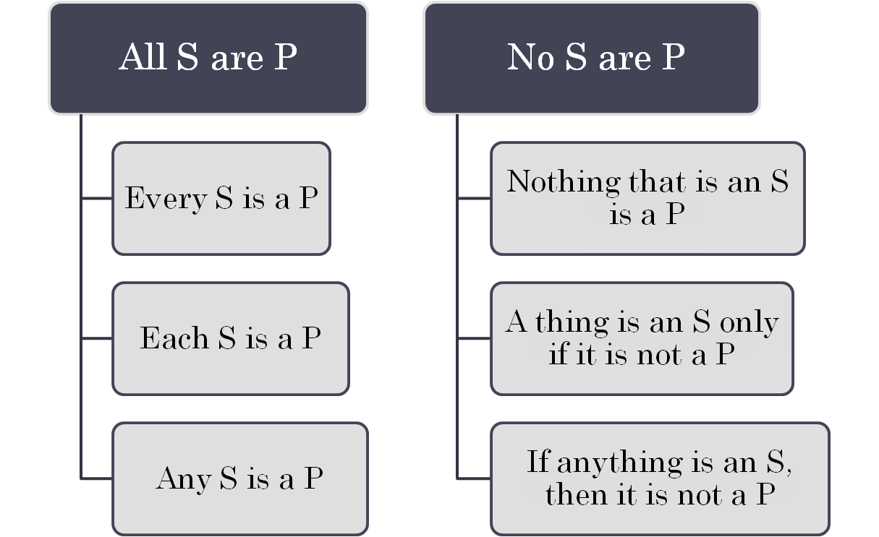
Each form (A,E,I,O) has Stylistic Variants
(see p 201)

Slide 16
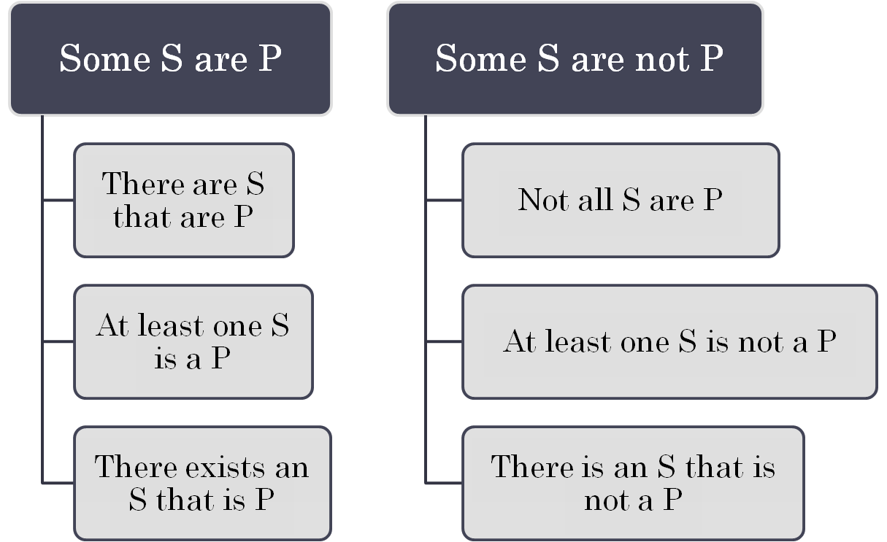

Slide 17
STANDARD CAT. STATEMENTS MUST BE IN ONE OF THESE FORMS
Name
Form
A
E
I
O
All S are P.
No S are P.
Some S are P.
Some S are not P.

