Slide 1
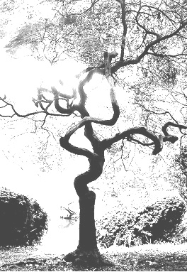
Today’s Lecture
Soundness
Famous Valid forms
Counter-examples
1/9/09

Slide 2
Validity (AGAIN)
A valid argument is one in which it is necessary that, if the premises are true, then the conclusion is true.
Notes:
Intentions only go so far.

Slide 3
soundness
If an argument is valid and the premises are true, then the argument is sound.
A sound argument is a valid argument in which all of the premises are true.
Valid + All True Premises = Sound

Slide 4
Examples of sound arguments
If Christian Bale played the Joker, then the actor who played the Joker is still alive.
It is false that the actor who played the Joker is still alive.
Therefore, Christian Bale did not play the Joker.
Either Obama won the democratic primary or Hilary Clinton won the democratic primary.
Hilary Clinton did not win the democratic primary.
Thus, Obama won the democratic primary

Slide 5
Valid? Sound?
Today is Thursday or the earth rests on the shell of a giant turtle.
The earth does not rest on the shell of a giant turtle.
Therefore, today is Thursday.
If Uma Thurman is a ninja, then she is stealthy.
Uma is not a ninja.
So, Uma is not stealthy.
If it rained last night, then my car is wet.
My car is wet.
Thus, it rained last night.

Slide 6
Valid? Sound?
Caesar sneezed on his wedding night.
Caesar sneezed on his wedding night only if someone sneezed on Caesar’s wedding night.
Thus, someone sneezed on Caesar’s wedding night.
Reptiles are robots.
Snow is green.
Therefore, 2 + 2 =4.
If possessing a human brain is required for having mentality, then my cat doesn’t have mentality.
But my cat does have mentality.
Thus, it is false that possessing a human brain is required for having mentality.

Slide 7

5 Famous Valid forms
Modus Ponens
Modus Tollens
Hypothetical Syllogism
Disjunctive Syllogism
Constructive Dilemma

Slide 8
Modus ponens
Compare these two arguments:
If the litmus paper turns green, then the solution contains acid.
The litmus paper turns green.
Thus, the solution contains acid.
If today is Friday, then tomorrow is Saturday.
Today is Friday.
Thus, tomorrow is Saturday.
They both have the following form:
If P then Q.
P.
Therefore Q.
where P and Q are variables that stand for complete statements.

Slide 9
Modus ponens
Compare these two arguments:
If the litmus paper turns green, then the solution contains acid.
The litmus paper turns green.
Thus, the solution contains acid.
If today is Friday, then tomorrow is Saturday.
Today is Friday.
Thus, tomorrow is Saturday.
They both have the following form:
If P then Q.
P.
Therefore Q.
where P and Q are variables that stand for complete statements.

Slide 10
Valid argument forms
There are an indefinite number of substitution instances of this general form.
A substitution instance of an argument form is an argument that results from uniformly replacing the variables in that form with statements.
A valid argument form is one in which every substitution instance is a valid argument.

Slide 11
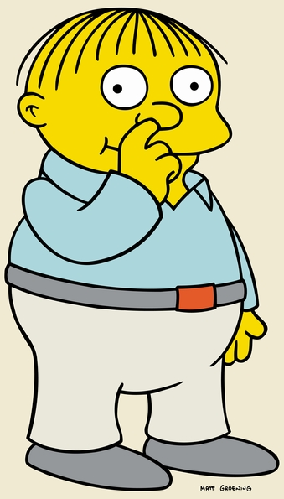
A sub. Instance of modus ponens
My cat’s breath smells.
If my cat’s breath smells, then my cat’s breath smells like cat food.
Therefore, my cat’s breath smells like cat food.

Slide 12
Modus tollens
Compare these two arguments:
If the litmus paper turns green, then the solution contains acid.
Its false that the solution contains acid.
Thus, the litmus paper does not turn green.
If today is Tuesday, then tomorrow is Wednesday.
Its false that tomorrow is Wednesday.
Thus, today is not Tuesday.
They both have the following form:
If P then not Q.
not Q.
Therefore not P.
where P and Q are variables that stand for complete statements.

Slide 13
Hypothetical syllogism
Compare these two arguments:
If grass is green, then something is green.
If something is green, then something is colored.
So, if grass is green, then something is colored.
If the universe is 15 billion years old, then the universe is a finite age.
If the universe is a finite age, then there was a first moment of time.
If the universe is 15 billion years old, then there was a first moment of time.
They both have the following form:
If P then Q.
If Q then R.
Thus, if P then R.
where P, Q, and R are variables that stand for complete statements.

Slide 14
Disjunctive syllogism
Compare these two arguments:
Either apples are rocks or lemons are blue.
Its false that apples are rocks.
So, lemons are blue.
Either we ride on Saturday or we hike on Sunday.
We do not hike on Sunday.
So we ride on Saturday.
They both have the following form:
Either P or Q.
Not Q.
So, P.
where P and Q are variables that stand for complete statements.

Slide 15
Constructive dilemma
Either your joke was cruel or it was very funny.
If your joke was cruel, then I ought to stop laughing.
If your joke was very funny, then I should shake your hand.
Thus, I ought to stop laughing or I should shake your hand.
Constructive dillemas have the following form:
Either P or Q.
If P then R.
If Q then S.
So, either R or S.
where P and Q are variables that stand for complete statements.

Slide 16
Constructive dilemma
Either your joke was cruel or your joke was very funny.
If your joke was cruel, then I ought to stop laughing.
If your joke was very funny, then I should shake your hand.
Thus, I ought to stop laughing or I should shake your hand.
Constructive dillemas have the following form:
Either P or Q.
If P then R.
If Q then S.
So, either R or S.
where P and Q are variables that stand for complete statements.

Slide 17
Famous logical forms summary
If P then Q.
P.
Therefore Q.
If P then not Q.
not Q.
Therefore not P.
If P then Q.
If Q then R.
Thus, if P then R.
Either P or Q.
not Q.
So, P.
Either P or Q.
If P then R.
If Q then S.
So, either R or S.
Modus Ponens
Modus Tollens
Hypothetical Syllogism
Disjunctive Syllogism
Constructive Dilemma

Slide 18
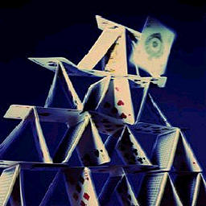
Counterexamples:
Statements

Slide 19
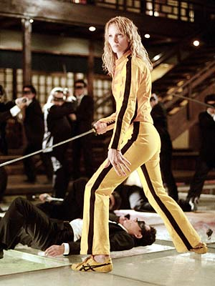
An example
If Uma Thurman is a ninja, then she is stealthy.
It’s not true that Uma is a ninja.
So, Uma is not stealthy.
First, extract the logical form. Use capital letters to stand for statements, leaving the logical connectives as they are:
If P, then Q.
Not P.
Therefore, not Q.

Slide 20
If P, then Q.
Not P.
Therefore, not Q.
Next, come up with statements to plug in uniformly for P and Q so that
the premises are true
the conclusion is false
Here is one instance:
For P let’s plug in “We live in San Francisco.”
For Q let’s plug in “We live in California.”
If we live in SF, then we live in CA. (TRUE)
It’s false that we live in SF. (TRUE)
Therefore, it’s false that we live in CA. (FALSE)

