Slide 1
Peter Singer
Utilitarian Morality and World Poverty

Slide 2
Peter Singer
Peter Singer: Australian philosopher who in 1972 published “Famine, Affluence and Morality.”
Very controversial article regarding the moral duties of those living in affluent countries vis-à-vis third world populations.
Now at Princeton. When he moved here in 1999 there was an uproar from conservatives regarding his appointment. The NY Times invited Singer to explain his views in an article. That is the article we will discuss.

Slide 3
Famine and Affluence
Singer’s position in “Famine, Affluence and Morality.”
“It is indefensible for people to spend money on luxuries while the less fortunate are starving. If we can prevent something bad from happening without sacrificing anything of comparable moral importance, then we ought to do so!”
How is this a Utilitarian Argument?
The argument seems far too demanding, yet it is very hard to refute—hence the controversy.

Slide 4
Dora
Article begins with the story of Dora in the Brazilian film “Central Station.”
Dora delivers a homeless child to a pre-arranged address for $1000, being told the child will be adopted by wealthy foreigners.
Dora buys a big luxury, a TV, with her $1000.
As is pointed out by the neighbor, Dora probably knew the adoption story was too good to be true, and that instead the boy is in for a dark fate (chopped up for organs…sound familiar?)

Slide 5
Dora
Question: “What is the difference between Dora and an American who already has a TV, but upgrades to a bigger better one knowing all the while that the money could be donated to an organization that would use it to save the lives of kids in need?”
What kind of argument is this?

Slide 6
Dora
Are there relevant disanalogies?
Dora herself is face to face with the child in need.
She directs him to his fate, instead of standing by while it overtakes him.
But are these disanalogies enough to blunt the force of the argument?
On the first count, should proximity really matter all that much? A life in need is a life in need.
On the second count, do we believe in the difference between killing and letting die?

Slide 7
Dora
Whatever side one comes down on regarding the moral differences between Dora and us (yes it is you and me Singer is talking about) Singer argues we must at least accept that:
“There is a troubling incongruity in being so quick to condemn Dora for taking the child to the organ peddlers while, at the same time, not regarding the American consumer’s behavior as raising a serious moral issue!”

Slide 8


Bob’s Bugatti (By Peter Unger)
Bob has not been able to insure the Bugatti. But so far that has worked out OK. He still enjoys driving the car, and it still retains and is indeed gaining in value, and Bob is close to retirement.
Bob has invested his life-savings into a Bugatti.
Notes:
Perhaps Bob is a sports car enthusiast, ($200,000)
Perhaps like me he prefers the stylish antique Bugattis. (2-3 Million)

Slide 9
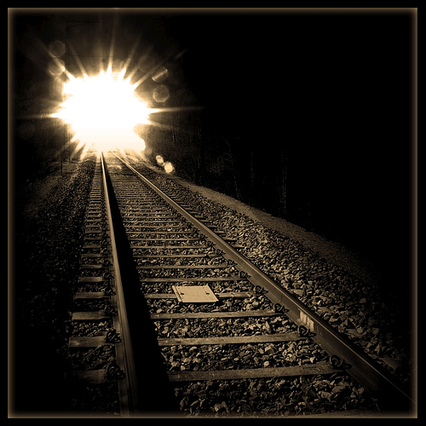
Bob’s Bugatti
One day, Bob parks the Bugatti near the end of a railway siding and goes for a walk up the track.
Coming to the railway switch for the siding he is strolling along Bob looks up the train tracks and sees a runaway train bearing down on him.

Slide 10

Looking down the main track to where the train is headed Bob sees the small figure of a child very likely to be killed by the runaway train.

Slide 11
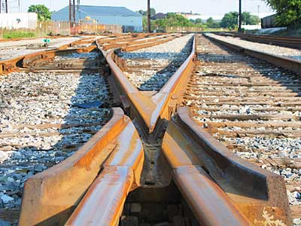
He can’t stop the train and the child is too far away to warn!
But Bob realizes he has a choice! In front of him is the rail switch!
Notes:
So who is going to die?
The Bugatti? AKA Bob’s life savings? (Click)
Or the Child?? (Click)
Click

Slide 12
Notes:
So which will it be???? Quickly!! The train is getting closer!
Hands for the Bugatti gets it!!!
Hands for the Kid gets it!!!!

Slide 13
Bob’s Bugatti
If Bob doesn’t flip the switch and allows the child to die it seems he would be deeply morally condemned. To choose possessions over a child’s life in this case seems deeply callous and viciously negligent.
Notes:
Imagine if Bob doesn’t flip the switch and allows the child to die.
Even if we thought the two relevant disanalogies in the Dora case were sufficient to isolate our conclusions from that case from the morality of affluent consumers the Bugatti case is removes these two objections to Singer’s conclusions.
Singer focuses on childrens lives, not because they are more important than adult lives, but because it simplifies things. Arguments like “well the thrid world brought their poverty on themselves” because obviously the children didn’t.

Slide 14
Bob’s Bugatti
Why the Bugatti case is even more damning than the Dora case.
Bob is not face to face with the child in some morally relevant sense. The child is a figure on the horizon.
Bob does not himself usher the child to its bitter fate, instead, like affluent consumers, he stands by and watches as a fate independent of Bob overtakes the child. (or perhaps he turns away and doesn’t watch, like we do to the 3rd world)

Slide 15
Bob’s Bugatti
If we consider what must be at stake before we allow Bob not to throw the switch, things get farcical quickly…
What if Bob has a toe stuck on the tracks so that it will get cut off if he throws the switch and saves the child?
Or an arm?
Or a leg?
The point is that we the sacrifice must be very great before we allow Bob to ignore the switch and the child.
Consider this in light of the fact that the price of the Bugatti ($1-2 mill. for the antique) could save 5,000-10,000 children, not just one!

Slide 16
Bob’s Bugatti
The analog in the affluent consumer’s case to Bob’s sacrifice is the amount that the consumer must give away relative to her income.
Ideally “An American household with an income of $50,000 spends about $30,000 annually on necessities […] Therefore, for a household bringing in $50,000 a year, donations to help the world’s poor should be as close as possible to $20,000.”
Much higher percentage for higher incomes.
In reality Singer “wouldn’t go out of [his] way to chastise [those] who give, say, 10 percent of their income.”

Slide 17
Objections to Singer
Three Responses to Singer:
The ‘Fair Share’ Argument
The “Government’s Job” Argument
The Psychological Argument

Slide 18
Objections to Singer
1. The “Fair Share” Argument:
“But if everyone gave, not just me, I wouldn’t have to give nearly this much. So you are asking me to do more than my fair share!”
Unfortunately the decision we face, much like Bob’s might very well require us to do more than our “fair share.” We face these decisions in the real world, not an ideal world where everyone does their fair share.
“While the idea that no one need do more than his or her fair share is a powerful one, should it prevail if we know that others are not doing their fair share and that children will die preventable deaths unless we do more than our fair share? That would be taking fairness too far.”

Slide 19
Objections to Singer
2. The “Government’s Job” Argument:
“The government ought to increase its overseas aid allocations, since that would spread the burden more equitably across all taxpayers.”
Again, the decision we face is framed by the realities of this world, in which “the United States government is not going to meet even the very modest target, recommended by the United Nations, of 0.7% of gross national product; at the moment it lags far below that, at 0.09%, not even half of Japan’s 0.22% or a tenth of Denmark’s 0.97%. Thus we know that the money we can give beyond that theoretical ‘fair share’ is still going to save lives that would otherwise be lost.”

Slide 20
Objections to Singer
The Psychological argument:
“evolutionary psychologists will tell us that human nature just isn’t sufficiently altruistic to make it plausible that many people will sacrifice so much for strangers.”
First point: This is a descriptive claim, has no normative implications by itself, so it cannot be claimed that just because people won’t actually do it, it is not something morality requires of us.
“We need to face this dilemma head-on […] not because it is good to wallow in guilt but because knowing where we should be going is the first step toward heading in that direction.”

Slide 21
Final Thought
“When Bob first grasped the dilemma that faced him as he stood by that railway switch, he must have thought how extraordinarily unlucky he was to be placed in a situation in which he must choose between the life of an innocent child and the sacrifice of most of his savings. Be he was not unlucky at all. We are all in that situation.”

