Slide 1
Utilitarianism, Part I

Slide 2
The Utilitarianism of J. S. Mill
Mill’s theory is composed of three primary claims:
(a) Act Consequentialism;
(b) A theory of value;
(c) A “first” or “general” principle of morality which combines the first two.
Notes:
We will discuss these in detail individually in turn.

Slide 3
(a) Act Consequentialism
Act Consequentialism (AC): The moral status of an action X is determined solely by the consequences of action X.
Neither the nature of the act itself, nor the motives of the actor play any role in the morality of the act.

Slide 4
(b) Mill’s Theory of Value
In general, utilitarian theories, including Mill’s, take some version of Hedonism as their theory of value.
Hedonism: the view that the one and only intrinsic good is pleasure/happiness.
“[T]he theory of [value] on which [Mill’s] theory of morality is grounded [is] that pleasure and freedom from pain are the only things desirable as ends; and that all desirable things…are desirable either for pleasure inherent in themselves or as means to the promotion of pleasure and the prevention of pain.” Mill, UT P. 55.

Slide 5
(b) Mill’s Theory of Value
Whose pleasure matters?
Two possible answers:
Egoistic Hedonism (EH): Only one’s own pleasure is valuable. Another’s pleasure is valuable only insofar as it gives one pleasure when the other has pleasure (so, another’s pleasure is only instrumentally valuable).
Altruistic Hedonism (AH): Everyone’s pleasure is equally valuable.

Slide 6
(b) Mill’s Theory of Value
Mill’s Altruistic Hedonism:
“[T]he happiness which forms the utilitarian standard of what is right in conduct is not the agent’s own happiness but that of all concerned. As between his own happiness and that of others, utilitarianism requires him to be as strictly impartial as a disinterested and benevolent spectator.”

Slide 7
(c) Mill’s Moral First Principle: The Principle of Utility
According to Mill, the development of morality is, in a sense, a “practical art.”Morality tells us how we should make things be.
“A test of right and wrong must be the means, one would think, of ascertaining what is right or wrong.”
Morality must provide us with rules of action.

Slide 8
The Principle of Utility (PU) (a.k.a. ‘the Greatest Happiness Principle)
Mill’s fundamental rule of action, his first moral principle, is the Principle of Utility.
“Actions are right in proportion as they tend to promote happiness [or pleasure]; wrong as they tend to produce the reverse of happiness.”
Another, simpler version of the PU is the following: The morally correct action is the one that maximizes aggregate happiness.

Slide 9
The Principle of Utility (PU) (a.k.a. ‘the Greatest Happiness Principle)
Question: what if, at a given time, more than one action satisfies this condition?
A more precise statement of (PU): At any given time you should perform one of the actions then available to you just in case it will lead to at least as much aggregate happiness as would any other action available to you at that time.

Slide 10
The Breakdown of Utilitarianism, Again
For our purposes, we will take Mill’s (initial) UT theory to consist of a conjunction of the following three claims:
(i) Act Consequentialism
(evaluate actions by their consequences only)
(ii) Altruistic Hedonism
(Happiness is the fundamental good, everyone’s happiness counts equally)
(iii) The Principle of Utility.
(The moral action is the one that maximizes aggregate happiness.)

Slide 11
Objections to Mill’s UT.
Two objections to altruistic hedonism:
The Swine Objection:
Nozick’s pleasure machine.
Notes:
When it comes to objections each part of AU can be objected to independently. And it is important to remember that in successfully undermining any one of the parts of AU we are undermining the entire theory, because it consists of a conjunction of all of its parts.
We will address 1 first. Why worthy of swine? What is the implication here? What kind of pleasures is this objector referring to?

Slide 12
Objections to UT’s Hedonism
The Swine Objection:
To suppose that life has no higher end than pleasure is a doctrine worthy only of swine.
If base pleasures like food, drink and sex are the ultimate moral good, then man is like the basest swine.

Slide 13
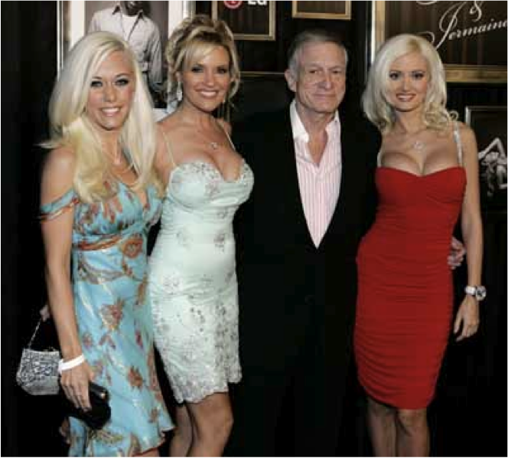
The Swine Objection
If this is true, this seems to set this fellow:

Slide 14
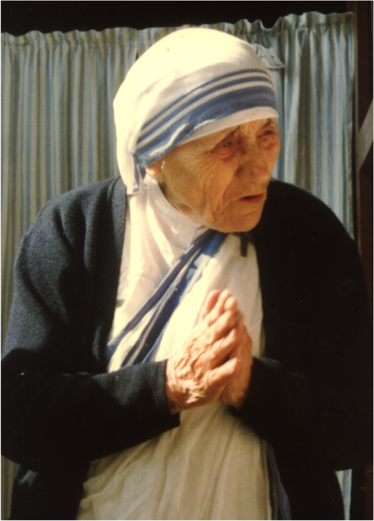
The Swine Objection
On a moral equivalent with this young lady:

Slide 15
The Swine Objection
Both have provided a great many pleasures (or at least privations of pain) to a great number of people. But there seems a clear sense in which we want to set Mother Teresa’s work on a higher moral plane.

Slide 16
Response to the Swine Objection
It is not the hedonist, but the objector who represents human nature in a degrading light, for such an objection only holds if human beings are capable of no pleasure except those of which swine are capable.
Mill develops a view of pleasure and pain according to which some pleasures/pains count more than others.

Slide 17
Response to the Swine Objection
“It is quite compatible with the principle of utility to recognize the fact that some kinds of pleasure are more desirable and more valuable than others. It would be absurd what while, in estimating all other things, quality is considered as well as quantity, [but] the estimation of pleasures should be supposed to depend on quantity alone.”
But how do we determine which pleasures are “of a higher quality”?

Slide 18
Response to the Swine Objection Ranking Pleasures
Mill suggests the following test:
“Of two pleasures, if there be one to which all or almost all who have experience of both give a decided preference, irrespective of any feeling of moral obligation to prefer it, […] and would not resign it for any quantity of the other pleasure their nature is capable of, we are justified in ascribing to the preferred enjoyment a superiority in quality so far outweighing quantity as to render it, in comparison, of small account.” P. 56.

Slide 19
Response to the Swine Objection Ranking Pleasures
Mill is confident that the pleasures which will emerge from this test as higher in value will be the “noble” pleasures, the pleasures one derives from the use of one’s “higher faculties.”
Question:
Is Mill’s prediction about the outcome of such a test correct?

