Slide 1

Subspace System Identification for Solar Power Prediction
A Data-Driven Approach to Model Physical Systems
Guided By:- Prof. Sujay Kadam
Assistant Professor
Dhirubhai Ambani University
Presented By:-Riya Dave (202318011)
Simran Dalvi (202318042)
M.Sc. Data Science
2023-2025

Slide 2
Why Subspace System Identification (SSID)?
Traditional machine learning models often ignore the system’s underlying dynamics.
SSID captures the temporal structure and noise characteristics of data.
It is robust for physical systems like solar power generation, where measurements are noisy and system behavior evolves over time.
There's a growing need for interpretable and reliable modeling approaches in domains like energy forecasting.
SSID is especially suitable for Linear Time-Invariant (LTI) systems, common in many engineering applications.

Slide 3
What Did We Aim to Achieve?
Apply SSID to model a solar PV system using real-world data.
Evaluate its effectiveness against ML models (SVR, MLP).
Understand the theoretical grounding and practical utility of SSID in data science.

Slide 4
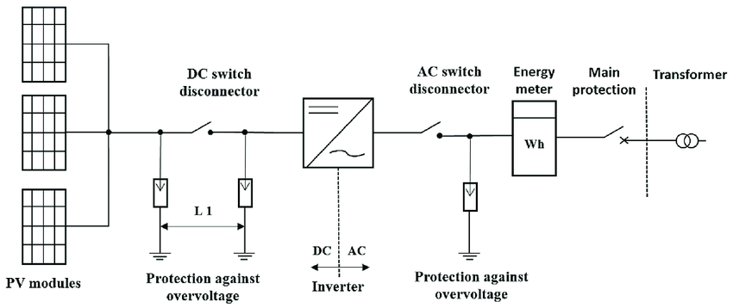
The Block Model of Solar Pannel

Slide 5
Theoretical Foundations of SSID

Slide 6
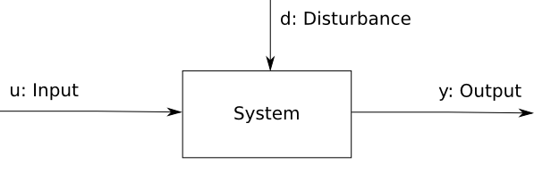
Subspace System Identification
SSID is a family of algorithms used to model dynamical systems directly from input-output data.
It identifies system matrices for state-space models without needing explicit system equations.
Uses linear algebra techniques like Singular Value Decomposition (SVD) to extract the system’s behavior from data.
Ideal for noisy real-world environments like solar energy systems where the internal process isn’t fully known.

Slide 7
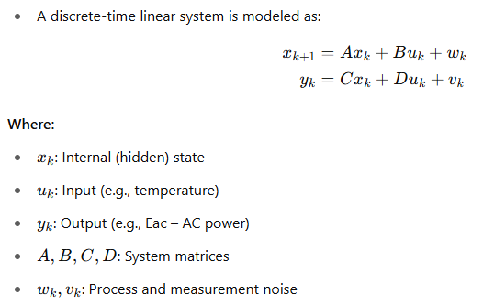
State-Space Models – The Mathematical Backbone

Slide 8
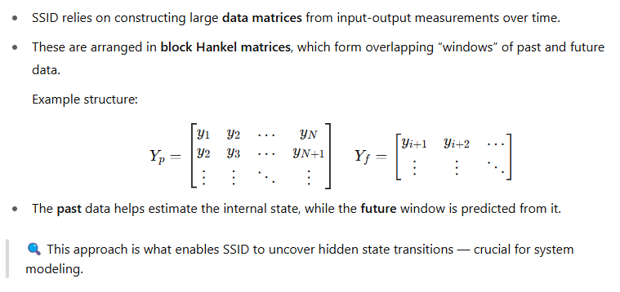
The Sliding Window Concept in SSID

Slide 9
Solar Power Application

Slide 10


Slide 11
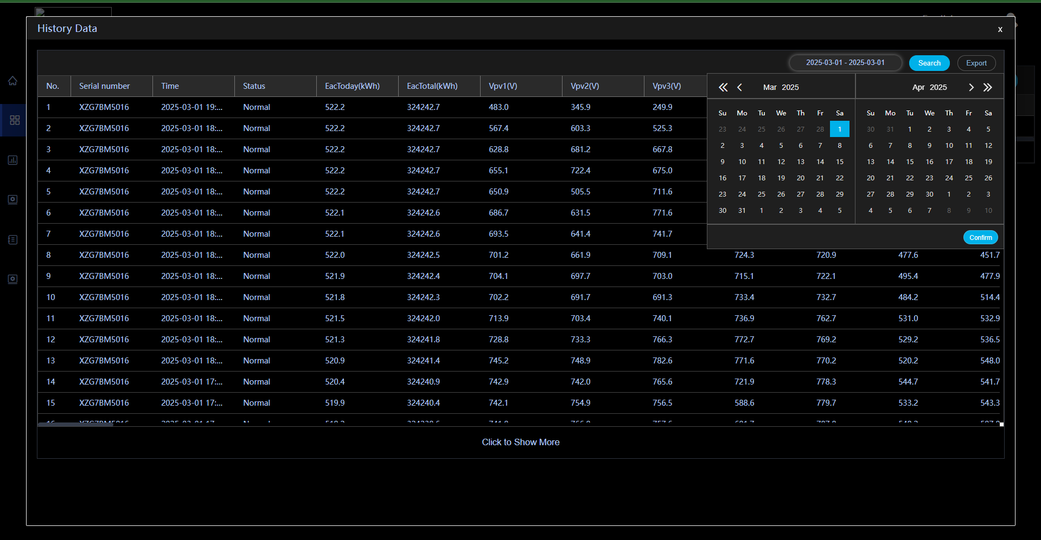

Slide 12
Data Preprocessing and Exploration

Slide 13
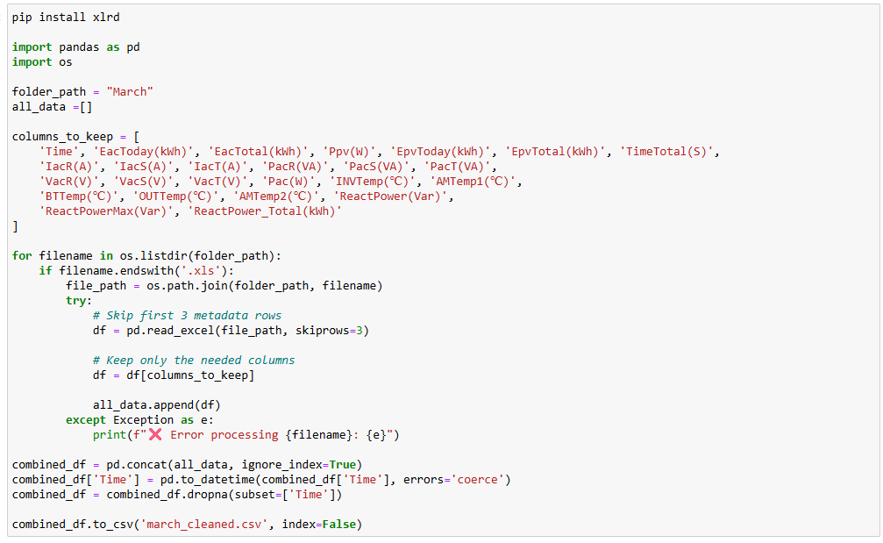

Slide 14
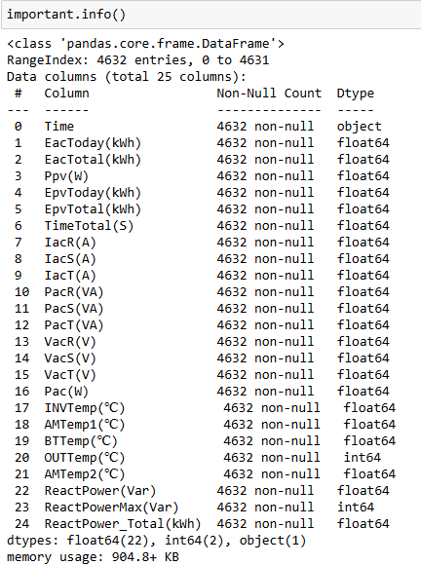



Data
The original dataset contained approximately 222 columns and 4,632 rows.
After removing columns with null values, we retained 71 relevant columns for analysis.
For model prediction, we selected 24 key features based on their significance to the project objectives.

Slide 15
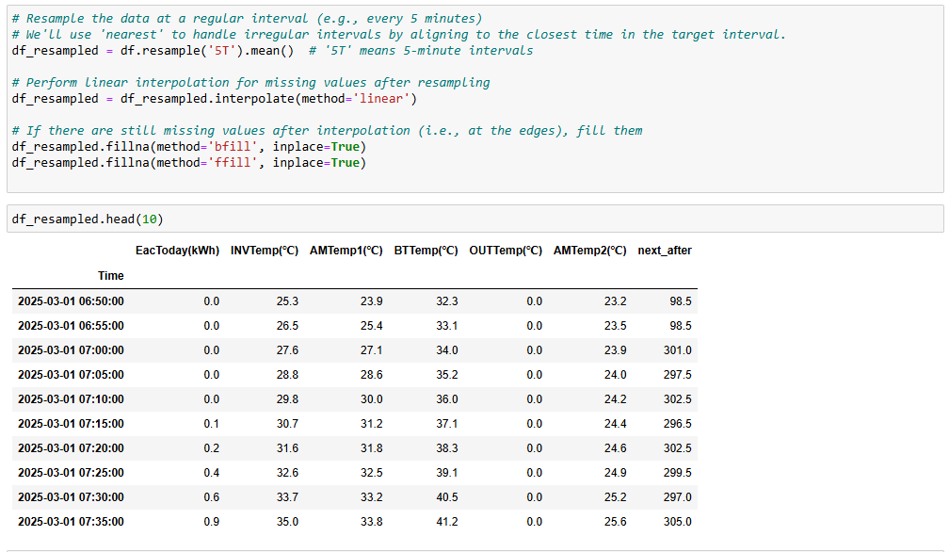

Slide 16
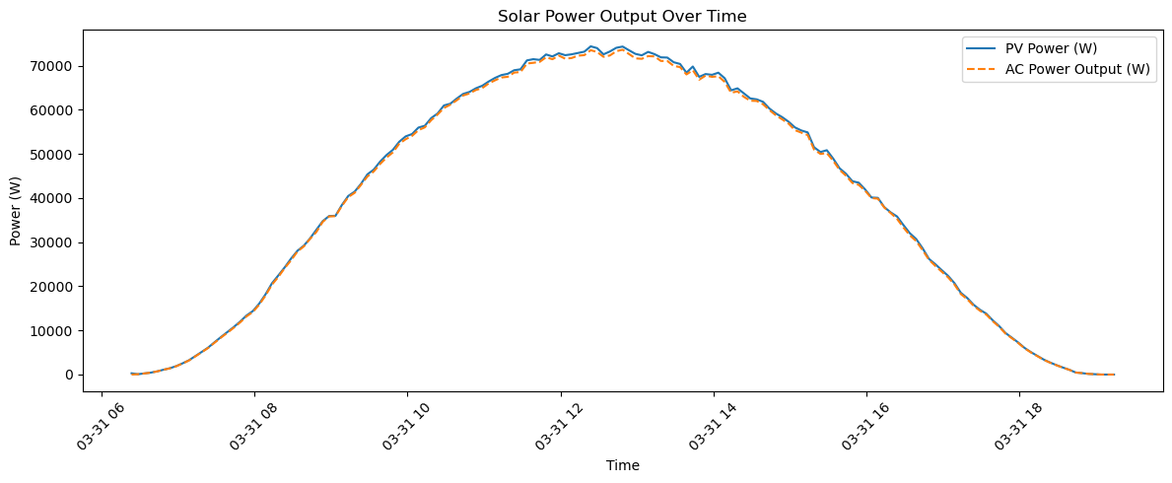
Photovoltaic(PV) and alternating current (AC) power output over a single day. The bell-shaped curve indicates a typical solar generation pattern, with peak power during midday.

Slide 17
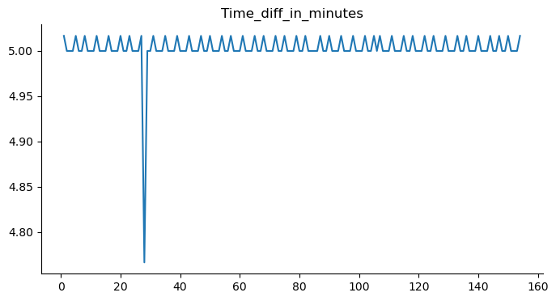
The difference in timestamps of each reading throughout a random day.

Slide 18
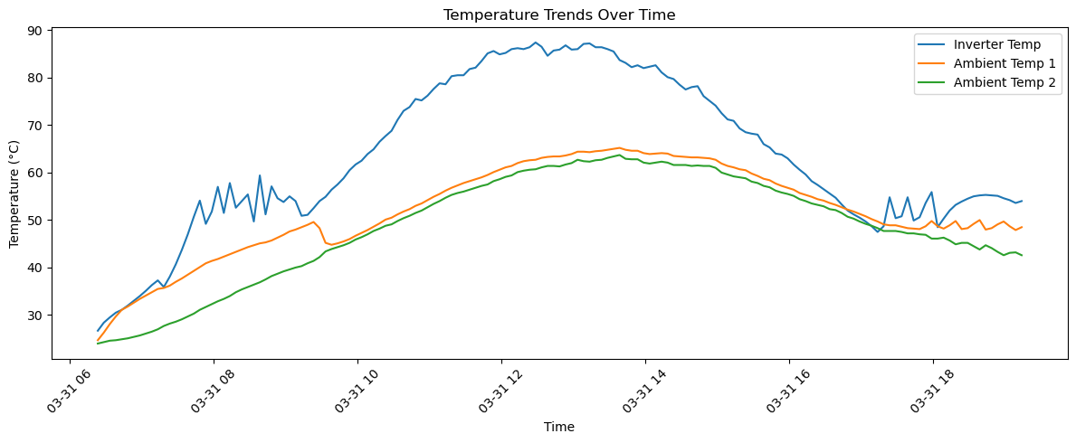
Different Temperature trends over time through out a month

Slide 19
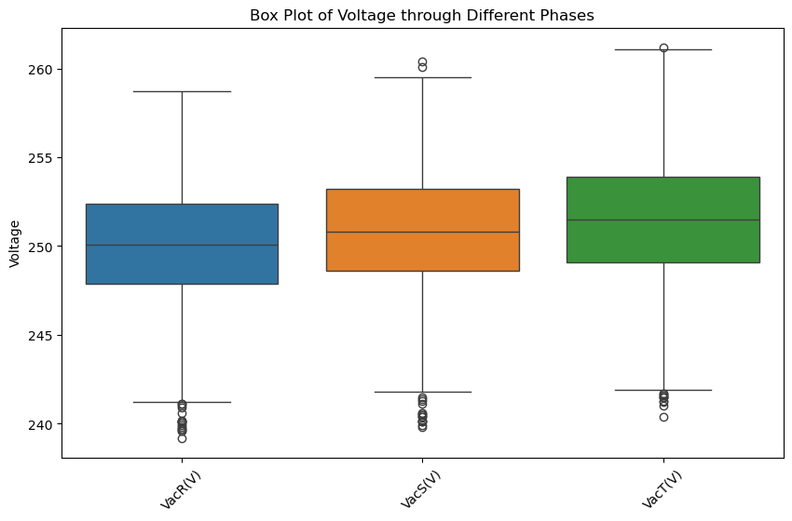
Voltage distributions over the month for all three phases. Outliers suggest occasional fluctuations or sensor errors.

Slide 20
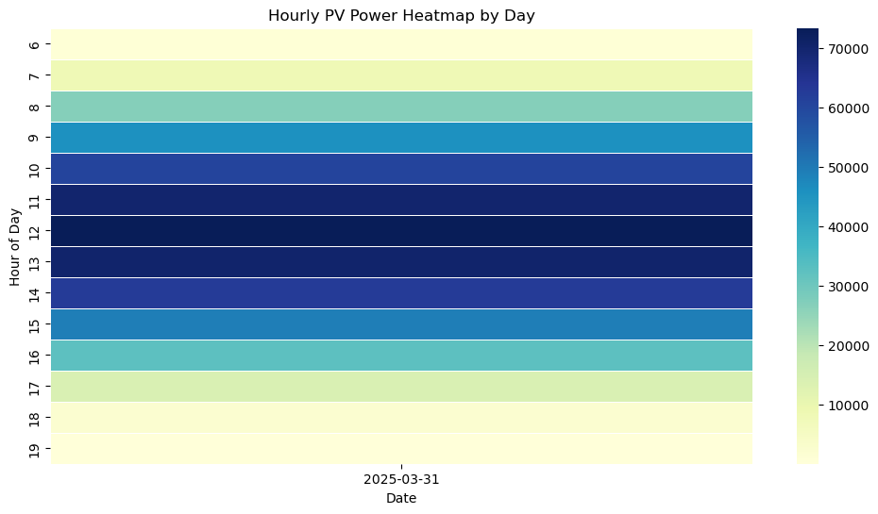
A heatmap captures hourly PV output for a single day, confirming midday dominance.

Slide 21
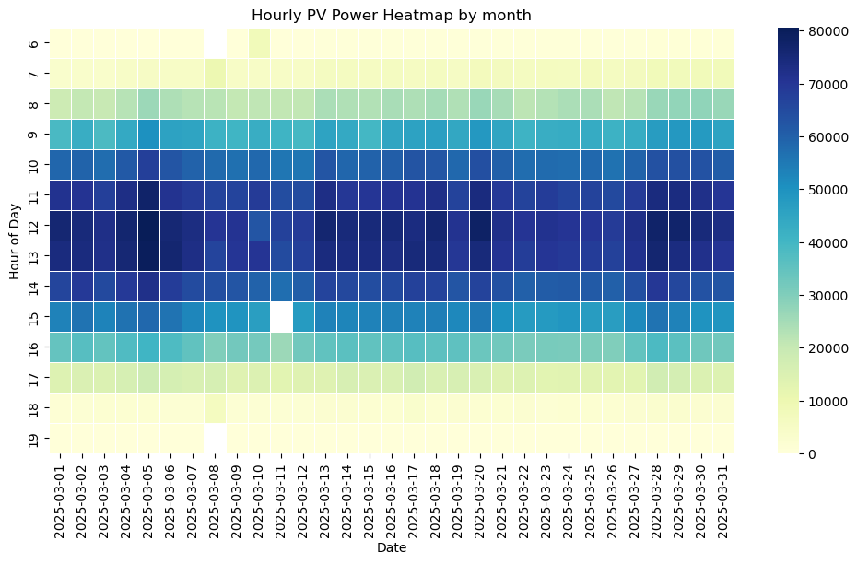
The heatmap to cover March 2025. Daily cycles of power output are consistent, with variations likely due to weather.

Slide 22
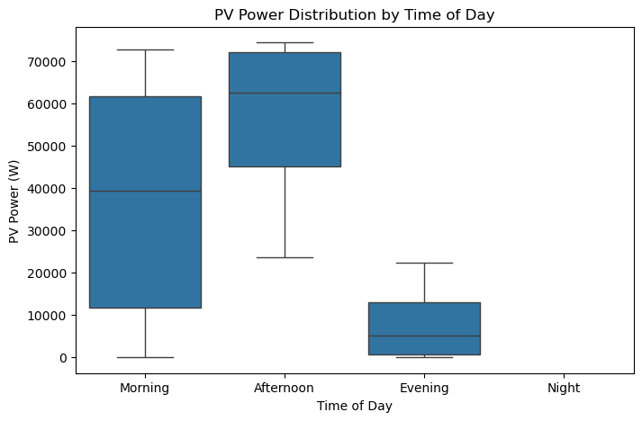
A boxplot categorizing PV power generation into time-of-day segments. Power generation is highest in the afternoon

Slide 23
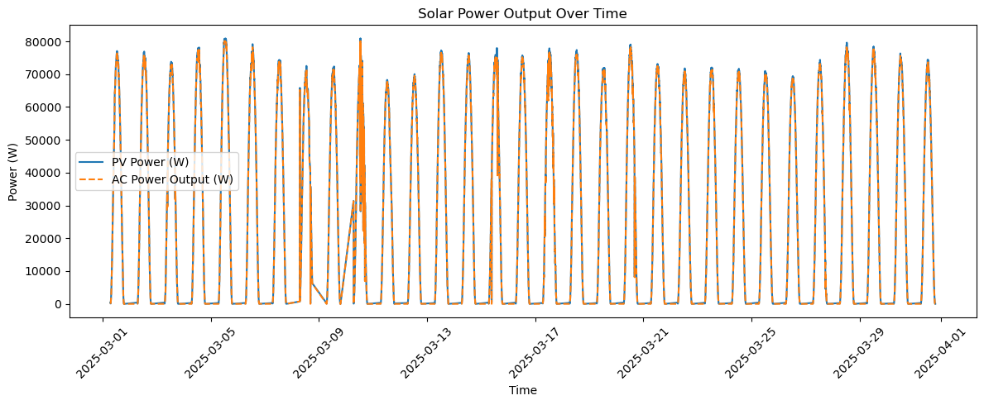

Slide 24
Machine Learning

Slide 25
Input Features:
Temperature Sensors: INVTemp (℃), AMTemp1 (℃), BTTemp (℃), OUTTemp (℃), AMTemp2 (℃)
Output Variable:
EacToday (kWh) – Daily AC energy output
Data Split:
80% training, 20% testing
Models Used:
Linear Regression
Decision Tree Regressor
Random Forest Regressor
XGBoost Regressor
Support Vector Regressor (SVR)
K-Nearest Neighbors (KNN)
Neural Network (MLPRegressor, max_iter=1000)

Slide 26
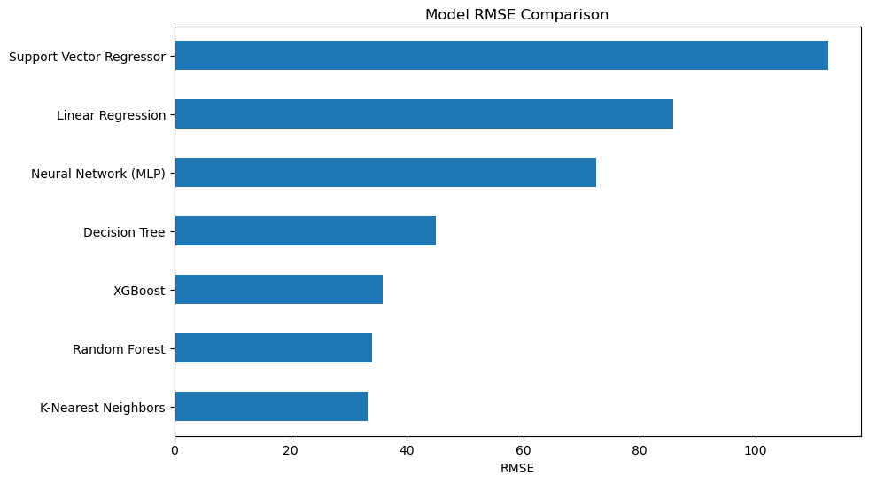

Slide 27
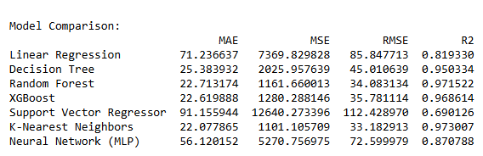

Slide 28
Subspace Identification Method

Slide 29
SISO System Identification using SSID
Configuration:
Input (u): Temperature (simulated periodic signal: ~15°C to 65°C)
Output (y): Eac (electricity output) — delayed, amplified, and smoothed (~up to 600)
Modeling Tool:
MATLAB Subspace Identification Toolkit
Algorithm: N4SID (Numerical Subspace State Space System ID)
Key Observations:
System shows clear lag and amplification — indicating dynamic behavior with memory (e.g., thermal inertia).
Despite structured input-output response, identified system was unstable.
Interpretation:
Unstable output suggests issues with either model order, noise, or system excitation settings.
Confirms that the solar system has latent dynamics, suitable for SSID, but needs careful tuning.

Slide 30
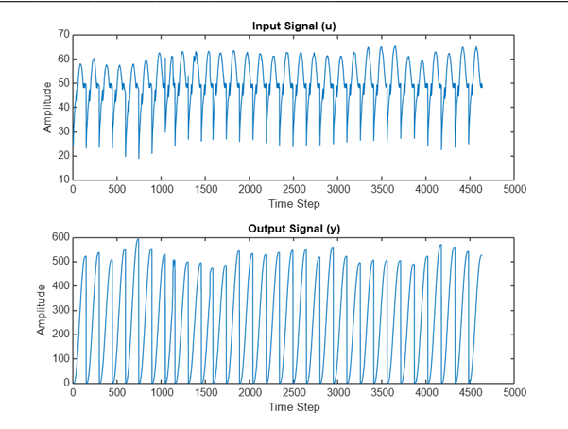

Slide 31
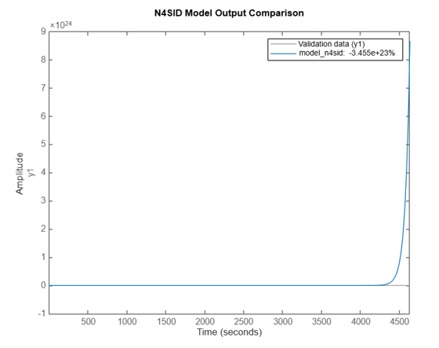
The model fit is extremely poor — we get a value of minus 3.455 times 10 to the power of 23 percent, which clearly indicates the model is unstable and not reliable.
This usually happens when the model contains unstable poles, or when the model order is not appropriate. It could also be due to unprocessed data or a mismatch in sampling time.

Slide 32
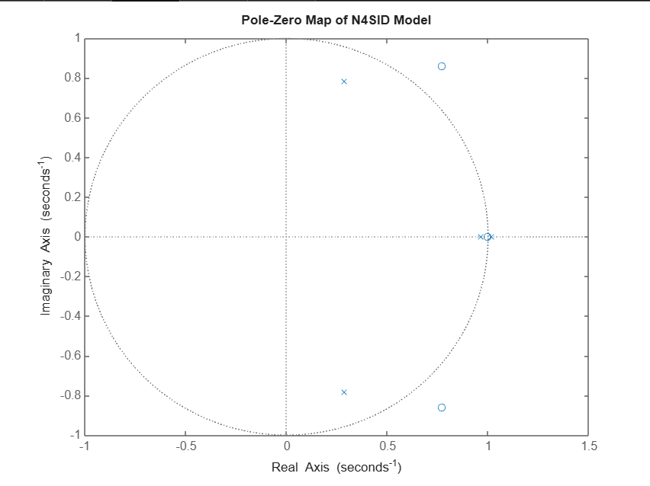
One or more poles lie on or very close to the unit circle (some possibly outside).
This indicates the system is unstable.
Therefore, the current model is not reliable for control or prediction

Slide 33
MISO System Identification using SSID
Configuration:
Inputs (u): Multiple temperature sensors (INVTemp, AMTemp1, BTTemp, AMTemp2)
Output (y): EacToday (kWh)
Preprocessing:
Applied Standard Scaling to normalize input and output signals
Implementation Setup:
Executed SSID via MATLAB Engine for Python
Identification method: N4SID
Results:
Successfully identified a stable system
Achieved an R² score of 0.94 → Demonstrated strong predictive capability and accurate dynamic modeling
Conclusion:
SSID effectively captures system dynamics in MISO configuration
Significantly outperformed traditional machine learning models

Slide 34
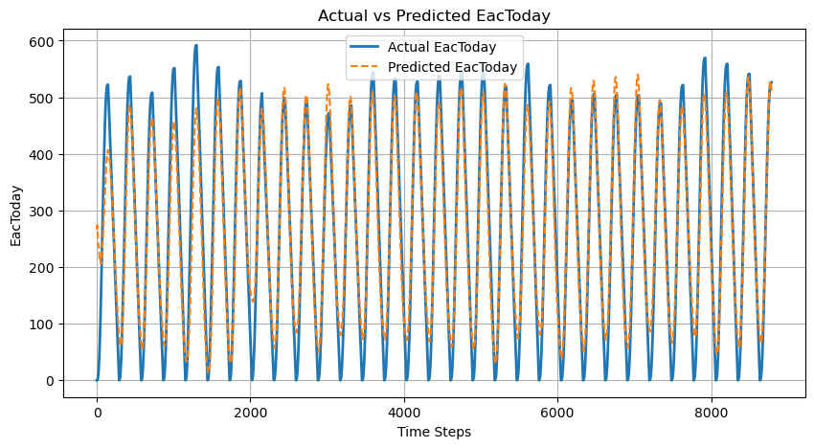

Slide 35
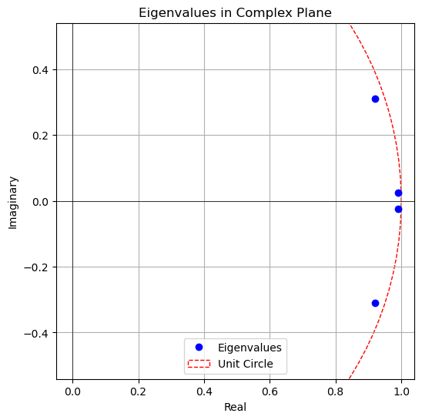
All values lie inside the unit circle for an order 4 model.
Providing the result that it is a stable system.

Slide 36
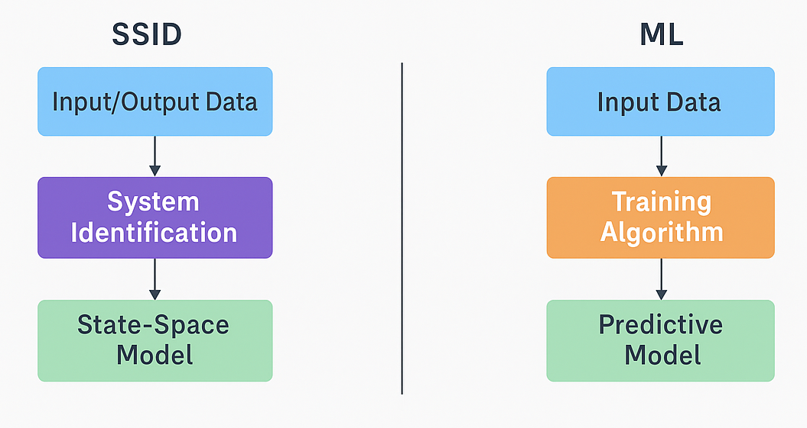
What We Learned
SSID is a valuable modeling tool for physical systems.
Outperforms black-box models in noisy environments.
Bridges control theory with data science practice.

Slide 37
What’s Next?
Automate data extraction from solar portals.
Test on other environmental variables (humidity, irradiance).
Extend SSID to multivariable systems (MIMO).

Slide 38
Key References
Van Overschee & De Moor (1996). Subspace Identification.
MATLAB N4SID documentation.
https://in.mathworks.com/help/ident/ref/n4sid.html
Project Report
https://github.com/Simran-Dalvi/solar
Growatt Data.
https://server.growatt.com/login

Slide 39
Questions?

Slide 40
Thank You!

