Slide 1





ONLINE BANKING SYSTEM
PRESENTED BY
BATCH 1, TEAM-3.
October 3, 2023.

Slide 2
OVERVIEW
Aims to provide users with a convenient and secure platform for managing their finances remotely.
This presentation will delve into the key aspects of the system, highlighting its features and functionalities.
Developed using Spring Boot and offers a range of features such as User Registration And Login, Account Details, Fund Transfers, Account Statements and much more.

Slide 3
KEY FEATURES
User Registration And Login
Seamless registration process.
Robust authentication and authorization mechanisms.
User-friendly login interface.
Account Overview
Users can view their account details at a glance.
Check account balances, recent transactions, and more.
User-friendly dashboard.

Slide 4
KEY FEATURES (cont.)
Fund Transfer
Enables users to transfer funds between accounts.
Secure and efficient transfer options.
Supports various transaction types.
Account Statement Generation
Generates detailed account statements.
Provides a comprehensive overview of transactions.
Easy access to historical data.

Slide 5
KEY FEATURES (cont.)
Deposit And Withdrawal Functionalities
Users can deposit and withdraw funds easily.
Multiple payment options are supported.
Streamlined processes.
Transaction History Tracking
Keeps a record of all transactions.
It helps users track their financial activity.
Enhances transparency.

Slide 6
KEY FEATURES (cont.)
Admin Functionality
Admin Dashboard equipped with the functionality of Verifying Customer KYC, activating/deactivating User Account(s).
Withdraw or Deposit Money in the Account(s).

Slide 7







TECHNOLOGY STACK

Slide 8
GOALS AND OBJECTIVES
GROWTH
Scalability: Ensures that the system's architecture handles increased user load, ensuring that it remains responsive and reliable even as user numbers grow.
Feature Expansion: Continuously enhancing the system's functionalities based on user feedback and emerging market trends, offering new services that cater to evolving financial needs.

Slide 9
GOALS AND OBJECTIVES
CUSTOMER SATISFACTION
Ensure a high level of customer satisfaction by prioritizing user experience and addressing their needs effectively

Slide 10
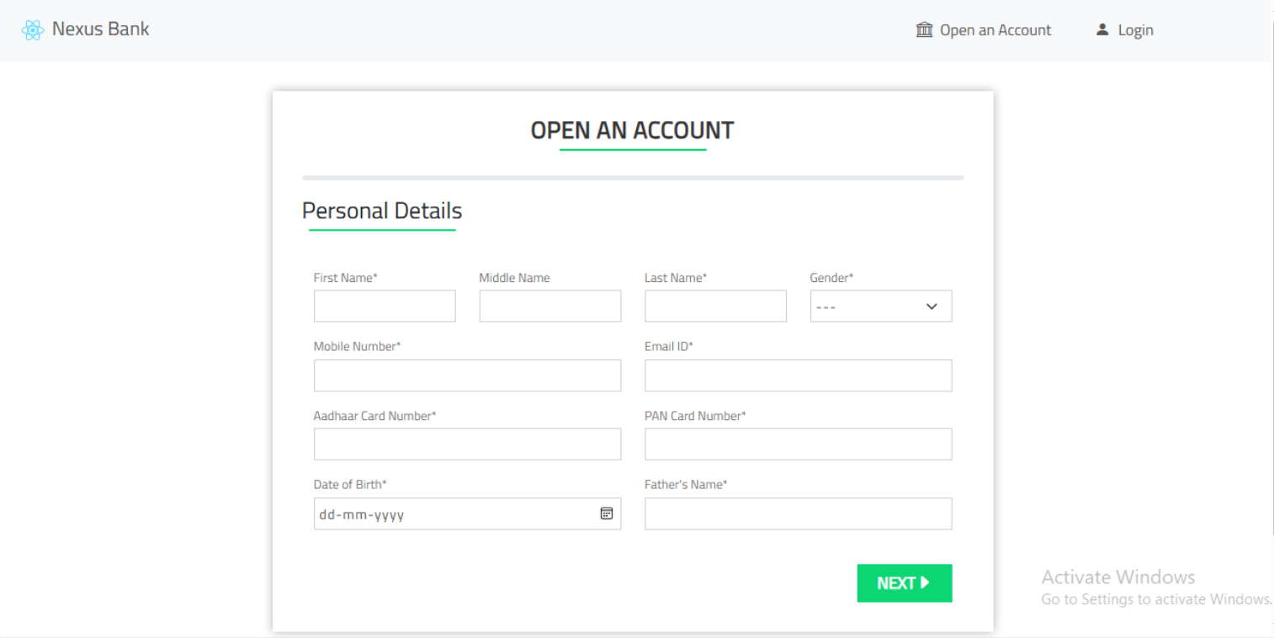


REST API
REpresentational State Transfer
GET/POST/PUT/DELETE
HTTP REQUEST
JSON/XML/HTML
HTTP RESPONSE
GET
PUT
CLIENT
SERVER
POST
DELETE
REST API

Slide 11
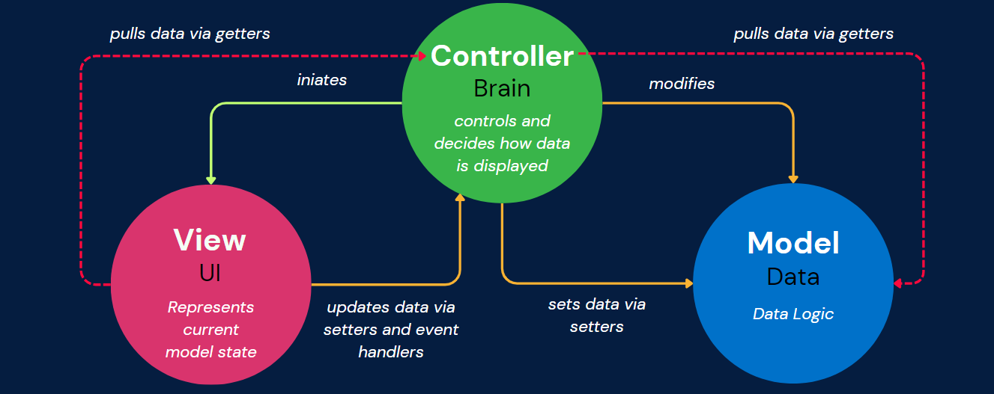
MVC
Model · View · Controller

Slide 12
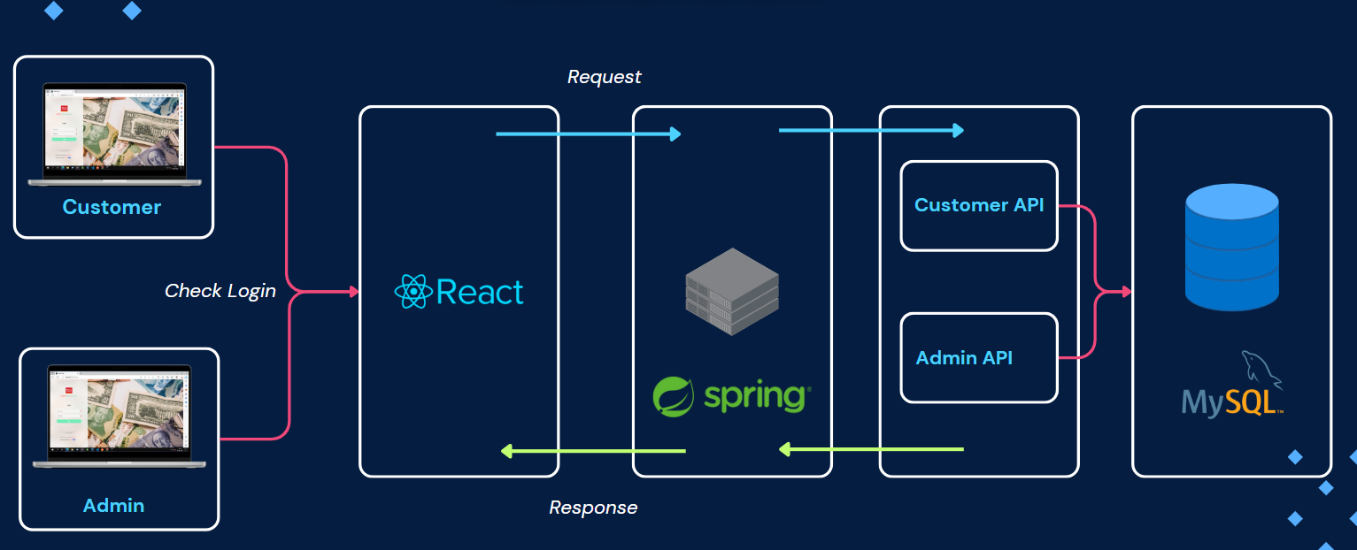
ARCHITECTURE DIAGRAM

Slide 13
OPEN AN ACCOUNT

Slide 14
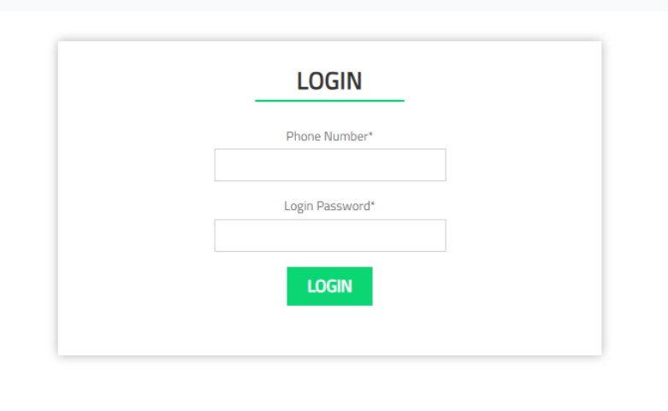
LOGIN/SIGNUP

Slide 15
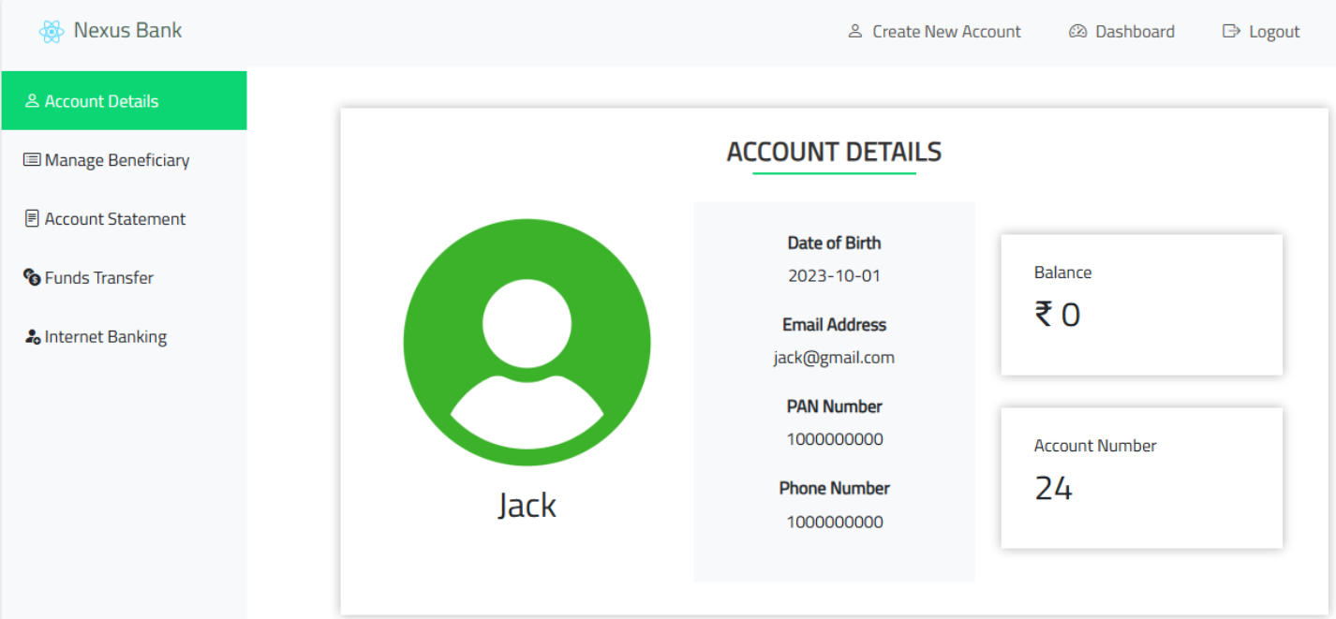
CUSTOMER DASHBOARD

Slide 16
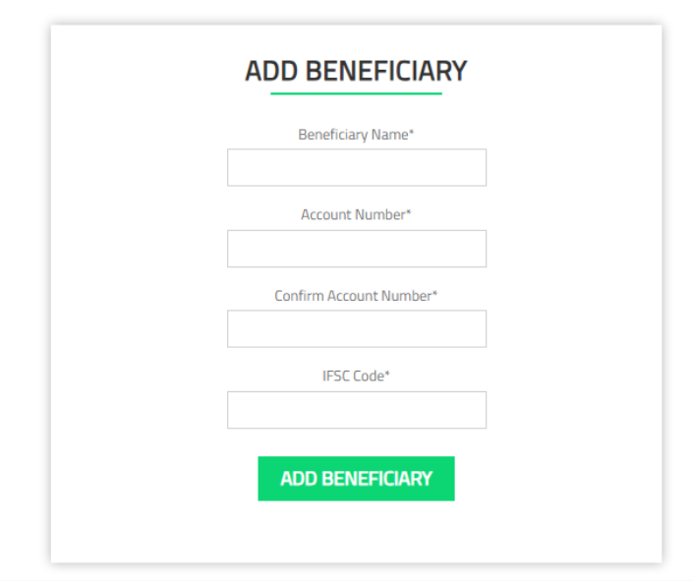
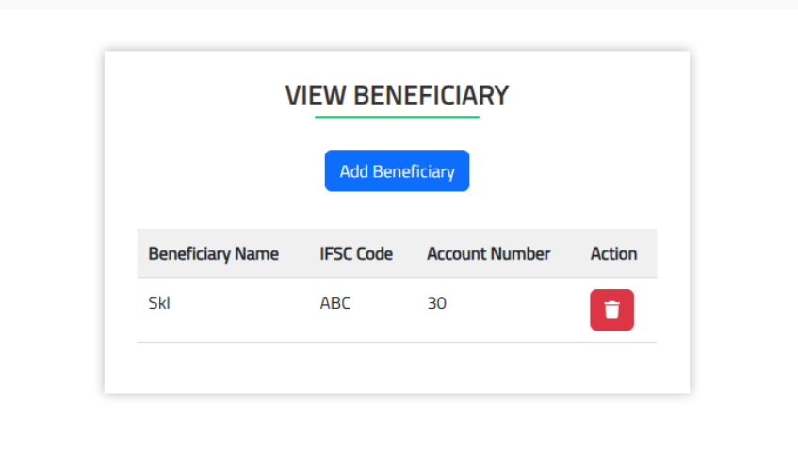
BENEFICIARY DETAILS

Slide 17
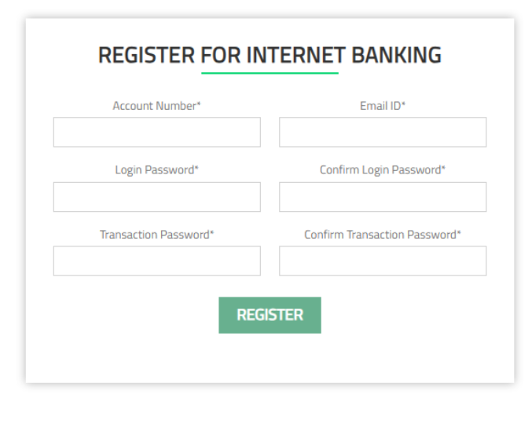
REGISTER FOR INTERNET BANKING

Slide 18
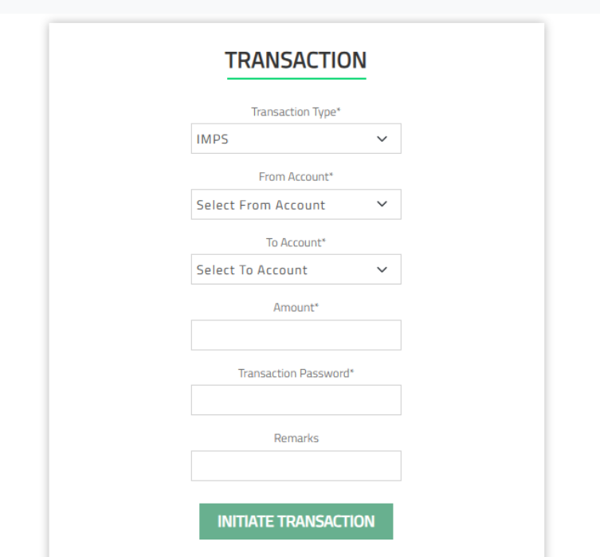
FUNDS TRANSFER

Slide 19
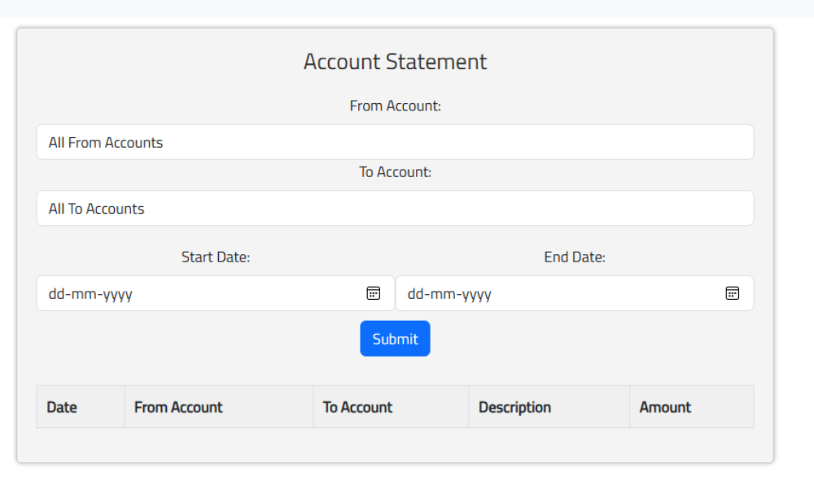
ACCOUNT STATEMENT

Slide 20
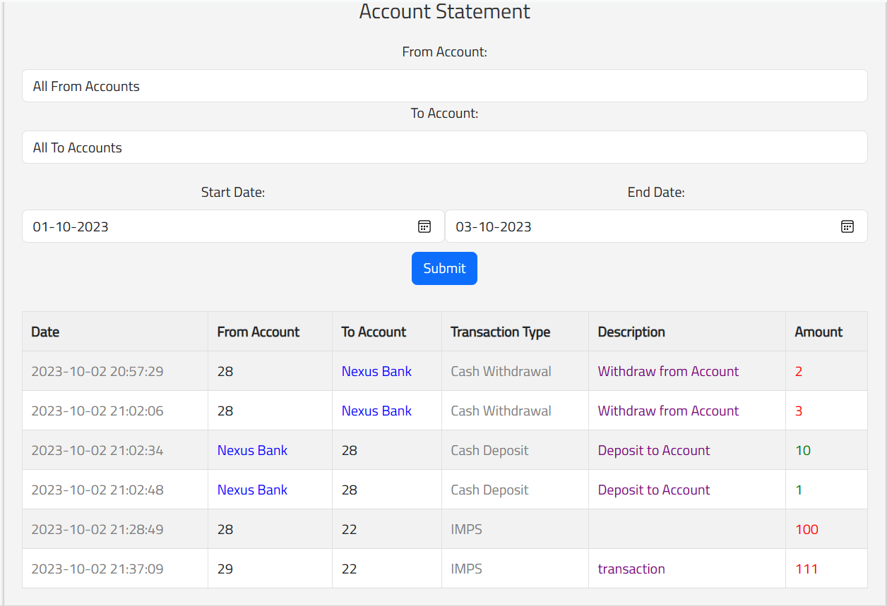
ACCOUNT STATEMENT

Slide 21
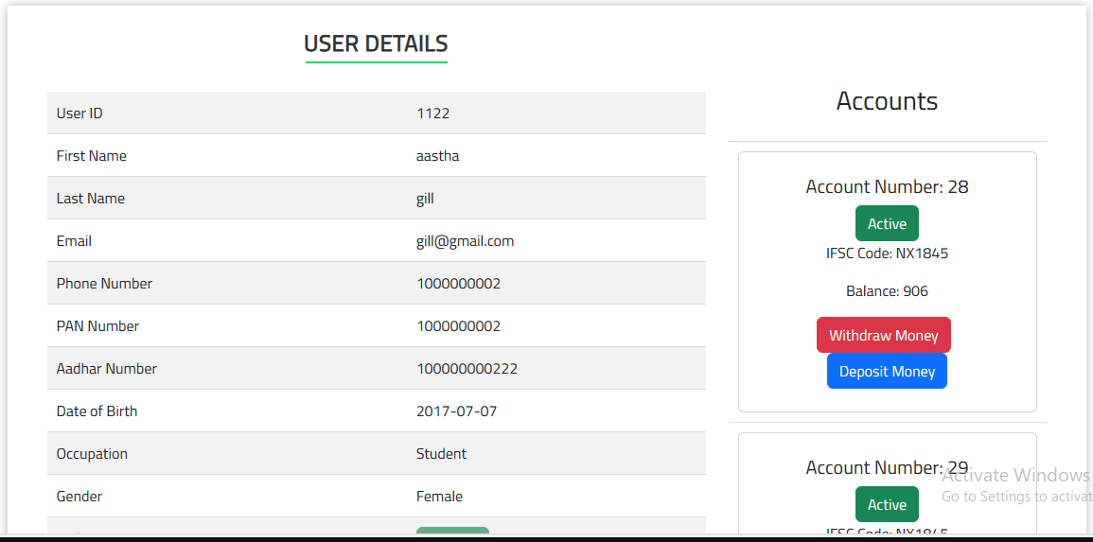
ADMIN DASHBOARD

Slide 22
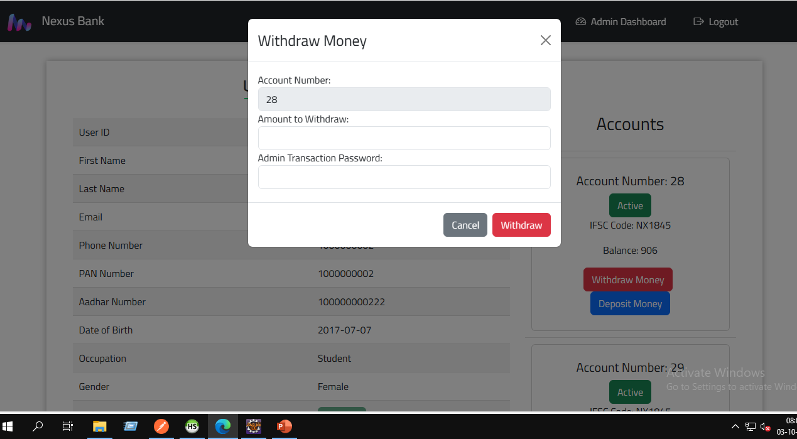
ADMIN DASHBOARD (cont.)

Slide 23

API ENDPOINTS
POST
/createUser
/loginUser
/register
/loginUser
/findUser/{userid}
/users/{userId}/verify
PUT
Customer
GET
/users/{uid}
/users/phone/{ph}
/users

Slide 24

API ENDPOINTS (cont.)
POST
/createAnotherNewAccount/{userId}
/addNewAccount/{userId}
/account/{accountId}/active
/account/{accountId}/withdraw
/account/{accountId}/deposit
PUT
/accounts/{accountNo}
/accounts/user/{uid}
/transactions/accounts/user/{uid}
/user/{uid}/accounts
/active/{userId}
Account
GET

Slide 25

API ENDPOINTS (cont.)
POST
/beneficiaries/{userId}
GET
/beneficiaries
/beneficiaries/{uid}
Beneficiary
DELETE
/beneficiaries/{bid}

Slide 26

API ENDPOINTS (cont.)
POST
/transactions/{fromId}/{toId}
/{transactionId}
/transactions/accounts/{accountNo}
/transactions/all
PUT
GET
/transactions/{transactionId}
/transactions/accounts/{accountNo}
/transactions/all
Transaction
DELETE
/{transactionId}

Slide 27
CHALLENGES
Learning Curve
Integration Complexity
Debugging in case of failures
Testing and QA
Version Control
Error Handling
Continuous Learning
Time Management

Slide 28
FUTURE ENHANCEMENTS
Enhanced Security Measures, such as Multi Factor Authentication for login and transactions.
Advanced Fraud Detection
Blockchain And Cryptocurrency Support
Personal Finance Management Tools
Mobile Wallet Integration
Enhanced Notifications
Automated Bill Payments
Savings And Investment Features
Continuous Testing And Quality Assurance

