Slide 1
Airline Customer classification
The dataset of airline company give the insight about customer satisfaction level .
AIM : To predict whether future customers will be satisfied based on various parameters including in the dataset.the columns likely cover a range of factors that influence customer satisfaction, such as flight punctuality , service quality and so . By analysing this dataset , airlines can gain valuable insight into the factors that contribute to customer satisfaction and tailor their services accordingly to enhance the overall customer experience.
Classification Problem
Alogrithm Use: K-nearest Neighbour , Random forest classification ,
Decision Tress classification , Logistic regression , XGBoost and also done Hyperparameter tuning .
SUBMITTED BY : SIMRAN (PGA 43)

Slide 2
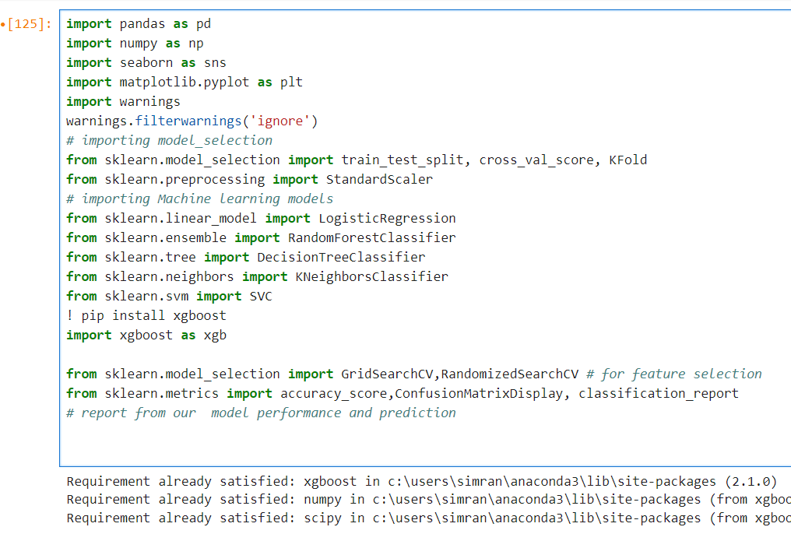
Importing important libraries.

Slide 3
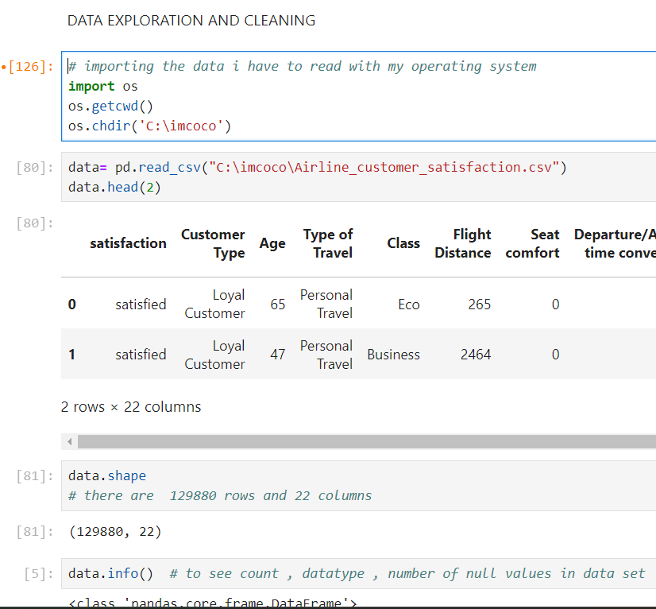
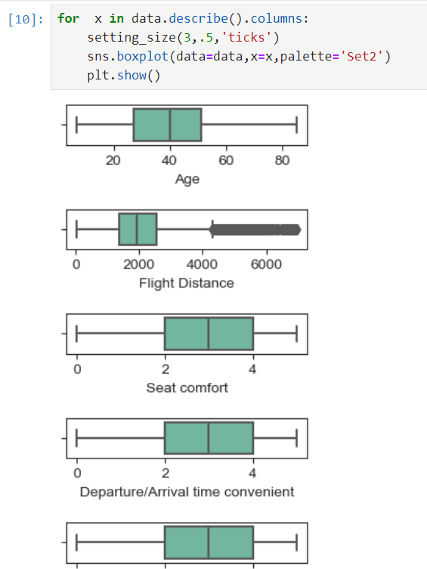
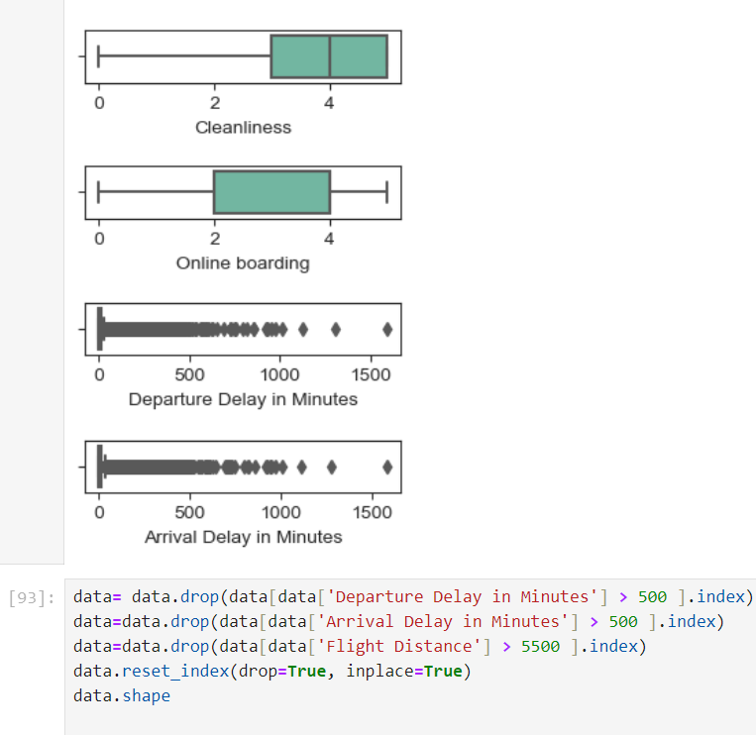
Importing Data Data exploring and cleaning 1.Shape () 2.Info () 3.Describe() 4. Object and numeric data 5.Missing Value Treatment 6.Outlier treatment

Slide 4
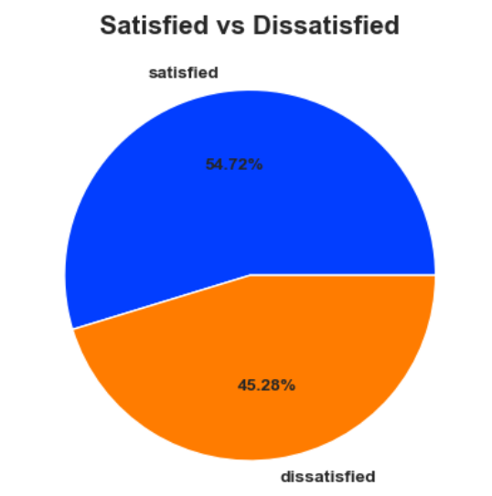
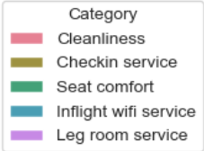
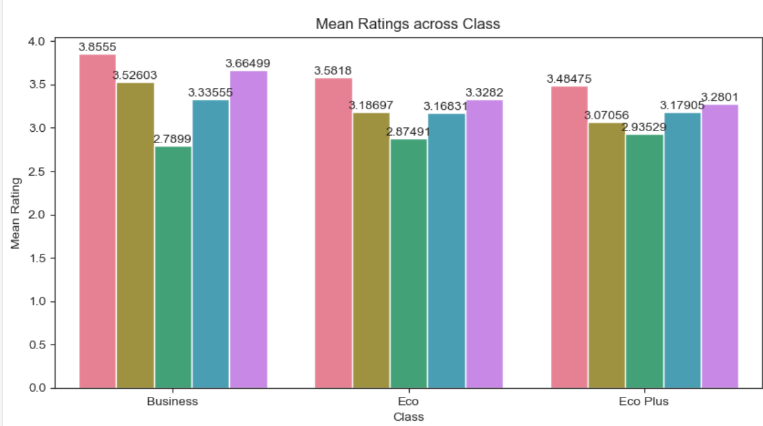
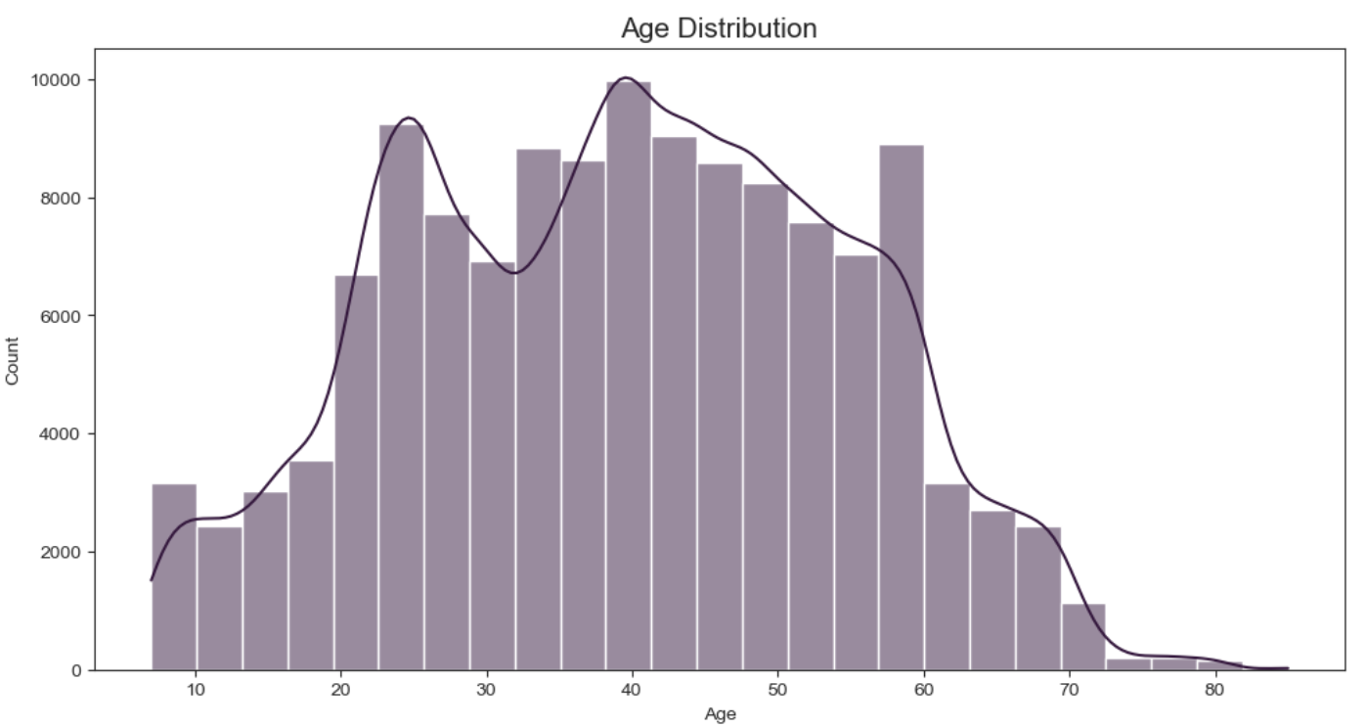
Exploratory Data Analysis: using Matplotlib and seaborn
Share of satisfied vs dissatisfied customer
Average rating across category
Age distribution of customers

Slide 5
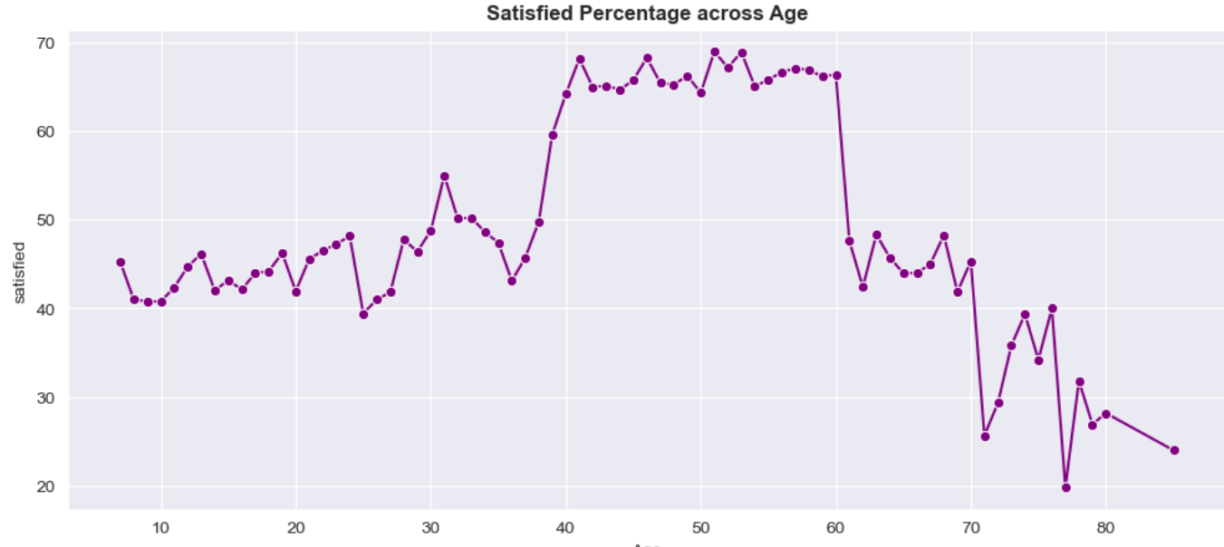
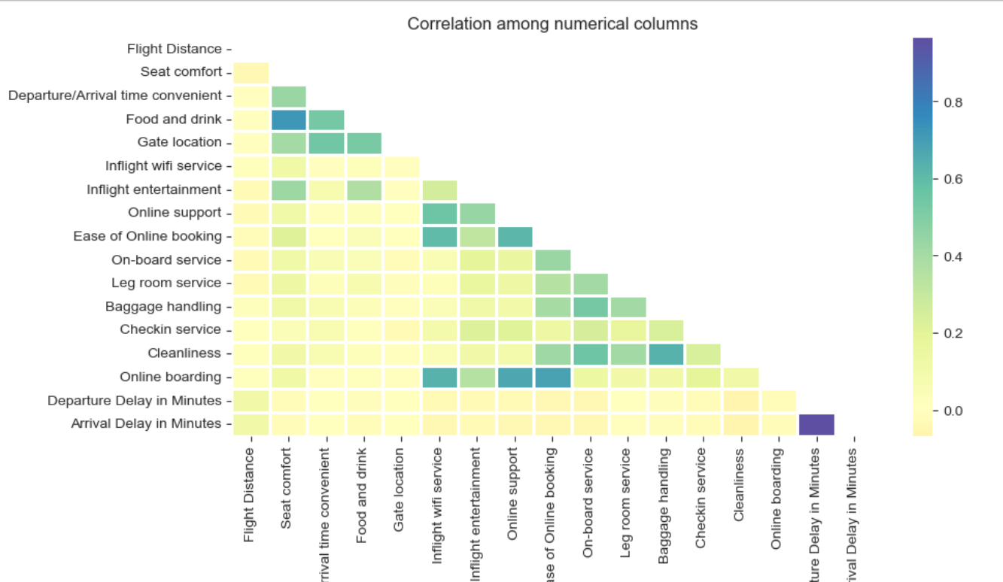
Visualization using Matplotlib and Seaborn .
Correlation across variable
Satisfied percentage across ages of customers

Slide 6
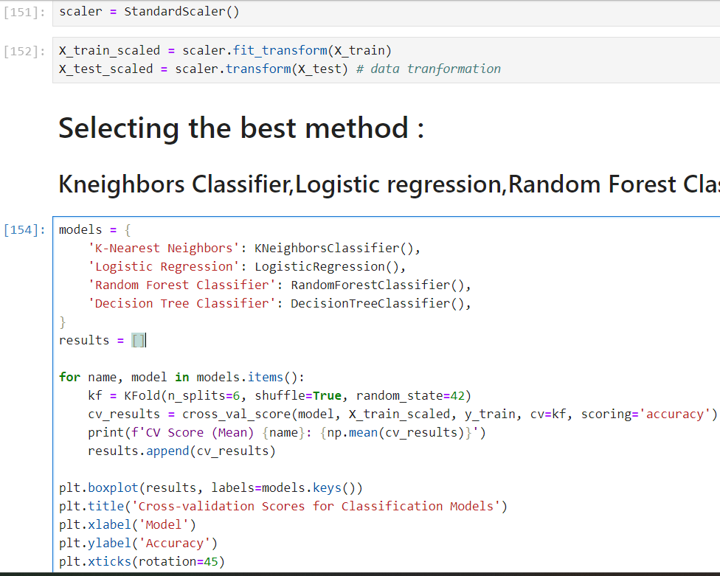
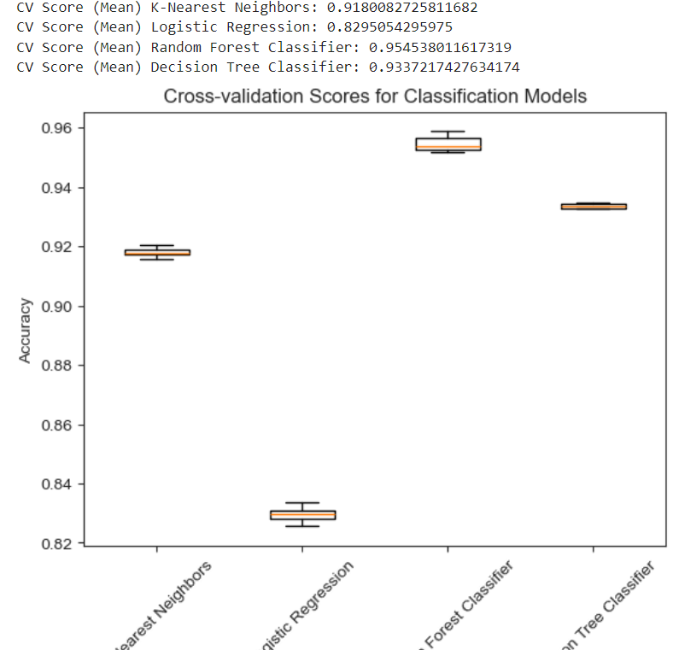
After EDA , data encoding and split the data into train and test , standard scaler .
From the model test we get the highest accuracy with RandomForestClassifier.

Slide 7
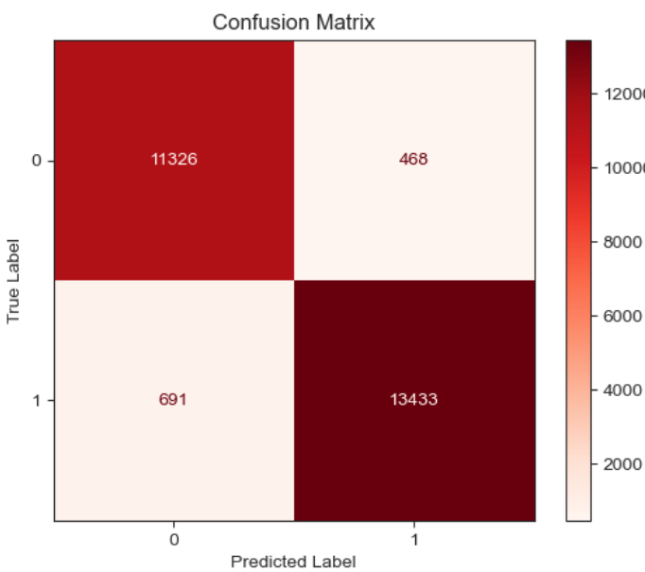
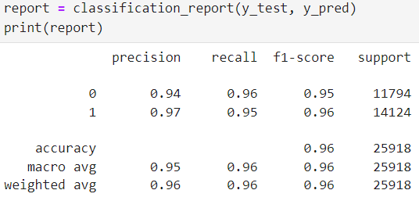
Random forest classifier give 96% accuracy . So after this we will check with the best parameter for that we perform hyperparameter tuning .
Random Forest Classifier

Slide 8
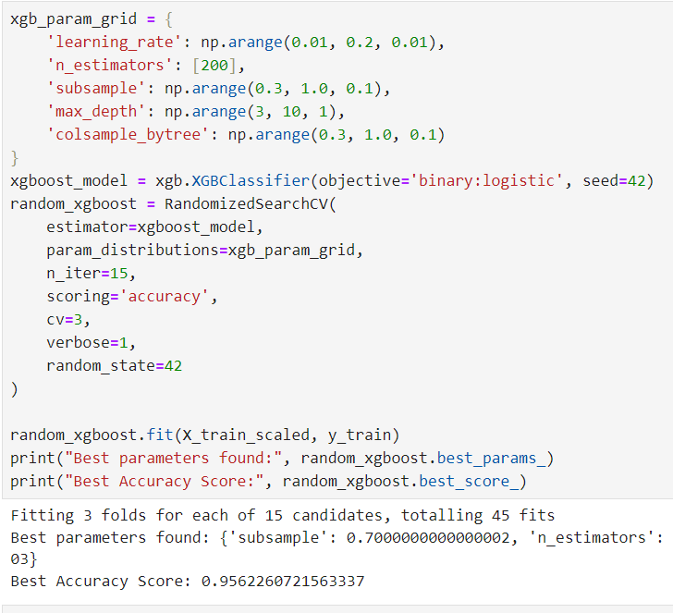
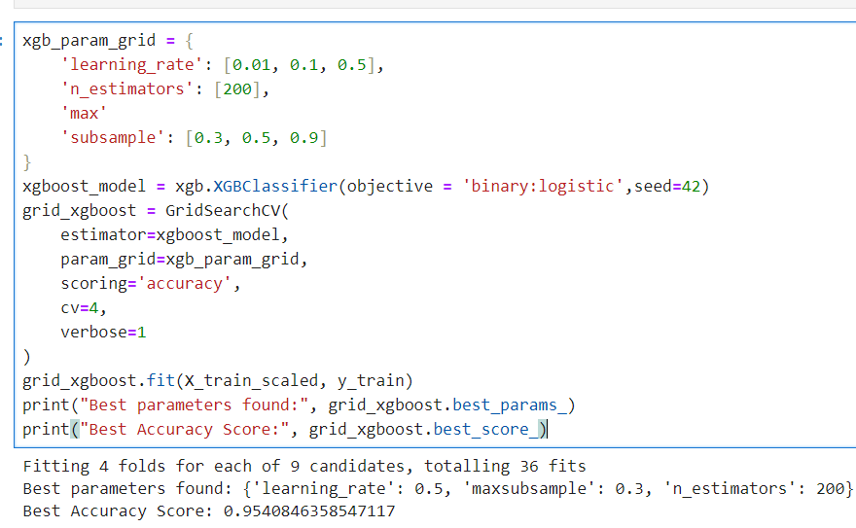
HyperParameter Tuning
Random Search cross validation
Grid Search Cross Validation
Best params: (objective = 'binary:logistic', subsample= 0.7 subsample= 0.7,n_estimators= 200, max_depth=9
,learning_rate = 0.11,colsample_bytree=0.8

Slide 9
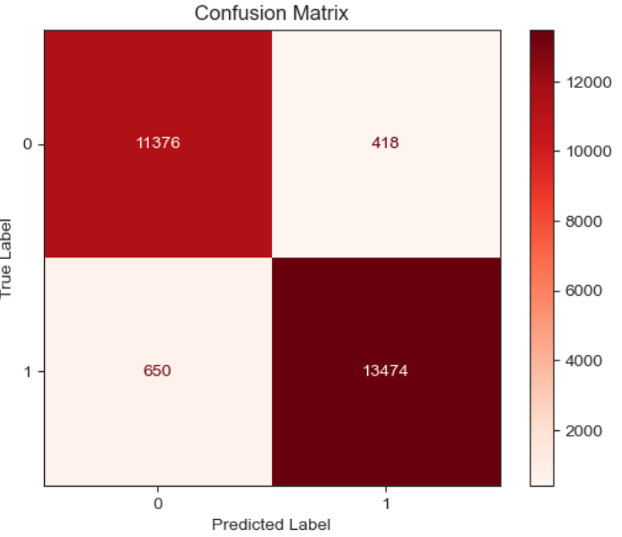
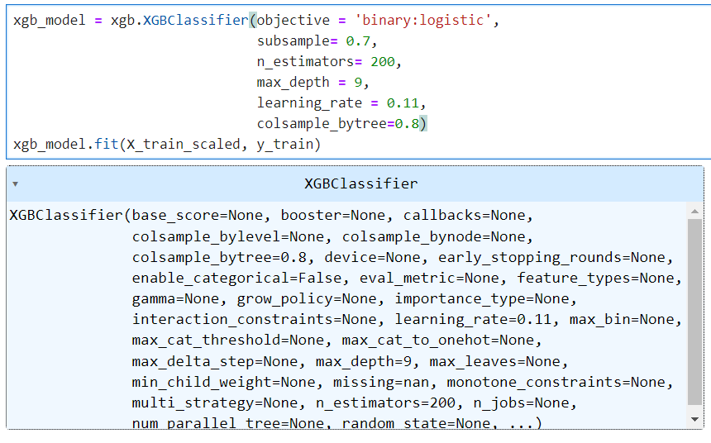
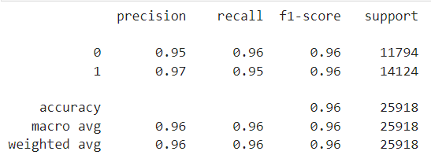
XGBClassifier extreme Gradient Boosting

Slide 10
Conclusion:
1.Both Random Forest and XGBoost models exhibit comparable performance metrics, including accuracy, precision, recall, and F1-score.
2.However, the XGBoost model demonstrates a slightly lower number of false positives and false negatives compared to the Random Forest model.
3.This suggests that the XGBoost model outperforms the Random Forest model slightly in terms of minimizing classification errors

Slide 11
THANK YOU SPECIAL THANKS TO THE FACULTY OF IMARTICUS LEARNING VIKAS ATRAY SIR PURUSHOTTAM SHARMA SIR
Submitted by : Simran
Course: PGA 43 : DATA SCIENCE AND ANALYSIS

