Slide 1



Authentication using Behavioral Biometrics
Jaypee University of Information Technology, Waknaghat - 173234 (India)
Major Project - II (18B19CI891) | AY 2024-25
Mid-Term Evaluation | March 17-22, 2025.
Group No.: 36
Team Member (s)
Akshit Sharma (211435)
Simran (211442)
Supervisor (s)
Name: Dr. Kushal Kanwar
Designation: Assistant Professor (SG)
Department: CSE & IT

Slide 2
Outline
Introduction
Problem Statement
Objectives
Work Done (after Major Project - I)
Project Design
Implementation
Experimental Results and Evaluation
Key Learnings
Work Plan (till End-Term Evaluation)
Work Contribution and Attendance
Supervisor Interactions
References

Slide 3
Introduction
Three key factors of authentication:
Something you know
Something you have
Something you are
Something you are : the way you behave / interact, that is, patterns in device usages
Base for our use : Sensor dynamics, touch strokes, keystroke patterns.
Our project aims to provide a seamless and non-intrusive form of second-factor authentication. It improves both usability and security. The project aims to authenticate a user, that is, know if the user is really him/herself, using their human behavioral traits, such as the way one holds their mobile phone

Slide 4
Problem Statement
Data security by means of authentication is emerging as a very prevalent challenge in today’s world.
The need to balance usability and security is high, as by nature, we humans tend to avoid effort.
To achieve this, service providers must invest in a lot to analyze user patterns in their activity, which is not only resource heavy, but also opens a door for privacy breaches on the user side.
Our proposed solution is to use behavioral biometrics, a relatively underexplored field, in which we use behavioral data from the user, in this case, the way he/she handles his/her phone.

Slide 5
Objectives
To develop an application to gather a user’s natural behavioral information.
To develop and tailor a machine learning model to accurately identify a particular user.
To develop a prototype that implements the concept of the project.
The main objective of this project is to provide a seamless and continuous second factor of authentication to users as well as services. At this stage, we are focusing on serving the mobile applications that require this security, such as banking or online shopping services, employee portals, and even parental controls on niche applications.

Slide 6
Work Done (after Major Project - I)
As per the plan stated in the End Term Evaluation presentation, we have successfully combined the data collected, pre-processed it, and are actively implementing Machine Learning Models to the collected data.
Simultaneously, we have also worked on the data collection app further, and it is now collecting long term data from the same user. This will help us further work on identifying one person in long term.
Initial dataset shape: (5563805, 25)
After removing duplicates: (5563805, 25)
After outlier removal: (4944276, 25)
After timestamp sampling (100ms) by Person: (218594, 25)

Slide 7
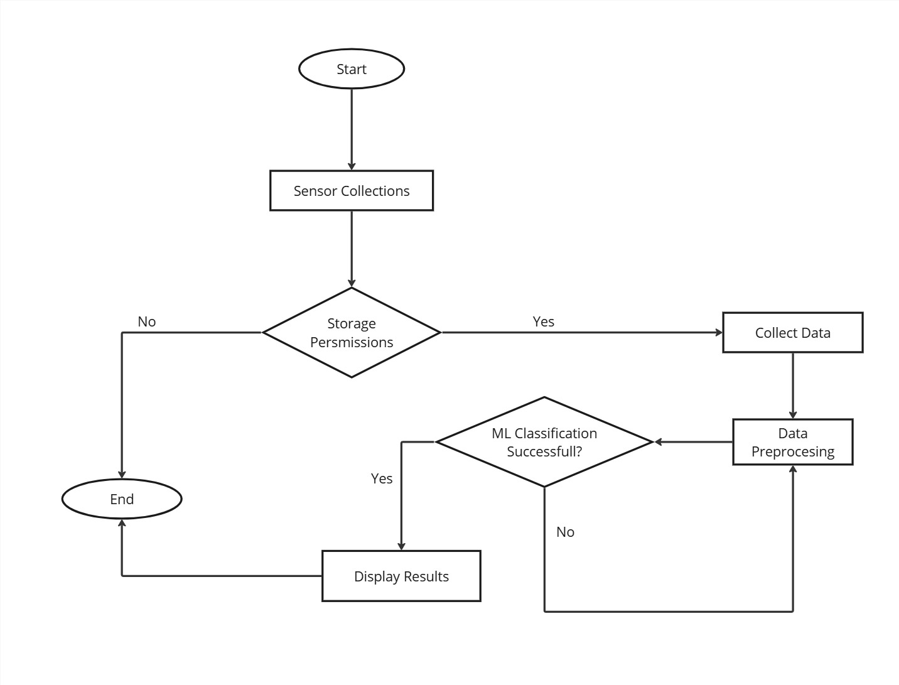
Project Design
Start: The process begins.
Sensor Collection: The system checks if the required sensors are enabled, and permissions are granted.
If No, it skips to displaying results.
If Yes, it proceeds to collect data from the sensors.
Data Collection & Preprocessing: The collected data undergoes preprocessing to make it suitable for machine learning.
ML Classification: The preprocessed data is evaluated using machine learning for classification.
If classification is successful, results are displayed.
If unsuccessful, it loops back for further processing.
End: The process ends.
Fig.1.1: Flow graph of the project

Slide 8
Project Design (cont…)
Use max. three slides for project design.
Clearly outline system architecture, data flow, and module interactions using neatly drawn diagrams and flowcharts.
Emphasize key design decisions, algorithms, and technologies with concise explanations and visual aids.

Slide 9
Project Design (cont…)
Use max. three slides for project design.
Clearly outline system architecture, data flow, and module interactions using neatly drawn diagrams and flowcharts.
Emphasize key design decisions, algorithms, and technologies with concise explanations and visual aids.

Slide 10
Implementation
First slide for data collected and screenshot of the app.

Slide 11
Implementation (cont…)
Pre-Processing and LSTM

Slide 12
Implementation (cont…)
GRU

Slide 13
Experimental Results and Evaluation
Visualized Results from Pre-Processing

Slide 14
Experimental Results and Evaluation (cont…)
Visualized results from LSTM

Slide 15
Experimental Results and Evaluation (cont…)
Visualized results from GRU

Slide 16
Key Learnings
How to gather useful data to be used in a project.
How to secure a device using Behavioral Biometrics and its advantages over the traditional forms of authentication.
How to pre-process data to be used for Machine Learning.
How to handle time-series data.
Understanding of how LSTM and GRU work.
Computation cost of training machine and deep learning models.

Slide 17
Work Plan (till End-Term Evaluation)
To find a model suitable for our data.
To collect long term data from a single user, rather than short term data(s) from multiple users.
To develop a prototype of the application that uses behavioral biometrics in real time.

Slide 18
Work Contribution and Attendance
GitHub Repository URL:
Team Member | Roll No. | Work Done (provide complete details) | Work Contribution (%) | Lines of Code (LoC) | Lab Attendance (%)
1. | 211435 | Combining and sampling the data. Pre-Processing the data Implementing LSTM | 50% | 157 (App) 227 (Colab) | >95%
2. | 211442 | Pre-processing the data Implementing GRU Changing the app such that it collects long term data from the same user. | 50% | 332 (App) 204 (Colab) | >90%

Slide 19
Supervisor Interactions (as mentioned in weekly log)
No. of Meetings with Supervisor:
Week No. | Duration | Remarks (as mentioned in the weekly log) | Incorporated (Yes/No)
1. | 13/01/2025 to 19/01/2025 | OK | Yes
2. | 20/01/2025 to 26/01/2025 | OK | Yes
3. | 27/01/2025 to 02/02/2025 | OK | Yes
4. | 03/02/2025 to 09/02/2025 | OK | Yes
5. | 10/02/2025 to 16/02/2025 | OK | Yes

Slide 20
Supervisor Interactions (cont…)
Week No. | Duration | Remarks (as mentioned in the weekly log) | Incorporated (Yes/No)
6. | 24/02/2025 to 02/03/2025 | OK | Yes
7. | 03/03/2025 to 09/03/2025 | OK | Yes
8. | 10/03/2025 to 16/03/2025 | ---- | ---

Slide 21
References
[1] O. L. Finnegan, J. W. White III, and B. Armstrong, "The utility of behavioral biometrics in user authentication and demographic detection: A scoping review," Syst. Rev., vol. 13, no. 1, p. 45, 2024.
[2] L. Sun, Y. Wang, Y. Ren, and F. Xia, "Path signature-based XAI-enabled network time series classification," Sci. China Inf. Sci., vol. 67, no. 4, pp. 1–15, 2024.
[3] E. C.-Y. Su and H.-M. Wu, "Dimension reduction and visualization of multiple time series data: A symbolic data analysis approach," Comput. Stat., vol. 39, no. 2, pp. 123–140, 2024.
[4] P. Bansal and A. Ouda, "Continuous authentication in the digital age: An analysis of reinforcement learning and behavioral biometrics," Computers, vol. 13, no. 6, p. 78, 2024.
[5] P. Yris, et al., "Deep features fusion for user authentication based on human activity," IET Biometrics, vol. 12, no. 1, pp. 45-57, 2023.
[6] R. Praveen, et al., "Continuous user authentication on smartphone via behavioral biometrics: a survey," Multimedia Tools and Applications, Springer, 2023.
[7] G. Stragapede, et al., "Mobile behavioral biometrics for passive authentication," Pattern Recognition Letters, vol. 157, pp. 130-140, 2022.
[8] Z. Shihong, et al., "A Robust Continuous Authentication System Using Smartphone Sensors and Wasserstein Generative Adversarial Networks," Communication Security in Socialnet-Oriented Cyber Spaces, 2021.

Slide 22
References (cont…)
[9] B. Lavanya, et al., "Impact of Behavioral Biometrics on Mobile Banking System," Journal of Physics: Conference Series, Advances in Computational Electronics and Communication Engineering, vol. 1964, 2021.
[10] G. Jianfeng, et al., "Design and Implementation of Continuous Authentication Mechanism Based on Multimodal Fusion Mechanism," Communication Security in Socialnet-Oriented Cyber Spaces, 2021.
[11] S. Ioannis, et al., "Behavioral biometrics & continuous user authentication on mobile devices: A survey," Information Fusion, 2021.
[12] M. Abuhamad, et al., "Sensor-based continuous authentication of smartphones’ users using behavioral biometrics: A contemporary survey," IEEE Internet of Things Journal, 2021.
[13] I. Alsaadi, "Study on most popular behavioral biometrics, advantages, disadvantages and recent applications," International Journal of Scientific & Technology Research, vol. 10, no. 12, pp. 320-326, 2021.
[14] T. L. Xu, K. de Barbaro, D. H. Abney, and R. F. A. Cox, "Finding structure in time: Visualizing and analyzing behavioral time series," Front. Psychol., vol. 11, p. 2735, 2020.
[15] A. Alzubaidi and J. Kalita, "Authentication of smartphone users using behavioral biometrics," IEEE Communications Surveys & Tutorials, vol. 18, no. 3, pp. 1998-2026, 2016.
[16] A. Buriro, B. Crispo, F. Del Frari, and K. Wrona, "Touchstroke: Smartphone user authentication based on touch-typing biometrics," Springer International Publishing, 2015.

Slide 23
References (cont…)
[17] N. Zheng, K. Bai, H. Huang, and H. Wang, "You are how you touch: User verification on smartphones via tapping behaviors," IEEE, 2014.
[18] H. Saevanee and P. Bhattarakosol, "Authenticating user using keystroke dynamics and finger pressure," IEEE Proceedings of the International Conference on Computing and Convergence Technology, 2009.
[19] L. Li, X. Zhao, and G. Xue, "Unobservable re-authentication for smartphones," IEEE Transactions on Mobile Computing, vol. 12, no. 2, pp. 1-10, 2013.
[20] X. Zhao, T. Feng, and W. Shi, "Continuous mobile authentication using a novel graphic touch gesture feature," IEEE Transactions on Mobile Computing, vol. 12, no. 9, pp. 1-15, 2013.
[21] A. De Luca, A. Hang, F. Brudy, C. Lindner, and H. Hussmann, "Touch me once and I know it's you! Implicit authentication based on touch screen patterns," in Proceedings of the ACM Conference on Human-Computer Interaction with Mobile Devices and Services (MobileHCI), 2012.

Slide 24
Thanks.

