Slide 1
Title: “Building an AI-Powered Dashboard for Sentiment Analysis of Amazon.in Sale Event Products Using Reddit Feedback”
Problem Statement: To develop a dashboard powered by an AI language model that provides actionable insights from Reddit comments about products sold during specific Amazon.in sale events. By scraping sale-specific Reddit discussions, the system will classify sentiment, extract user feedback, and recommend improvements to enhance product quality, increase customer satisfaction, and boost future sales performance.
🔧 PHASE 1: Define Scope & Requirements
Identify Target Sale Events
Example: "Amazon Fab TV Sale (June 1–10)"
Note sale names, dates, and product categories.
Define Product List per Sale
Use Amazon’s official sale pages (manually or via web scraping) to get products sold during each event.
📥 PHASE 2: Data Collection
Reddit Data Scraping (PRAW)
Use PRAW to scrape posts and comments from subreddits like:
r/IndianGaming
r/IndiaDeals
r/AmazonIndia
r/AskIndia, etc.
Filter posts/comments by:
Sale dates (e.g., June 1–10)
Keywords: ["Amazon", "Fab TV Sale", product names, etc.]

Slide 2
Store Raw Data
Save scraped data into a database or CSV (include timestamp, username, comment body, post title, subreddit, etc.)
🧠 PHASE 3: Preprocess & Clean the Data
Data Cleaning (Python)
Remove spam, bot comments, emojis, URLs, non-English comments.
Normalize text (lowercase, punctuation removal, etc.)
Label or Annotate Sentiment (Optional)
If training your own model: Use tools like Prodigy or label manually.
Or skip if using OpenAI API for zero-shot/few-shot classification.
🤖 PHASE 4: AI/LLM Integration
Using OpenAI for Sentiment & Insight Extraction
Use Chat Completion API via Python or curl to:
Classify sentiment (positive/negative/neutral)
Extract complaints/suggestions/praise
Tag product names and issues (e.g., "Remote not working", "Delivery delay")

Slide 3
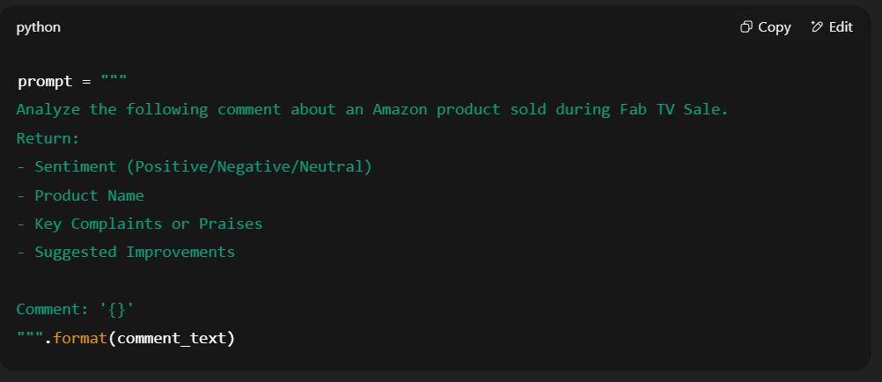
Example Prompt (for ChatGPT API):

Slide 4
📊 PHASE 5: Dashboard Development
Backend (Python Flask or FastAPI)
Serve processed data (JSON API with product names, sentiments, feedback, suggestions)
Frontend (React.js or Dash/Streamlit)
Build visual dashboard with:
Sentiment trends per product
Common complaints/praises (word cloud, tags)
Suggested improvements
Filter by product, date, sentiment, category
🧪 PHASE 6: Fine-tuning (Optional)
Fine-tune a Local LLM (Optional) If you want to train/fine-tune your own small LLM (e.g., using LLaMA2, Mistral, etc.):
Collect labeled Reddit data
Use HuggingFace Transformers + Datasets
Fine-tune on classification + insight extraction tasks
💡 You can skip this and continue using OpenAI API to save time/resources.

Slide 5
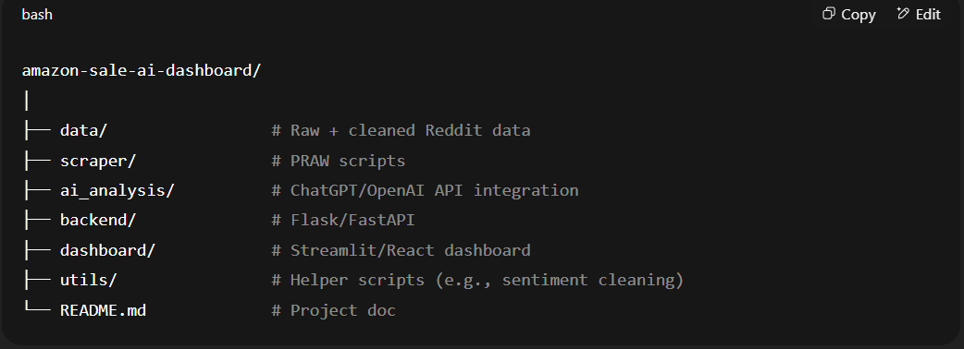
✅ PHASE 7: Evaluation & Deployment
Evaluate Accuracy
Manually verify a sample of AI outputs
Refine prompts or post-process responses as needed
Deploy
Host backend on Render/Heroku
Host dashboard on Vercel/Streamlit Cloud
Schedule PRAW scrapers to auto-run during new sale events
🗂 Folder Structure (Suggested)

Slide 6
https://www.reddit.com/r/indiasocial/comments/198x3cd/great_savings_on_amazon_republic_day_sale/?utm_source=share&utm_medium=web3x&utm_name=web3xcss&utm_term=1&utm_content=share_button
https://www.reddit.com/r/IndiaTech/comments/1fkjcp7/great_india_sale_by_amazon/?utm_source=share&utm_medium=web3x&utm_name=web3xcss&utm_term=1&utm_content=share_button
https://www.reddit.com/r/IndiaPS5/comments/1hzugqr/is_amazon_fooling_us_with_republic_day_sale/?utm_source=share&utm_medium=web3x&utm_name=web3xcss&utm_term=1&utm_content=share_button
https://www.reddit.com/r/IndianGaming/comments/195ml77/best_gaming_laptops_to_buy_during_the_republic/?utm_source=share&utm_medium=web3x&utm_name=web3xcss&utm_term=1&utm_content=share_button
https://www.reddit.com/r/developersIndia/comments/1atae2b/how_does_amazon_pay_insane_joining_bonus/?utm_source=share&utm_medium=web3x&utm_name=web3xcss&utm_term=1&utm_content=share_button

