Slide 1
HEART DISEASE PREDICTION WITH MACHINE LEARNING ALGORITHMS
AN ENDEAVOUR TO PREDICT HEART HEALTH BY:
NAME | ROLL NO. | REGISTRATION NO.
SHRUTI GUPTA | 25500120052 | 202550100110048
SIMRAN SHARMA | 25500120061 | 202550100110039
SRISHTI BOSE | 25500120065 | 202550100110035
ANUBHAV MISHRA | 25500120071 | 202550100110029

Slide 2
PURPOSE OF THE PROJECT
Identify individuals at risk of heart disease based on specific features or risk factors.
Assist healthcare professionals in early detection for better treatment outcomes and patient care.
Contribute to heart disease prevention through targeted interventions like lifestyle modifications.

Slide 3
WORKFLOW OF PROPOSED APPROACH
Problem definition: Define the goal of predicting heart disease.
Data collection: Gather relevant data from diverse sources.
Data preprocessing: Clean and prepare the dataset.
Feature selection: Identify important features for prediction.
Data splitting: Split data into training and testing subsets.
Model selection: Choose a suitable machine learning algorithm.
Model training: Teach the algorithm patterns using training data.
Model evaluation: Measure performance using testing data.
Result validation: Assess performance on new, unseen data.
Model deployment: Make the model accessible for real-world use.
Monitoring and updating: Regularly update the model for accuracy and adaptability.

Slide 4
DATA COLLECTION
Model focuses on predicting heart disease in a diverse population.
DATASET HAS BEEN TAKEN FROM KAGGLE.
Combines five heart datasets with a total of 918 observations.
Largest heart disease dataset for research purposes.
Limitations include data availability, UNBALANCED NATURE(W.R.T GENDER) AND geographical considerations.

Slide 5
FEATURE DESCRIPTION
Age: Age of the patient [years]
Sex: Sex of the patient:
M: Male
F: Female
ChestPainType: Chest pain type
TA: Typical Angina
ATA: Atypical Angina
NAP: Non-Anginal Pain
ASY: Asymptomatic
RestingBP: Resting blood pressure [mm Hg]
Cholesterol: Serum cholesterol [mm/dl]
FastingBS: Fasting Blood Sugar
1: if FastingBS > 120 mg/dl
0: otherwise
RestingECG: Resting electrocardiogram results
Normal: Normal
ST: having ST-T wave abnormality (T wave inversions and/or ST elevation or depression of > 0.05 mV)
LVH: showing probable or definite left ventricular hypertrophy by Estes' criteria
MaxHR: Maximum heart rate achieved [Numeric value between 60 and 202]
ExerciseAngina: Exercise-induced angina
Y: Yes
N: No
Oldpeak: Oldpeak = ST [Numeric value measured in depression]
ST_Slope: The slope of the peak exercise ST segment
Up: upsloping
Flat: flat
Down: downsloping

Slide 6
DATA PREPROCESSING
CLEAN AND PREPARE THE DATASET
HANDLE MISSING VALUES AND OUTLIERS
SCALE THE FEATURES
ENCODING CATEGORICAL DATA

Slide 7
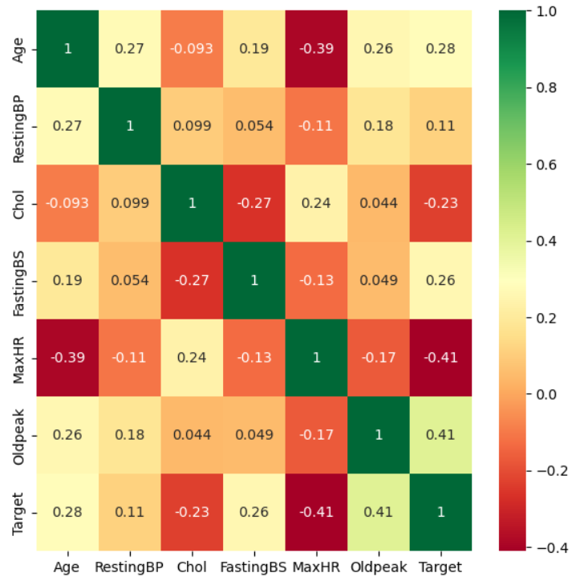
FEATURE SELECTION
ANALYSE THE CORRELATION BETWEEN THE ATTRIBUTES
IDENTIFY important features
CORRELATION MATRIX

Slide 8
MODEL TRAINING
Data
Splitting
Divide the dataset into training and testing subsets to assess the model's performance on unseen data.
Model
Selection
Choose an appropriate machine learning algorithm or model based on the nature of the problem and the characteristics of the data.
Fit the Model
Train the selected model on the training dataset, allowing it to learn patterns and relationships within the data.
Predict
Values
Apply the trained model to the test set to generate predictions and evaluate its performance on data it has not encountered during the training phase.

Slide 9
SELECTED ML ALGORITHMS
TRADITIONAL CLASSIFERS
ENSEMBLE CLASSIFIERS
CODE (EXAMPLES)
LOGISTIC REGRESSION
K-NEAREST NEIGHBOURS
SUPPORT VECTOR MACHINE
DECISION TREE
NAÏVE BAYES CLASSIFIER
RANDOM FOREST
BAGGING
ADAPTIVE BOOSTING
EXTREME GRADIENT BOOSTING
MAXVOTING CLASSIFIER
Bagging
Logistic Regression

Slide 10
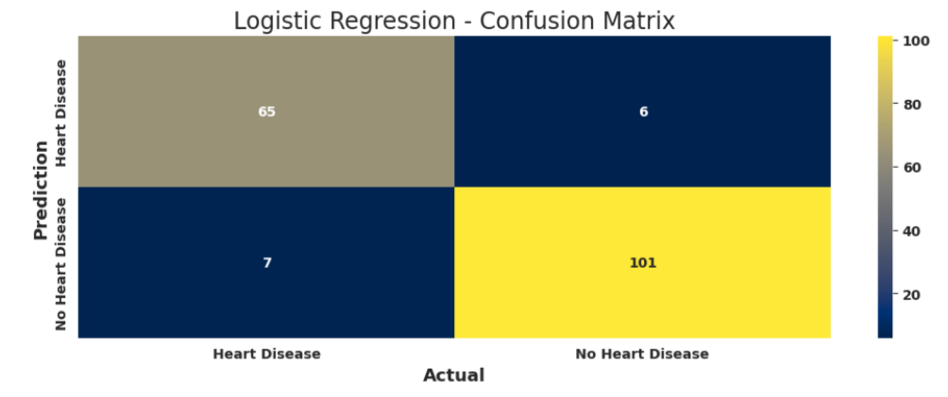
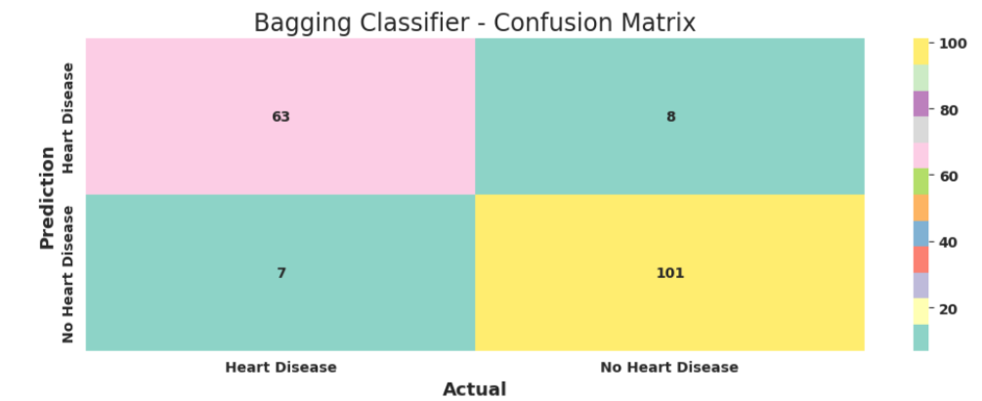
MODEL EVALUATION
ML Algorithm Comparison Table For 80/20 Split
Performance Metrics: A set of performance metrics, such as accuracy, precision, recall, and F1-score, to quantitatively assess how well the model is predicting outcomes.
Visual Inspection: Visualisations, such as confusion matrices, have been employed to gain insights into the model's behavior and identify areas where it may excel or require improvement.

Slide 11
DEPLOY THE MODEL
Model Serialization and Integration: Save the most accurate model, Logistic Regression, in a pickle file, preserving its parameters and structure in a serialized binary format in Python.
Website Integration using Flask, HTML, CSS, and Python: Deploy the model by integrating the pickle file into a website, developed with Flask for the backend and HTML/CSS for the frontend.
User-Friendly Interface with Form Input: Create a user-friendly interface on the website, allowing users to input health attributes through a form, with Flask handling backend processing.
Prediction Output Display: Process the form inputs using Python scripts, generate predictions using the stored model, and display the output prediction on the website for easy user interaction.
Accessibility, Scalability, and Maintenance: Seamlessly integrate the stored model (pickle file) into the website. This deployment setup enables real-time predictions and user-friendly interaction, making the heart disease prediction system practical and accessible.

Slide 12
TECHNOLOGY USED
Front-end Web Development:
HTML, CSS
Back-end Web Development:
Python, Flask
Web-based environment:
Jupyter Notebook
Code Editor:
VSCode (Visual Studio Code)
Data Science and Analysis Libraries:
Pandas
NumPy
Matplotlib
Seaborn
Scikit-learn
Pickle

Slide 13
THANK YOU
Dataset: https://www.kaggle.com/datasets/fedesoriano/heart-failure-prediction
GitHub Repository: https://github.com/SimranS22/Heart-Disease-Prediction-Model-SurTech
Website: https://b87c4231-668a-48e2-a055-42cb89e1676e-00-1rsj2y8z34rp4.picard.replit.dev/

