Slide 1
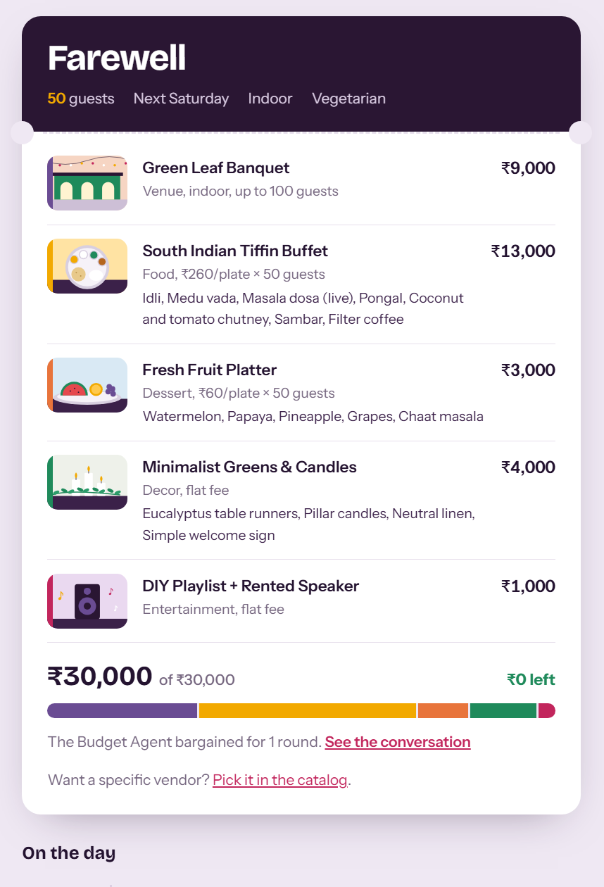
EventCraft
Tell it about your event. A team of software agents plans it and keeps it inside your budget.
Team EventCraft
Department of Computer Science & Engineering
Computational Linguistics project review
Notes:
Open with the one-line idea, then go straight to the problem. The picture on the right is a real plan produced by the system.

Slide 2
Planning one party means five separate conversations
Every vendor is booked separately. Venue, caterer, decorator, DJ, each with its own price and its own back-and-forth.
Nobody owns the total. You find out you are over budget after everything is already half agreed.
You repeat yourself. Guest count, date and diet get explained again to every person you call.
“Farewell party for 50 people next Saturday. My budget is ₹30,000. I want an indoor venue and vegetarian food.”
Our question: what if this one message was enough?
2
Notes:
Keep this short. The point is that the budget is the thing nobody owns when each vendor is booked separately.

Slide 3
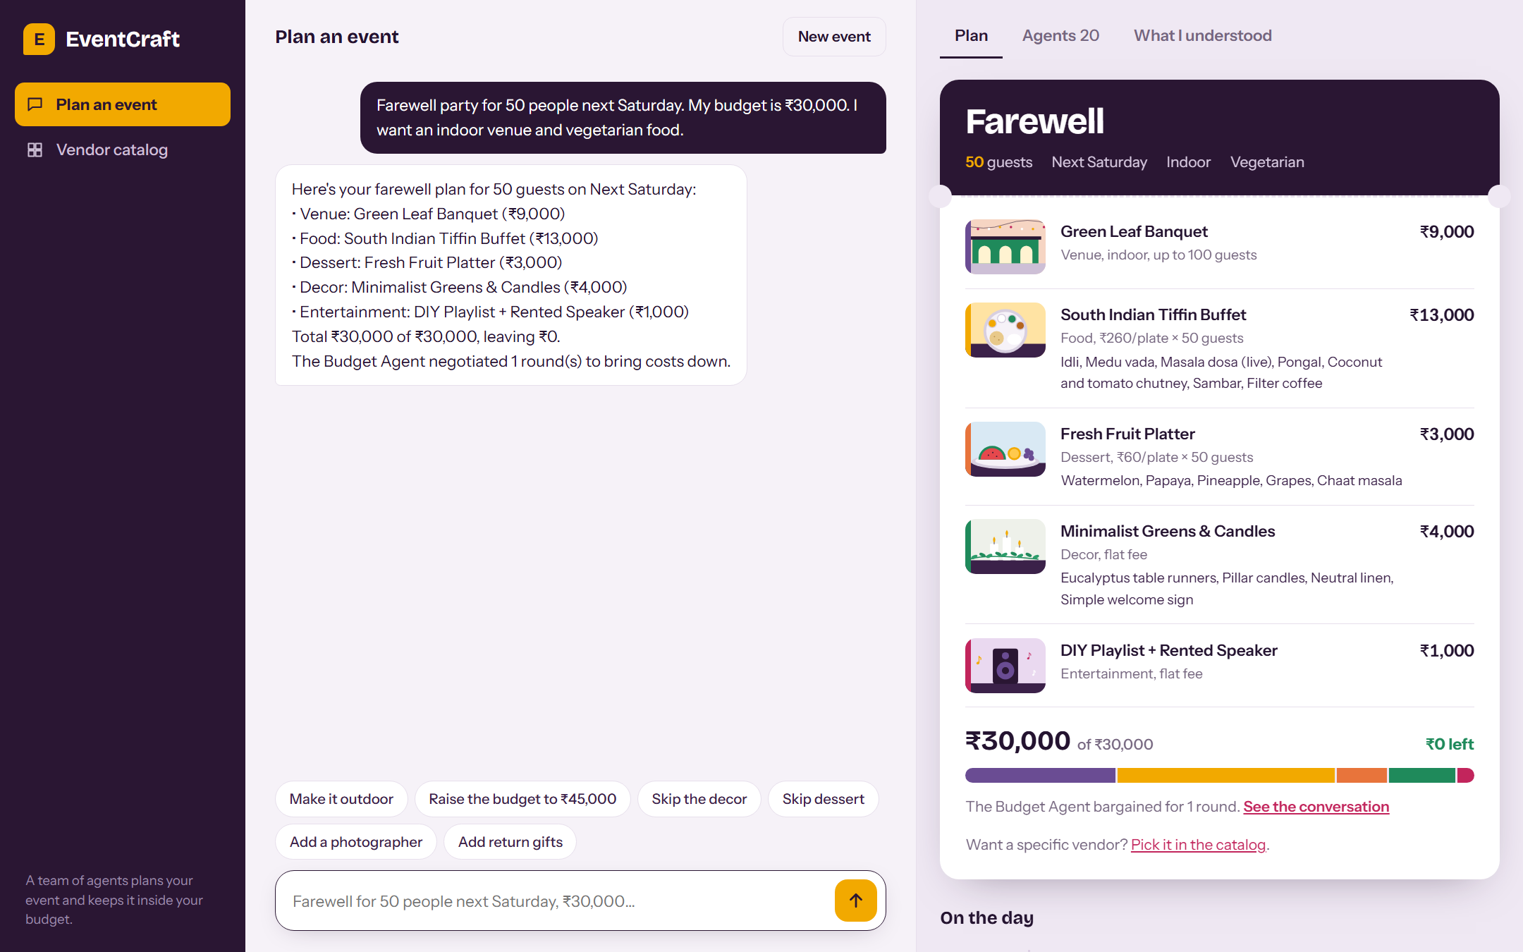
The whole product fits on one screen
The conversation
You type the way you would text a friend. Follow-ups like “make it outdoor” change the same plan.
The plan, as a ticket
Venue, food, dessert, decor and entertainment, with what is on each plate.
The budget bar
One colour per category, measured against what you said you can spend.
3
Notes:
This is a real screenshot, not a mock-up. Left is the chat, right is the plan. Point at the budget bar: each colour is one category.

Slide 4
How a sentence becomes a plan
Your message
Language module
Requirement
(JSON)
Coordinator
Venue
Food
Dessert
Decor
Entertain-
ment
Photo-
graphy
Gifts
Budget Agent
7 specialists, each bids one option
Budget Agent asks for cheaper options until the total fits
Schedule Agent
One plan + timeline
Agents never call each other directly. Every request and reply is a small JSON message on a shared bus, and the app shows you all of them.
4
Notes:
Walk left to right along the top row, then down. Ten agents in total: the Coordinator, seven specialists, the Budget Agent and the Schedule Agent.

Slide 5
Step 1: working out what you asked for
Farewell party for 50 people next Saturday. My budget is ₹30,000. I want an indoor venue and vegetarian food.
{
"intent": "PlanEvent",
"event_type": "Farewell",
"guests": 50,
"date": "Next Saturday",
"budget": 30000,
"venue_pref": "Indoor",
"food_pref": "Vegetarian"
}
What the module does
Splits the text into tokens, including ₹ and “30k”
Finds amounts, counts and dates, and resolves “next Saturday” to a real date
Decides the intent: plan, change, greeting, reset
Remembers earlier turns, so “make it outdoor” edits the same event
It is patterns and rules, not a trained model. That makes it fast and predictable, and it means phrasing we did not anticipate is missed.
5
Notes:
Be upfront that this is rule-based. If asked why: no labelled event-planning data exists, and rules let us show the agent side working end to end.

Slide 6
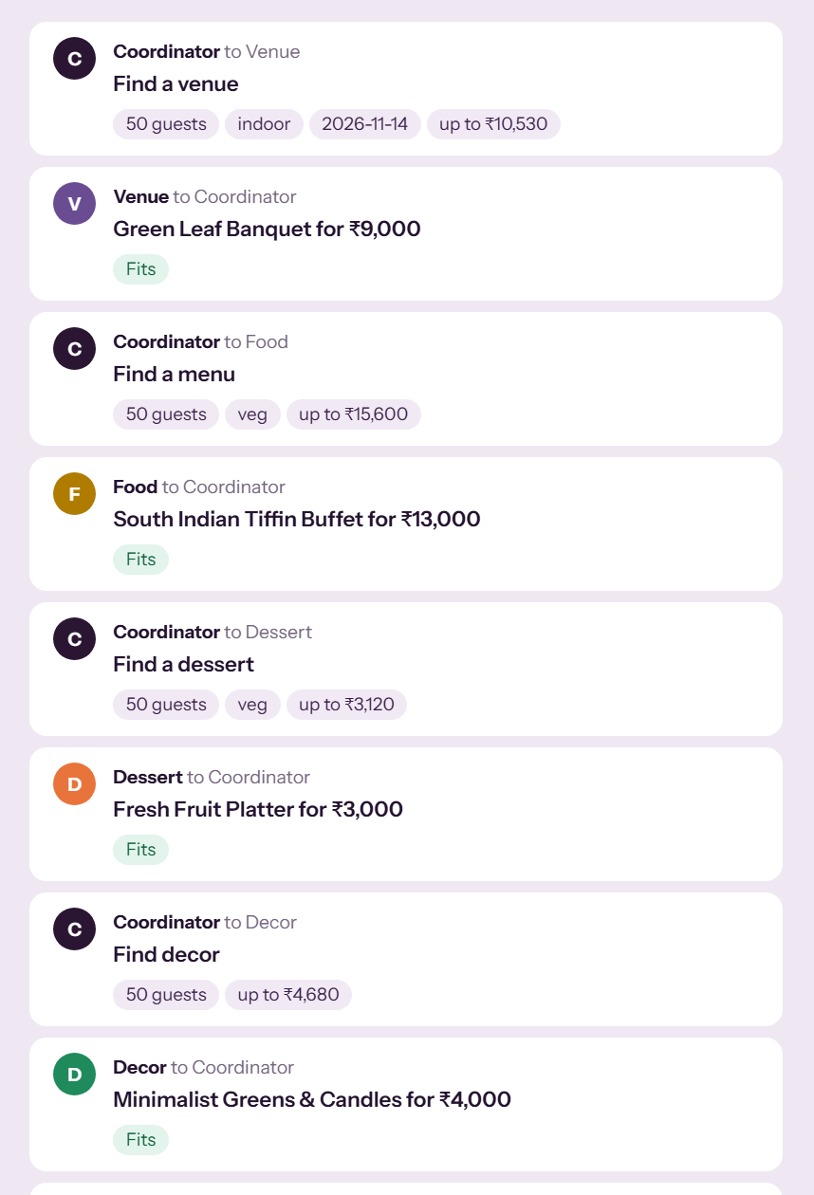
Step 2: the agents bid for the job
1
The Coordinator announces each task
“Find a venue: 50 guests, indoor, up to ₹10,530.” The cap is that agent's share of the budget plus some headroom.
2
Each specialist replies with one bid
Its best-rated option that meets the hard limits: capacity, diet, date.
3
The Budget Agent adds up the bids
If the total fits, the plan is accepted. If not, bargaining starts.
The design follows the Contract Net Protocol (Smith, 1980): a manager announces work and contractors bid for it.
6
Notes:
The screenshot is the Agents tab from the app. Every row is one message. This follows the Contract Net idea: announce a task, collect bids, award.

Slide 7
Step 3: the Budget Agent bargains the total down
Birthday for 60, budget ₹20,000, “with a DJ”
The first bids came to ₹29,900, which is ₹9,900 over.
The Budget Agent asked Entertainment to come down by that much.
No cheaper DJ exists, so it offered a ₹1,000 playlist and speaker instead.
Final plan: ₹18,900. The user is told the DJ preference was relaxed.
Who gets asked first: gifts, photography, entertainment, decor, dessert, venue, then food. Food is protected longest.
7
Notes:
Real run. Say plainly that the DJ was lost: the system tells the user the preference was relaxed rather than hiding it.

Slide 8
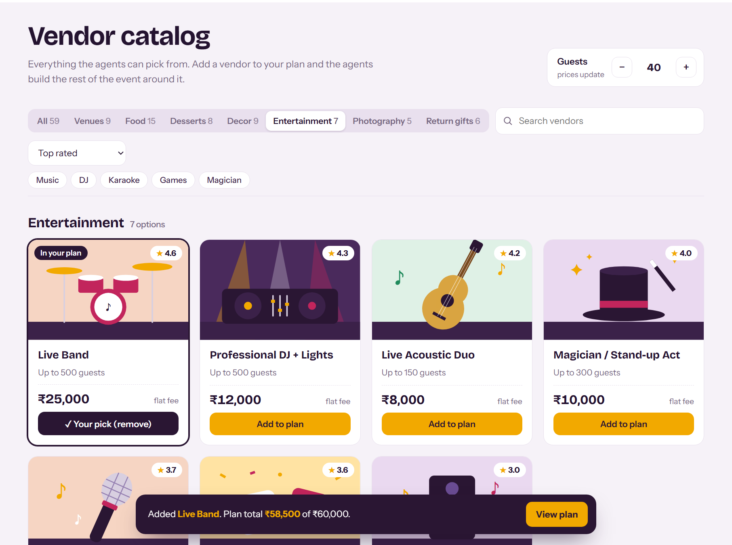
You can overrule the agents
Add to plan pins a vendor. The agents rebuild everything else around your choice.
A pinned vendor is never bargained away. When we pinned a ₹25,000 band on a ₹60,000 birthday, the decor was downgraded to pay for it.
A pick that cannot work is refused. Too small, booked that day or the wrong diet, and you are told which.
8
Notes:
Demo this live if time allows: add Live Band in the catalog, go back to the plan and show the decor got cheaper to pay for it.

Slide 9
What we measured
Measure | Target | Result
Intent identified correctly | at least 90% | 100%
Details extracted (F1) | at least 0.85 | 1.00
Plans within budget, where one is possible | at least 95% | 100%
Bargaining rounds per plan | 3 or fewer | 2.6 average, 8 worst
Conversations ending in a full plan | at least 90% | 100%
Response time (server only) | under 2 s | under 1 ms
User satisfaction survey | 4 of 5 | not done yet
Read these with care
The 66 test sentences were generated from templates, by us. Real people phrase things in ways our rules will miss.
8 of the 60 planning requests had a budget below the cheapest possible plan. Counting those, 86.7% fit.
The worst case took 8 bargaining rounds, well over our target of 3.
Nobody outside the team has used it yet.
9
Notes:
These come from our own evaluation script, run on generated sentences. Say the caveats yourself before the panel asks.

Slide 10
What is not finished
Limits today
What we would do next
Language understanding is hand-written rules
All 59 vendors, their prices and the booking calendar are sample data we made up
Bargaining follows a fixed order. It is not learned, unlike Lewis et al. (2017)
Plans are kept in memory and lost when the server restarts
No invitations, transport or guest tracking
Train an intent and slot model on Schema-Guided Dialogue plus our own labelled sentences
Load real vendors from a database, with real availability
Let agents weigh quality against price instead of a fixed order
Store sessions so a plan survives a restart
Test with real users and report the survey score
10
Notes:
End the content on honesty. Each limit on the left has its matching next step on the right.

Slide 11
What it is built with
Work we built on
Python 3 + Flask
Plain HTML, CSS, JavaScript
R. G. Smith, “The contract net protocol,” IEEE Trans. Computers, 1980.
B. Liu and I. Lane, “Attention-based recurrent neural network models for joint intent detection and slot filling,” Interspeech, 2016.
M. Lewis et al., “Deal or no deal? End-to-end learning of negotiation dialogues,” EMNLP, 2017.
A. Rastogi et al., “Towards scalable multi-domain conversational agents: the schema-guided dialogue dataset,” AAAI, 2020.
Server, agents and the message bus
Chat, plan ticket and catalog. No framework
15 automated tests
No database yet
Extraction, bargaining, catalog picks, availability
Catalog is in code; the chat is saved in the browser
11
Notes:
Only if asked. Fifteen automated tests cover extraction, bargaining, picks and availability.

Slide 12
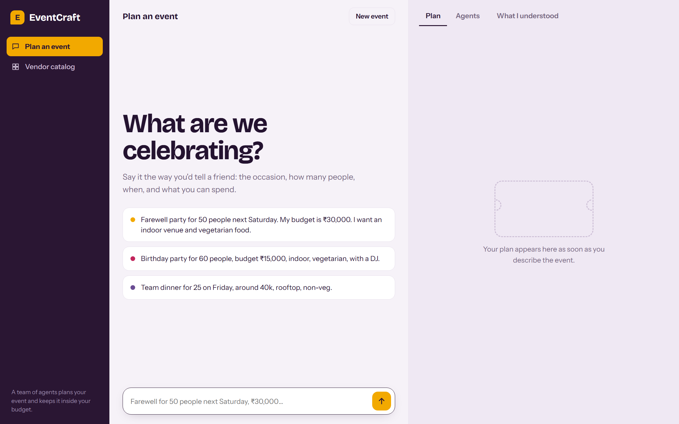
Let us show you
Live demo, then questions.
http://127.0.0.1:5000
Notes:
Switch to the browser. Suggested demo: the farewell sentence, then “make it outdoor”, then add a band from the catalog.

