Slide 1
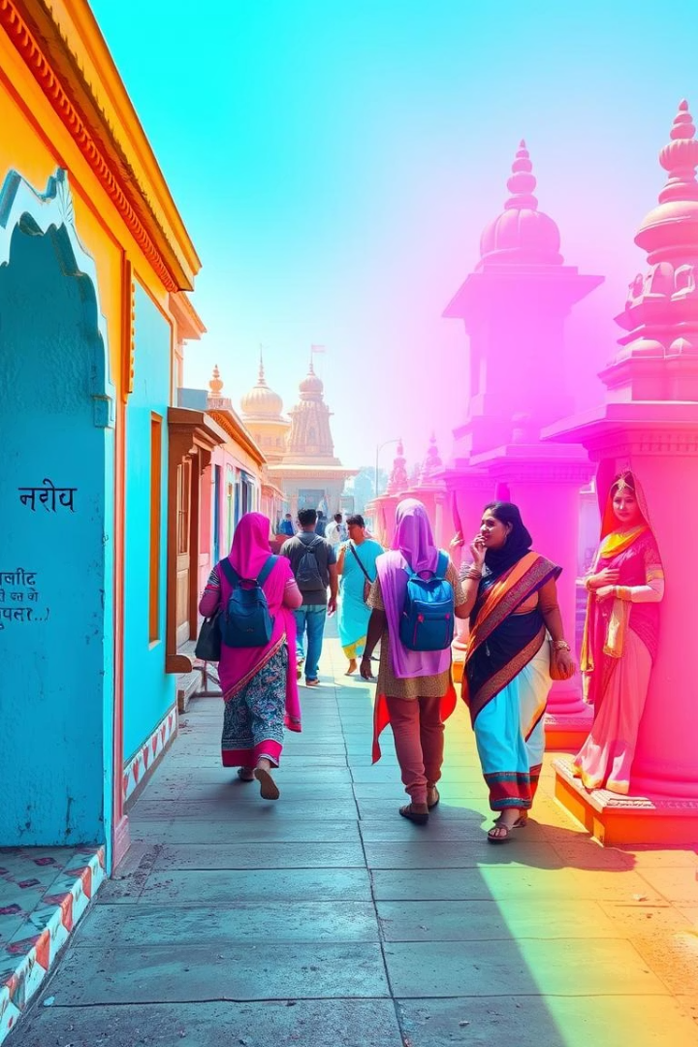

SanskritiScope - AI-Powered Platform for Sustainable Cultural Tourism in India
This platform promotes responsible travel while preserving India's endangered art forms. It connects travellers to hidden cultural gems using AI-driven maps, personalised itineraries, and an interactive chatbot.
by Simran Shaikh

Slide 2
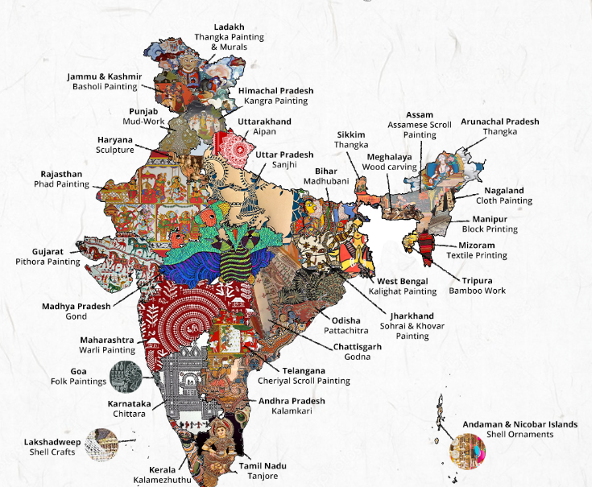
Exploring Endangered Indian Art Forms via Interactive Maps
Interactive Map
Users discover rare art forms with advanced filters for region and endangerment status.
Data-Driven Insights
Maps display UNESCO tags and distance to each site, aiding informed travel planning.

Slide 3
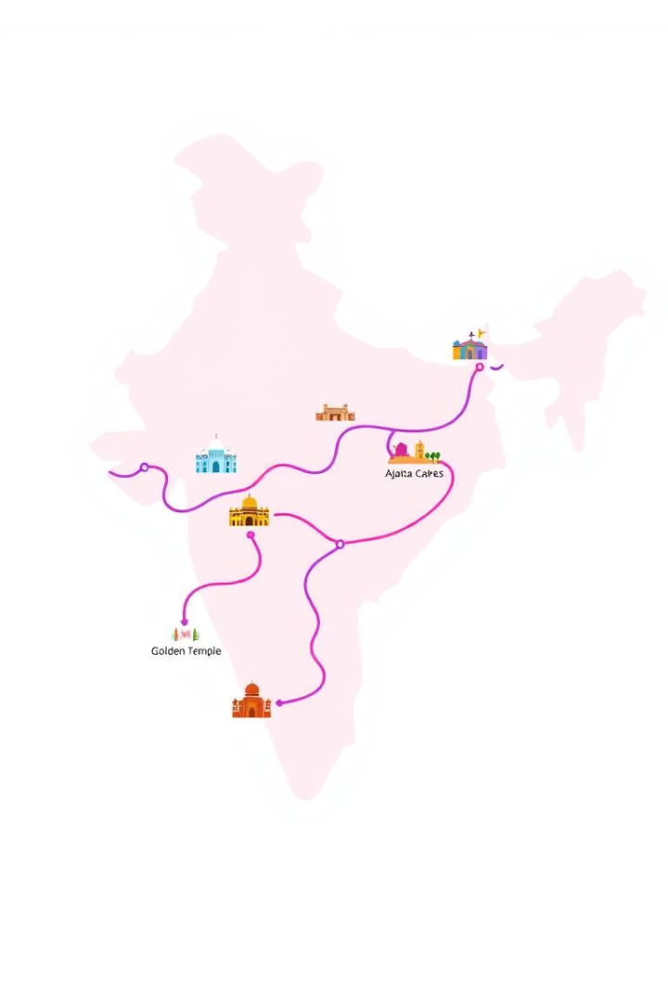



Smart Routes for Personalised Cultural Travel Itineraries
Endangerment Status
Priority is given to vulnerable cultural sites to raise awareness.
UNESCO Heritage Sites
Boosts visits to recognised world heritage locations.
Distance Calculation
Efficient routes created using the Haversine formula for travel optimisation.

Slide 4
AI-Powered Chatbot Guide for Real-Time Cultural Insights
Conversational AI
Educational Support
Answers heritage questions dynamically using the LLaMA-4 model via Groq API.
Engages travellers with contextual knowledge to deepen cultural appreciation.
Secure Integration
Chatbot operates securely with environment variables for API keys and secrets.

Slide 5
Festival Calendar Highlighting Local Cultural Events
Monthly Events
Regional Focus
Users explore festivals by month to plan trips around cultural highlights.
Calendar highlights local traditions supporting community-based tourism.

Slide 6




Technology Stack Supporting Heritage Preservation
Snowflake & Snowpark
Data storage and in-database Python processing for heritage datasets.
Groq API with LLaMA-4
Delivers AI-driven NLP powering chatbot and insights.
Streamlit & Folium
Interactive frontend with real-time maps and user interface.

Slide 7



Scalable, Secure and Impact-Driven Architecture
2
Security Best Practices
Environment variables keep sensitive data safe and private.
Serverless Deployment
Allows cost-effective scaling based on user demand.
1
Analytics Fusion
Combines data analytics and conversational AI for user impact.
3

Slide 8
Conclusion
SanskritiScope isn't just about tourism—it's a movement to preserve India's cultural soul through technology and data-driven action
Thank You !

