Slide 1
Sports Management System
Team Members :
Simran (06501172020)
Simran Singh (03301172020)

Slide 2
INTRODUCTION
The goal of the sports management system is to ensure that it handles the practice of multiple sports at a time. It also oversees student placement programs at the college and state levels. User can waste less time as compared to manual paperwork on an automatic device. The device will take care of all the services operations in a fast way. The handling of data is simpler . It would be able to review any reports at a time. Paperwork and manual work are minimised.

Slide 3
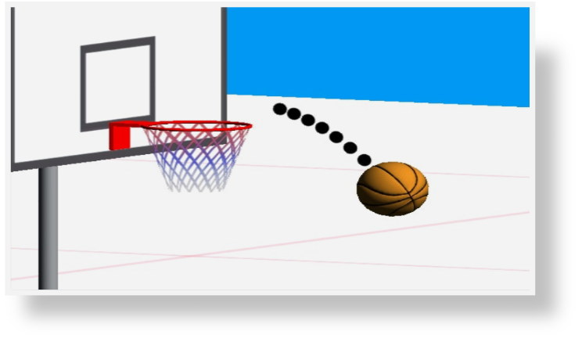
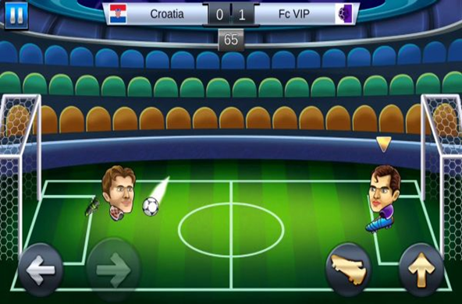
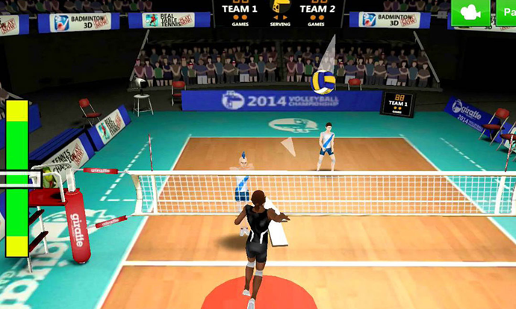
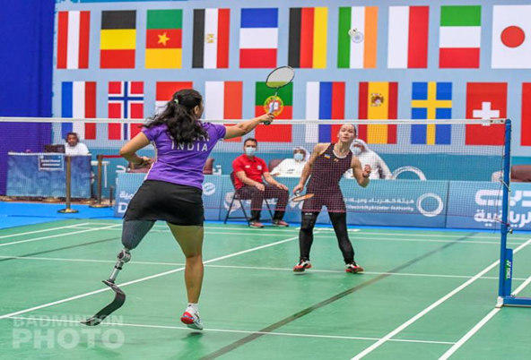
GAMES

Slide 4
Literature Review
Taking input from the user that the player required :
Basketball
  Football
  Volleyball
  Badminton
  In all game 4-5 things are same such as
  First Name
    Last Name
    Blood Group
    Gender
    Age
    Mobile Number
    If player is state level qualified then there will be automatically first player which is taken to Trainer

Slide 5
System Architecture:
Structure player
Class linked queue
  Input()
  Insertatend()
  Insertatbeg()
  Getplayerout(
  Listofplayers()
  Search()
  Read number()
  Output()
  Department menu()
Int main()

Slide 6
Code Explanation
structure player : In the block of structure we will define some variables which is used in our code like : ✓ Long id ✓ String firstname
        String lastname
        Int age
        Char blood
        Char gender
        Player* next
        class linkedqueue : In this block we will define some declaration and definition :
        private :
        player *head,*last
        public :
            define constructor as head=last=NULL
            char departmentname[50]
            playerinput() {which insert the data of player}

Slide 7
Code Explanation
  insertatend() {player will be add in the end of list}
  insertatbeg() {player will be add in the beginning of list this will totally depends on condition of player}
  getplayerout() {player operating start according to their priorty}
  listofplayer() {Ready a list of player}
  search() {searching of particular player}
  output() : Give the all data of player like player name, age, gender, mobile number etc.
  departmentmenu() : In this function various department input are enter by user such as :
    Add Normal Player
    Add Player according to their performance
    Take Player to Trainer
    Change Department

Slide 8
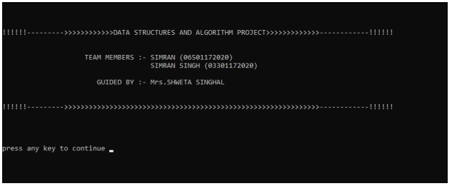
OUTPUT

Slide 9
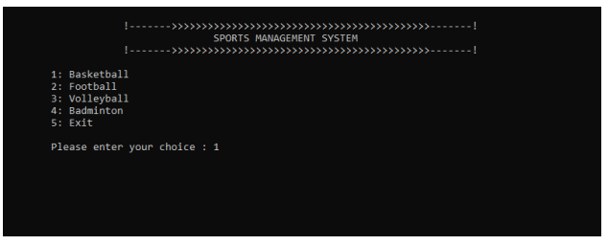
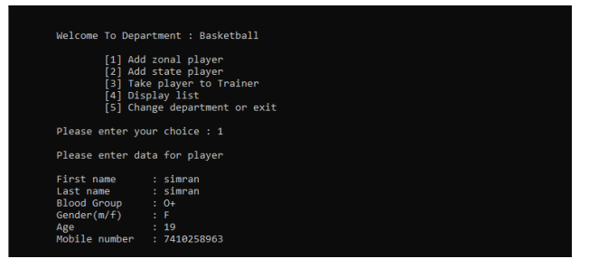

Slide 10
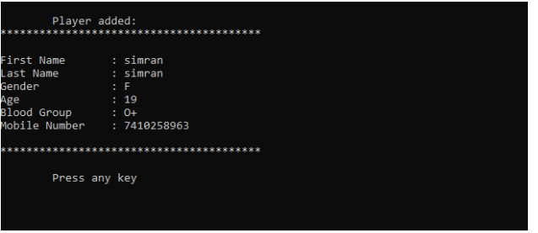
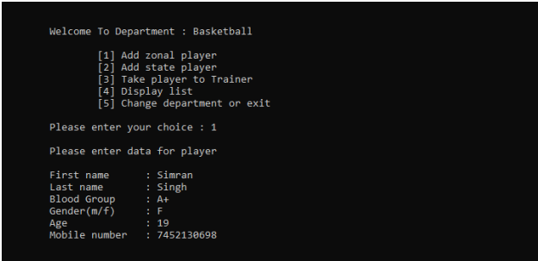

Slide 11
