Slide 1
Next Hikes – Project 3
Housing Data Analysis
By : Simran Singh Bhatti

Slide 2
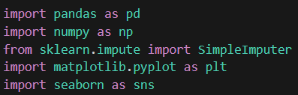
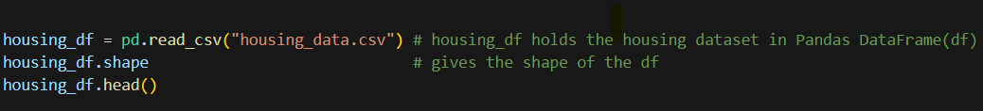
Libraries Used
Pandas
Numpy
Sklearn
Matplotlib
Seaborn

Slide 3
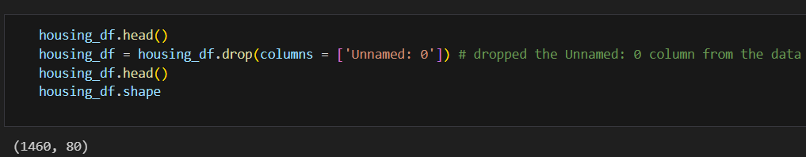
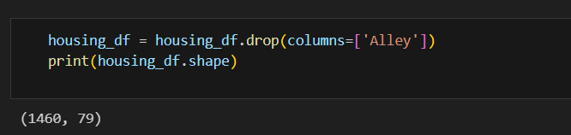
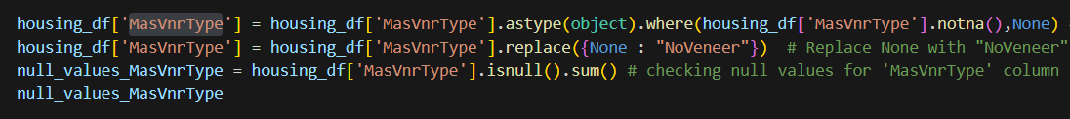
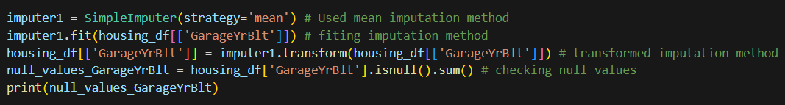
Cleaning of dataset
Removed an ‘Unnamed: 0 column’ as it holds only index value.
Removed an ‘Alley column’ as it contains 1369 Null values.
Replaced the Nan value of ‘MasVnrType’ with ‘None’.
Applied mode imputation to the ‘Electrical’ column and mean imputation to the ‘GarageYrBlt’ column.
The dataset didn’t contain any duplicate rows.

Slide 4
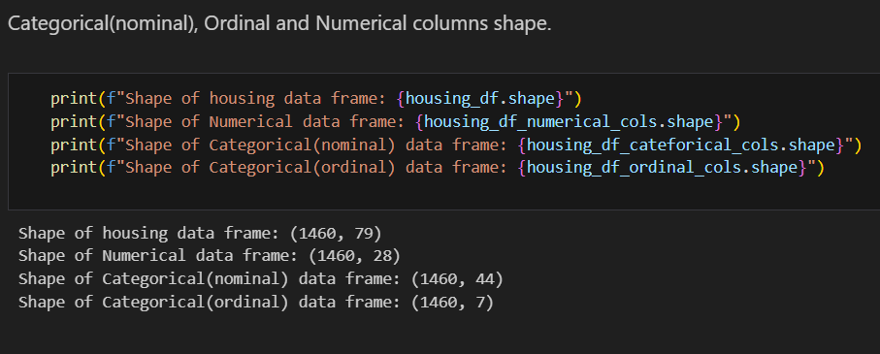
Dataset Classification
Divide the given dataset into three data frames– Numerical, Categorical(nominal), Categorical(ordinal).

Slide 5
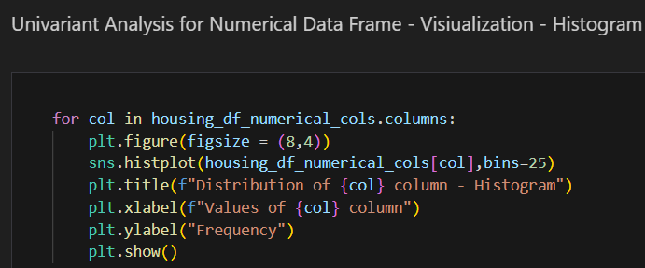
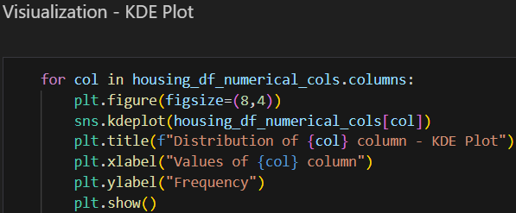
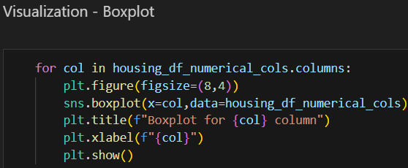
Univariant Analysis
Performed univariant analysis on Numerical data frame first using histograms, kde and box plots.

Slide 6
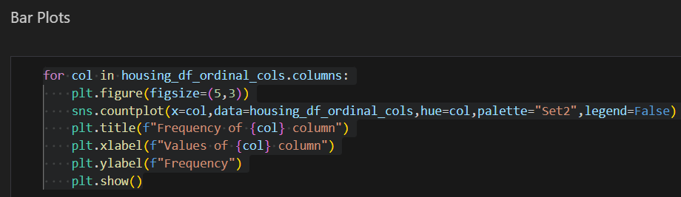
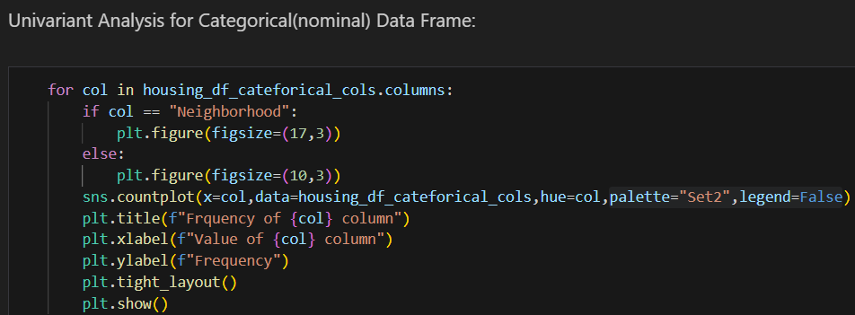
Univariant Analysis
Performed univariant analysis on Categorical – ordinal and nominal data frames by using bar plots

Slide 7
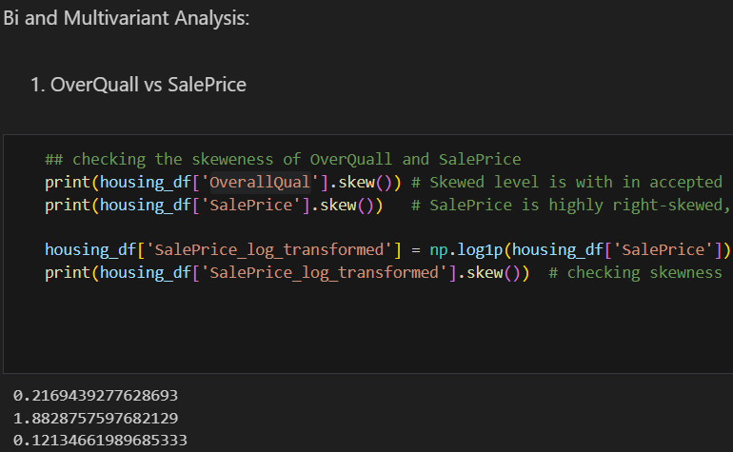
Skewness Check and Transformation
Before performing bi‑variate or multi‑variate analysis, checked each column for skewness and normality.
Applied appropriate transformations (Square Root or Log1P) to reduce skewness in highly skewed columns.

Slide 8
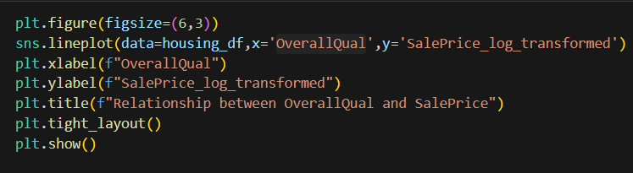
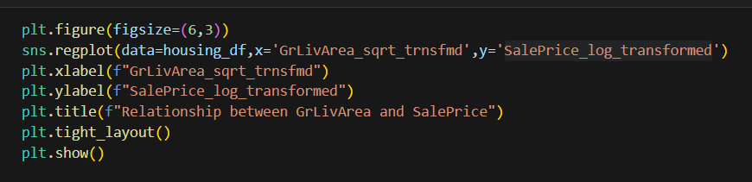
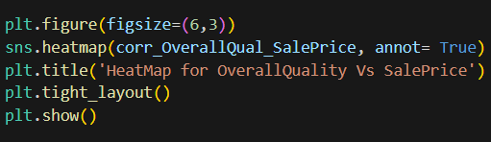
Bi and Multivariant Analysis
  Performed bivariate and multivariate analysis using line plots, scatter plots, heatmaps, and bar plots lmplots.

Slide 9
Thank you
Simran Singh Bhatti

