Slide 1
Next Hikes – Project 1 Bike Registration Analysis By : Simran Singh Bhatti

Slide 2
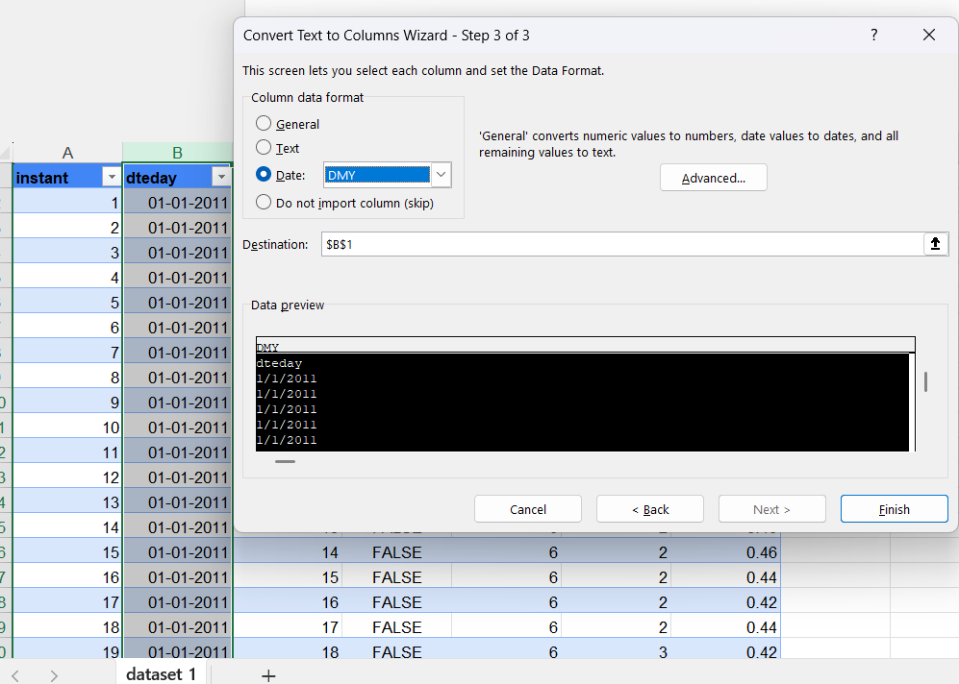
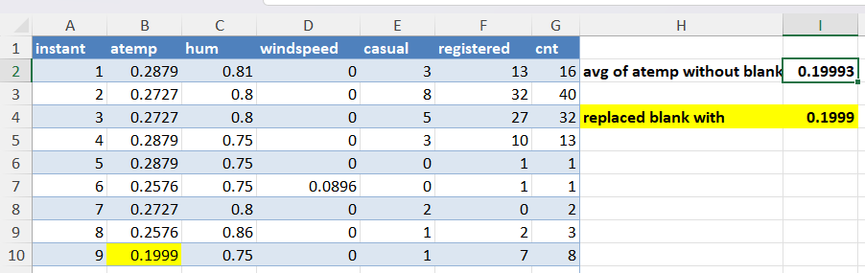
Cleaning of datasets 1 and 2
Dataset_1
In dataset_1, address the inconsistencies in the 'dteday' column—particularly those related to date formatting—by applying the 'Text to Columns' feature in Excel
In dataset_2, missing values in the 'atemp' column were imputed using the column's average value
Unnecessary columns were removed from dataset_1 to enhance data clarity and relevance
Dataset_2

Slide 3
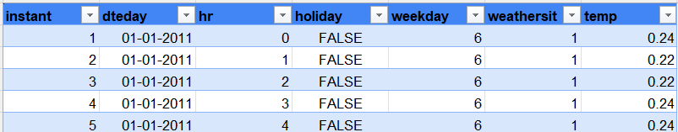
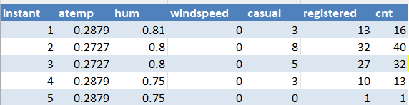
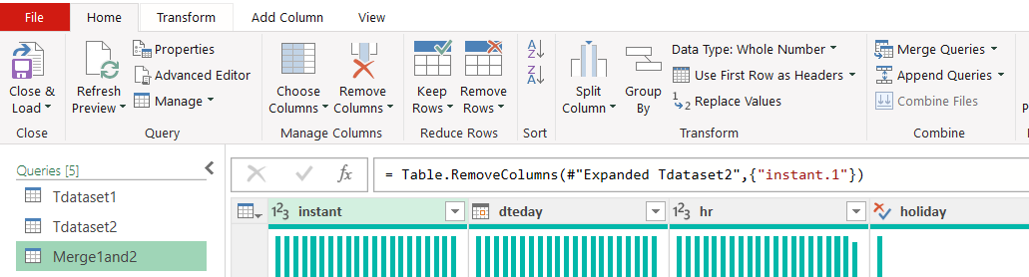
Merging of dataset 1 and 2
Table 1- Tdataset1
Highlighted the data range in each Excel file (dataset_1 and dataset_2), then converted the selection into a structured table using the shortcut Ctrl + T
In a new Excel workbook named NextHikes_1stProject, both previously created tables were imported as query connections
Used Power Query to merge the previously created query connections and loaded the data
Table 2 – Tdataset2
Merged Table1 and 2

Slide 4
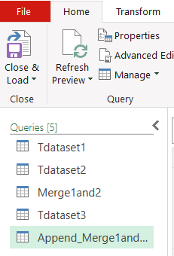
Appending of previously merged data with dataset 3
Table 3 – Tdataset3
Converted the data range in dataset_3 into a table using Ctrl + T
In excel workbook named NextHikes_1stProject, create a query connection for the above created table
Appended the merged dataset from the previous slide to the query connection created in the last step using Power Query and loaded the data
Appended merged datasets with Table 3

Slide 5
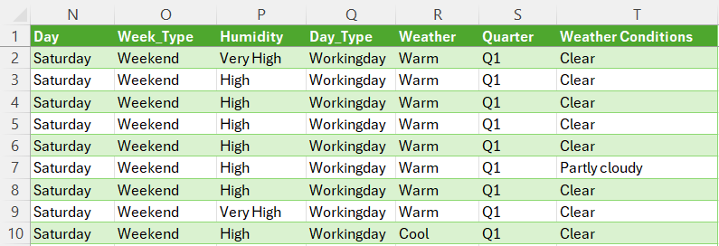
Crated new features after combining all three datasets
New columns were created
The following columns were created after combining all three datasets
Day – Represents day name of the week
Week_Type – Represents whether the day is a weekday or weekend.
Humidity – Represents humidity level
Day_Type – Represents whether the day is working day or holiday
Weather – Represents the day temperature
Quarter – Represents quarter of the year
WeatherCondtions – Represents weather condition for the day

Slide 6
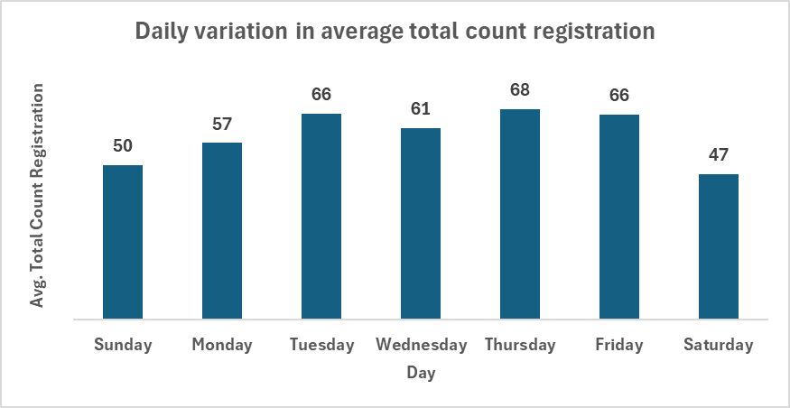
Trend of Average Total Count Across Days
Daily variation in average total count
The analysis reveals that average total registrations are highest on Thursday, outperforming other days of the week
Tuesday and Friday follow closely, ranking second in registration volume

Slide 7
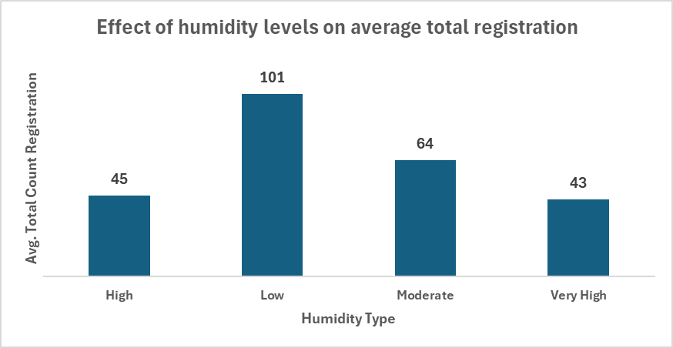
Influence of Humidity on User Registration Pattern
Humidity vs. Average Total Registrations
The analysis indicates that average total registrations peak during periods of low humidity

Slide 8
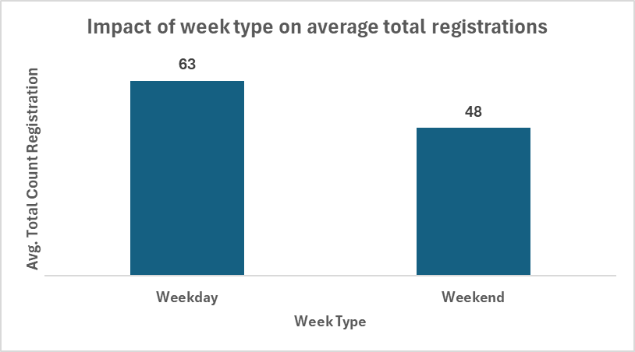
Effect of Week Type on Registration Volume
Influence of Weektype on Total Registration Trend
The analysis indicates that average total registrations peak during weekdays

Slide 9
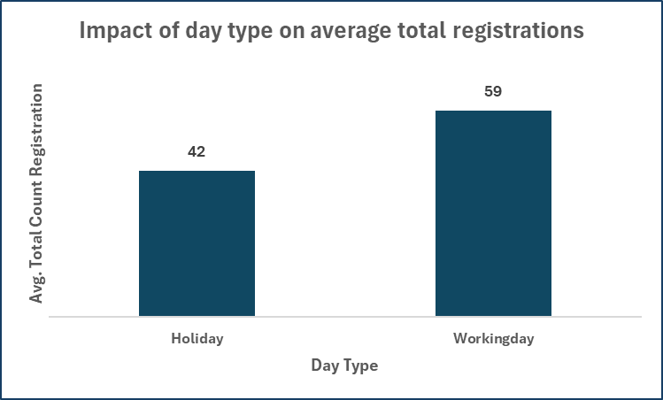
Effect of Day Classification on Registration Volume
Influence of Day Type on Total Registrations
The analysis shows that average total registrations are highest on working days as compared to holidays

Slide 10
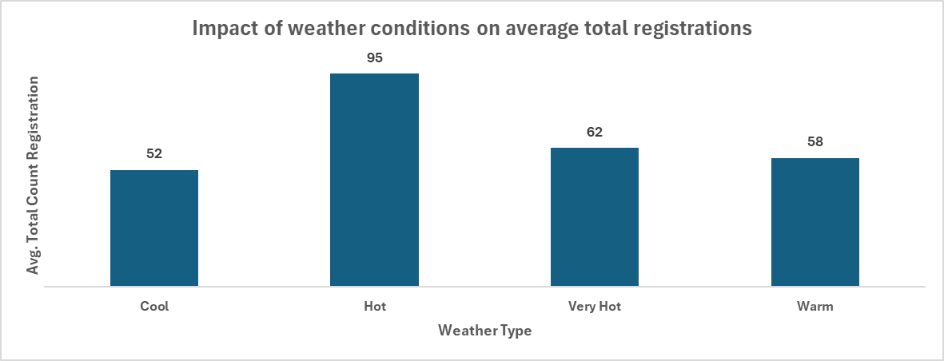
Effect of Weather Conditions on Registration Volume
Influence of Weather Patterns on Registration Trends
The analysis shows that average total registrations are highest on working days compared to holidays

Slide 11
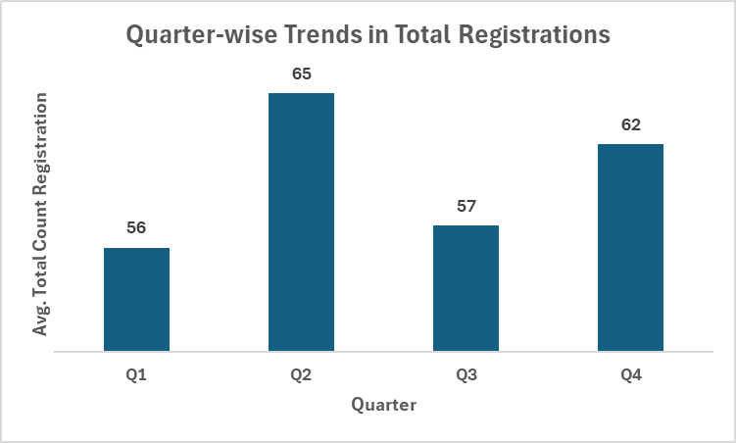
Average Total Registrations by Quarter
Quarterly Breakdown of Average Registrations
The analysis indicates that average total registrations peak in the second quarter (Q2)

Slide 12
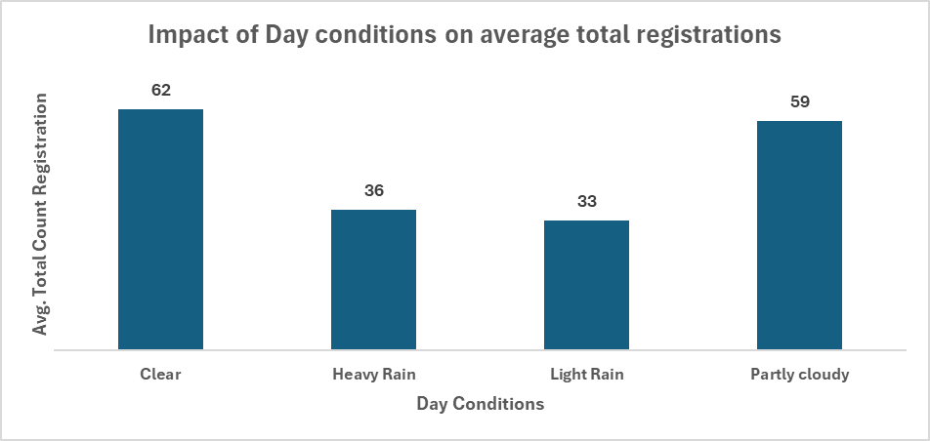
Effect of Daily Conditions on Registration Volume
Average Total Registrations by Day Conditions
Clear days see the highest average total registrations, with partly cloudy days ranking second

Slide 13
Thank you
Simran Singh Bhatti

