Slide 1




DOCUMENT MANAGEMENT AND ​
APPROVAL WORKFLOW AUTOMATION
Presented By:
Simranjeet Gill

Slide 2
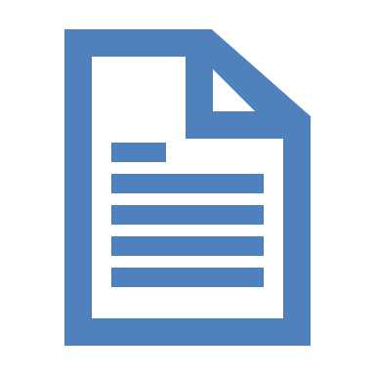





INTRODUCTION
Efficient document management and approval workflows are crucial for productivity and compliance.
Manual processes cause delays, errors, and compliance issues, hindering efficiency.
Automated solutions are increasingly necessary for competitiveness and efficiency.
Automation streamlines document management, driving productivity, accuracy, and compliance.
Transitioning from manual to automated systems overcomes limitations.
Implementing an Electronic Document Management System (EDMS) with automated workflows and electronic signatures is key.
SG
1

Slide 3
OVERVIEW
Introduction to Document Management
Document management entails storing, organizing, and tracking documents to ensure data integrity, security, and compliance.
Traditional Manual Process and Challenges
Manual routing and processing cause delays and lack of visibility. It increases risk of errors, discrepancies, and compliance issues due to inconsistent approval processes.​
Documents follow a set sequence of steps, routing between stakeholders or departments until approved or rejected.
The Approval Workflow Process
Approval delays can result from manual routing, limited visibility, and increased error risk, potentially leading to compliance issues from inconsistent processes.
Bottlenecks and Challenges
SG
2

Slide 4
CURRENT PROCESS
Manual Routing of Paper Documents
Manual routing of paper documents slows down approval processes, leading to inefficiencies and delays.
Traditional Manual Process and Challenges
Tracking document status via email results in cluttered inboxes and difficulty in locating the latest version, risking stakeholders missing critical updates
Physical Signatures Required for Approvals
Obtaining physical signatures adds complexity and time to approvals, especially when multiple stakeholders are involved
Limited version control with paper documents causes confusion and increases the likelihood of outdated versions being used, leading to rework and delays.
Limited Version Control
AA
3

Slide 5
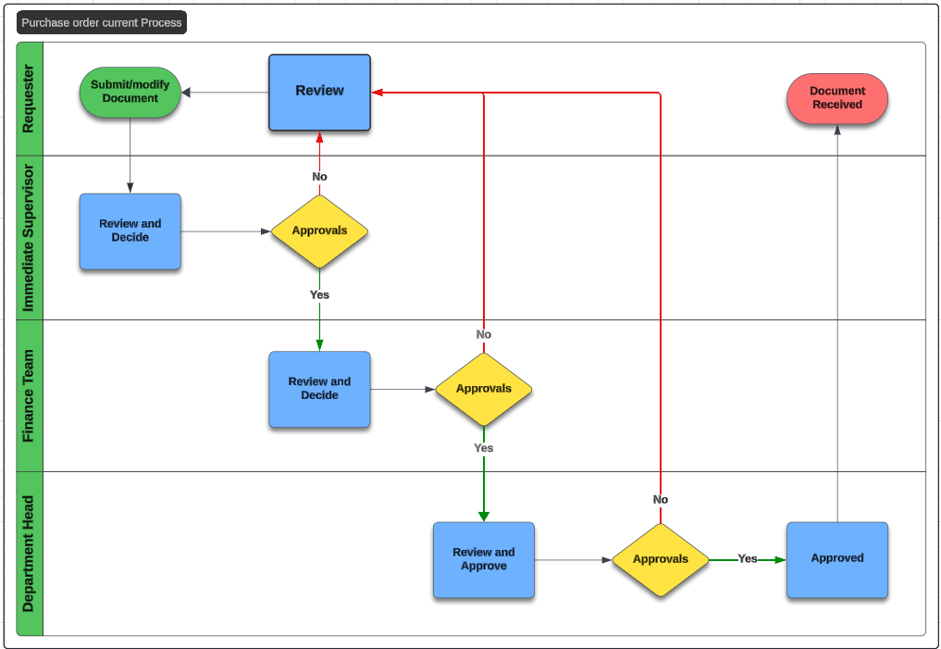
SWIMLANE AS IS
AA
4

Slide 6
CHALLENGES
Many companies still used the manual method to enter the information into documents. This often leads to errors as there can be errors in this process, which makes the process inaccurate.​
Manual Data Entry
The approval procedure currently is challenging and is prone to errors as its manual. It is possible for requesters or approvers to complete forms incorrectly or forget to sign them entirely. ​
Error-Prone Procedure
Currently, the documents are created and uploaded in different formats Word documents, PDFs, and spreadsheets. Different document formats cause problems for document management systems, as it makes it harder to handle and review papers.
Inconsistent Document Formats
Stakeholders frequently need to approve papers while on the go in today's mobile-centric society. But for stakeholders who are far away, the inability of document management and approval systems can limit and prevent timely approvals.​
Lack of Accessibility
SS
5

Slide 7
CHALLENGES
The current As-Is process it's possible that stakeholders aren't aware of the workflow process as a whole or the status of document approvals. This lack of openness may cause misunderstandings, and problems with accountability.​
Limited Visibility
It might be difficult to keep track of and preserve audit trails for document approvals when using manual or paper-based procedures. Organizations may find it difficult to prove compliance with internal policies or regulatory obligations in the absence of a audit trail.​
Difficulty in Audit Trails
The main concerns is safeguarding confidential information from breaches, illegal access, and data loss when managing documents manually.​ Sensitive information contained in physical documents is at danger of theft, loss, or destruction, which could compromise its security.​
Concern Related to Data Security
SS
6

Slide 8
TO BE PROCESS
Electronic Document Management Systems (EDMS)
The Electronic Document Management System can be used to replace the manual paper-based approval processes.
The EDMS can be used as a mainstream medium for approvals using automated workflow and electronic signatures and serves as a platform for multiple people to collaborate to a single document.
Enables approvals and collaboration
A central location to store all the files and documents securely, reducing the risk of losing paperwork. It helps in version control of documents.
Central and Secure Storage
A personalized Dashboard can be created to help the companies and clients track the documents.
Dashboard Tracking
SP
7

Slide 9
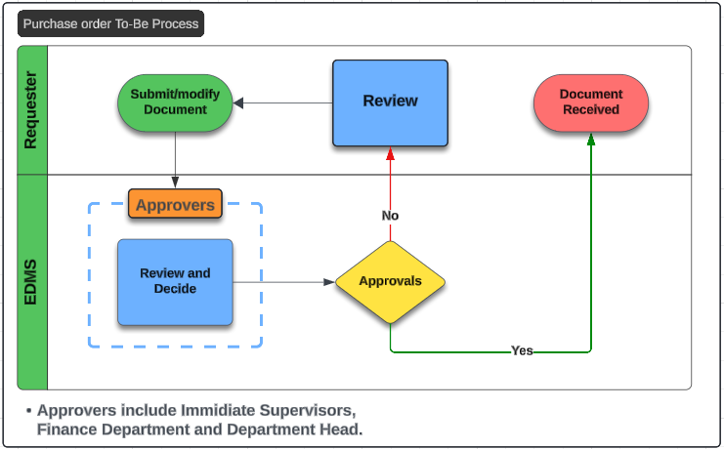
SWIMLANE TO BE
SP
8

Slide 10
BENEFITS
ENHANCED EFFICIENCY
DECISION MAKING
Automation of approval workflows with an Electronic Document Management System (EDMS) speeds up the entire approval process.
Faster processing and readily available information enable swifter decision-making.
STREAMLINED COLLABORATION
ENHANCED SECURITY
An EDMS facilitates efficient collaboration, allowing simultaneous work on documents without version conflicts.
Centralized storage in an EDMS enhances security against unauthorized access..
COST REDUCTION
REAL-TIME TRACKING
Electronic workflows ensure completeness and correctness, reducing errors and compliance issues.
Personalized dashboards provide real-time tracking of document statuses, improving transparency.
RS
9

Slide 11




CONCLUSION
Transitioning to an Electronic Document Management System (EDMS) modernizes processes for increased efficiency and accuracy.
The revamped workflow ensures streamlining and error reduction.
Implementing an EDMS eliminates challenges, enhancing productivity.
This system enables seamless collaboration, reduces processing time, and provides greater visibility and control.
Overall, adopting an EDMS enhances efficiency, reduces turnaround time, and offers transparency for all involved parties.
RS
10

Slide 12
THANK YOU

