Slide 1
Number guessing

Slide 2
What is Number Guessing ?
How it is difference to play Number Guessing with your computer ?

Slide 3
Task:
Build a Number guessing game, with predefine range.
Let’s say User select a number, i.e., from A to B, where A and B belong to Integer.
Some random integer will be selected by the system and the user has to guess that integer in the minimum number of guesses.

Slide 4
Flow Chart:
Start
Guess a Number
Not Matched
Check
Matched
Range
Congrulations!
Not Reached
Reached at MAX
Restart
Restart

Slide 5


GUI(Tkinter)
Tkinter is the most common, fast and easy to use Python package to build GUI application.
To install the library, you can use pip install command to the command prompt:

Slide 6
Geometric Manager
There are mainly three geometery manager classes class.
Pack() method
Grid() method
Place() method

Slide 7

Widgets used:
Button
Label

Slide 8
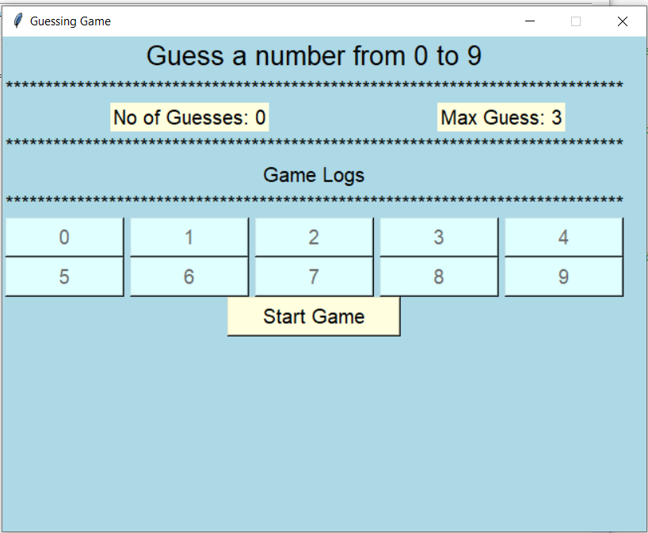
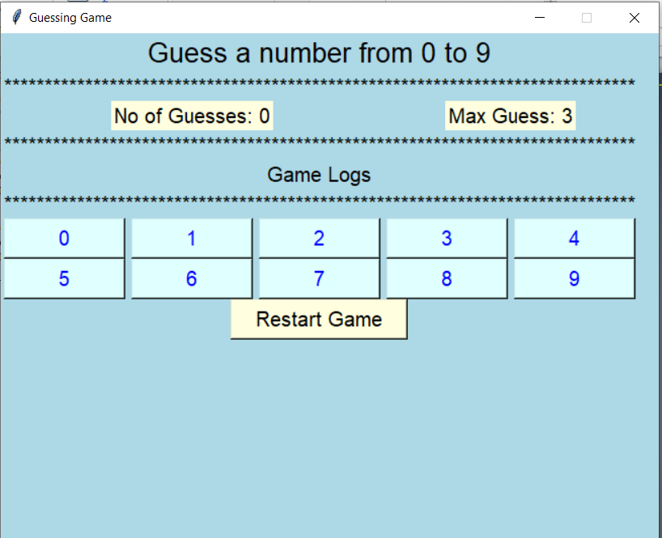
Project working

Slide 9
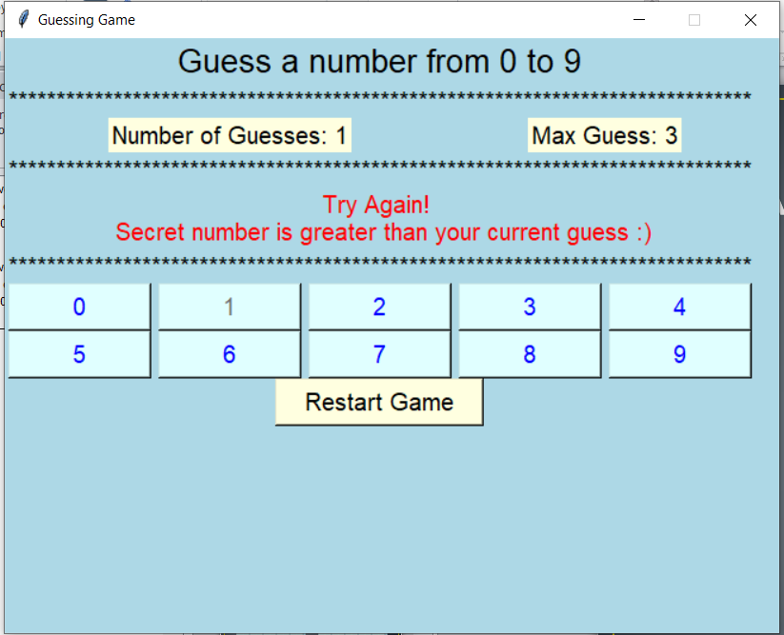
First guess:
Choose a number for first input.

Slide 10
Disable Button:
i.e 1 is disable.

Slide 11
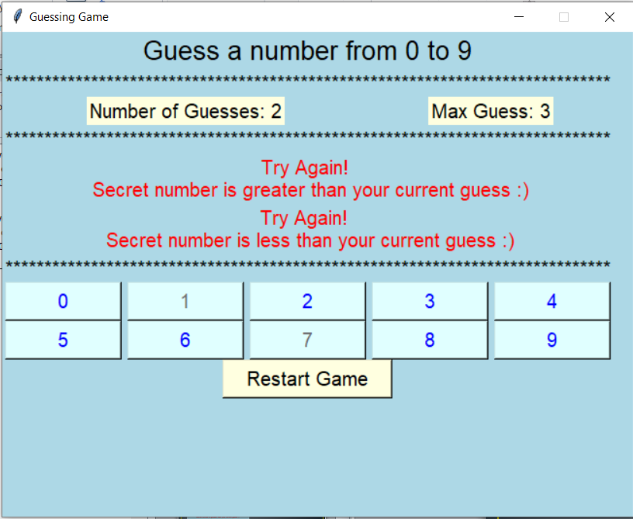
Second guess :
Number of Guesses reached 2.

Slide 12
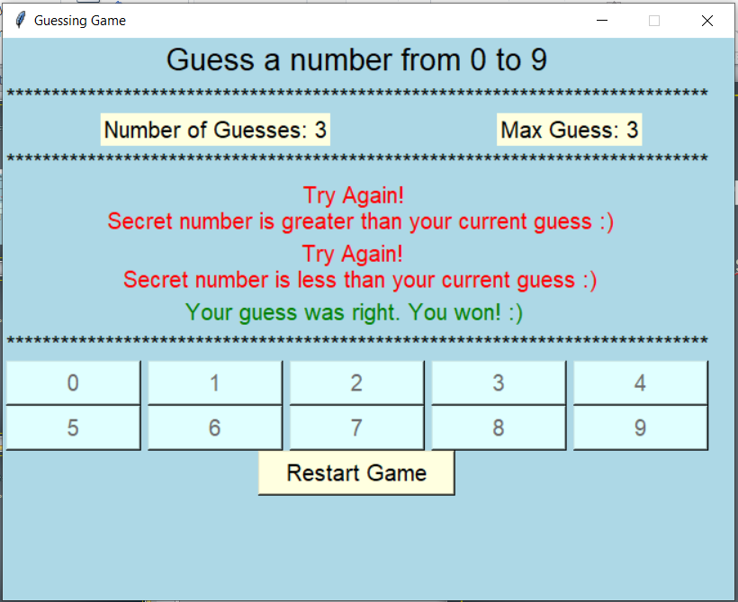
Third guess :
Number of Gusses reached 3.

Slide 13
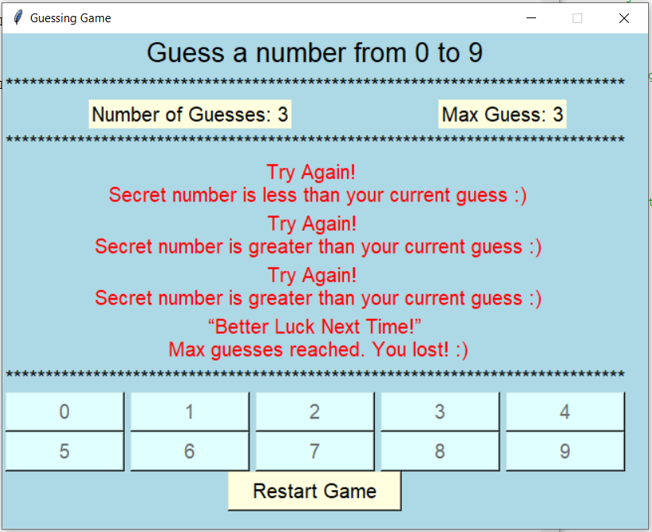
Max Limit Reached:
Max Gusses Reached at this Stage you start again by clicking Restart.

Slide 14
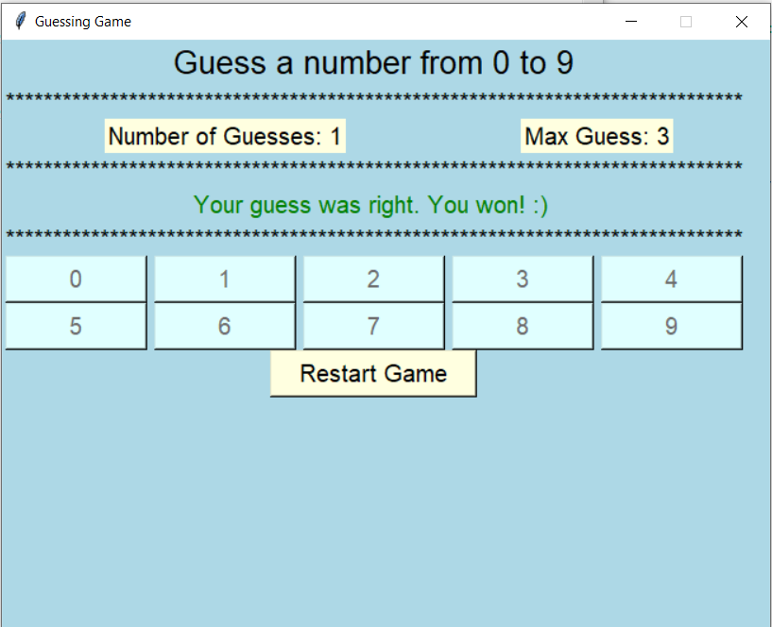
Restart
Max guess reached
Won or in Between

