Slide 1
E MAIL SLICER

Slide 2

Email short for electronic mail is a method of exchanging messages between people using electronic devices, along with the web. It allows you to send and receive messages to and from anyone with an email address, anywhere in the world.

Slide 3

E-mail address breakdown:
The first portion of all e-mail addresses, the part before the @ symbol, contains the alias, user, group, or department of a company.
Next, the @ (at sign) is a divider in the e-mail address. It's required for all SMTP e-mail addresses
Finally, gmail.com is the domain.

Slide 4

Slice method() [Basic python]
The slice() function returns a slice object.
A slice object is used to specify how to slice a sequence. You can specify where to start the slicing, and where to end. You can also specify the step, which allows you to e.g. slice only every other item.
SYNTAX :-

Slide 5
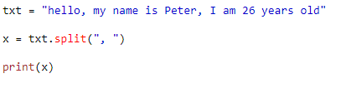

Split method
The split() method splits a string into a list.
You can specify the separator, default separator is any whitespace.
Example.
INPUT:
OUTPUT:

Slide 6
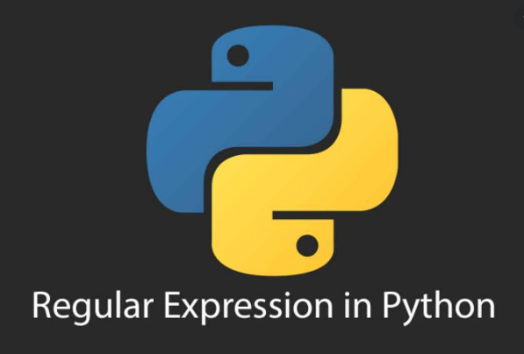
RE MODULE
A regular expression is a special sequence of characters that helps you match or find other strings or sets of strings, using a specialized syntax held in a pattern.

Slide 7
SPECIAL CHARACTERS
SYMBOLS | DESCRIPTION
. (DOT) | In the default mode, this matches any character except a newline.
^ (Caret.) | Matches the start of the string.
$(DOLLAR) | Matches the end of the string or just before the newline at the end of the string.
*(MUL.) | Causes the resulting RE to match 0 or more repetitions of the preceding RE, as many repetitions as are possible.
+(ADD) | Causes the resulting RE to match 1 or more repetitions of the preceding RE.
?(QUES.) | Causes the resulting RE to match 0 or 1 repetitions of the preceding RE.ab? will match either ‘a’ or ‘ab’.
\(BACK.) | Either escapes special characters (permitting you to match characters like '*', '?', and so forth), or signals a special sequence;

Slide 8
regular expression methods
The "re" package provides several methods to actually perform queries on an input string. We will see the methods of re in Python:
re.match()
re.search()
re.findall()

Slide 9
Re.match()
re.match() function of re in Python will search the regular expression pattern and return the first occurrence. The Python RegEx Match method checks for a match only at the beginning of the string. So, if a match is found in the first line, it returns the match object. But if a match is found in some other line, the Python RegEx Match function returns null.

Slide 10
Re.search()
re.search() function will search the regular expression pattern and return the first occurrence. Unlike Python re.match(), it will check all lines of the input string. The Python re.search() function returns a match object when the pattern is found and “null” if the pattern is not found.

Slide 11
Re.findall()
findall() module is used to search for “all” occurrences that match a given pattern. In contrast, search() module will only return the first occurrence that matches the specified pattern. findall() will iterate over all the lines of the file and will return all non-overlapping matches of pattern in a single step.

Slide 12


GUI(Tkinter)
Tkinter is the most common, fast and easy to use Python package to build GUI application.
To install the library, you can use pip install command to the command prompt.

Slide 13
Geometric manager
There are mainly three geometry manager classes.
Pack() method
Grid() method
Place() method

Slide 14


Widgets used
Label
Entry
Button

Slide 15
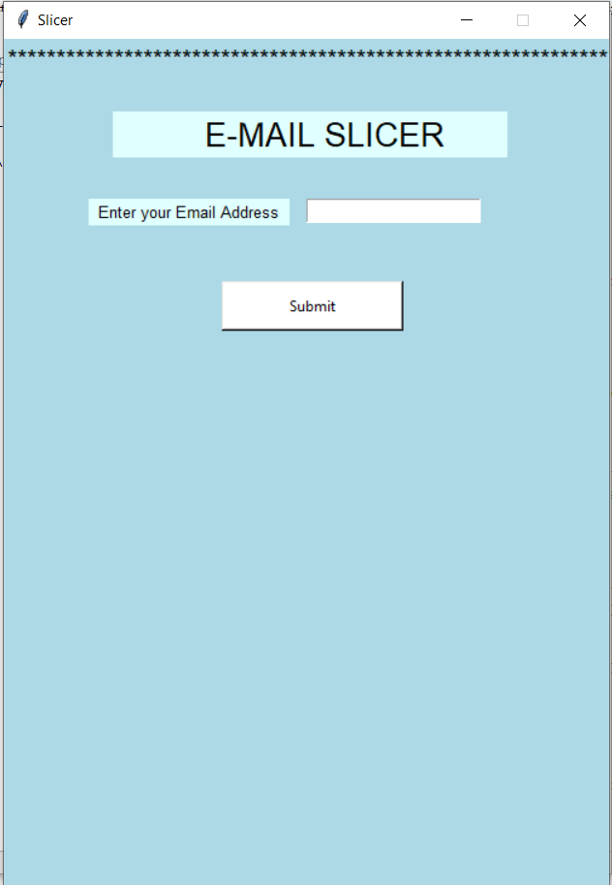
Project working
Step 1: Enter the input to check the input is in the valid format or not. Or to slice the address.

Slide 16
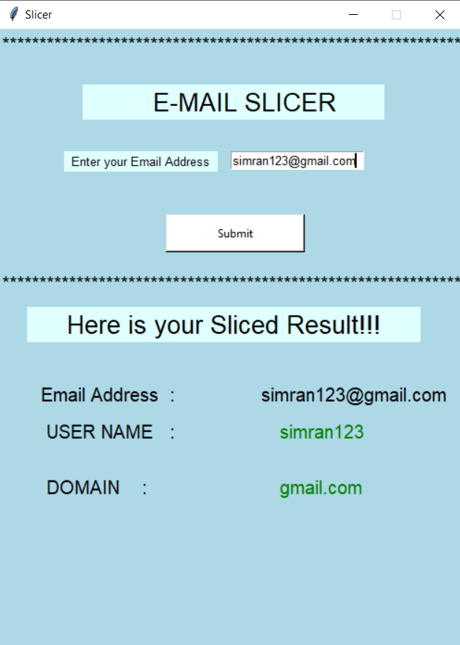
output
OUTPUT:- If the address is valid then the output shown in the following manner.

Slide 17
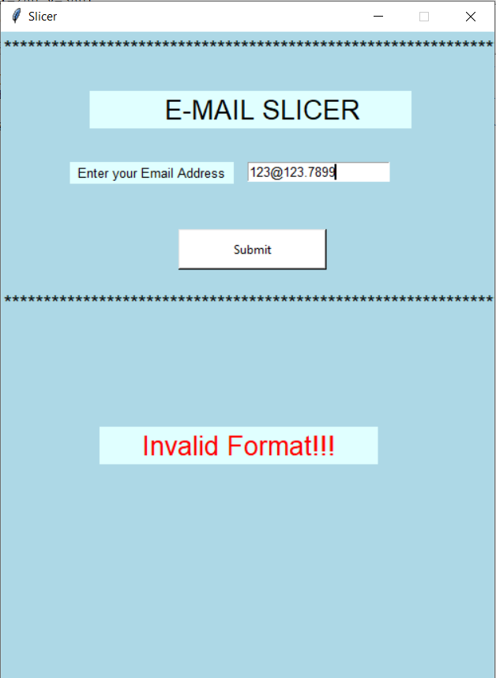
Invalid format
The Output shown “INVALID FORMAT” if the format of the input is not supportable.

Slide 18
LEAP IT

Slide 19

A leap year is a calendar year that contains an additional day added to keep the calendar year synchronized with the astronomical year or seasonal year.

Slide 20

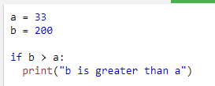

"if statements"
Simple if Statements
if statement" is written by using the if keyword.
Syntax:
Example:

Slide 21
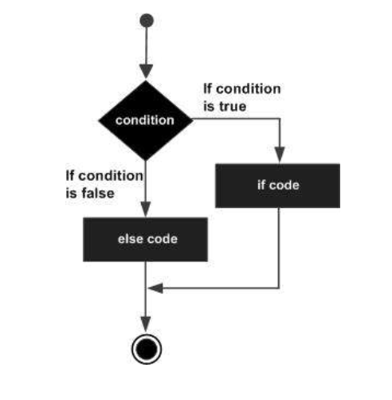
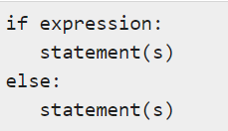
if-else Statements
Syntax:
Flow Diagram:

Slide 22
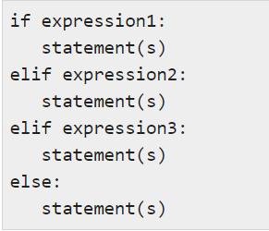
The elif statement
The elif statement allows you to check multiple expressions for TRUE and execute a block of code as soon as one of the conditions evaluates to TRUE.
Syntax:

Slide 23
Logical operators
There are 3 types of operators.
and : True if both the operands are true
or : True if either of the operands is true.
not : True if operand is false(complements the operand)

Slide 24
Gui(Tkinter)
Tkinter is the most common, fast and easy to use Python package to build GUI application.
To install the library, you can use pip install command to the command prompt:

Slide 25
Geometric manager
There are mainly three geometry manager classes .
Pack() method
Grid() method
Place() method

Slide 26
Widget used:
Button
Label
Entry

Slide 27
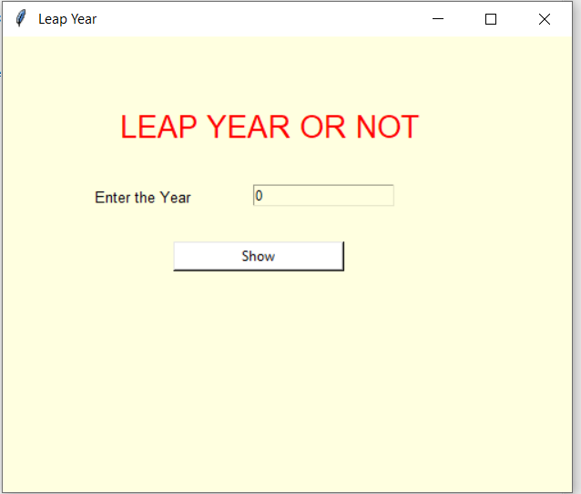
Working of project
Enter year to check the year is leap or not.

Slide 28
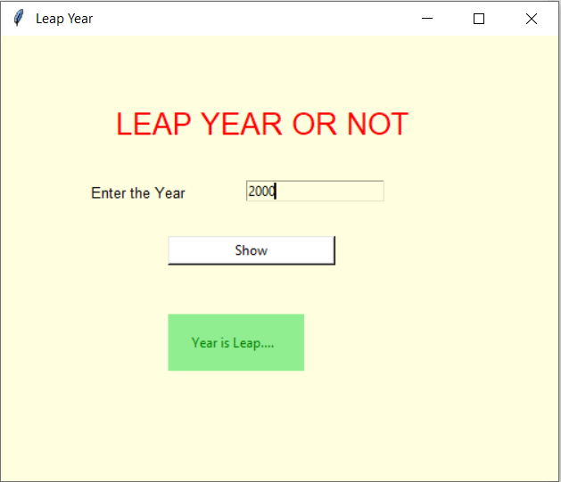
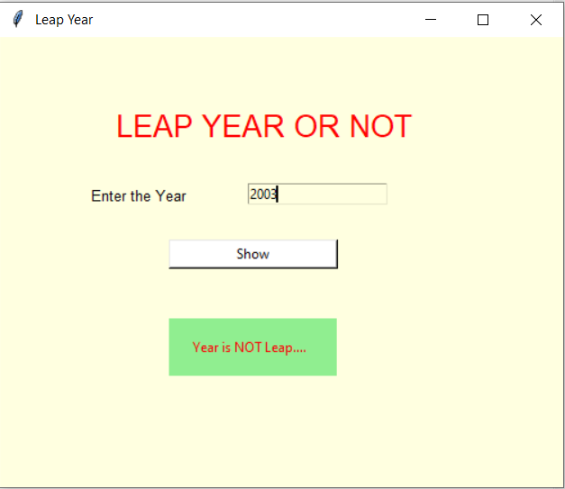
Output:
Displaying output for yr.2000
Displaying output for yr.2003

Slide 29
Number guessing

Slide 30
What is Number Guessing ?
How different to play Number Guessing with your computer ?

Slide 31
Task:
Build a Number guessing game, with predefine range.
Let’s say User select a number, i.e., from A to B, where A and B belong to Integer.
Some random integer will be selected by the system and the user has to guess that integer in the minimum number of guesses.

Slide 32
Flow Chart:
Start
Guess a Number
Not Matched
Check
Matched
Range
Congrulations!
Not Reached
Reached at MAX
Restart
Restart

Slide 33
GUI(Tkinter)
Tkinter is the most common, fast and easy to use Python package to build GUI application.
To install the library, you can use pip install command to the command prompt:

Slide 34
Geometric Manager
There are mainly three geometry manager classes class.
Pack() method
Grid() method
Place() method

Slide 35

Widgets used:
Button
Label

Slide 36
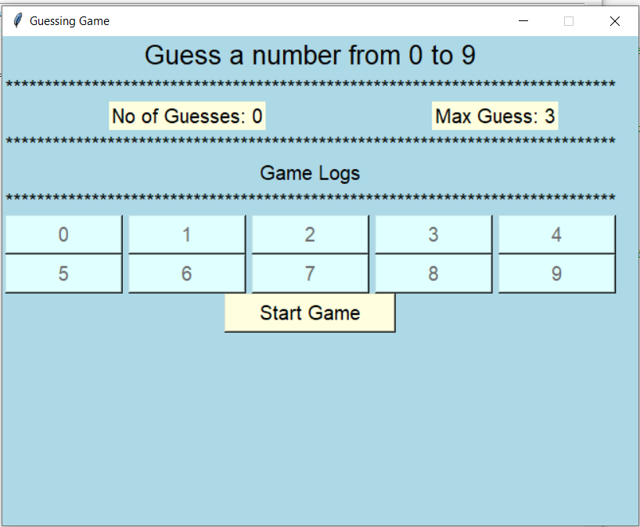
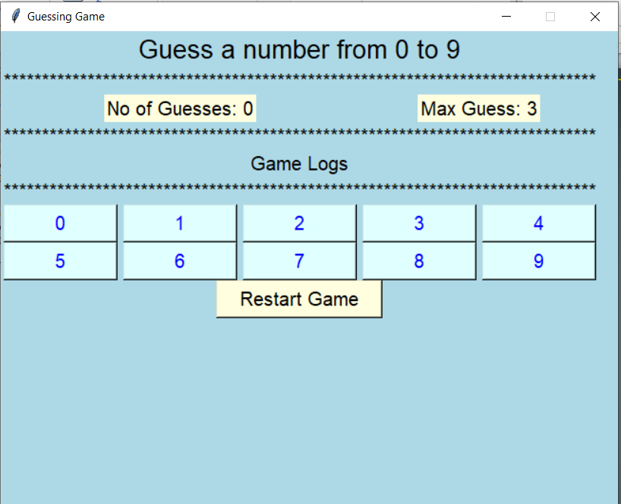
Working of Project

Slide 37
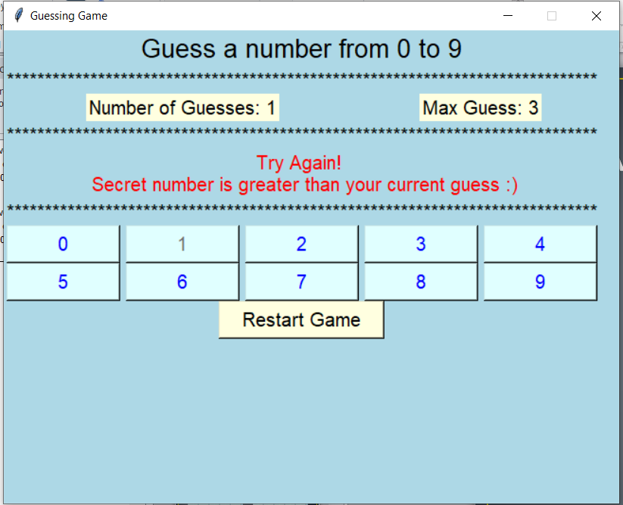
First guess:
Choose a number for first input.
i.e: user select 1

Slide 38
Disable Button:
i.e 1 is disable.

Slide 39
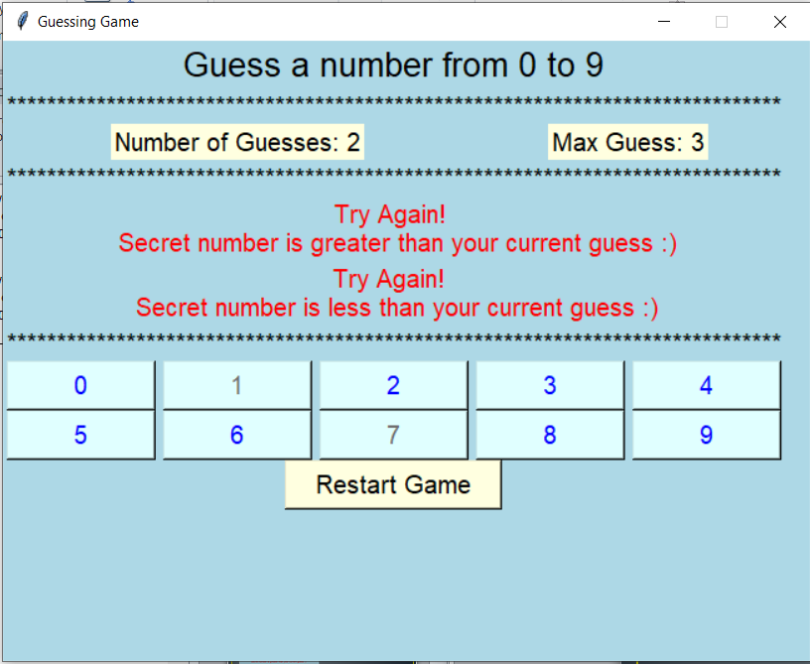
Second guess :
Number of Guesses reached 2.
i.e. user select 7

Slide 40
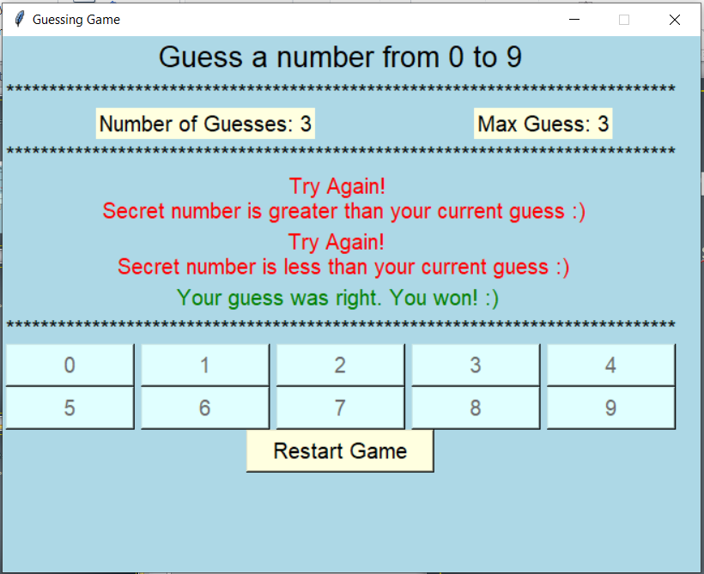
Third guess :
Number of Guesses reached 3.

Slide 41
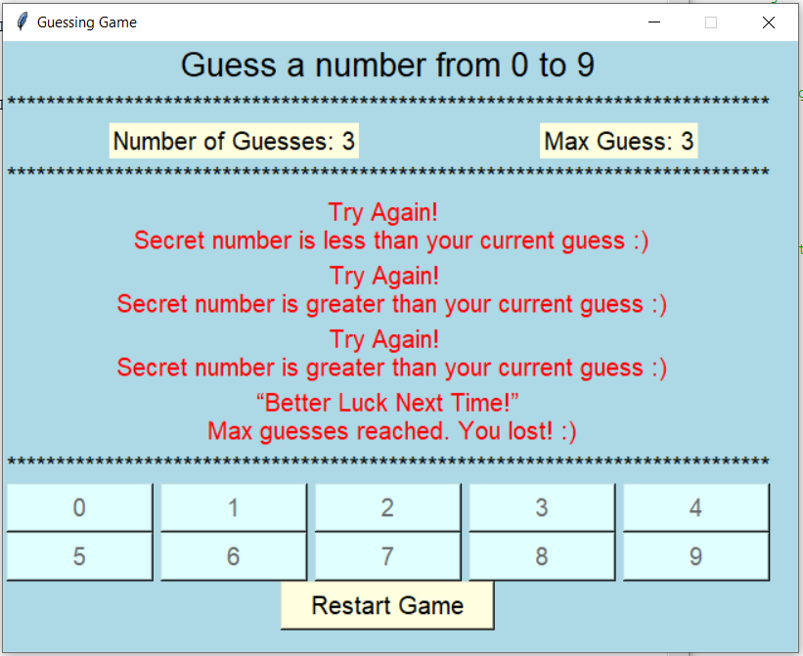
Max Limit Reached:
At this Stage when user is unable to guess the number generated by the system. and user lost.

Slide 42
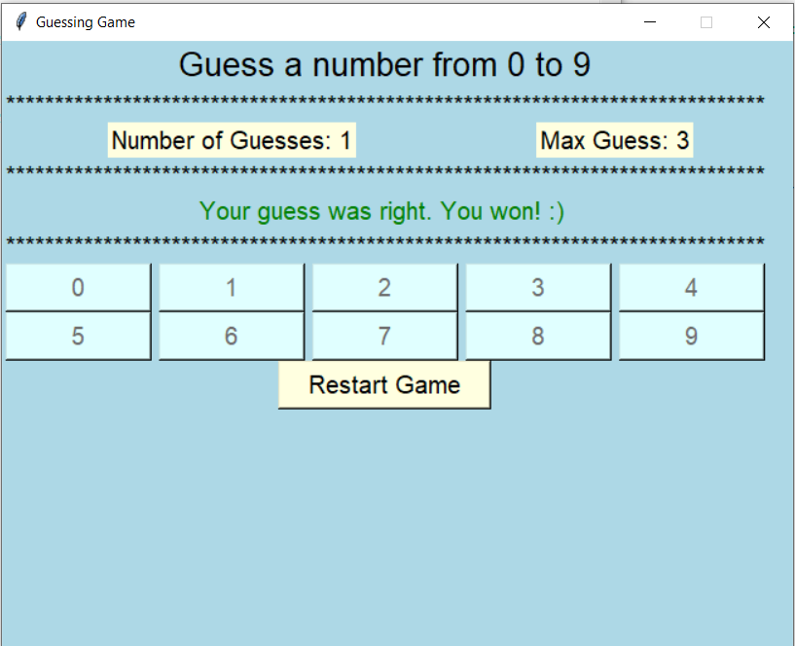
Restart
Max no.of guesses reached
In Between or The user Won

Slide 43
Python web blocker

Slide 44
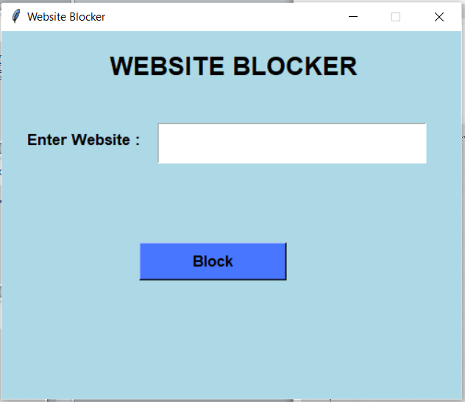
Website Blocker is a tool that denies access to websites permanently or by schedule. To use the internet safely we can block all websites from unwanted categories.

Slide 45
objective
This project will help the user to stay away from their distraction by blocking websites from their device so that they can not open them.
In this Python Website Blocker Project, the user can enter multiple websites to block, and then clicking on the block button will check the condition that if the website already blocked then print ‘already blocked’ else blocked all that websites and print ‘blocked’.

Slide 46
Project Prerequisites
To implement website blocker project, we will use the basic concepts of Python and Tkinter library.
Tkinter is a standard GUI Python library. It is one of the fastest and easiest ways to build GUI applications using Tkinter.
To install the library, you can use pip install command to the command prompt:

Slide 47
Steps to build Website blocker Python Project
Importing the module
Create the display window
Create an entry widget
Define function
Create a block button

Slide 48
Create the display window
Tk()
geometry()
resizable(0,0)
title()
Label()
font
root – name which we refer to our window
text – which we display on the label
pack – organized widget in block

Slide 49
File Handling
Data is small then this processing can be done every time you run the script but in case of humongous data repetitive processing cannot be performed, hence the processed data needs to be stored. This is where data storage or writing to a file comes in.

Slide 50

Open a File in Python
Reading and writing file:
We use open () function in Python to open a file in read or write mode.
open ( ) will return a file object.
Syntax:

Slide 51
Access Modes.
There are Six kinds of mode:
Read Only (‘r’)
Read and Write (‘r+’)
Write Only (‘w’)
Write and Read (‘w+’)
Append Only (‘a’)
Append and Read (‘a+’)

Slide 52
Working of Project
When the user enter the URL.
(i.e www.facebook.com) and on click the block button user blocks the url.

Slide 53
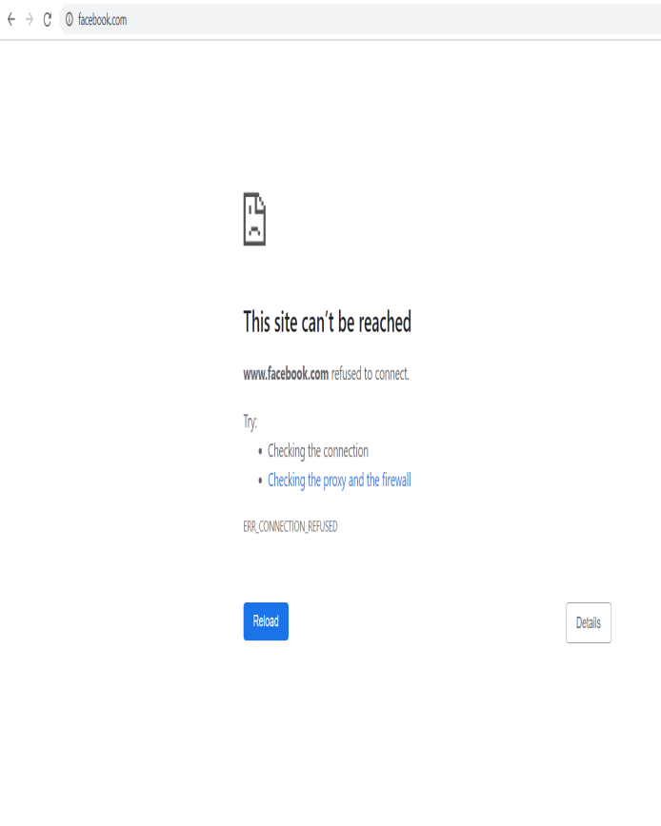
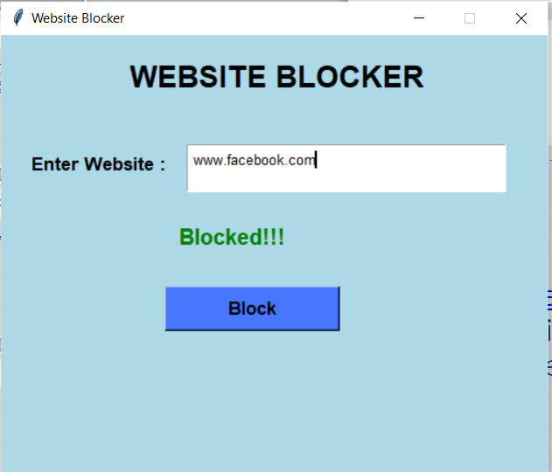
Working of Project

Slide 54
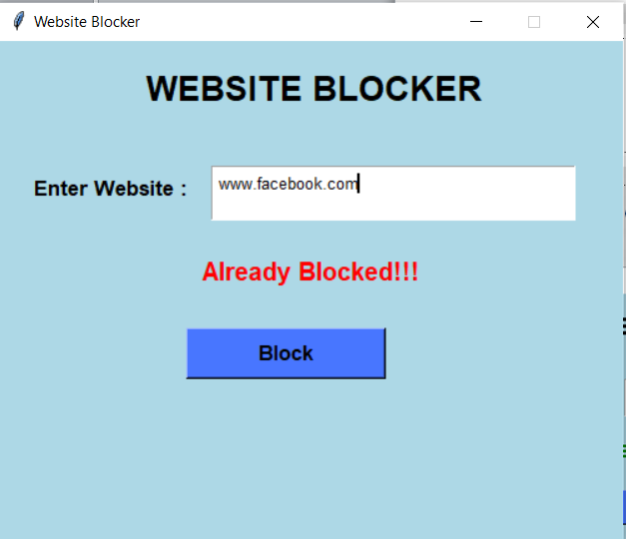
Working of Project
User will not allowed to block already blocked sites.

Slide 55
Dice rolling simulator

Slide 56
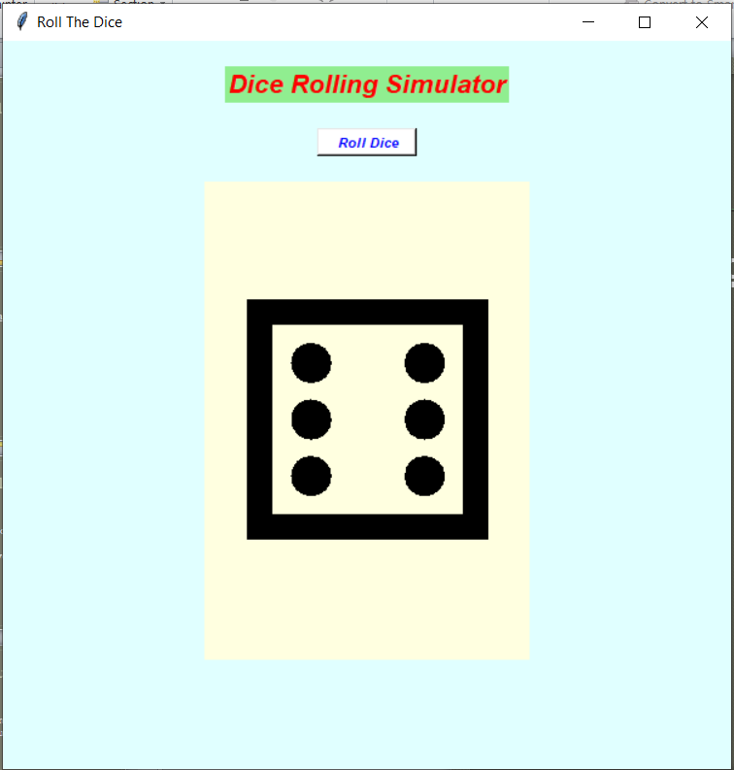
Dice rolling Simulator???

Slide 57
What is Simulator???
A simulation is a program or machine that simulates a real life situation, meaning that it creates a virtual version of it.

Slide 58
Types of simulator.
Live Simulation
Virtual Simulation
Constructive Simulation

Slide 59

Live Simulation
This simulation involving real people operating real systems.

Slide 60

Virtual Simulation
This simulation involving real people operating simulated systems.
This inject Human-In-The-Loop in a central role by exercising.

Slide 61
Constructive Simulation
Real people can simulate(make inputs) but are not involved in determining outcomes.

Slide 62
GUI (Graphic User Interface)
Tkinter is the most common, fast and easy to use Python package to build GUI application.To install the library, you can use pip install command to the command prompt:

Slide 63
Geometric Manager
There are mainly three geometry manager classes class.
Pack() method
Grid() method
Place() method

Slide 64
Widgets in Tkinter
Button
Canvas
Check Button
Entry
Frame
Label
List Box

Slide 65

Random Module
It is used to generate the pseudo-random variables.
To use random module
we have to import first the module into our file.

Slide 66
Methods in Random Module
Randrange()
Randint()
Random()
Uniform()
Choice()
Shuffle()

Slide 67
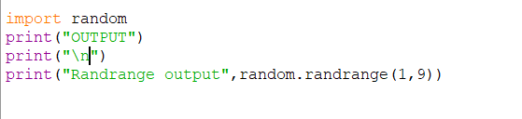
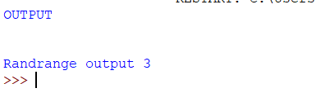
Randrange()
Always returns an
integer value which
include
the lower limit and
exclude the upper
limit.

Slide 68
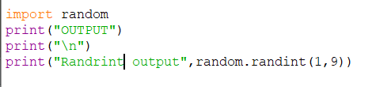
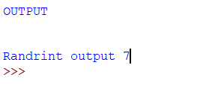
Randint()
Always returns an
integer value which
includes
both lower limit and
the upper limit.

Slide 69
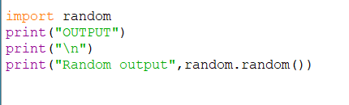
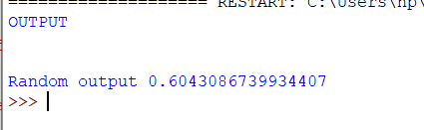
Random()
Always returns
floating value
between 0 and 1.
no parameters
requires for this
method.

Slide 70
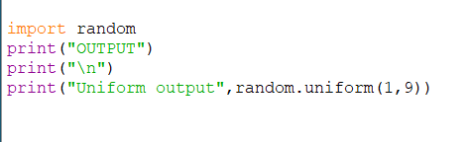
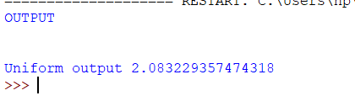
Uniform()
Always returns
floating value
which include
the lower limit and
exclude the upper
limit.

Slide 71
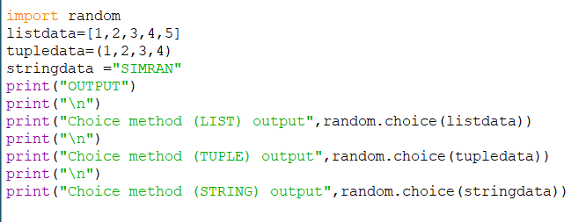
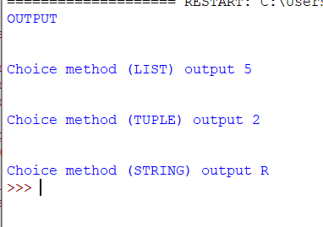
Choice()
This method is
used for random
selection from
list, tuple, string.

Slide 72
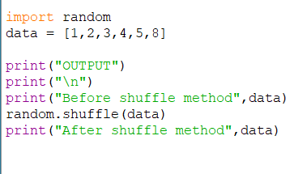
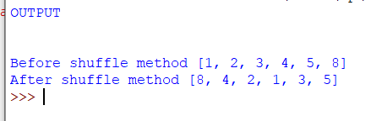
Shuffle()
This method shuffle
the items of a
given list.
(change the order
of the list item)

Slide 73
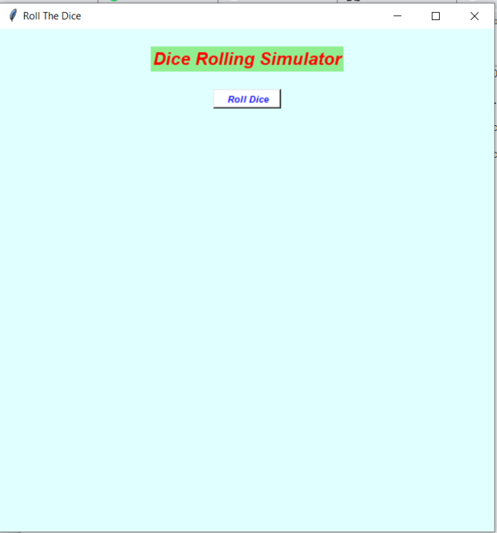
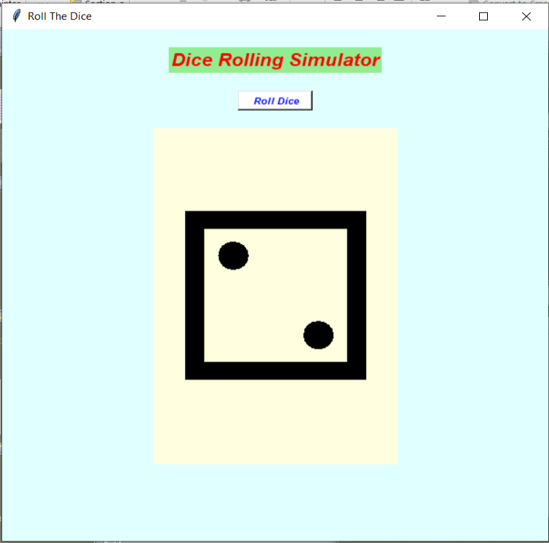
Working of simulator
Initial stage
Functional stage

Slide 74
Thankyou…

