Slide 1
LEAP IT
simran

Slide 2
A leap year is a calendar year that contains an additional day added to keep the calendar year synchronized with the astronomical year or seasonal year.

Slide 3

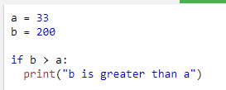

"if statements"
Simple if Statements
if statement" is written by using the if keyword.
Syntax:
Example:

Slide 4
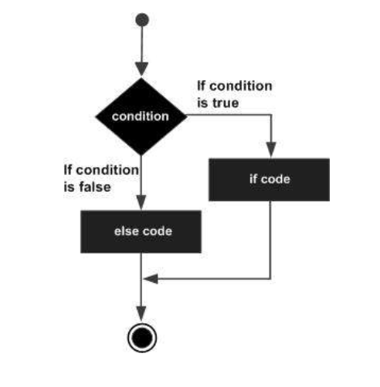
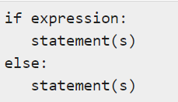
if-else Statements
Syntax:
Flow Diagram:

Slide 5
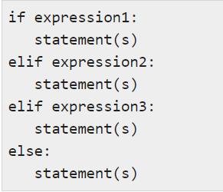
The elif statement
The elif statement allows you to check multiple expressions for TRUE and execute a block of code as soon as one of the conditions evaluates to TRUE.
Syntax:

Slide 6
Logical operators
There are 3 types of operators.
and : True if both the operands are true
or : True if either of the operands is true.
not : True if operand is false(complements the operand)

Slide 7


Gui(Tkinter)
Tkinter is the most common, fast and easy to use Python package to build GUI application.
To install the library, you can use pip install command to the command prompt:

Slide 8
Geometric manager
There are mainly three geometery manager classes class.
Pack() method
Grid() method
Place() method

Slide 9


Widget used:
Button
Label
Entry

Slide 10
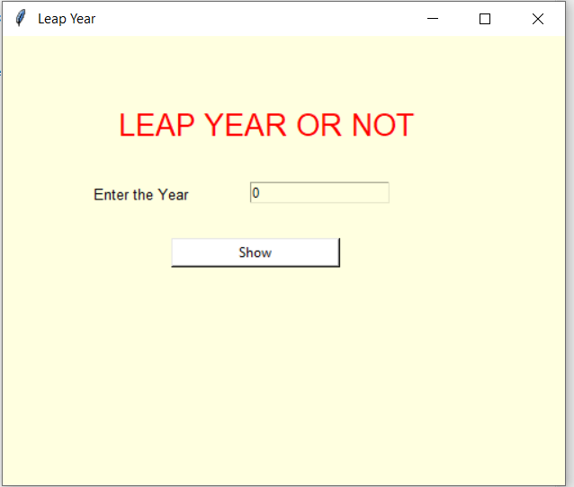
Working of project
Enter year to check the year is leap or not.

Slide 11
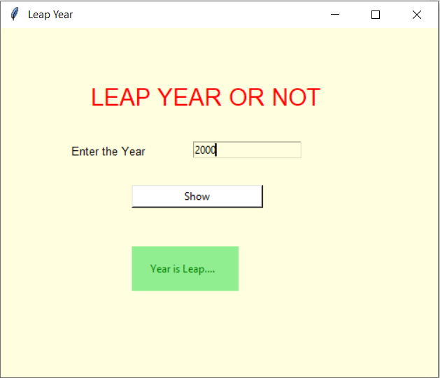
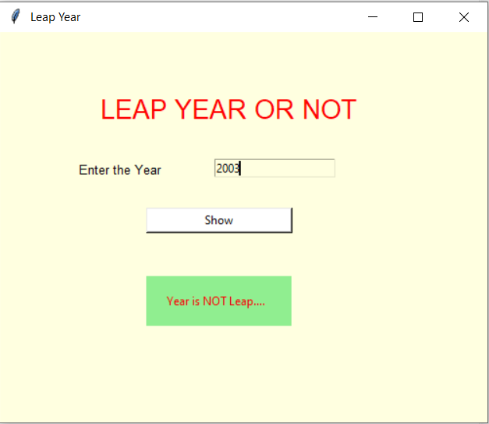
Output:
Displaying output for yr.2000
Displaying output for yr.2003

