Slide 1
Github Simplified
By:- Simranjit Singh Monga

Slide 2
Version Control
What is Version Control?
Why should you care?
Version control is a system that record changes to a file or set of files over time so that you can recall specific versions later.

Slide 3
Local Version Control System
Many people’s version-control method of choice is to copy files into another directory.
Common and simple approach.
Incredibly error prone.
It is easy to forget which directory you’re in and accidentally write to the wrong file or copy over files you don’t mean to.
Collaboration

Slide 4
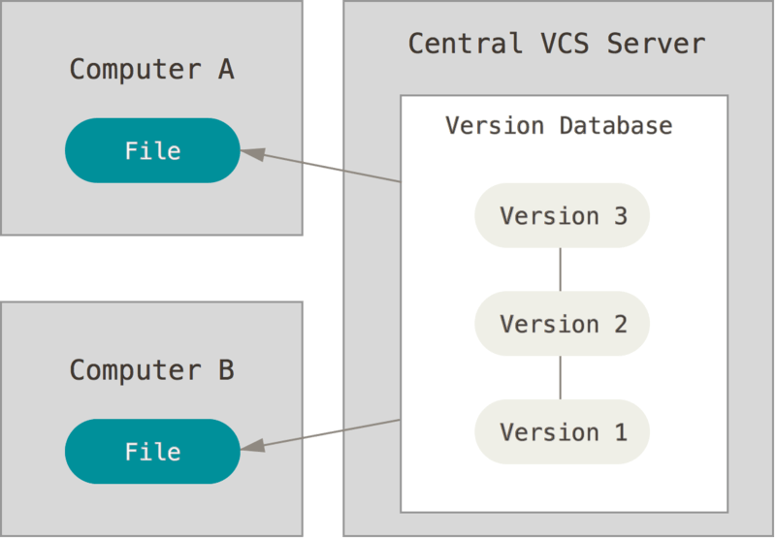
Centralized Version Control System

Slide 5
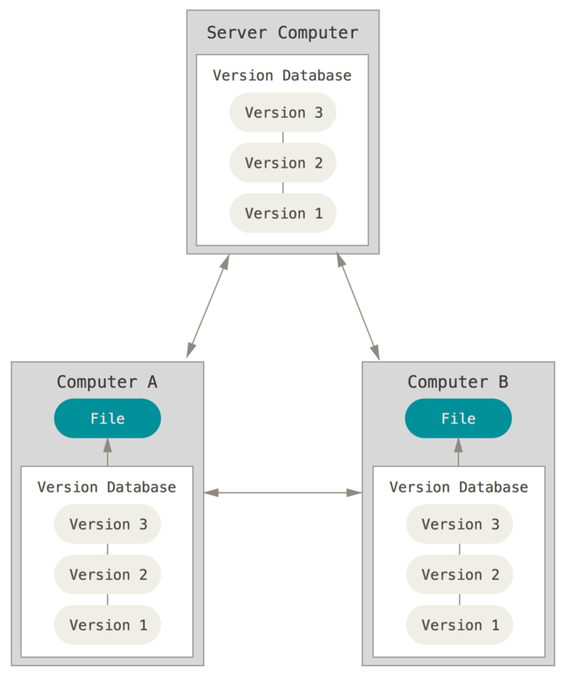
Distributed Version Control System

Slide 6
Git :- Three States
Committed :- Data is safely stored in your local database
Modified :-You have changed the file but have not committed it to your database yet.
Staged :- You have marked a modified file in its current version to go into your commit snapshot.

Slide 7
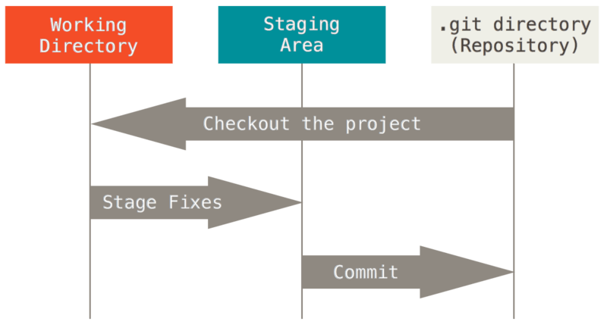
Graphical Representation
Git Directory: - Git stores metadata and object database for your project.
The working directory is a single checkout of one version of the project. These files are pulled out of the compressed database in the Git directory and placed on disk for you to use or modify.
The staging area is a file, generally contained in your Git directory, that stores information about what will go into your next commit. It’s sometimes referred to as the “index”, but it’s also common to refer to it as the staging area.

Slide 8
The basic Git workflow goes something like this:
You modify files in your working directory.
You stage the files, adding snapshots of them to your staging area.
You do a commit, which takes the files as they are in the staging area and stores that snapshot permanently to your Git directory.

Slide 9
Git Installation & Updates
https://git-scm.com/downloads
git clone git://git.kernel.org/pub/scm/git/git.git

Slide 10
First time git setup
$ git config –global user.name “SimranjitSinghMonga”
$ git config –global user.email “Simran_monga2003@Hotmail.com”

Slide 11
Section 2
Getting a Git Repository

Slide 12
First Way:- Creating new repository
If you’re starting to track an existing project in Git, you need to go to the project’s directory and type
  git init
This creates a new subdirectory named .git that contains all of your necessary repository files – a Git repository skeleton
If you want to start version-controlling existing files , you should probably begin tracking those files and do an initial commit
  E.g git add .
  git add *.c
  git add licence
Commit changes
  git commit –m “initial project version”

Slide 13
Second Way :-
Clone other projects
  git clone https://github.com/libgit2/libgit2
  It will create directory with the same name as of repository “ligbit2”
Second option :
  Git clone https://github.com/libgit2/libgit2 Simran
  It will create directory with your given name

Slide 14
Recording Changes to the Repository
You have a bona fide Git repository and a checkout or working copy of the files for that project
You need to make some changes and commit snapshots of those changes into your repository each time the project reaches a state you want to record.
Remember that each file in your working directory can be in one of two states: tracked or untracked. Tracked files are files that were in the last snapshot; they can be unmodified, modified, or staged.

Slide 15
Recording Changes to the Repository
Untracked files are everything else – any files in your working directory that were not in your last snapshot and are not in your staging area.
When you first clone a repository, all of your files will be tracked and unmodified because Git just checked them out and you haven’t edited anything .
As you edit files, Git sees them as modified, because you’ve changed them since your last commit. You stage these modified files and then commit all your staged changes, and the cycle repeats.

Slide 16
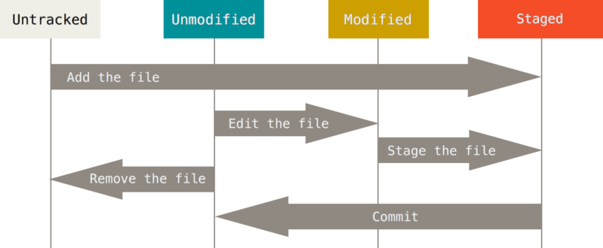
Graphical Representation..

Slide 17

Checking the status of your file.
git status to check current status
git status

Slide 18
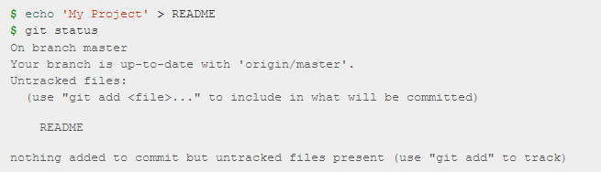
Let’s say you have added a new file , now when you will run git status command :-
  git status

Slide 19
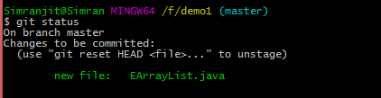
Track New File
git add EArrayList
git checkout EArrayList :- It will uncommit changes.

Slide 20
Commit History

Slide 21
Viewing the Commit History
git log
git log –p -2 to see difference between two entries
git log –stat

Slide 22
Remote push
git remote add origin
https://github.com/SimranjitSinghMonga/Example.git
git push -u origin master
Git checkout –b branchname

Slide 23
Thank You

