Slide 1



Topic: STACK
Group Members:
Ruder Razdan (2022a1r001)
Bhuvan Sharma (2022a1r003)
Simriti Kak (2022a1r004)
Aakash Sharma (2022a1r008)
Dhananjay Singh (2022a1r018)
Pratham Seth (2022a1r037)
Model Institute of Engineering & Technology (Autonomous)
Notes:
Presentation slide for courses, classes, lectures et al.

Slide 2
STACK
(), and isFull()
A stack is a linear data structure that follows the Last In, First Out (LIFO) principle, where elements are inserted (pushed) and removed (popped) from the same end, called the top of the stack.
It can be implemented using arrays or linked lists, and supports key operations like:
PUSH() - TOP() - isFull()
POP() - isEmpty()

Slide 3

Merits and Demerits of stack
Merits | Demerits
Easy to implement | Limited size in arrays (fixed size)
Fast access to last inserted data | No random access to elements
Efficient memory usage in some scenarios | May lead to stack overflow/underflow errors

Slide 4
Why stack is important ?
1. Undo/Redo Functionality: In many applications, stacks are used to store the history of user actions, allowing users to easily undo or redo changes.
2. Function Call Management: Stacks store return addresses and local variables during function calls, enabling proper execution flow and allowing functions to return to the correct location.
3. Helps in Syntax: Parsing Compilers use stacks to validate syntax, especially matching parentheses or nested expressions.

Slide 5
Real World Application of Stack
Undo operations in editors (Ctrl +Z)
Web browser history
Expression evaluation

Slide 6
Stack Operations
push(x): Insert element x at the top
1
pop(): Remove the top element
2
top(): Return top element without removing it
3
isEmpty(): Check if the stack is empty
4
isFull(): Check if the stack is full
5

Slide 7
Time and Space Complexity
Operation | Time Complexity | Space Complexity
Push | O(1) | O(1)
Pop | O(1) | O(1)
Top | O(1) | O(1)
isEmpty | O(1) | O(1)
isFull | O(1) | O(1)

Slide 8
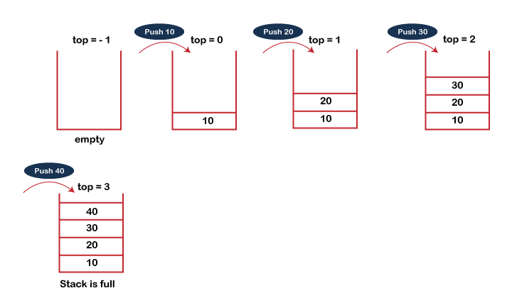
Example of Push() operation

Slide 9
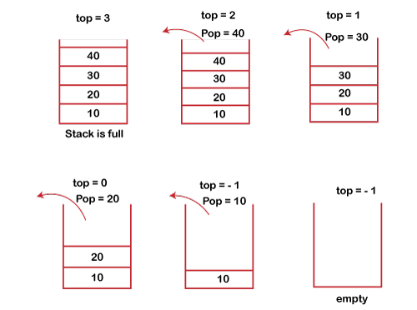
Example of Pop() operation

Slide 10
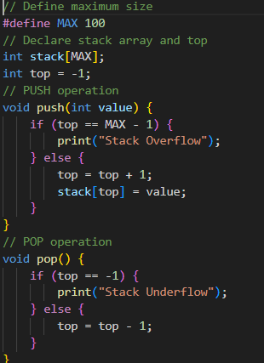
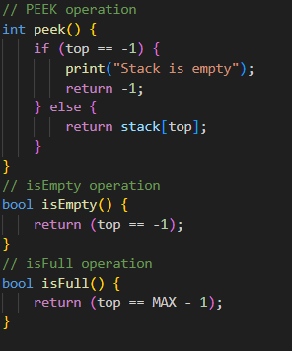
Stack Implementation using Array Pseudocode:

Slide 11
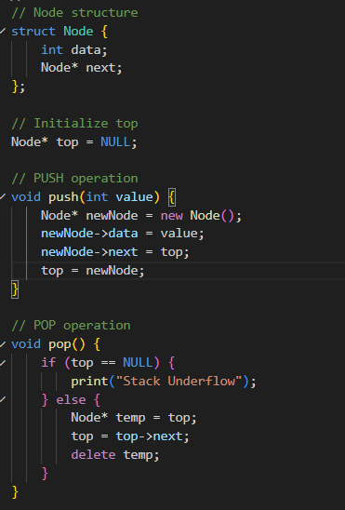
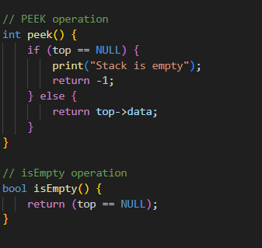
Stack Implementation using Linked List Pseudocode:

Slide 12
Polish Notations
Polish Notation, also called Postfix Notation, is a way of writing arithmetic expressions without the need for parentheses to define operator precedence.
Polish notation in data structure tells us about different ways to write an arithmetic expression.
There are mainly three type of polish Notation:
1. Infix notation: This polish notation in data structure states that the operator is written in between the operands.
2. Prefix notation: This notation in data structure states that the operator should be present as a prefix or before the operands.
3. Postfix notation: This notation in data structure states that the operator should be present as a after the operands.

Slide 13
Operator Precedence Table
Precedence Level | Operator(s) | Description | Associativity
1 (Highest) | () | Parentheses | Left to Right
2 | ^ | Exponentiation | Right to Left
3 | *, /, % | Multiplication / Division / Modulo | Left to Right
4 | +, - | Addition / Subtraction | Left to Right
5 (Lowest) | = | Assignment (in programming) | Right to Left

Slide 14
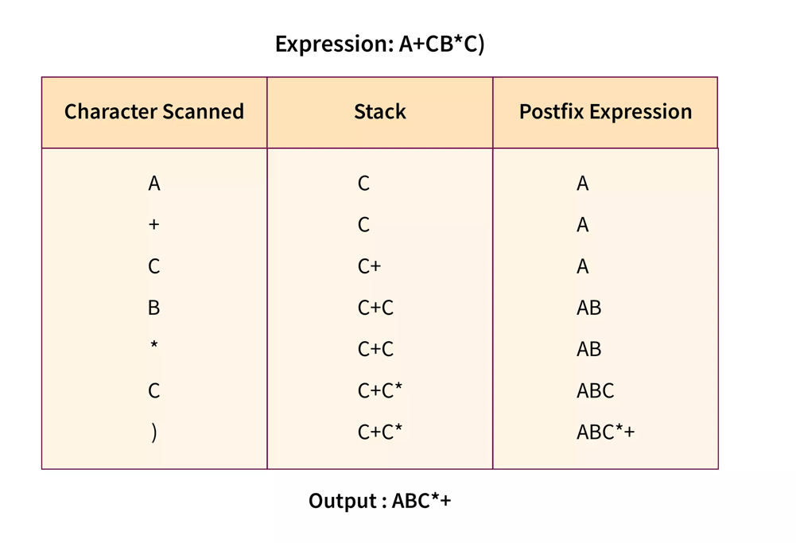
Postfix Example

Slide 15
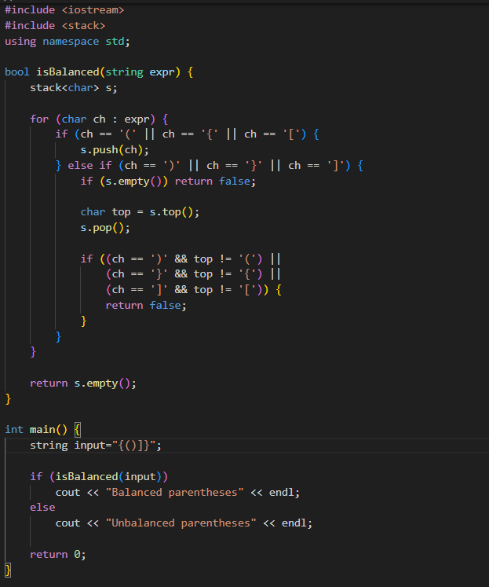
Balancing Parentheses

