Slide 1
Instacart Data Warehouse
Name : Simron Waskar
ID – U39071640
Prof. John Russo

Slide 2








Agenda
Project background
Dataset source
Snowflake Schema
ETL process
Lesson Learned

Slide 3


Project background
A grocery ordering and delivery app (Instacart), aims to make it easy to fill customers’ needs. After selecting products through the app, personal shoppers review orders and do the in-store shopping and delivery.
In this project, we will use transactional data to create a data warehouse and develop dashboard that answers our business questions.

Slide 4
Dataset source
Dataset: https://www.kaggle.com/c/instacart-market-basket-analysis/data
For each user, dataset provides between 4 and 100 orders, with the sequence of products purchased in each order. Dataset also provides the week and hour of day the order was placed, and a relative measure of time between orders.
Size: 205.77 MB
The dataset contains a sample of over 3 million grocery orders from more than 200,000 Instacart users.

Slide 5
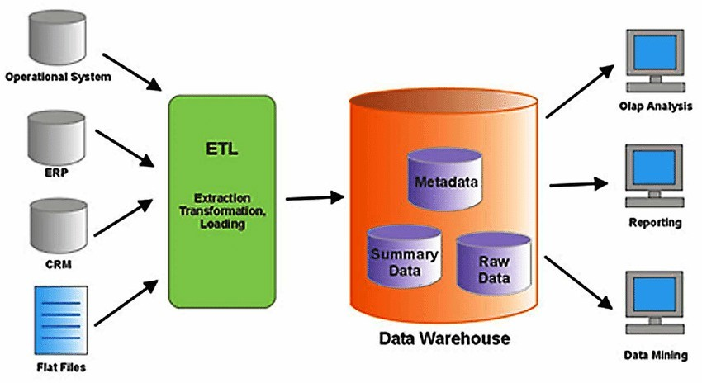
Data Warehouse Modeling

Slide 6
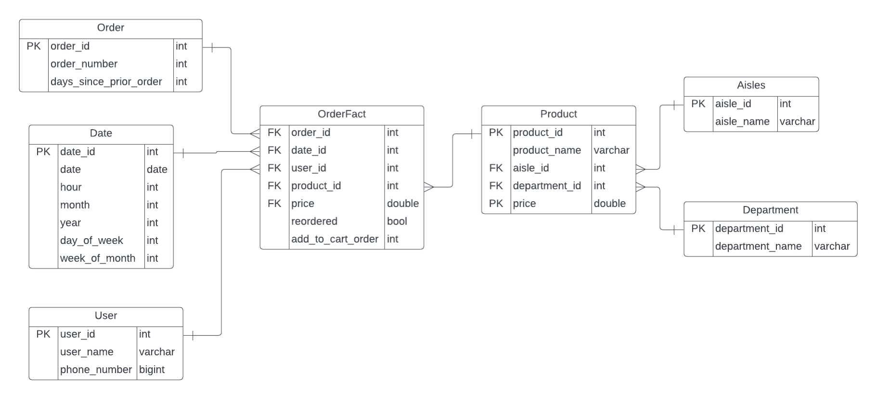
Schema

Slide 7
ETL Process
We are doing SCD (type 2) on column phone_number as it usually change relatively slow
We have 6 dimension tables, including a date dimension:
Order
User
Product
Aisles
Department
Date
We also have a fact table i.e., OrderFact
we have around 250,000 record in our fact table

Slide 8
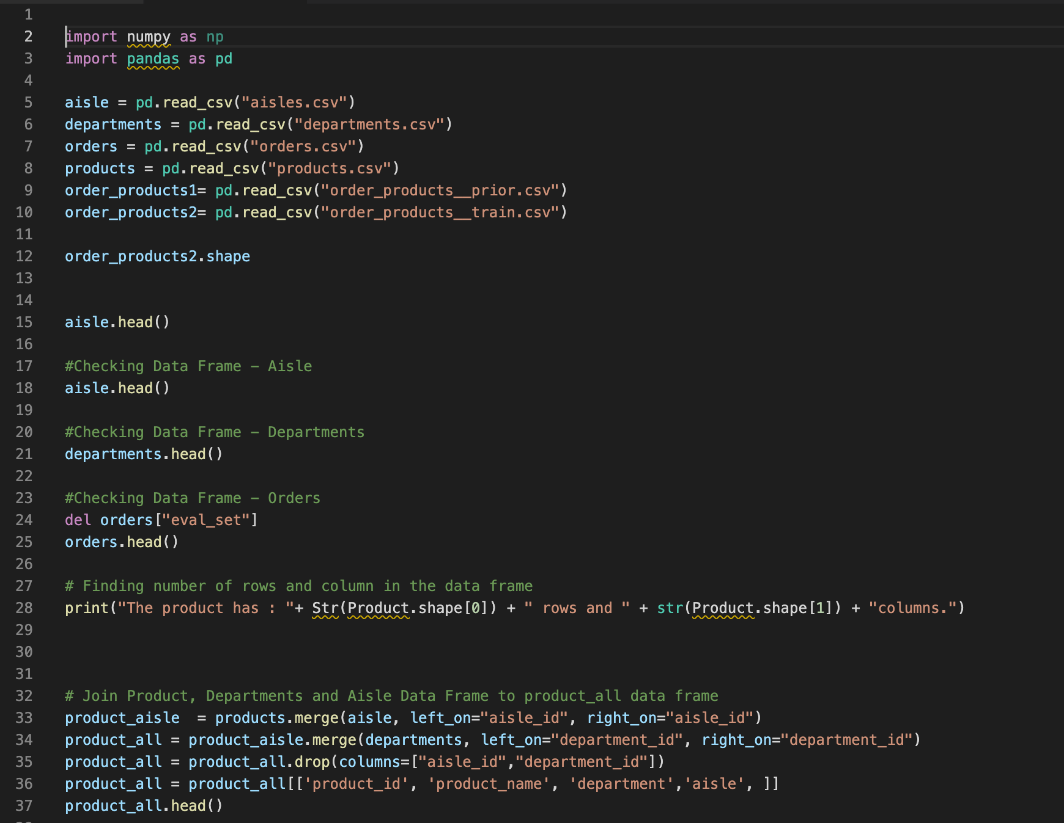
ETL cont.

Slide 9
When do people usually make their orders?
When do people usually make their orders again?
How many products people have in one order on average? What are the most reordered products?
Business Questions
What is average spending for a user monthly?
Which items people add to their cart first?
Which department generated the most sales?
Which aisle generated the most sales? Who are the top 50 spenders?
How many users made more than 3 orders using Instacart app in the same day of the week?

Slide 10
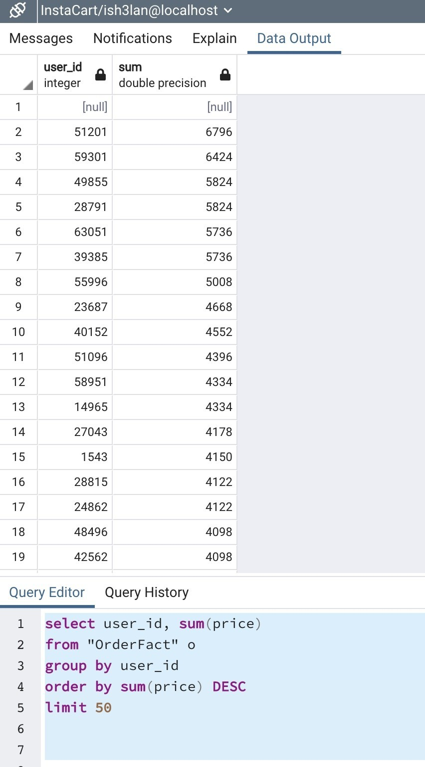
Business Question- Query
Who are the top 50 spenders?

Slide 11
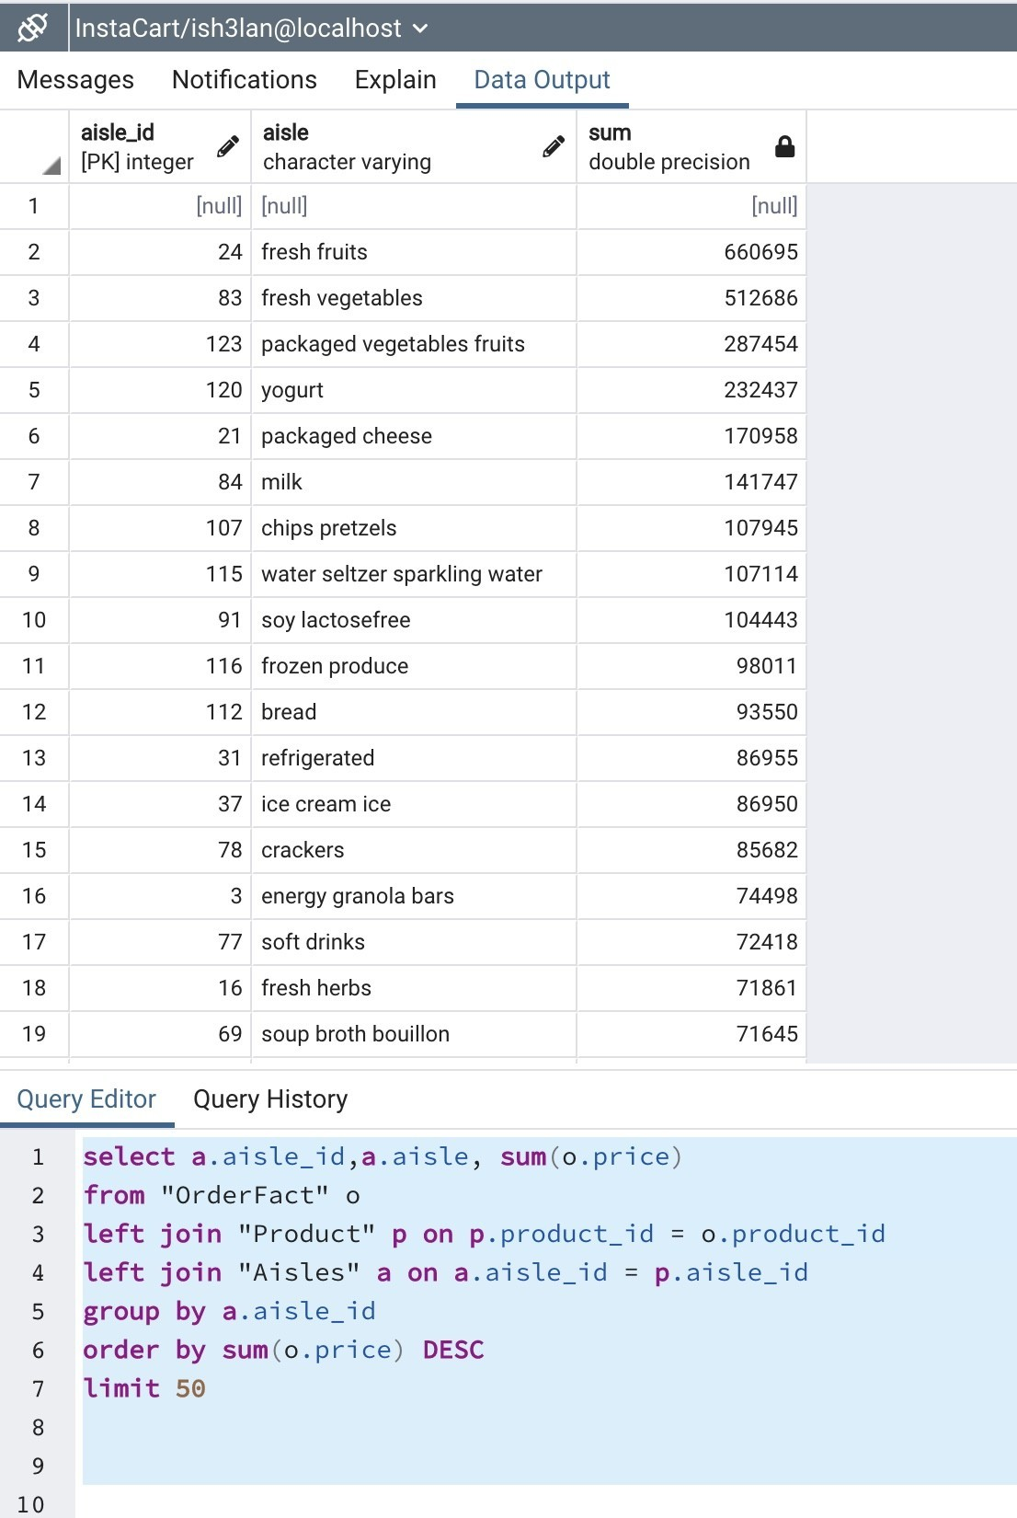
Business Question – Query Cont.
Which aisle generated the most sales?

Slide 12



Visualization

Slide 13
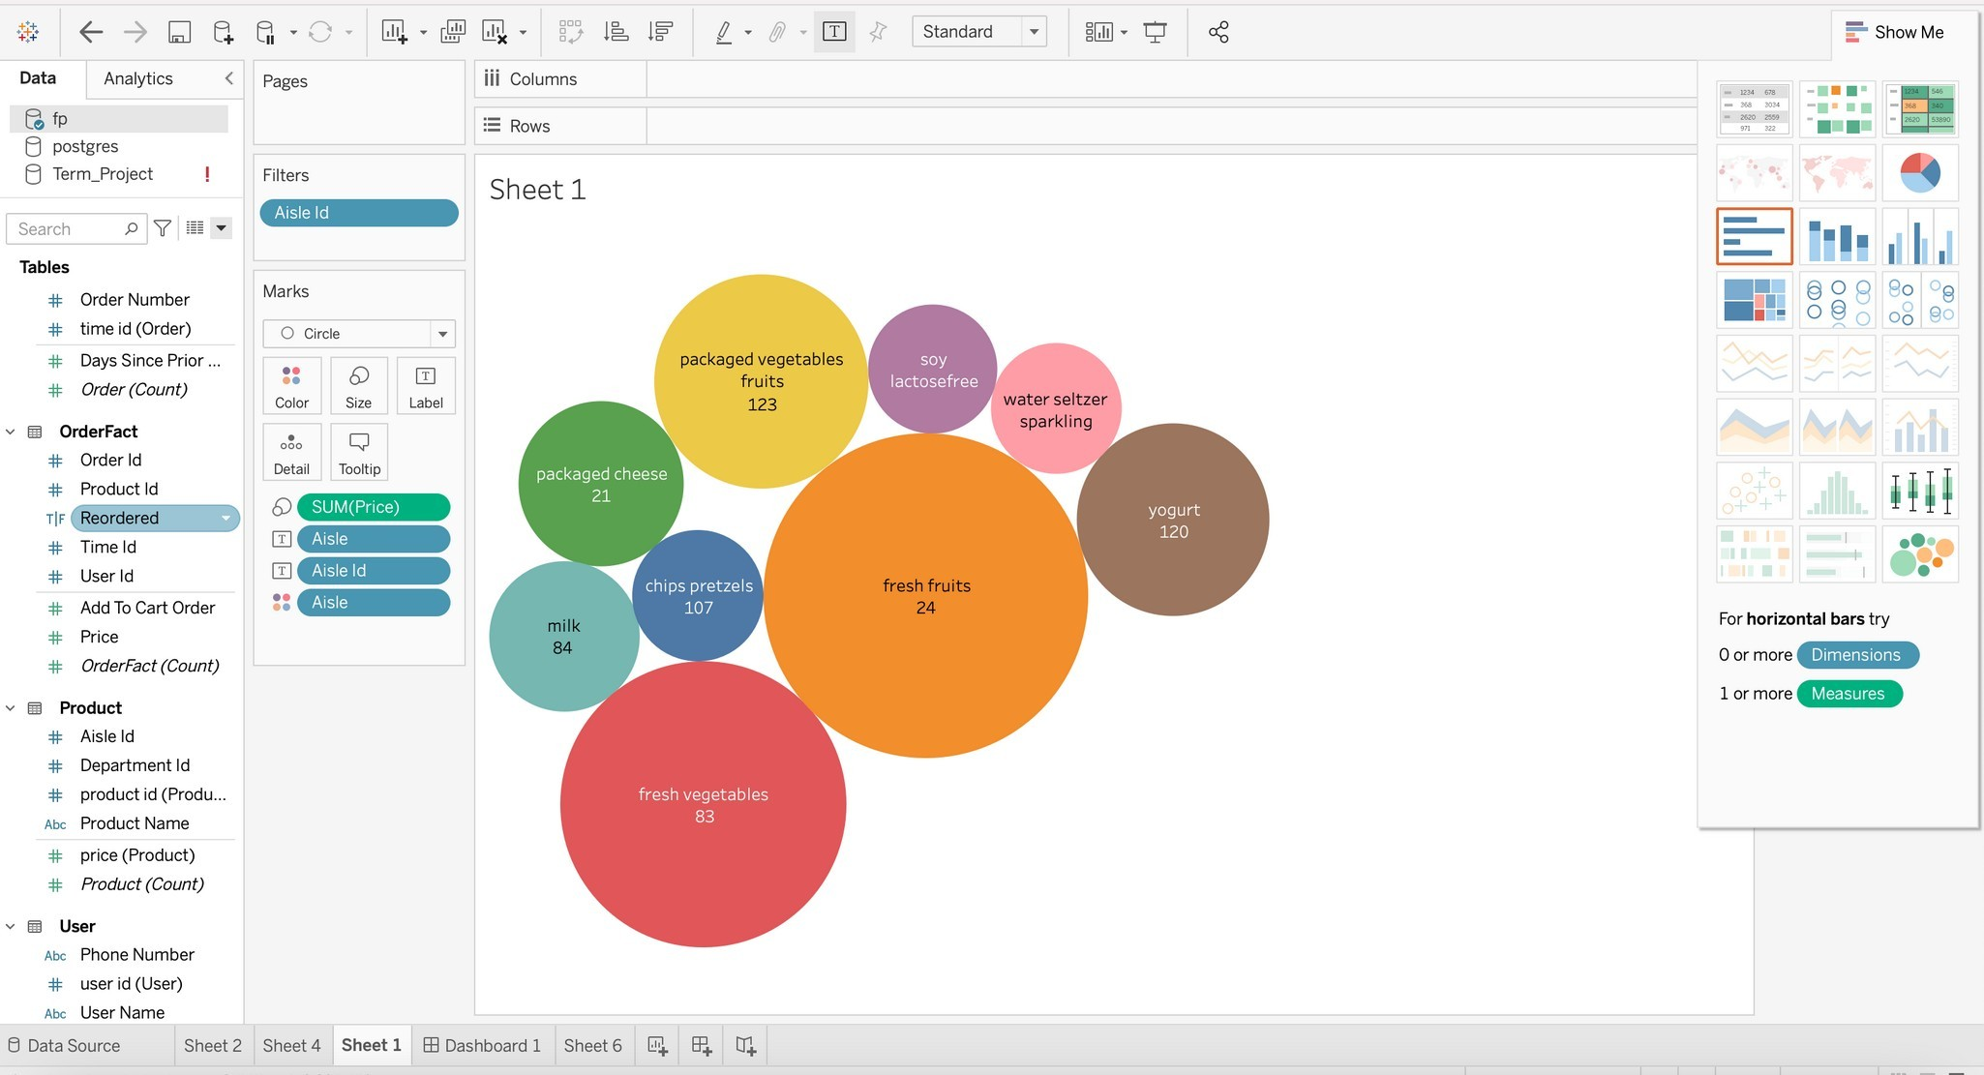
Visualization 1
Which aisle generated the most sales?

Slide 14
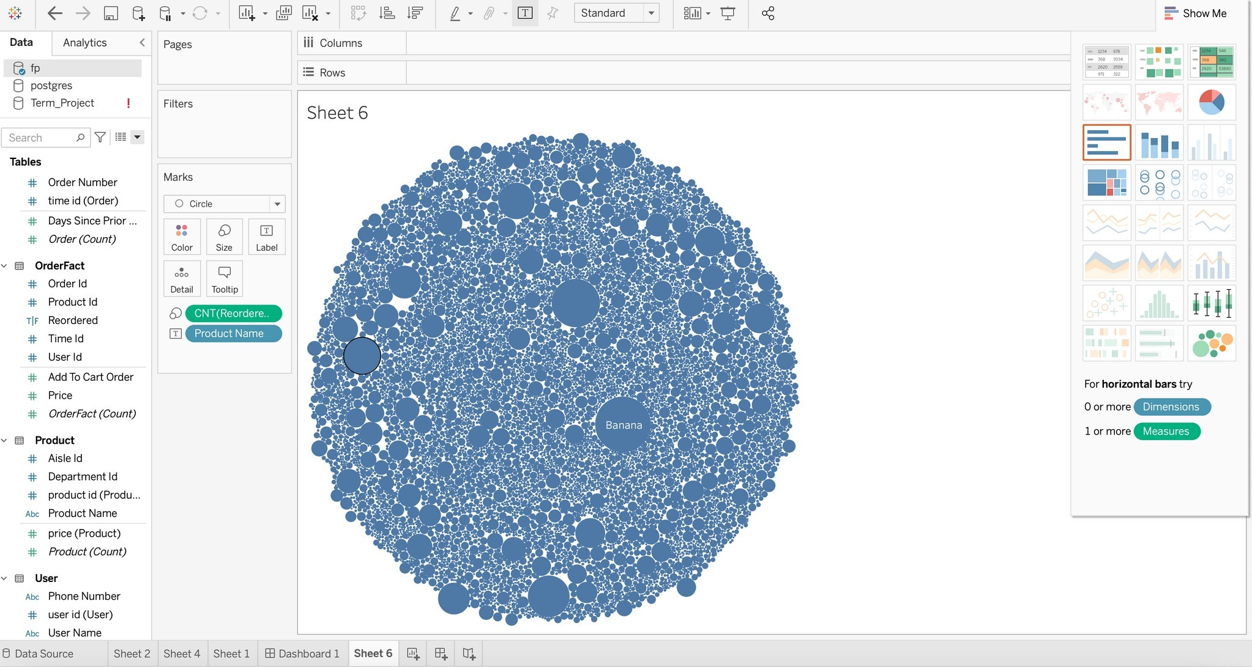
Visualization 2
What are the most reordered products?

Slide 15
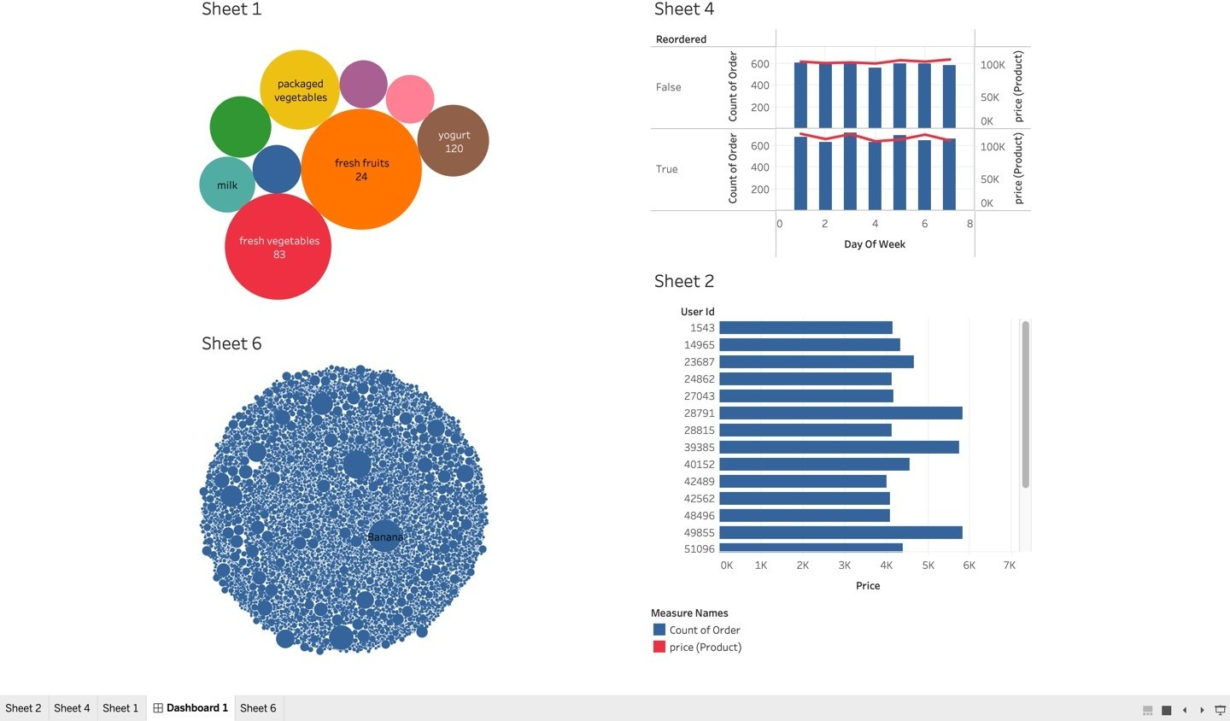
Dashboard

Slide 16



Future Work
– what we
Implement prediction models
would do with more time and resources
Consolidate more data sources
Use different ETL tools like informatica…

Slide 17

Thank you!

