Slide 1

Facial Expression Recognition
Ajithkrishna Raghuraman (U46407261)
Rutuja Sunil Bhamare (U25832532)
Simron Simon Waskar (U39071640)

Slide 2

PROBLEM STATEMENT
This project aims to predict, from the grayscale picture of a person’s face, which emotion the facial expression conveys.

Slide 3
ABSTRACT
Facial expression is an important indicator of a person’s emotion.
Improves human-machine interfaces.
In this project, we used CNN to distinguish between 7 emotions from pictures of facial expressions.
Accuracy -> 72%
Significance:
Security and healthcare
Video game testing
Online education

Slide 4
MAJOR REQUIREMENTS
Keras and Convolution Neural Network
Dataset: Face Expression Recognition Dataset (Kaggle)
Test model: OpenCV
Emotions:
Angry,
Disgust,
Fear,
Happy,
Neutral,
Sad,
Surprise

Slide 5
PROJECT FLOW
Fully Connected Layers
CNN Layers
flatten()
dense()
INPUT
Adam Optimizer
OUTPUT

Slide 6
OUTPUT

Slide 7
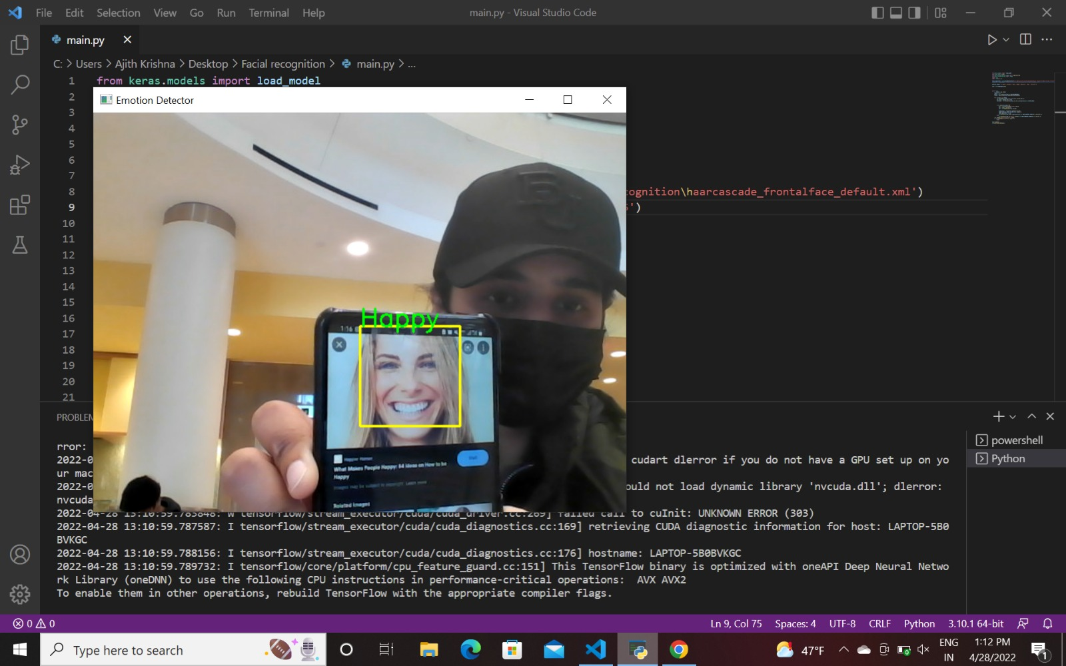
HAPPY

Slide 8
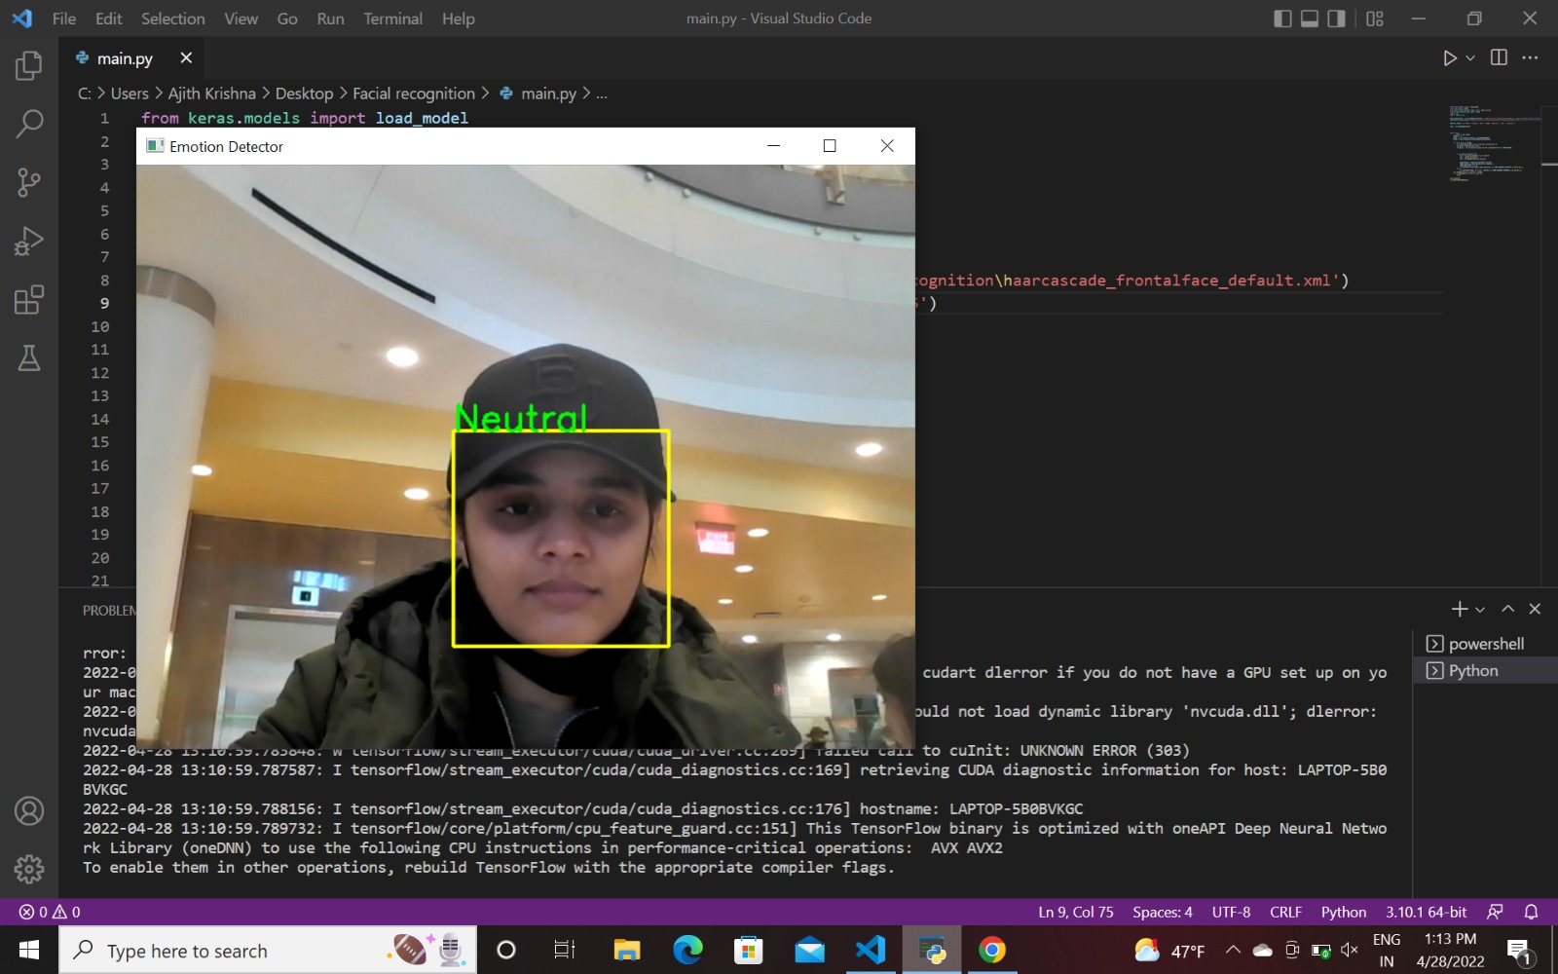
NEUTRAL

Slide 9
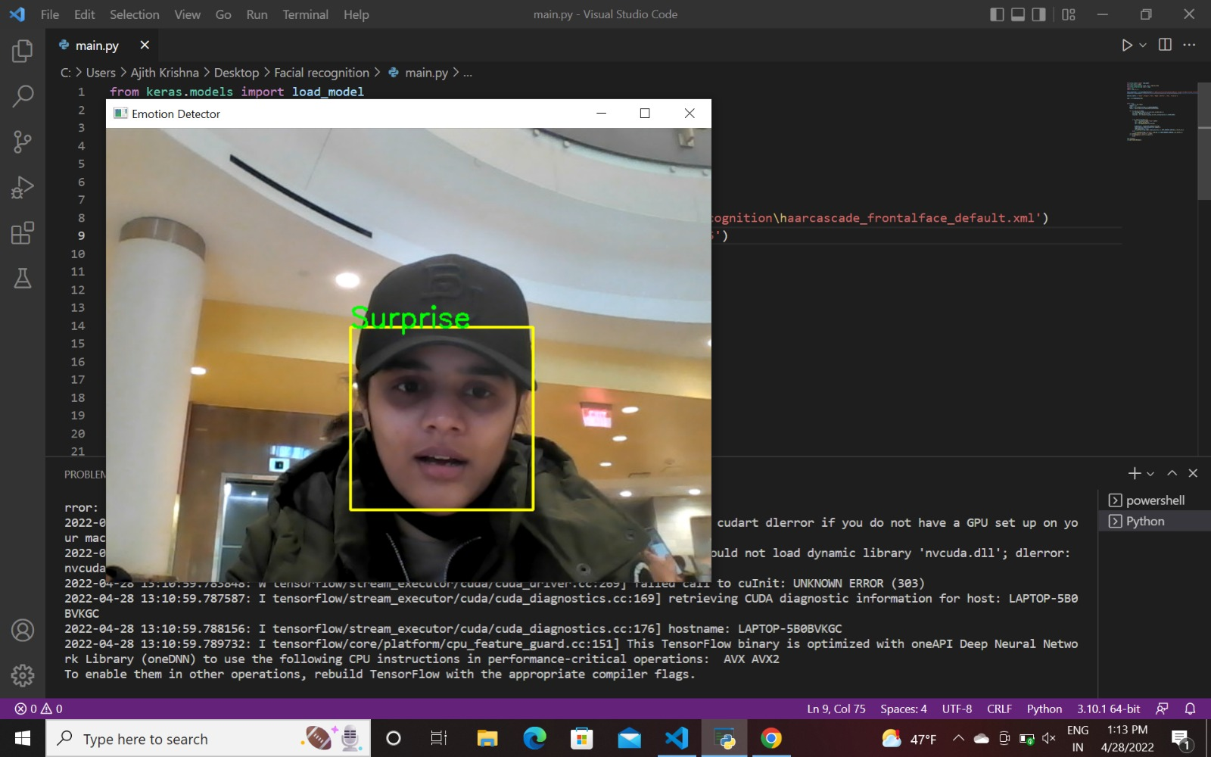
SURPRISE

Slide 10
THANK YOU!

