Slide 1
Week 8 Binary Search Tree

Slide 2
Outline
This topic covers binary search trees:
Background
Definition and examples
Implementation details of BST operations

Slide 3
Background
Recall that with a binary tree, we can dictate an order on
the two children
We will exploit this order:
Require all objects in the left sub-tree to be less than the object stored in the root node, and
Require all objects in the right sub-tree to be greater than the
object in the root object

Slide 4
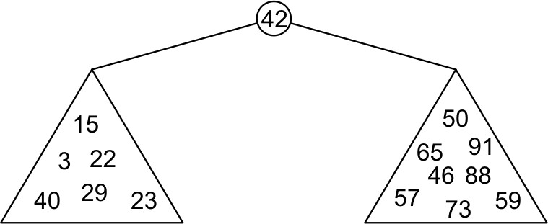
Binary Search Trees
Graphically, we may relationship
– Each of the two sub-trees will themselves be binary search trees

Slide 5
Binary Search Trees
Notice that we have already used this structure for searching: examine the root node and if we have not found what we are looking for:
If the object is less than what is stored in the root node, continue searching in the left sub-tree
Otherwise, continue searching the right sub-tree
With a linear order, one of the following three must be true:
a < b a = b a > b

Slide 6
Definition
Thus, we define a non-empty binary search tree as a
binary tree with the following properties:
The left sub-tree (if any) is a binary search tree and all values are less than the root value, and
The right sub-tree (if any) is a binary search tree and all values
are greater than the root value

Slide 7
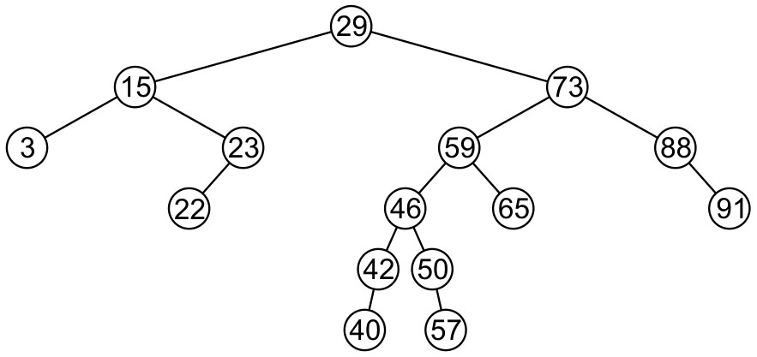
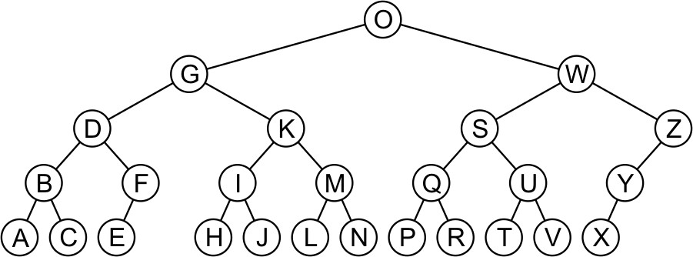
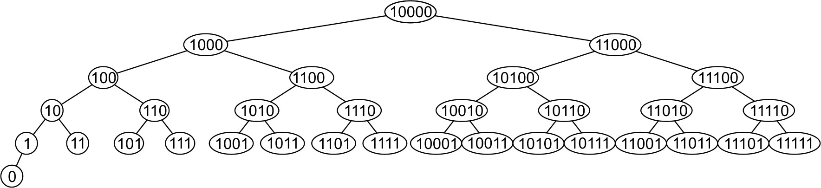
Examples
Here are other examples of binary search trees:

Slide 8
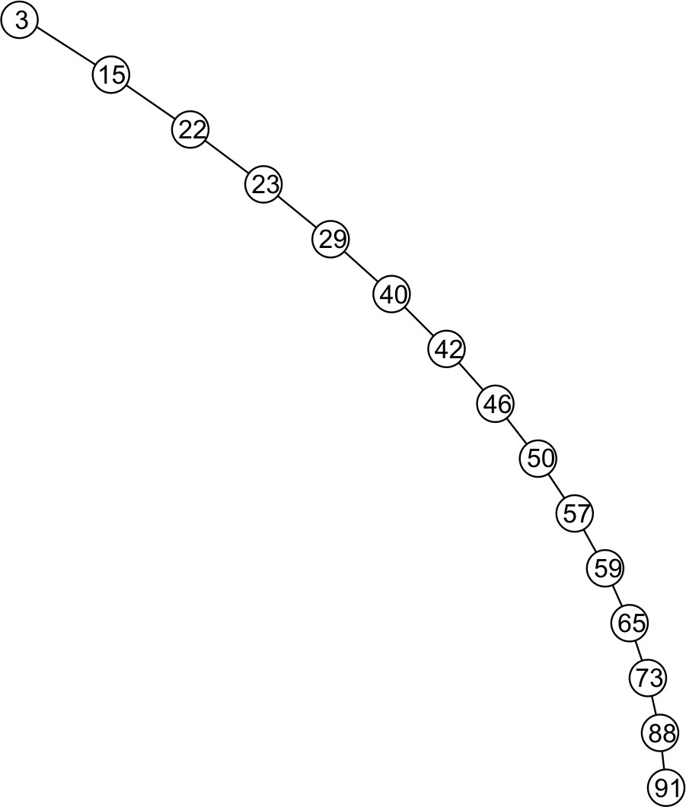
Examples
Unfortunately, it is possible to construct degenerate binary search
trees
– This is equivalent to a linked list, i.e., O(n)

Slide 9
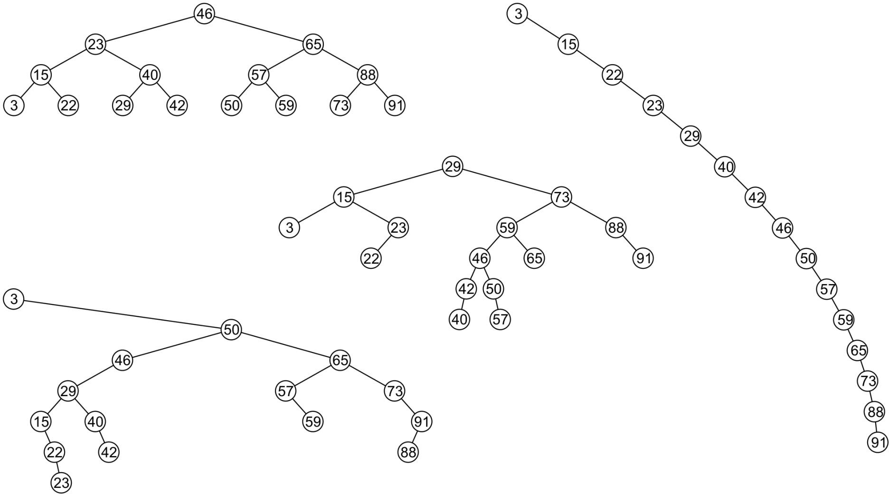
Examples
All these binary search trees store the same data

Slide 10
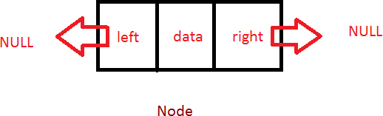
Structure of BST Node
Struct node{
int data; node * left; node *right;
};

Slide 11
Operations on a BST
Insert
Update
Search
Delete
Traversal
  BFT
  DFS
    In-order, post-order, and pre-order
Finding minimum
Finding maximum
Finding predecessor
Finding Successor
Finding height

Slide 12
Insert
Let’s insert any random data into a BST (Discussion)

Slide 13
Implementation Details
Node* insert (int data, node *head)
{
if(head == NULL)
{
head= new node; head->data= data; head->left= NULL; head->right= NULL;
}
else if (data < head->data)
head->left= insert(data, head->left); else if(data > head->data)
head->right= insert(data, head->right); return head;
}

Slide 14
Search
Node* search(node* head, int data){ if(head == NULL)
return NULL;
else if( data < head->data)
return search(head->left, data); else if (data > head->data)
return search(head->right, data);
else
return head;
}

Slide 15
Finding minimum
Node* min(node *head)
{
if(head == NULL)
return NULL;
else if (head->left == NULL) return head;
else
return min(head->left);
}

Slide 16
Finding Maximum
Node* max(node *head)
{
if(head == NULL)
return NULL;
else if (head->right == NULL) return head;
else
return max(head->right);
}

Slide 17
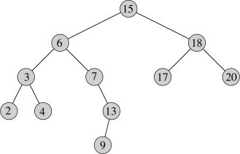
Finding Predecessor
A predecessor is a maximum value in a left sub tree
A predecessor of a node is a right most element in a left sub tree.
If(head->left!=NULL)
return max(head->left)

Slide 18
Finding Successor
A successor is a minimum value in a right sub tree
A successor of a node is a left most element in a right sub tree.
If(head->right!=NULL)
return min(head->right)

Slide 19
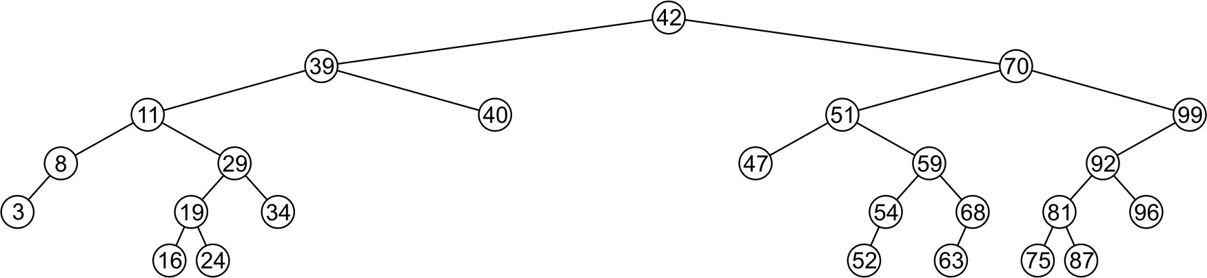
Delete
A node being erased is not always going to be a leaf node There are three possible scenarios:
The node is a leaf node,
It has exactly one child, or
It has two children (it is a full node)

Slide 20
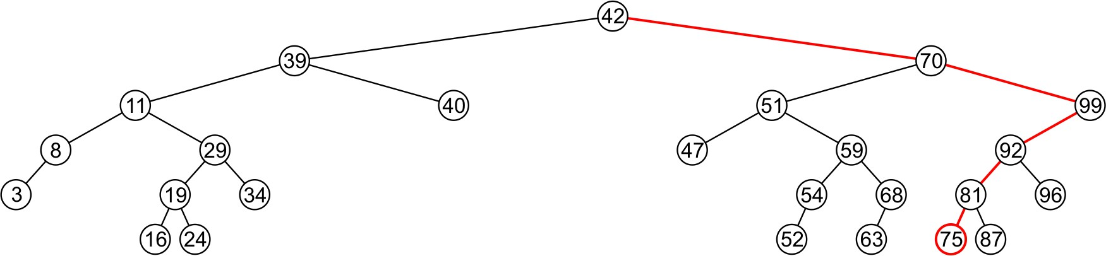
Delete
A leaf node simply must be removed and the appropriate
member variable of the parent is set to nullptr
– Consider removing 75

Slide 21
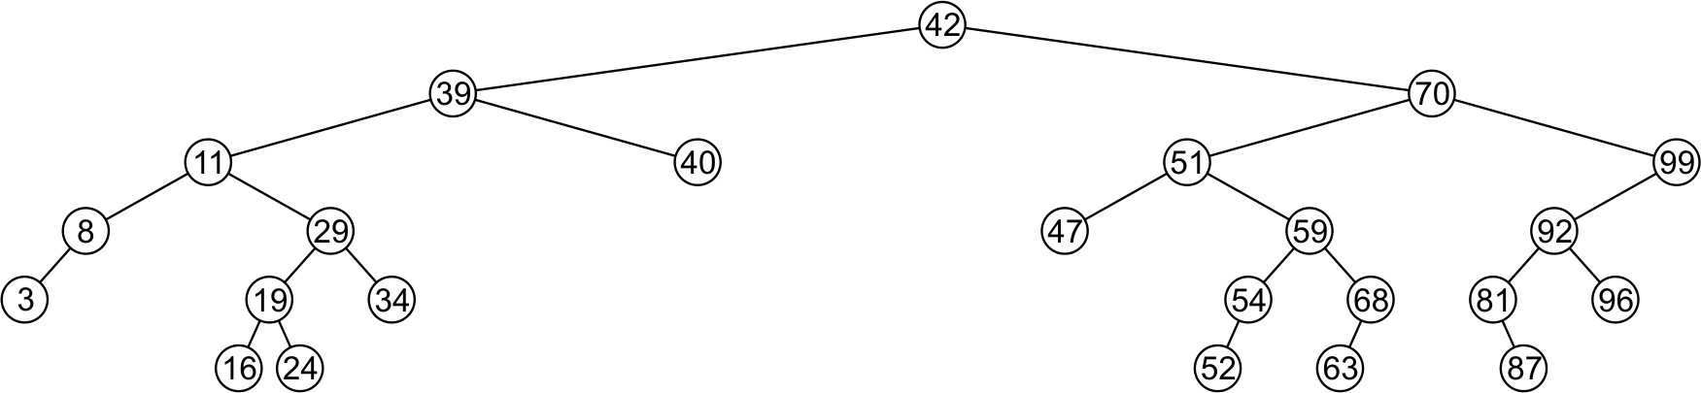
Delete
The node is deleted and left_tree of 81 is set to
nullptr

Slide 22
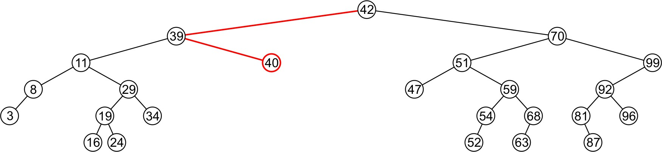
Delete
Erasing the node containing 40 is similar

Slide 23
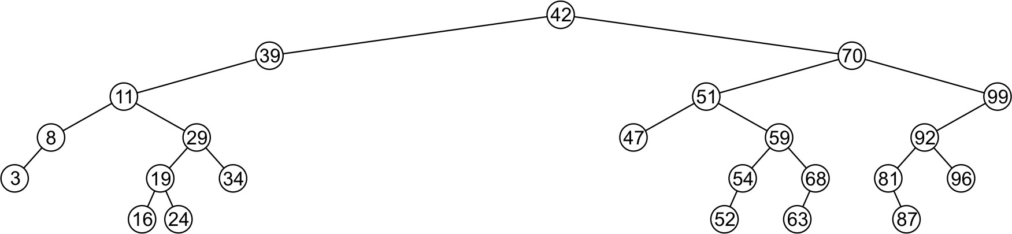
Delete
The node is deleted and right_tree of 39 is set to
nullptr

Slide 24
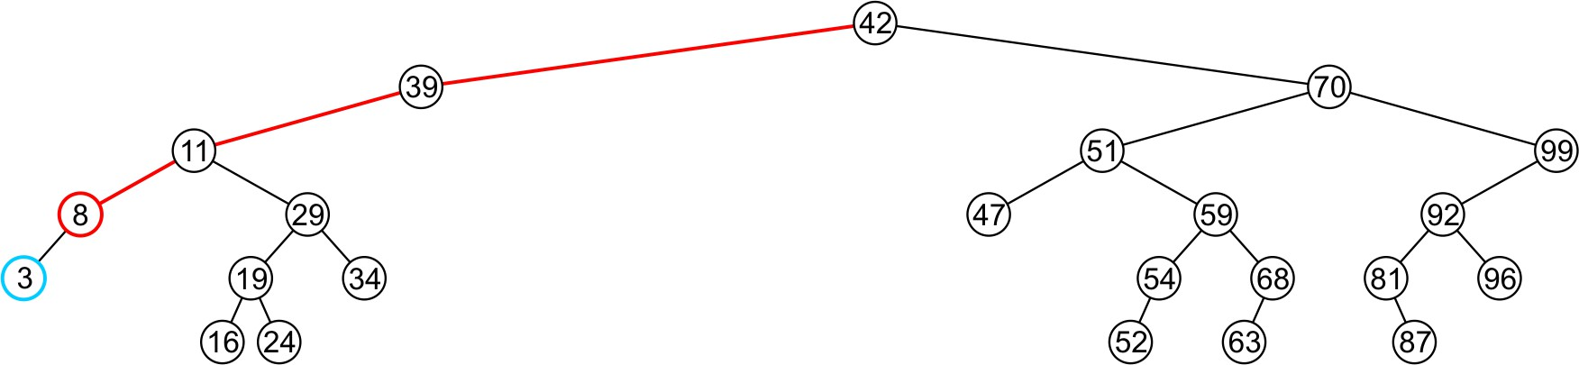
Delete
If a node has only one child, we can simply promote the
sub-tree associated with the child
– Consider removing 8 which has one left child

Slide 25
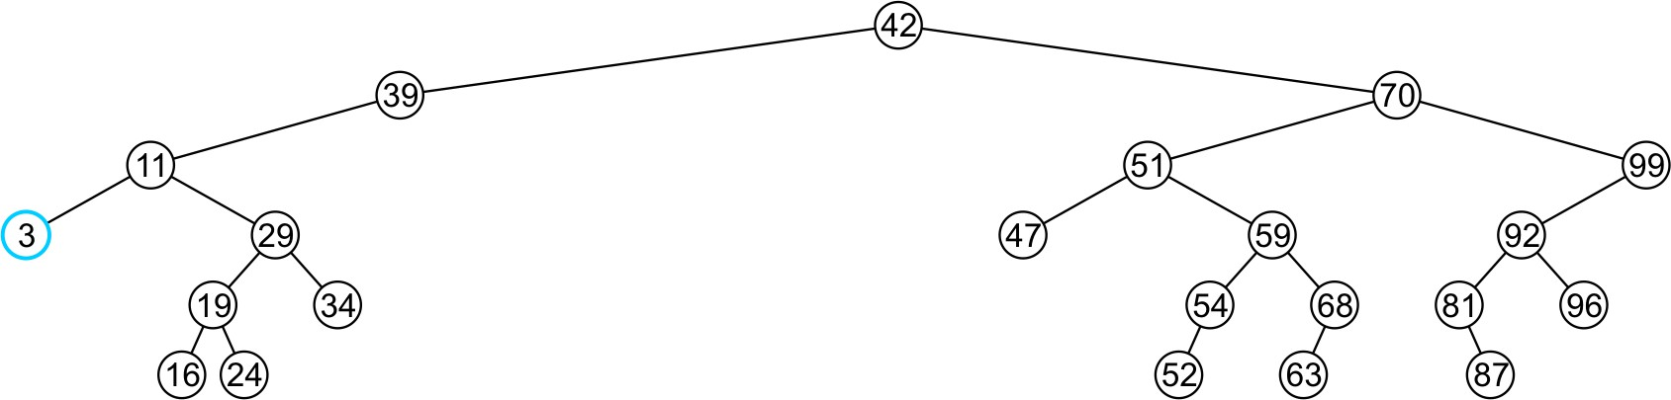
Delete
The node 8 is deleted and the left_tree of 11
is updated to point to 3

Slide 26
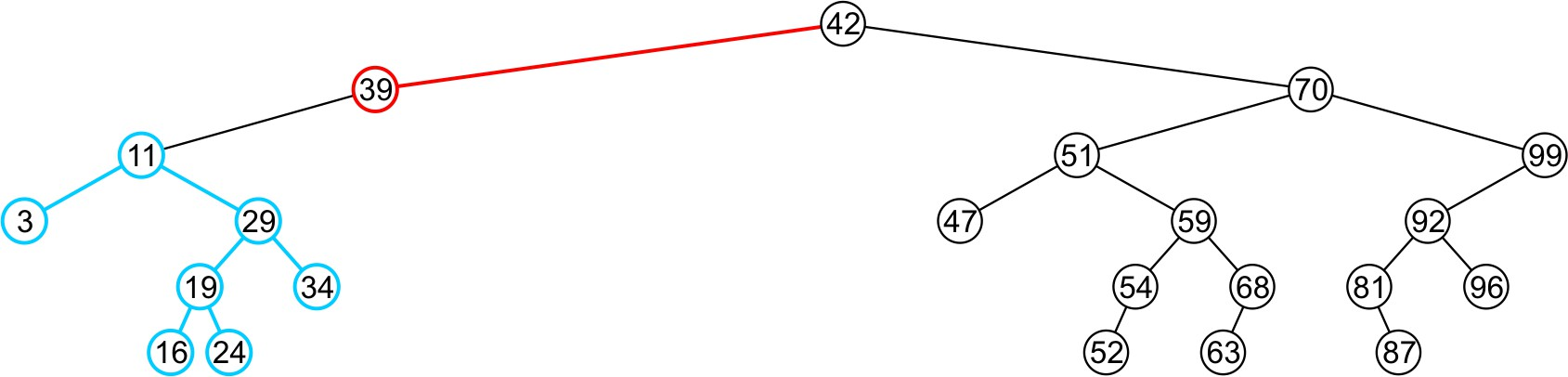
Delete
There is no difference in promoting a single node or a
sub-tree
– To remove 39, it has a single child 11

Slide 27
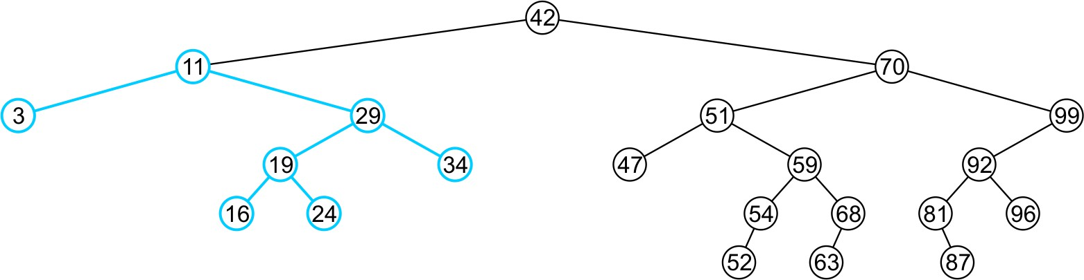
Delete
The node containing 39 is deleted and left_node of 42
is updated to point to 11
– Notice that order is still maintained

Slide 28
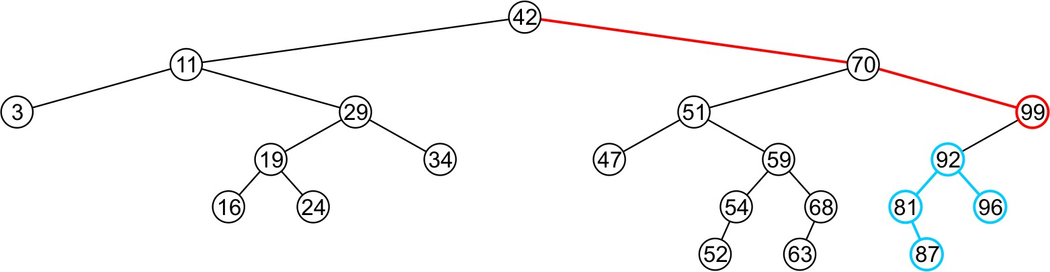
Delete
Consider erasing the node containing 99

Slide 29
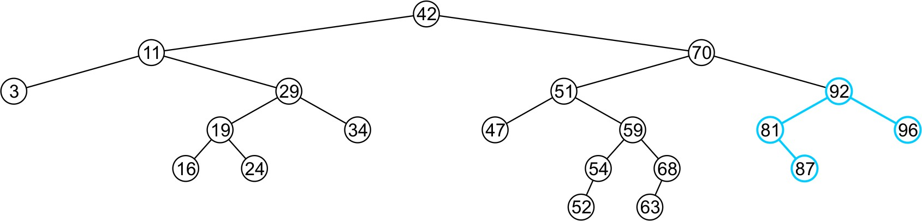
Delete
The node is deleted and the left sub-tree is promoted:
The member variable right_tree of 70 is set to point to 92
Again, the order of the tree is maintained

Slide 30
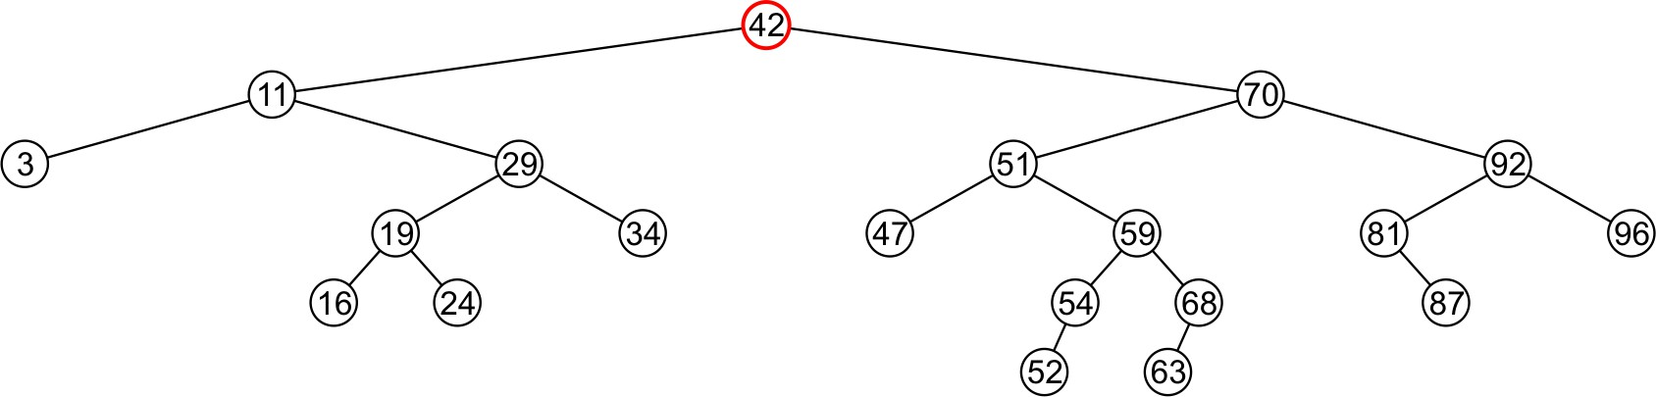
Delete
Finally, we will consider the problem of erasing a full node, e.g., 42
We will perform two operations:
Replace 42 with the minimum object in the right sub-tree
Erase that object from the right sub-tree

Slide 31
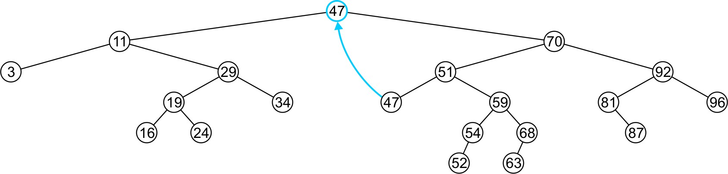
Delete
In this case, we replace 42 with 47
– We temporarily have two copies of 47 in the tree

Slide 32
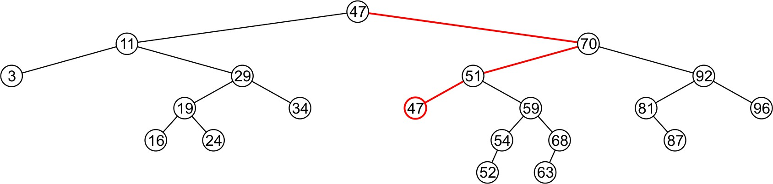
Delete
We now recursively erase 47 from the right sub-tree
– We note that 47 is a leaf node in the right sub-tree

Slide 33
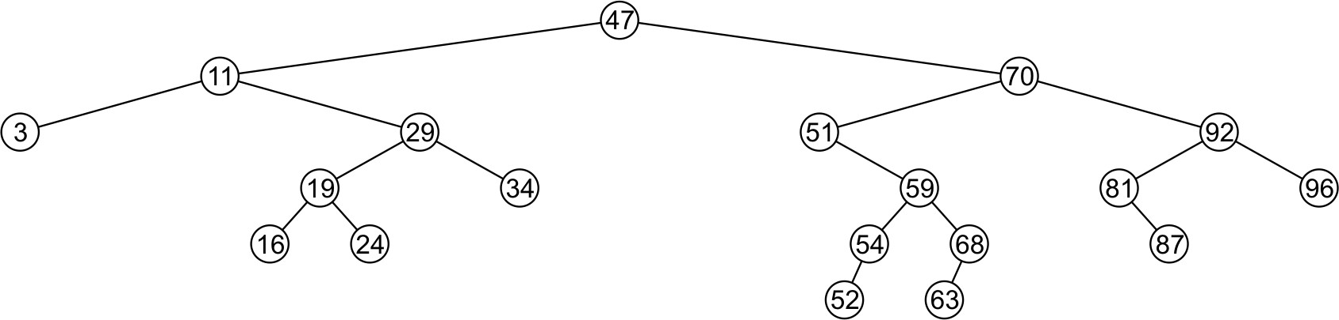
Delete
Leaf nodes are simply removed and left_tree of 51 is set to nullptr
– Notice that the tree is still sorted:
47 was the least object in the right sub-tree

Slide 34
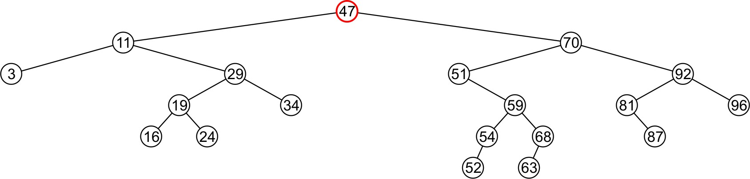
Delete
Suppose we want to erase the root 47 again:
We must copy the minimum of the right sub-tree
We could promote the maximum object in the left sub-tree and achieve similar results

Slide 35
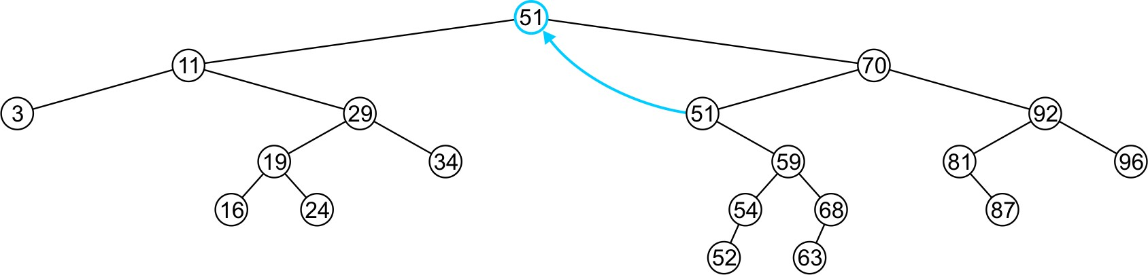
Delete
We copy 51 from the right sub-tree

Slide 36
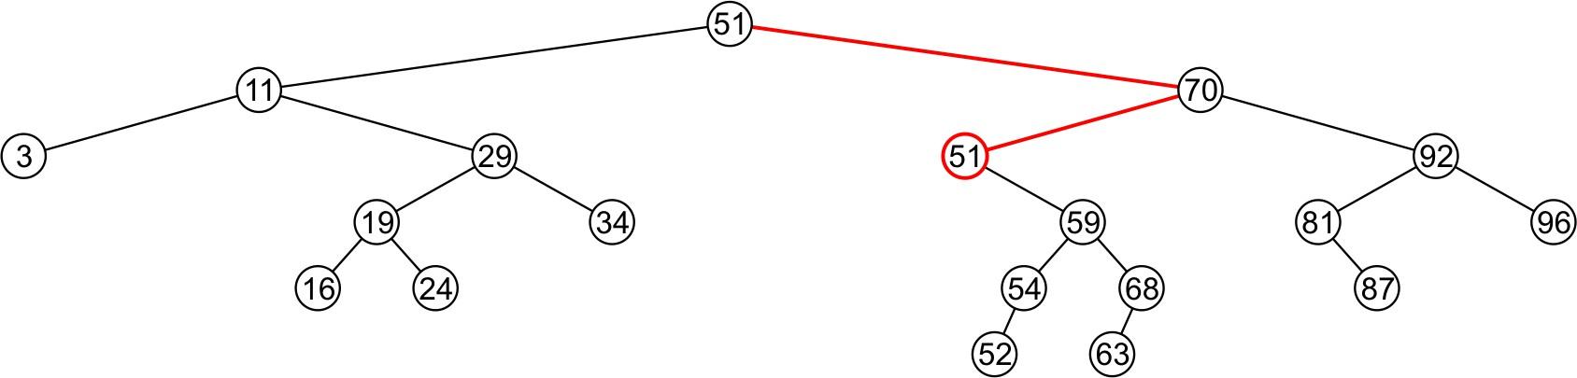
Delete
We must proceed by delete 51 from the right sub-tree

Slide 37
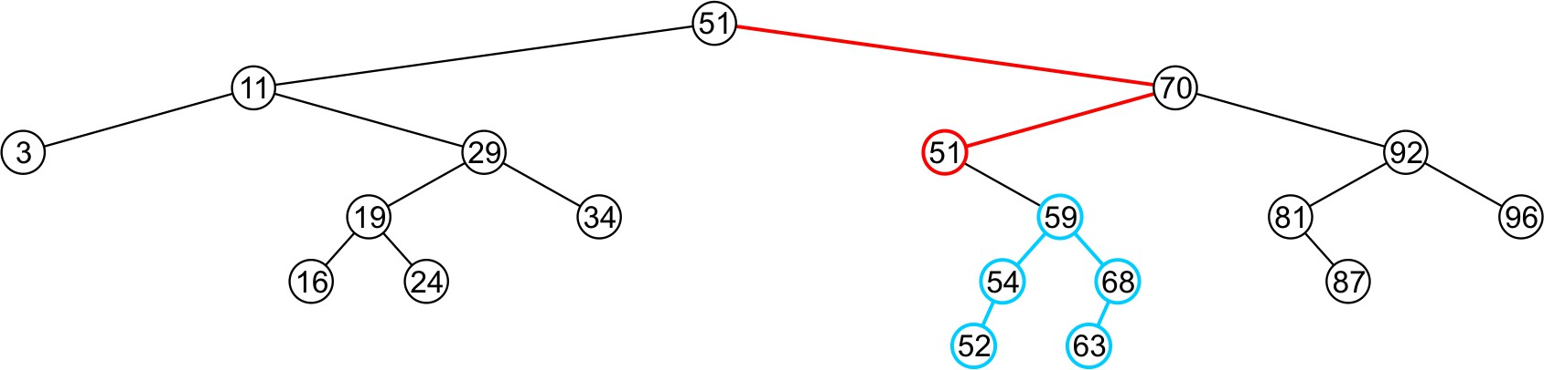
Delete
In this case, the node storing 51 has just a single child

Slide 38
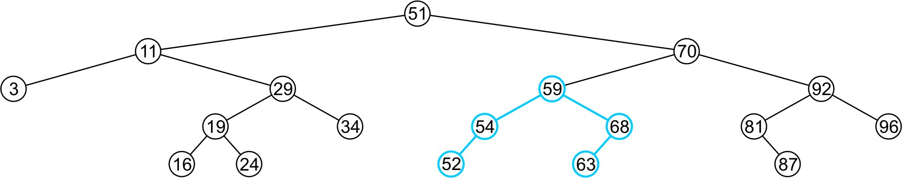
Delete
We delete the node containing 51 and assign the member variable
left_tree of 70 to point to 59

Slide 39
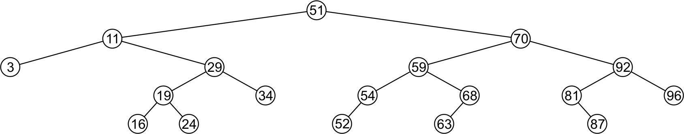
Delete
Note that after seven removals, the remaining tree is still correctly
sorted

Slide 40
Implementation (Delete)
Node * delete(int x, node* head)
{
node *temp;
if( head == NULL)
return NULL;
else if (data < head->data) //left leaf node head->left = delete (data, head->left);
else if (data > head->data) //left right node
head->right = delete (data, head->right); else if( head->left && head->right ) //full node
{
temp= min(head->right); head->data= temp->data;
head->right= delete (head->data, head->right);
}

Slide 41
Implementation (Delete) cont..
else
{
temp=head;
if(head->left == NULL) //neither node head=head->right;
else if (head->right ==NULL) //neither node head=head->left;
delete temp;
}
return head;
}

Slide 42
Traversal in a BST
There are two types of traversals
  Breadth First Search Traversal (BFS)
    Make use of Queue ADT (Already covered)
  Depth First Search Traversal (DFS)
Make use of Stack ADT
    Inorder
    Preorder
    Postorder

Slide 43
In-order Traversal
It is a type of depth
first search traversal.
Following is the traversing order
– Left node, root node, right node
Example discussion
Void inorder (node *head)
{
if (head == NULL)
return; inorder (head->left);
cout << head-data << “ ”; inorder (head->right);
}

Slide 44
Pre-order Traversal
It is a type of depth
first search traversal.
Following is the traversing order
– root node, left node, right node
Example discussion
Void preorder (node *head)
{
if (head == NULL)
return;
cout << head-data << “ ”; preorder (head->left); preorder(head->right);
}

Slide 45
Post-order Traversal
It is a type of depth
first search traversal.
Following is the traversing order
– Left node, right node, root node
Example discussion
Void postorder (node *head)
{
if (head == NULL)
return; postorder (head->left); postorder(head->right);
cout << head-data << “ ”;
}

Slide 46
Finding Height of a BST
Int height (node * head)
{
if(head == NULL)
return NULL;
else
{
int h_left= height(head->left);
int h_right = height (head ->right);
if (h_left > h_right)
return (h_left + 1); else return ( h_right + 1);
}
}

Slide 47
Summary
In this topic, we covered binary search trees
Described Abstract Sorted Lists
Problems using arrays and linked lists
Definition of a binary search tree
Looked at the implementation of:
  Insert
  Delete
  Search
  Traversals
  Height

