Slide 1


Slide 2
Initial Plan
1
Simon Jenni
Laurent Hayez

Slide 3
People involved in the project
Patrice Leroy
Simon Jenni
Laurent Hayez
(profs?)

Slide 4
Problem, Motivation & Context
PMI Research & Developement:
Develope products which potentially reduce risk of tobacco consumption
New products need to be tested against ordinary cigarettes!
One way: Analyse ciliary beating
Goal:
Tool for automatic analyis of ciliary beating movies

Slide 5
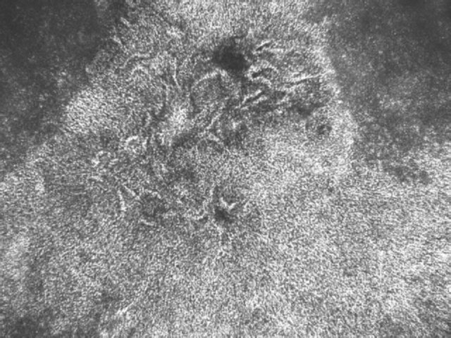
Goals & Objectives
Batch processing of video data in folder
Pre-processing (noise-removal)
Surface activity image
Frequency analysis
Multiscale processing
Illustration of phase for regions of similar frequency

Slide 6
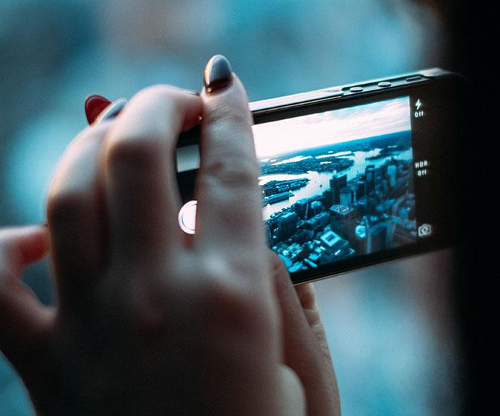
Maybe add demo video of input?

Slide 7
Organisation
Simon
- Simons tasks
Laurent
- Laurents tasks

Slide 8
Methodology & Tools
Methodology:
Iterative & Incremental Devolopement
Scrum
Testing
Code Reviews
Tools:
Matlab
Git
Taiga

Slide 9
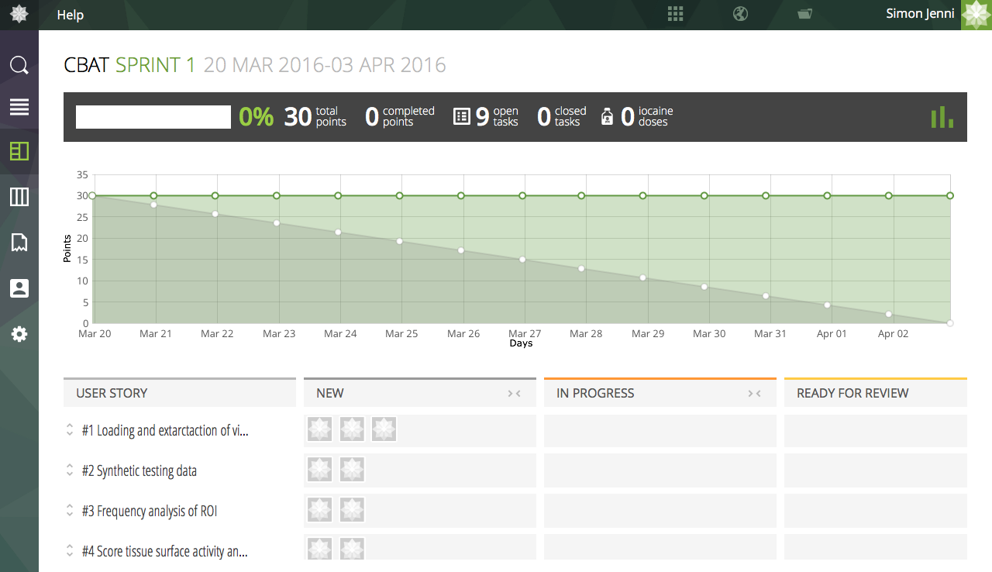
Methodology &Tools

Slide 10
Constraints and elements of risk
Matlab license
Learning about video processing
Time consumption of the FFT and WT
(Encoding?)

Slide 11
Schedule
6 Sprints, 2 weeks each
Goal: Deliverable tool at the end of each sprint!
Sprint 1: Minimum Requirements
Subsequent sprints:
Add new features
Test alternative methods
etc ...

Slide 12
Task Outline (Sprint 1)
1. Loading and extraction of video data
2. Frequency analysis per ROI using FFT
3. Scoring tissue surface activity
4. Synthetic test-data generation (optional)

Slide 13
Research
Should we already add a slide on what we should do for the research part?

Slide 14
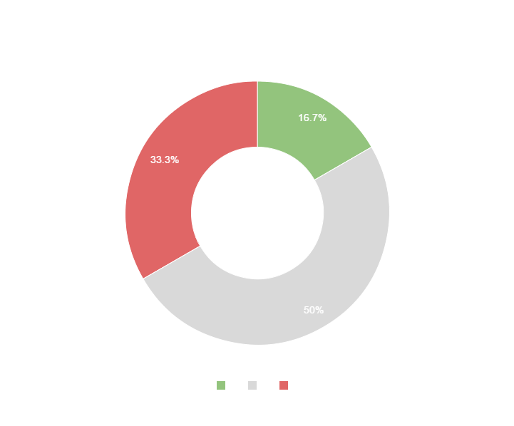
Maybe a graph to show estimated distribution of time on tasks?
You can copy&paste graphs from Google Sheets

Slide 15
Thanks!
ANY QUESTIONS?

