Slide 1


Slide 2
Initial Plan
1

Slide 3
Team members
Patrice Leroy (product owner)
Simon Jenni (development team)
Laurent Hayez (development team)

Slide 4
Problem, Motivation & Context
PMI Research & Developement:
Develope products which potentially reduce risk of tobacco consumption
New products need to be tested against ordinary cigarettes!
One way: Analyse ciliary beating
Goal:
Tool for automatic analyis of ciliary beating movies

Slide 5
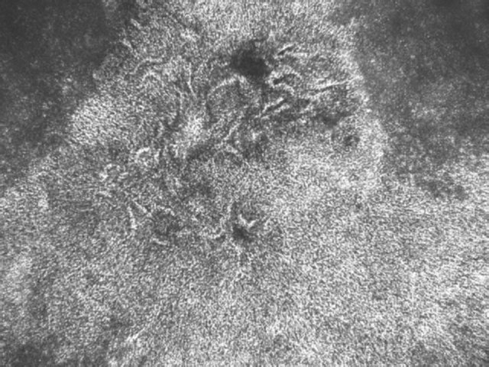
Goals & Objectives (implementation)
Batch processing of video data in folder
Pre-processing (noise-removal)
Surface activity image
Frequency analysis
Multiscale processing
Illustration of phase for regions of similar frequency

Slide 6
Goals & Objectives (research)
Evaluate the effect of the ROI size on performance
Evaluate the probable shape of the beating pattern on a « by cilia beating movie » basis
Compare different techniques for the frequency analysis

Slide 7
Methodology & Tools
Methodology:
Iterative & Incremental Devolopement
Scrum
Testing
Code Reviews
Tools:
Matlab
Git
Taiga

Slide 8
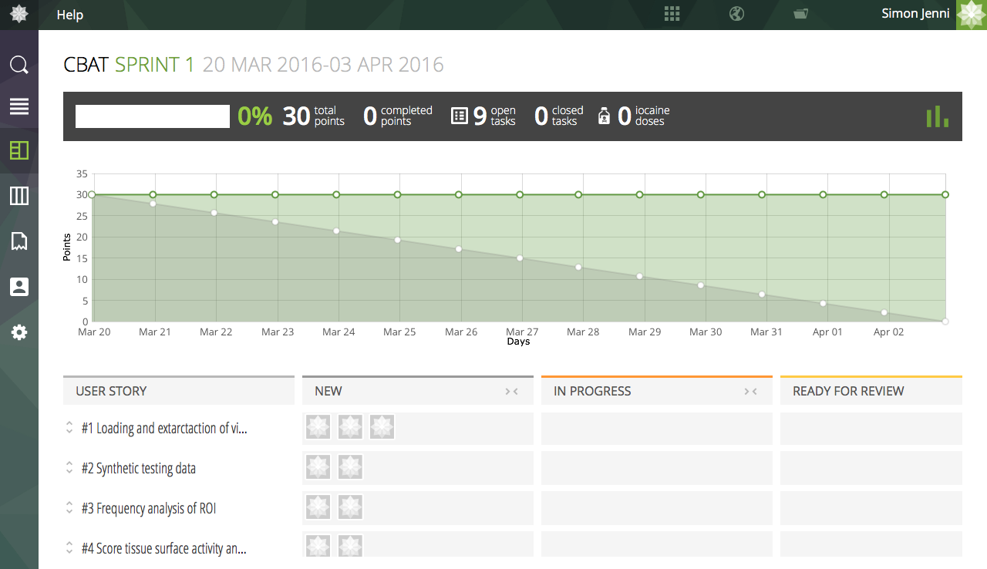
Methodology &Tools

Slide 9
Schedule
6 Sprints, 2 weeks each
Goal: Deliverable tool at the end of each sprint!
Sprint 1: Minimum Requirements
Subsequent sprints:
Add new features
Test alternative methods
etc ...

Slide 10
Task Outline (Sprint 1)
1. Loading and extraction of video data
2. Frequency analysis per ROI using FFT
3. Scoring tissue surface activity
4. Synthetic test-data generation (optional)

Slide 11
Organisation (example)
Simon
Load all videos contained in folder and subfolder
Generation of synthetic video data for sanity checks
Laurent
Extract video data to 3d-array
Save extracted data for later reuse
Add random noise to synthetic generated data

Slide 12
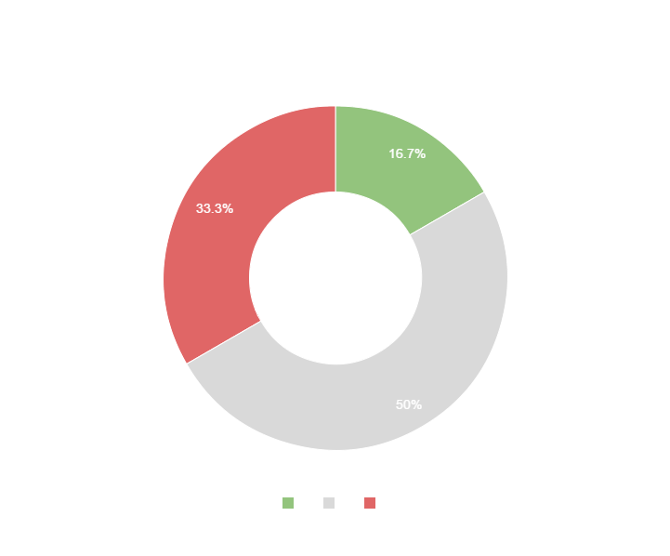
Maybe a graph to show estimated distribution of time on tasks?
You can copy&paste graphs from Google Sheets

Slide 13
Constraints and elements of risk
Learning about video processing
Synthetic data vs real-world data
Correctness of the implementations
Evaluation of the performances can be time consuming

Slide 14
Thanks!
ANY QUESTIONS?

