Slide 1


Slide 2
Data Analysis Improvement of Ciliary Beating of 3D Epithelial Tissue
Initial Plan

Slide 3
Team members
Patrice Leroy (product owner)
Simon Jenni (development team)
Laurent Hayez (development team)

Slide 4
Problem, Motivation & Context
PMI Research & Developement:
Develope products which potentially reduce risk of tobacco consumption
New products need to be tested against ordinary cigarettes!
One way: Analyse ciliary beating
Goal:
Tool for automatic analyis of ciliary beating movies
Notes:
R&D program of PMI: New products ...
PMI has facilities where human tissue samples are exposed to both products.
-> Analyse videos of tissues after exposure wrt several features.

Slide 5
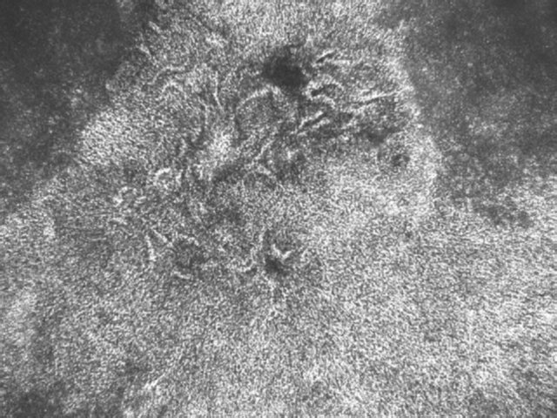
Goals & Objectives (implementation)
Batch processing of video data in folder
Pre-processing (noise-removal)
Surface activity image
Frequency analysis
Multiscale processing
Illustration of phase for regions of similar frequency

Slide 6
Goals & Objectives (research)
Evaluate the effect of the ROI size on performance
Evaluate the probable shape of the beating pattern on a « by cilia beating movie » basis
Compare different techniques for the frequency analysis
Notes:
Project also contains research related tasks...
Evaluate and compare different techniques implemented

Slide 7
Methodology & Tools
Methodology:
Iterative & Incremental Developement
Scrum
Testing
Code Reviews
Tools:
Matlab
Git
Taiga

Slide 8
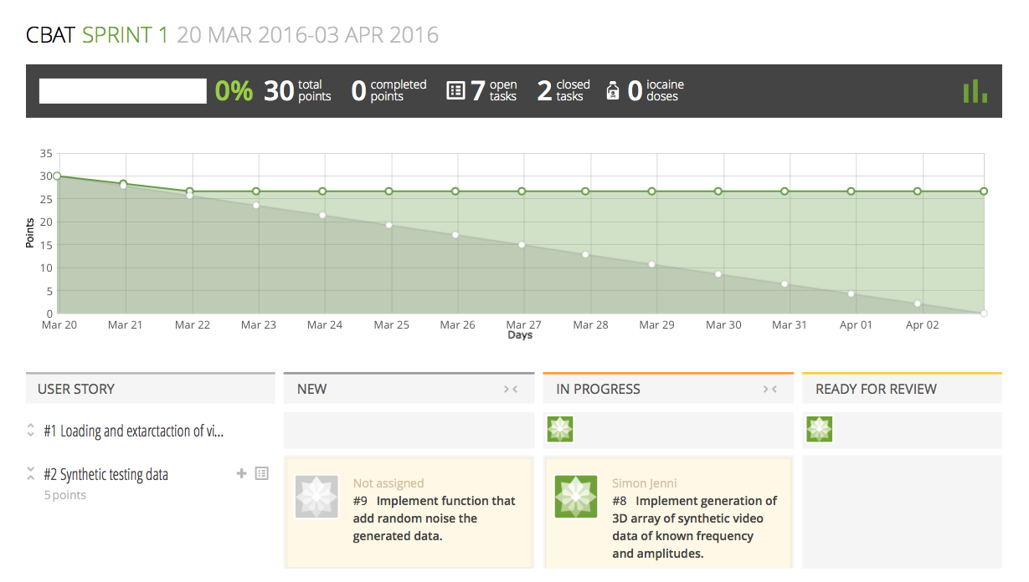
Methodology & Tools

Slide 9
Schedule
6 Sprints, 2 weeks each
Goal: Deliverable tool at the end of each sprint!
Sprint 1: Minimum Requirements
Subsequent sprints:
Add new features
Test alternative methods
etc ...
Notes:
Scrum as mentioned...
Allows to get and incorparate feedback on the tool in each sprint
Details of sprint 1 follow…
Sprint planning at the end of each sprint

Slide 10
Schedule
Sprint 1 | Sprint 2 | Sprint 3 | Sprint 4 | Sprint 5 | Sprint 6
Minimal requirements | Noise-removal | Phase image WT | Explore alternatives | Evaluation | Reserved
Notes:
Sprint 1 already in progress (on track!)
Sprint 6 also for final report

Slide 11
Task Outline (Sprint 1)
1. Loading and extraction of video data
2. Frequency analysis per ROI using FFT
3. Scoring tissue surface activity
4. Synthetic test-data generation (optional)

Slide 12
Workflow (example)
Simon
Assigns unassigned task #1 to himself
Commits solution
Requests review by assigning to Laurent
Is happy with Laurent’s work => Closed
Solves bugs and closes task
Laurent
Grabs task #2 & sets status to In Progress
Commits solution and sets status to Ready to Review
Assigns to Simon for review
Points out bugs to Simon and reassigns for fixing
Notes:
Illustration of workflow
Task 1 blue
Task 2 red

Slide 13
Deliverables
Matlab toolbox for batch analysis of 8bit grey scale .avi movies
Documentation of the code
Final report with methods used and results from the research part
Notes:
Minimal documentation with emphasis on meaningful variable and function naming

Slide 14
Constraints and elements of risk
Learning about video processing
Synthetic data vs. real-world data
Correctness of the implementations
Evaluation of the performances and parameter-tweaking

Slide 15
Thanks!
ANY QUESTIONS?

