Slide 1


Slide 2
Initial Plan
1
Simon Jenni
Laurent Hayez

Slide 3
The Problem
Problem description:
Introduce client
Put project in context
Motivation
Goals & objectives

Slide 4

Problem
Add some images to explain the problem and approach

Slide 5
Maybe add demo video of input?

Slide 6
Methodology
Describe our approach:
Techniques
Tools
...

Slide 7
Task Outline
First
Second
Third
Fourth

Slide 8
Organisation
Simon
- Simons tasks
Laurent
- Laurents tasks

Slide 9
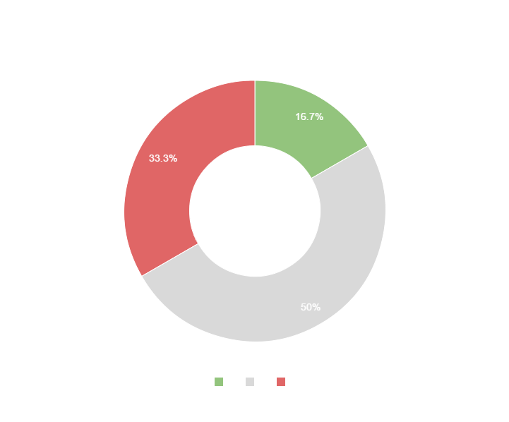
Maybe a graph to show estimated distribution of time on tasks?
You can copy&paste graphs from Google Sheets

Slide 10
Thanks!
ANY QUESTIONS?

