Slide 1
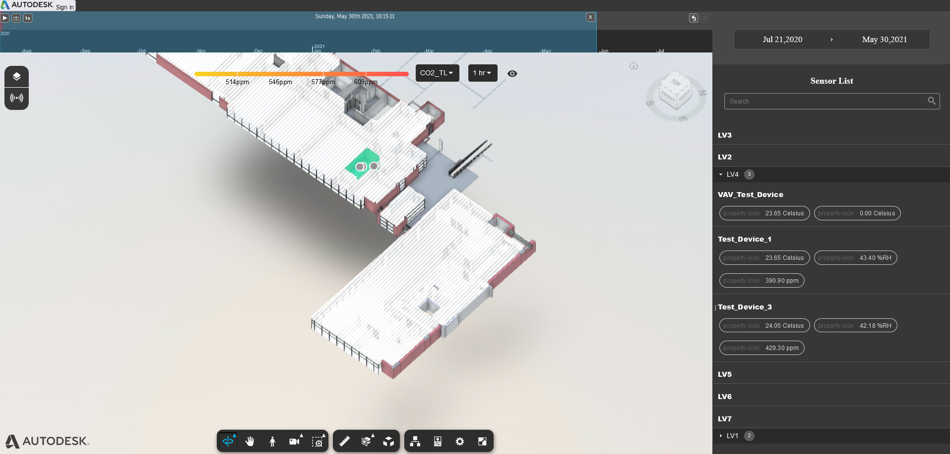

Slide 2
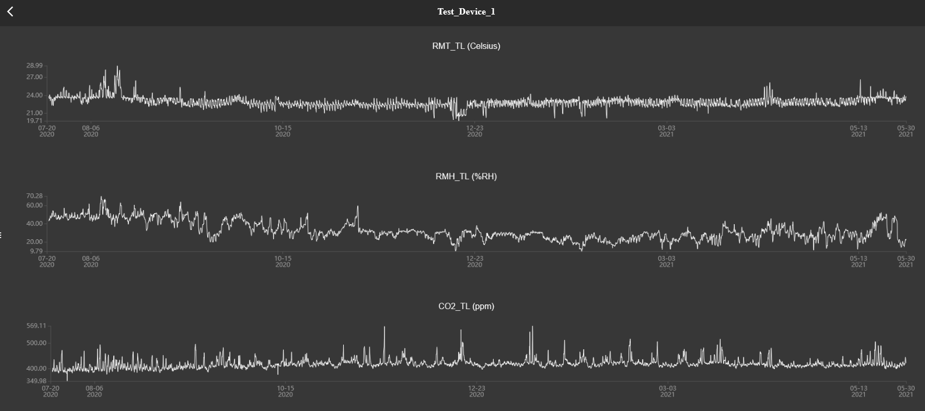

Slide 3
General Flow
Downloaded by Script
Autodesk
Reference app
Kaizen Data
CSV Files
Read By

Slide 4
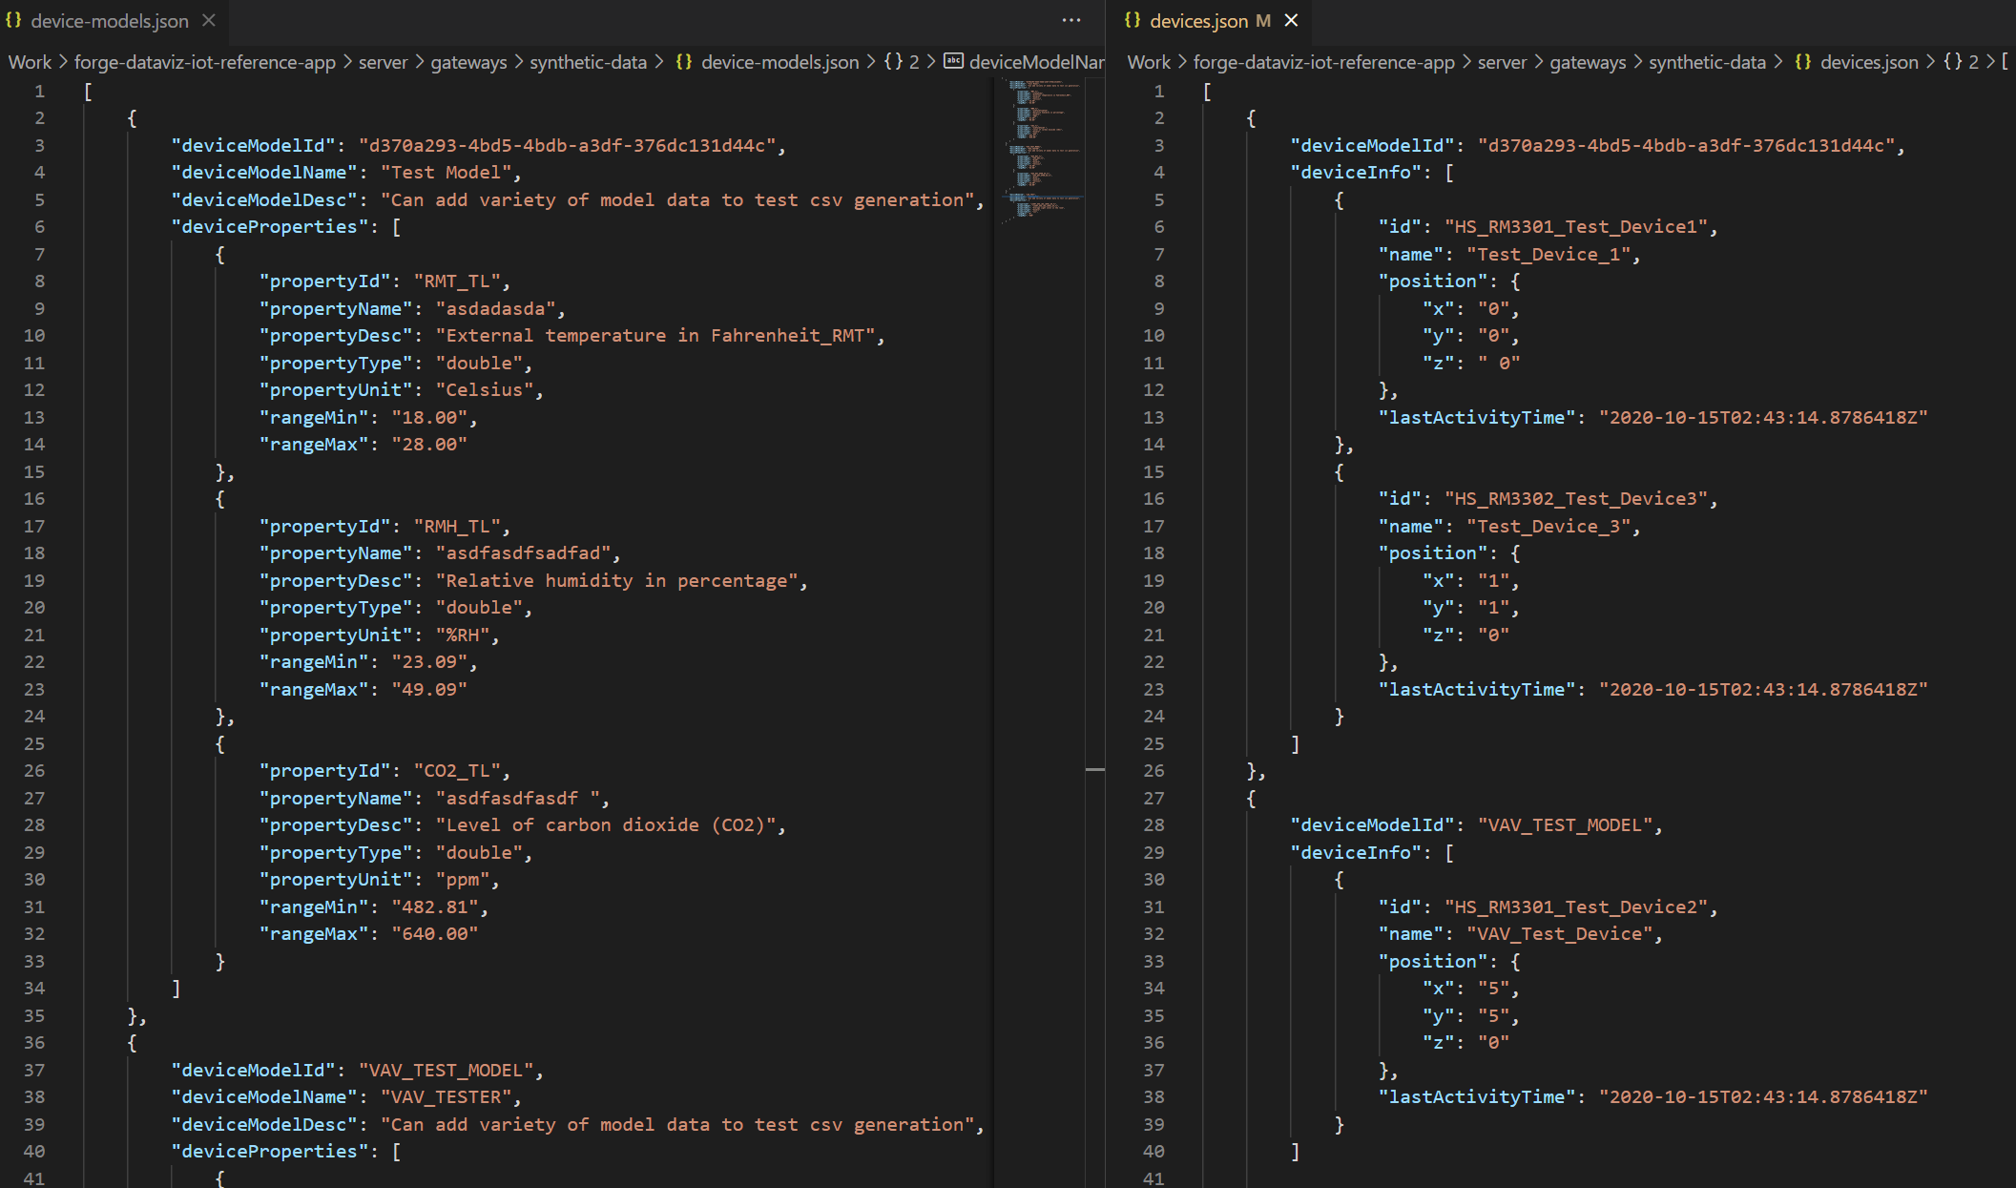
How HRA Reads CSV Data
Types of sensor devices are registered in device-models.json
Then instances of a given type of sensor devices are defined in devices.json
The Reference App looks for a csv file based on the device ID given and then reads that file to get the data
Data will be regularly added to csv files via script that will run at regular intervals
Refers to file
Reference App
Reads Data From
HS_RM3301_Test_Device1.csv

Slide 5
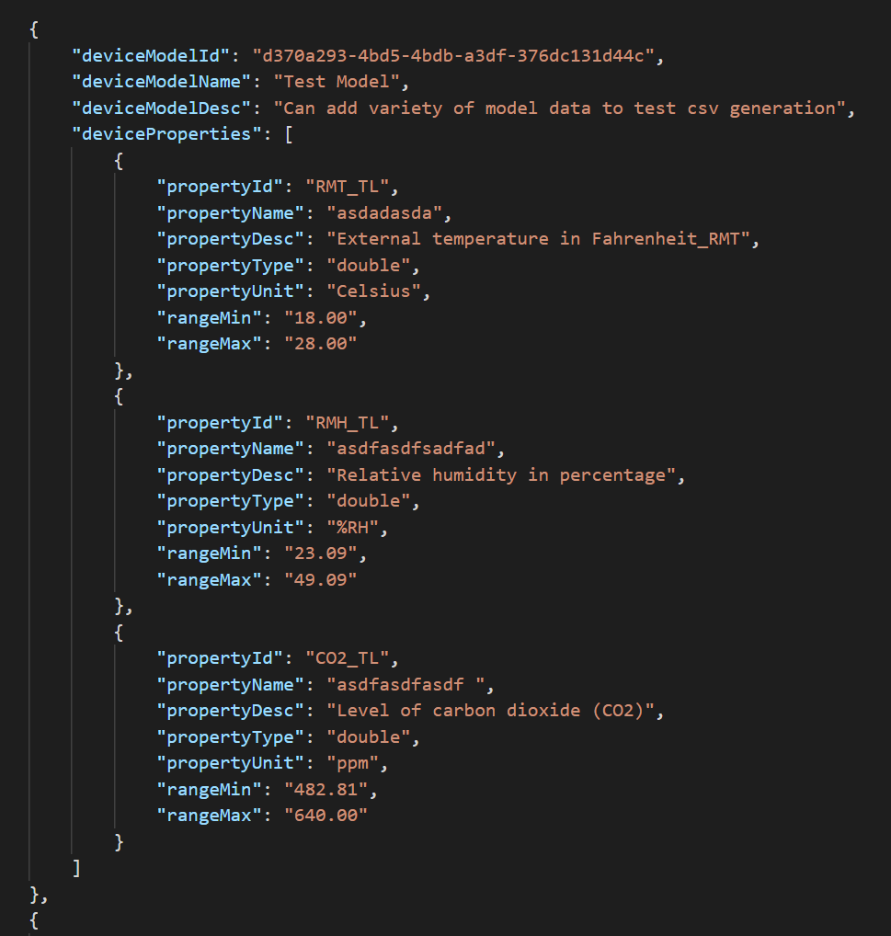
Device Model json Format
deviceModelID: Unique Identifier used to define a device model
deviceModelName: Name of Model
deviceModelDesc: Description of Model
deviceProperties:
  propertyID: Name of property that visualizer will search for in csv file
  propertyName: Not Actually Used
  propertyDesc: Description of property for users
  propertyUnit: Displayed unit of values in visualizer

Slide 6
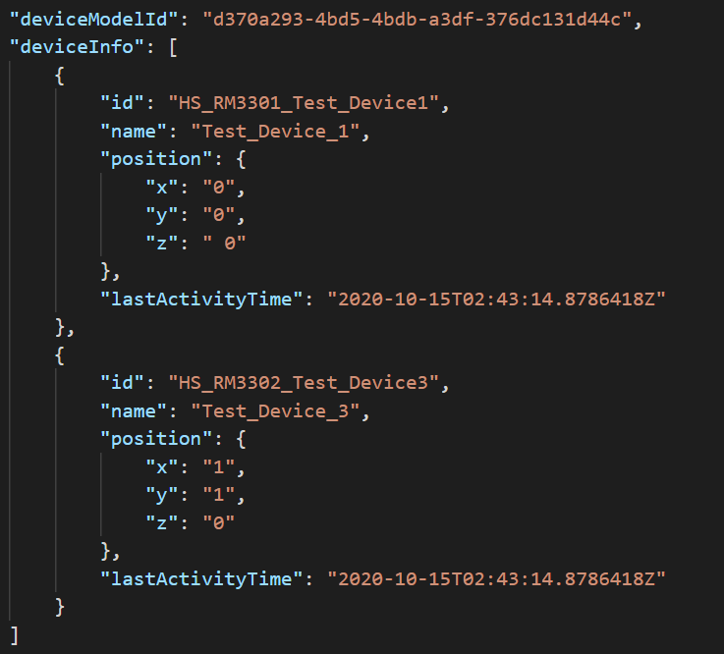
Device Json Format
deviceModelID: Indicates what model the device being added is
deviceInfo:
  Id: unique id identifying the device, also used as name of csv file that visualizer pulls data from
  Name: name of device displayed by reference app
  Position: x,y, and z coordinates of device (note if not in room the system will not display the device
  lastActivityTime: timestamp of last time entry of device

Slide 7
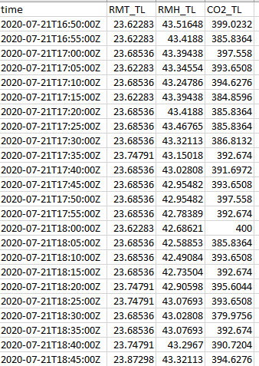
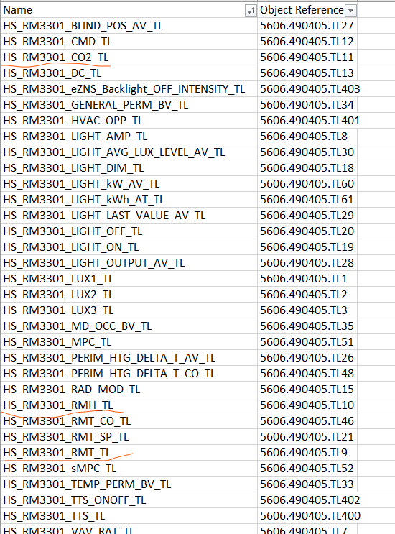
Download Script Operation Flow
Device CSV file
Reference File
Get Address
Read what sensor properties are needed and last download time from device csv
Get address of sensor properties in Kaizen from reference file
Use Kaizen API to get sensor data
Compile new data together and then append to end of device csv file
Write to CSV
Latest Time
New Device Data
Request Data
Response
From Server
Kaizen Server

Slide 8
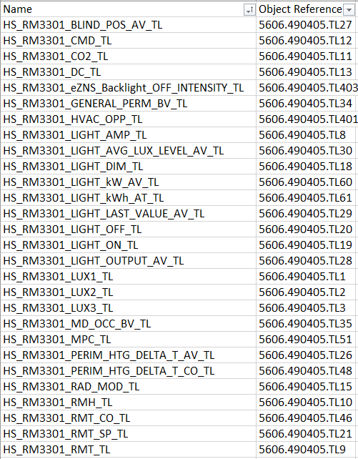
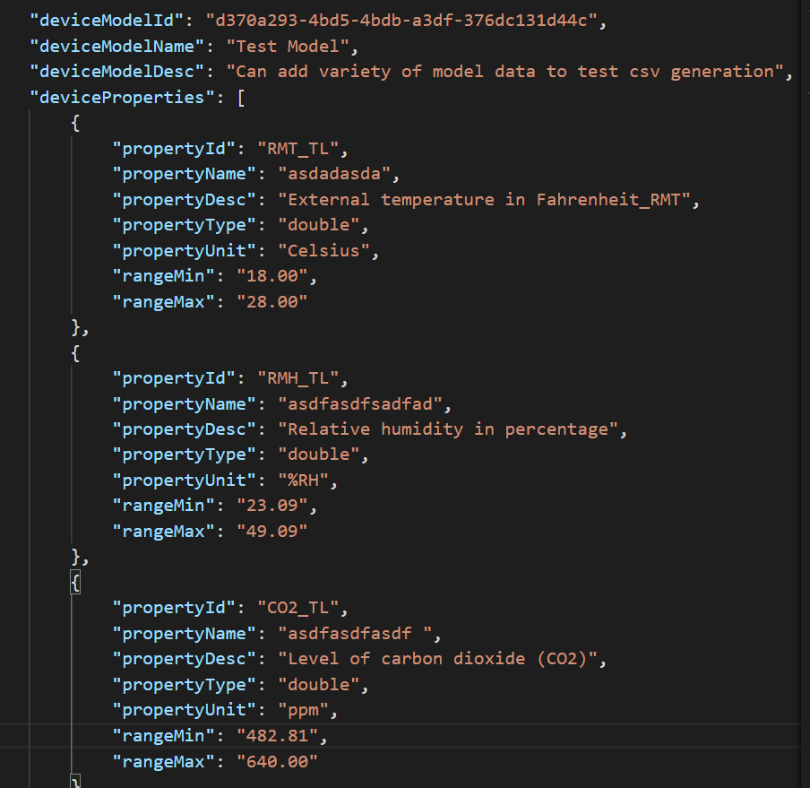
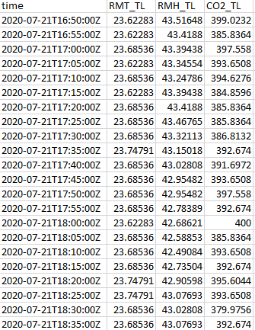
Getting Property Addresses
Reference File
Request Co2
Device CSV file
Request Temp
Request Humidity

Slide 9
Device CSV file
Request Temp
New Data Temp
Append New Data
Request Humidity
Kaizen Server
Request Humidity
New Device Data
New Device Data
Request Co2
Request Co2

Slide 10
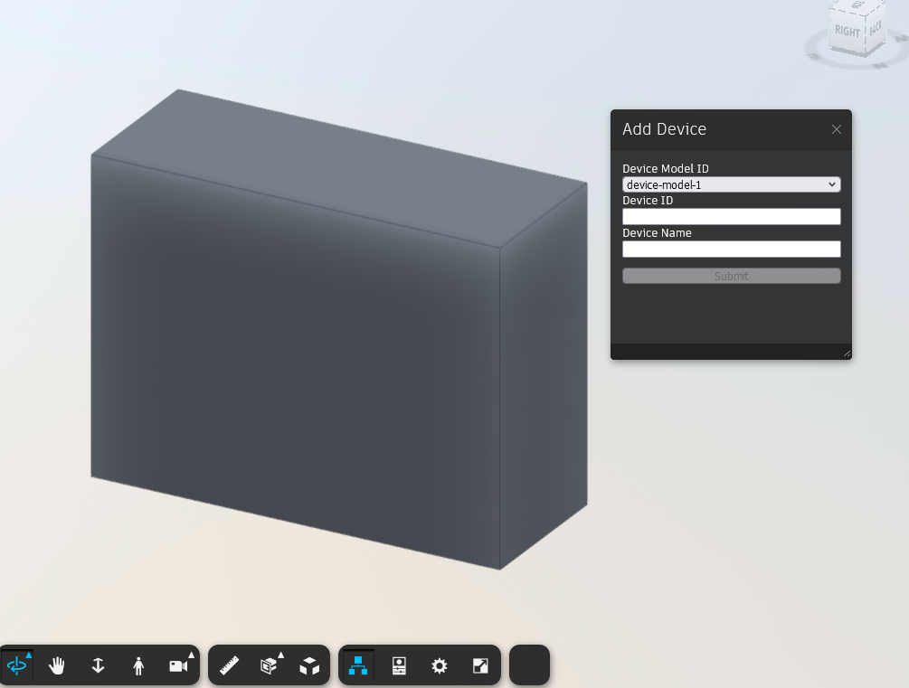
Adding New Devices
(IN DEV)
Select a room to add a new device to
Click button to open device add prompt
Select Device model from drop down and add device name and ID

Slide 11
Current Time

Slide 12
Current Limitations
Requires specific naming schemes for properties to have system to function properly
New sensors have to be of either an existing or new device model first
If a device is improperly mapped to a room, the device will not be displayed on the model
New sensor properties will have to be added manually to reference file to be properly downloaded
Interface for adding new device models also needs to be created

